Slide 1
World Without Waste Progress
Georgia Recycling Coalition Annual Conference
September 28th, 2022
1

Slide 2
AGENDA
Our World Without Waste Goals and Progress
Designing Our Packaging for Circularity
Consumer Education
Reuse – Returnable and Refillable
Collection Efforts

Slide 3
WORLD WITHOUT WASTE GOALS AND PROGRESS
GOAL
GOAL
GOAL
GOAL
NEW REUSE GOAL
  Make 100% of
  our packaging
  recyclable
  globally by 2025
  Use at least 50%
  recycled content
  In our packaging
  by 2030
Collect and recycle a bottle or can for each one we sell by 2030
  Reduce our use of virgin plastic derived from non-renewable sources by a cumulative 3 million metric tons by 2025
  By 2030, we aim to have at least 25% of our beverages worldwide by volume sold in refillable/returnable glass or plastic bottles or in fountain dispensers with reusable packaging
2021 STATUS
90% globally
2021 STATUS
23% recycled material in our packaging globally and 13.6% for PET plastic packaging
2021 STATUS
61%
2021 STATUS
We avoided almost half a million tons of virgin plastic usage through our lightweighting, recycled plastic and renewable material efforts in 2021
Notes:
100% of packaging is recyclable by 2025
50% recycled content by 2030
Collect & recycle the equivalent of a bottle or can for each one we sell by 2030.
Reduce vPET by 1 year’s worth of material from 2020-2025
25% of our global volume will be in Reusable (returnable or Refillable) packaging by 2030

Slide 4
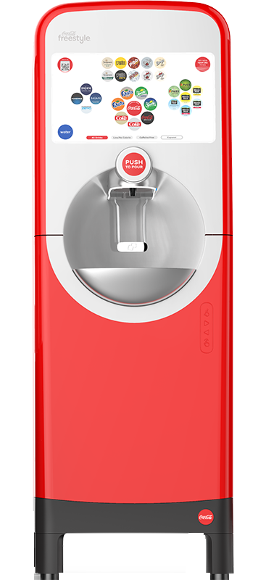
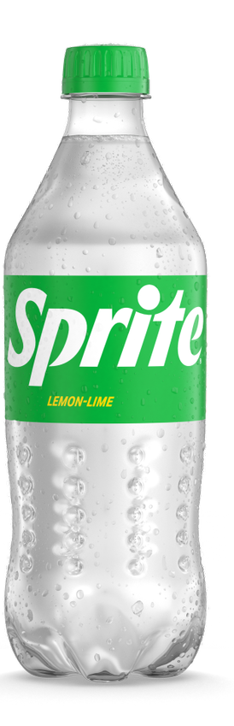
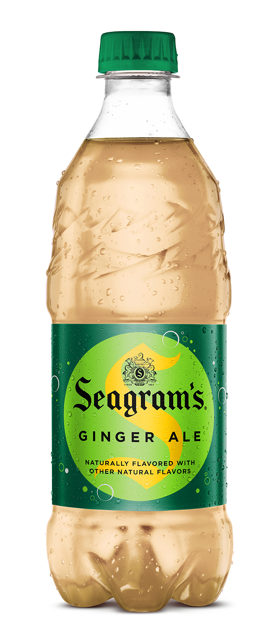
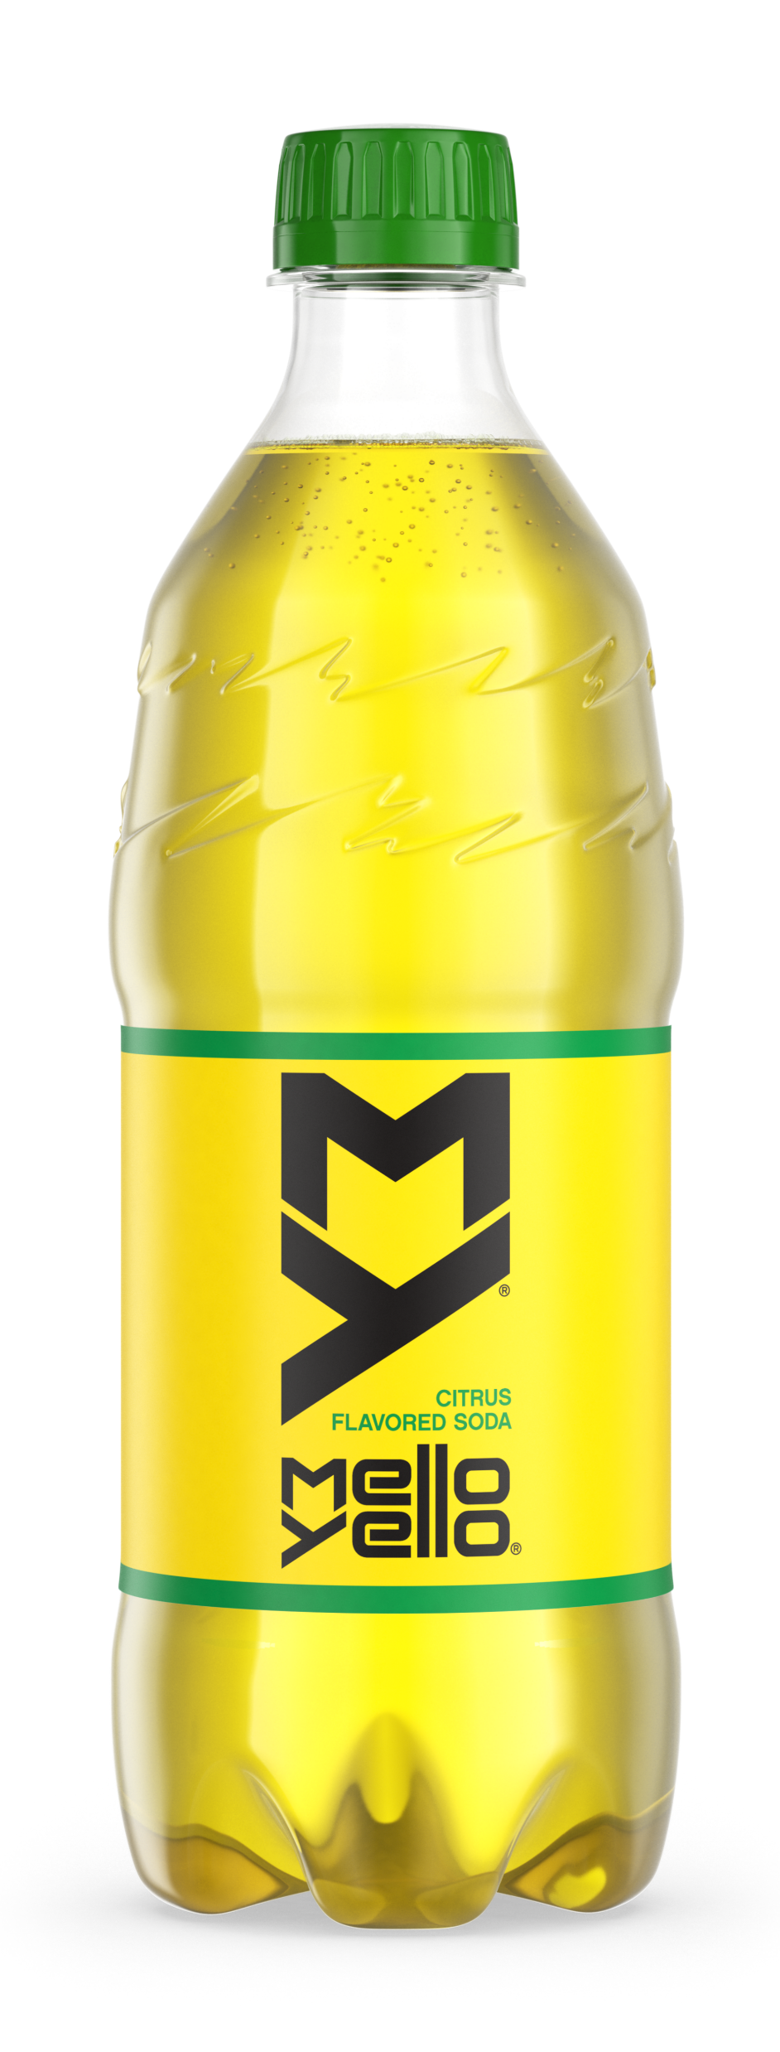
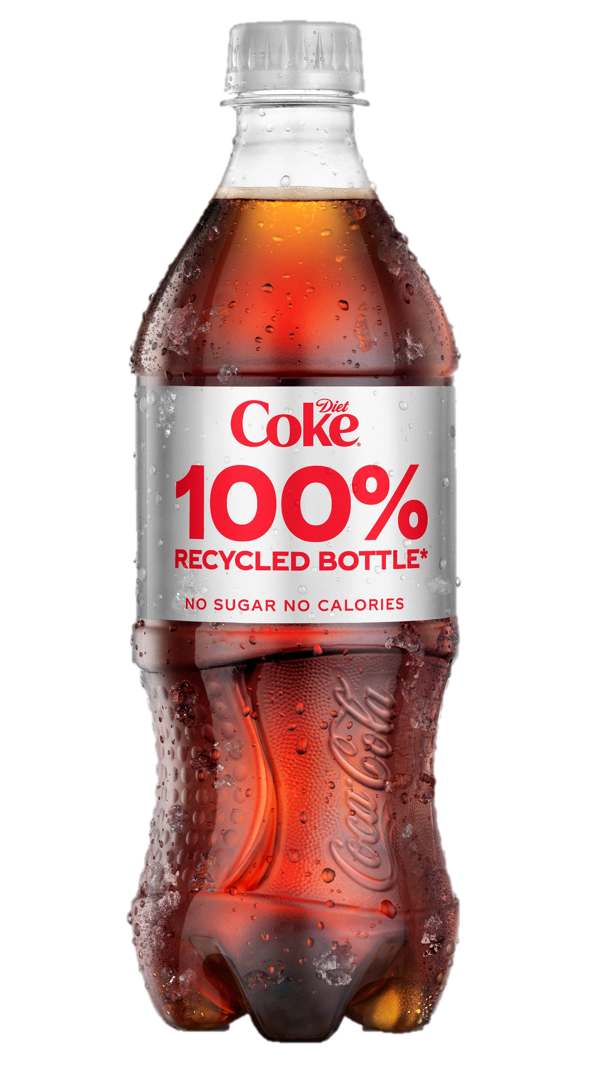
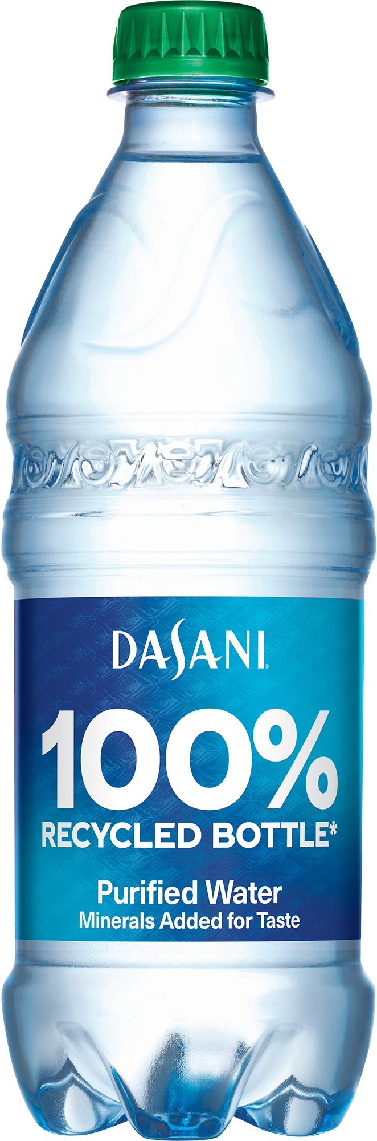
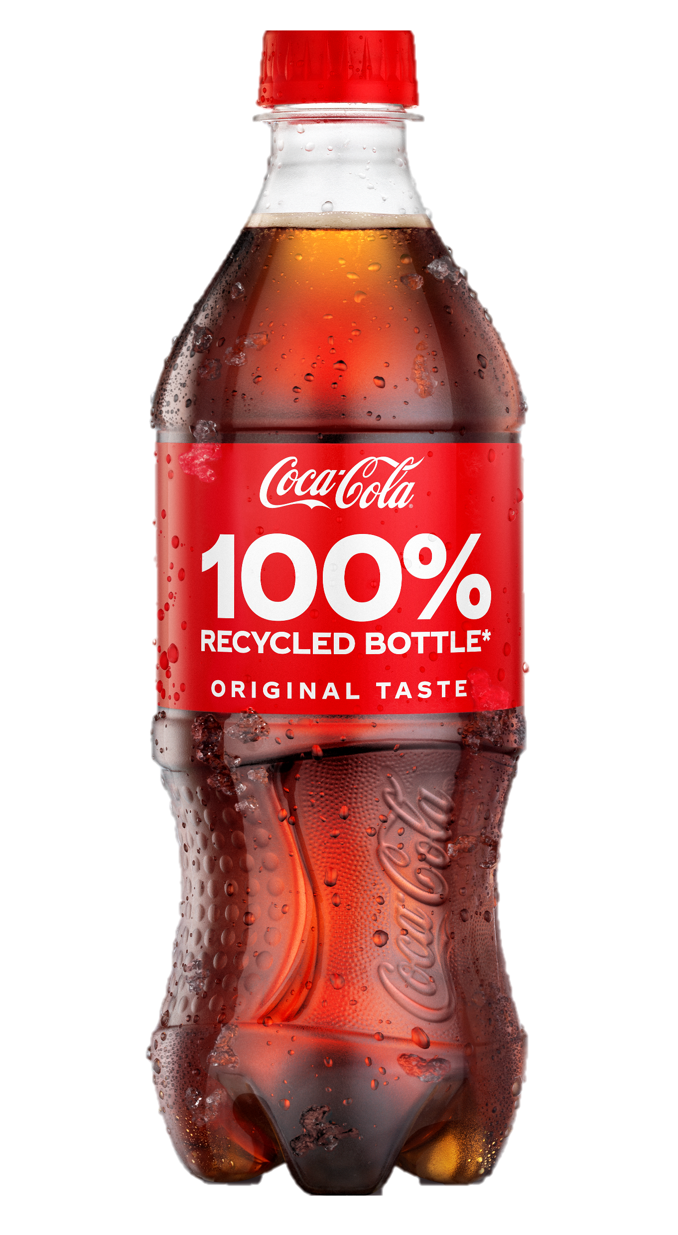
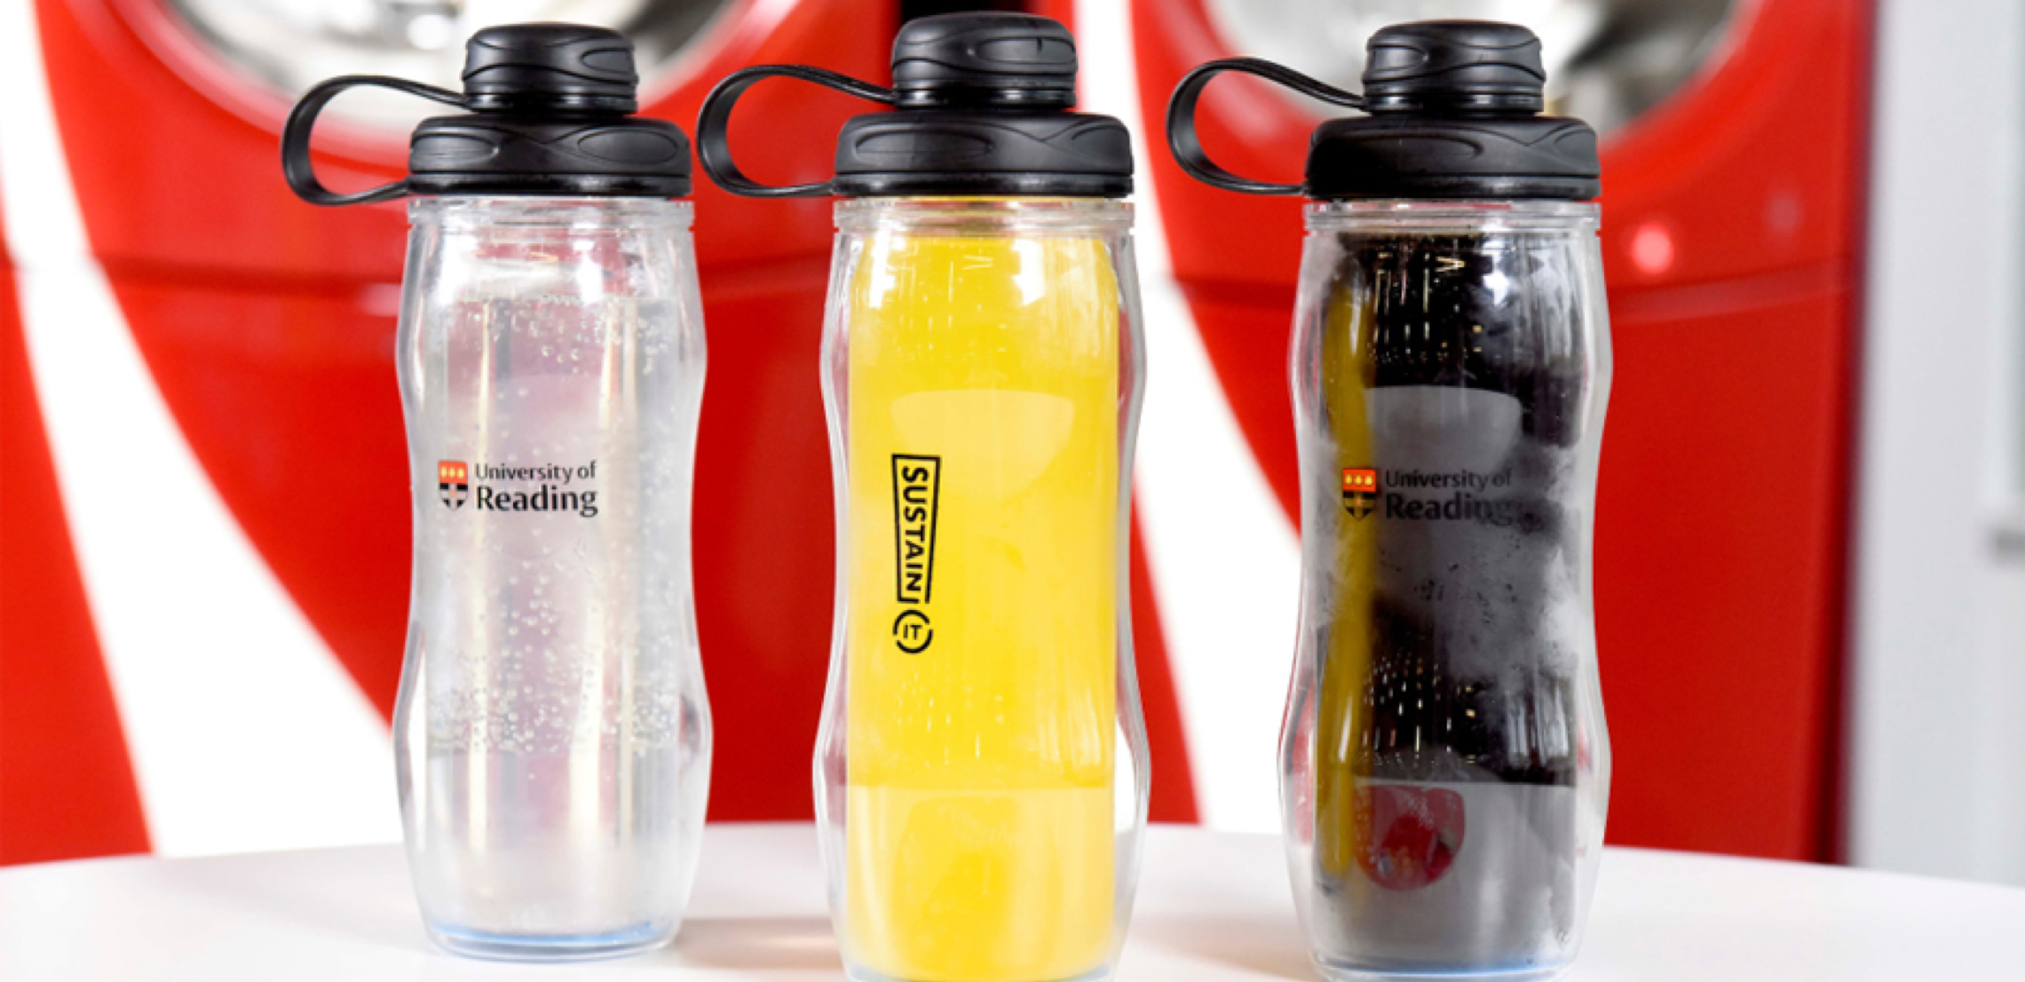
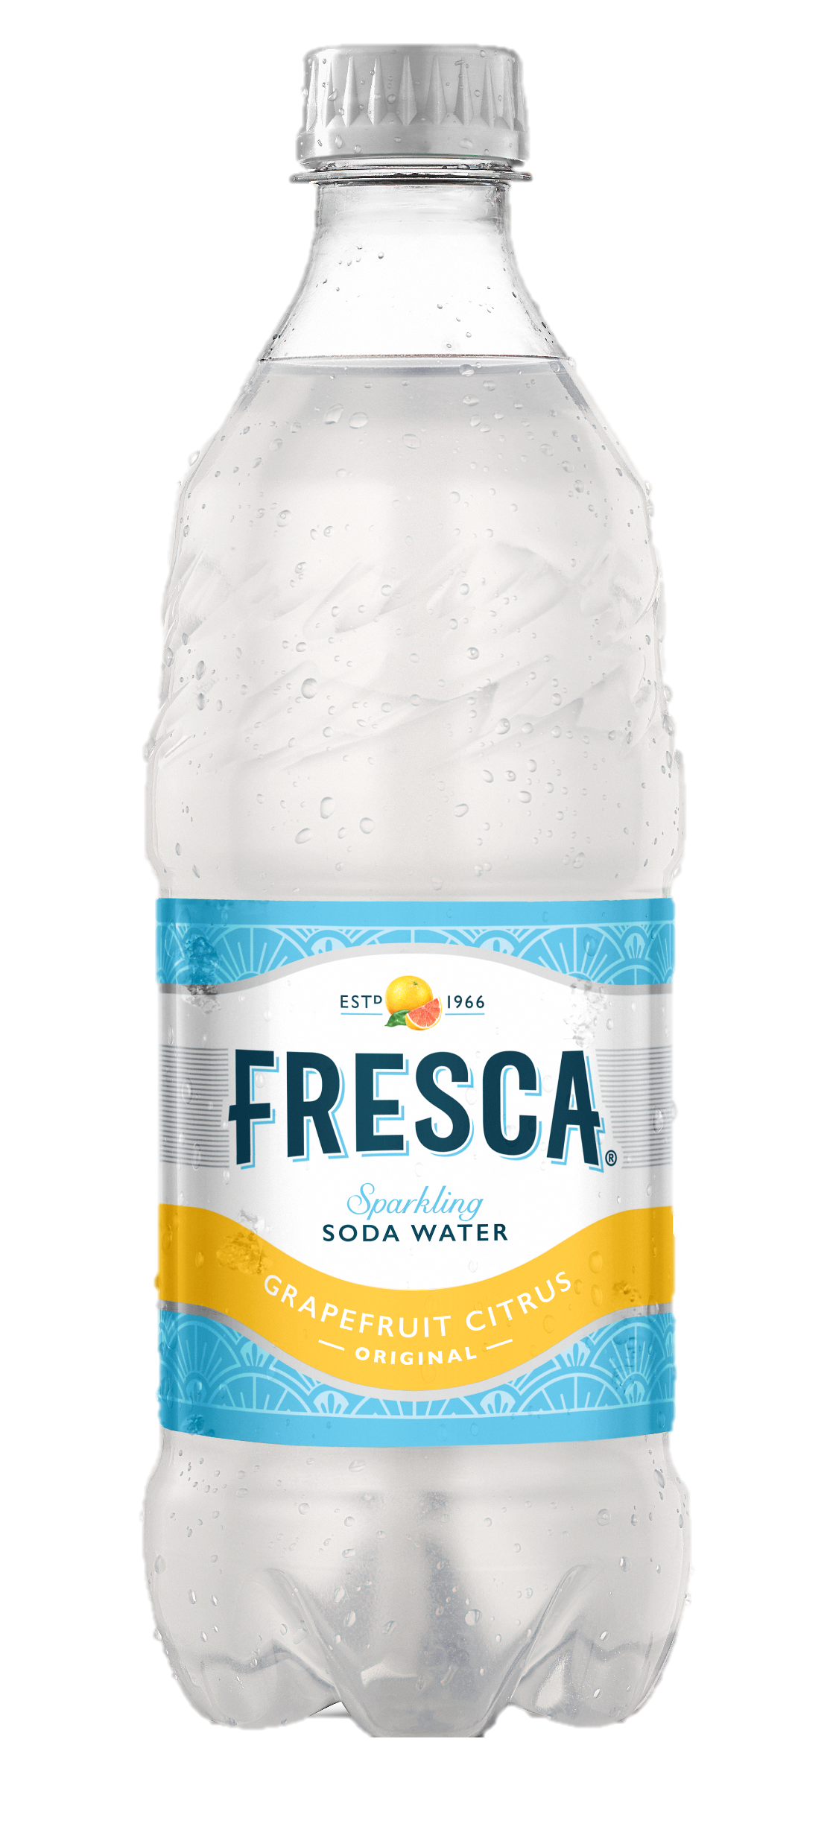
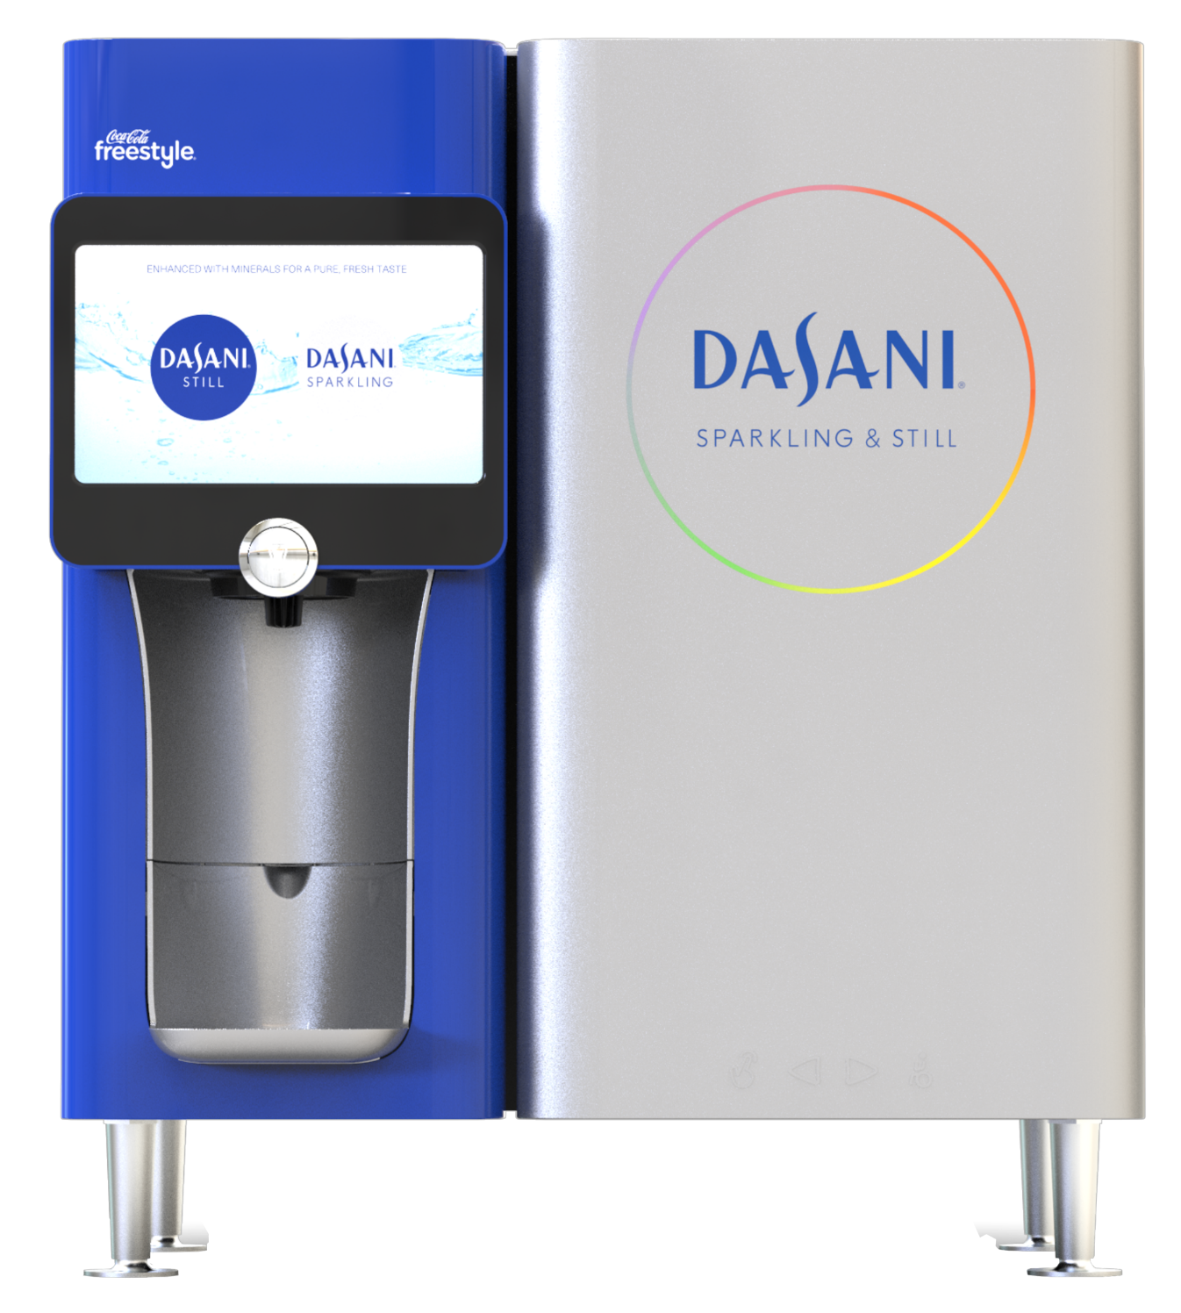
DESIGNING FOR CIRCULARITY
PACKAGELESS INNOVATIONS
VIRGIN PLASTIC REDUCTION
CLEAR PACKAGING
100% RECYCLED PLASTIC*
50 MILLION POUNDS
*Excludes cap and label
Notes:
We continue to innovate to make our beverage packaging more sustainable.
Packageless Innovations
One way we're innovating is through the development of packageless beverage delivery options, like Coca-Cola Freestyle – Coca-Cola Freestyle machines can contribute to cutting waste in product transportation and manufacturing. Refillable cups with micro-chipped ValidFill technology are being used with Coca-Cola Freestyle machines in theme parks, on university campuses and by cruise lines. "Smart" refillable cups directly interact with Coca-Cola Freestyle, allowing consumers to reuse the cup vessel.
Another example is DASANI PureFill 2.0. DASANI PureFill gives consumers the ability to fill and refill bottles with ultra-filtered, still, flavored and sparkling DASANI water in a compact, table-top vessel. This is the next evolution of DASANI PureFill 1.0 that launched in 2017 at Georgia Tech. DASANI PureFill 2.0 launched fall 2019.
Virgin Plastic Reduction
Our North American business avoided 50 million pounds of virgin plastic usage through our lightweighting, recycled plastic and renewable material efforts in 2021.
Clear Packaging
Sprite’s status as one of the biggest and most recognized brands in the world can largely be attributed to its crisp lemon-lime taste and its iconic green bottle. Sprite has transitioned from green to clear plastic, increasing the material’s likelihood to be remade into a new bottle.
Sprite’s new clear bottles will increase the amount of high-quality, food-grade, recycled plastic available in the marketplace, ultimately allowing more of our brands the opportunity to use 100% recycled plastic like DASANI, which decreases carbon emissions and minimizes new plastic.
When recycled, green plastic is more often converted into single-use items that do not get recycled again. Clear plastic (PET) gives Sprite the opportunity to be remade into another bottle, therefore taking part in the circular economy – an economic system aimed at eliminating waste through the continual use of existing, valuable resources.
Our entire green plastic portfolio is transitioning to clear plastic. In October, Fresca, Seagram’s and Mello Yello will also convert from green to clear plastic.
100% Recycled PET
Coca-Cola North America has transitioned a selection of plastic bottles across the portfolio to 100% recycled plastic (excluding caps and labels) helping to address one of the globe’s largest environmental concerns, plastic waste. Using 100% recycled plastic in our bottles decreases carbon emissions and minimizes new plastic.
This summer DASANI launched new bottles made from 100% recycled plastic (excluding caps and labels) across the U.S. By moving to bottles made of 100% recycled plastic*, DASANI expects to save over 20 million pounds of new plastic compared to 2019 – the equivalent of 552 million bottles – in 2023 alone.
As part of a portfolio approach, we have also introduced 20oz bottles made with 100% recycled plastic* across Coca-Cola trademark and Diet Coke throughout the Northeast, California, New York and Texas.
We continue to actively invest in and increase recycled PET to meet our World Without Waste goal of using at least 50% recycled material in our packaging globally by 2030.
Together, these transformations help drive a circular economy for our packaging, the fundamental principle behind our sustainable packaging initiative, World Without Waste.

Slide 5
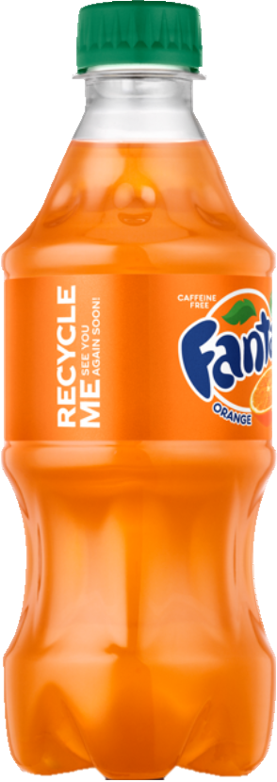
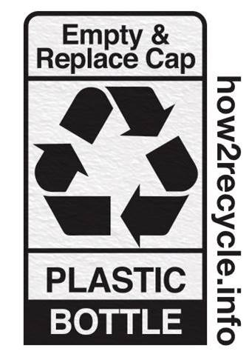
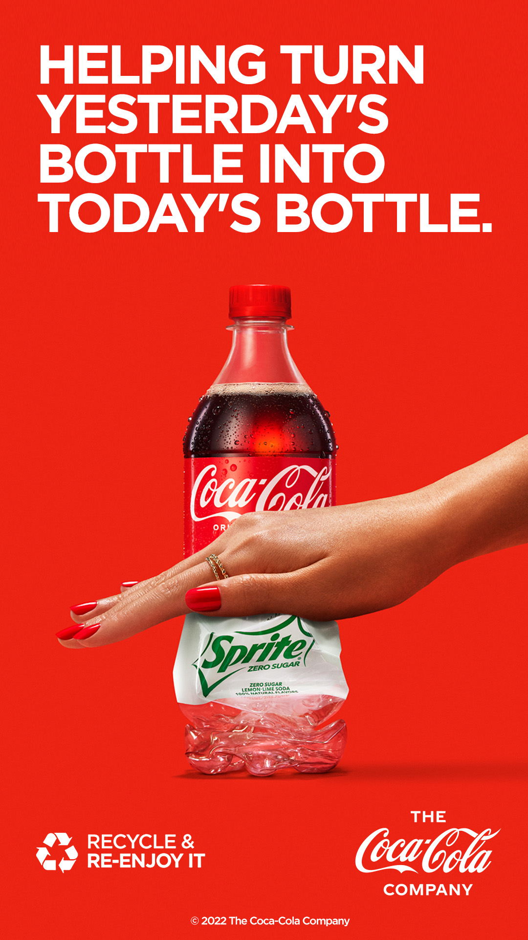
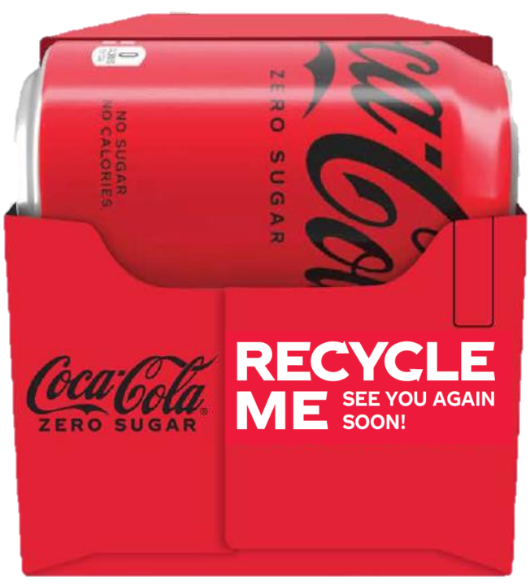
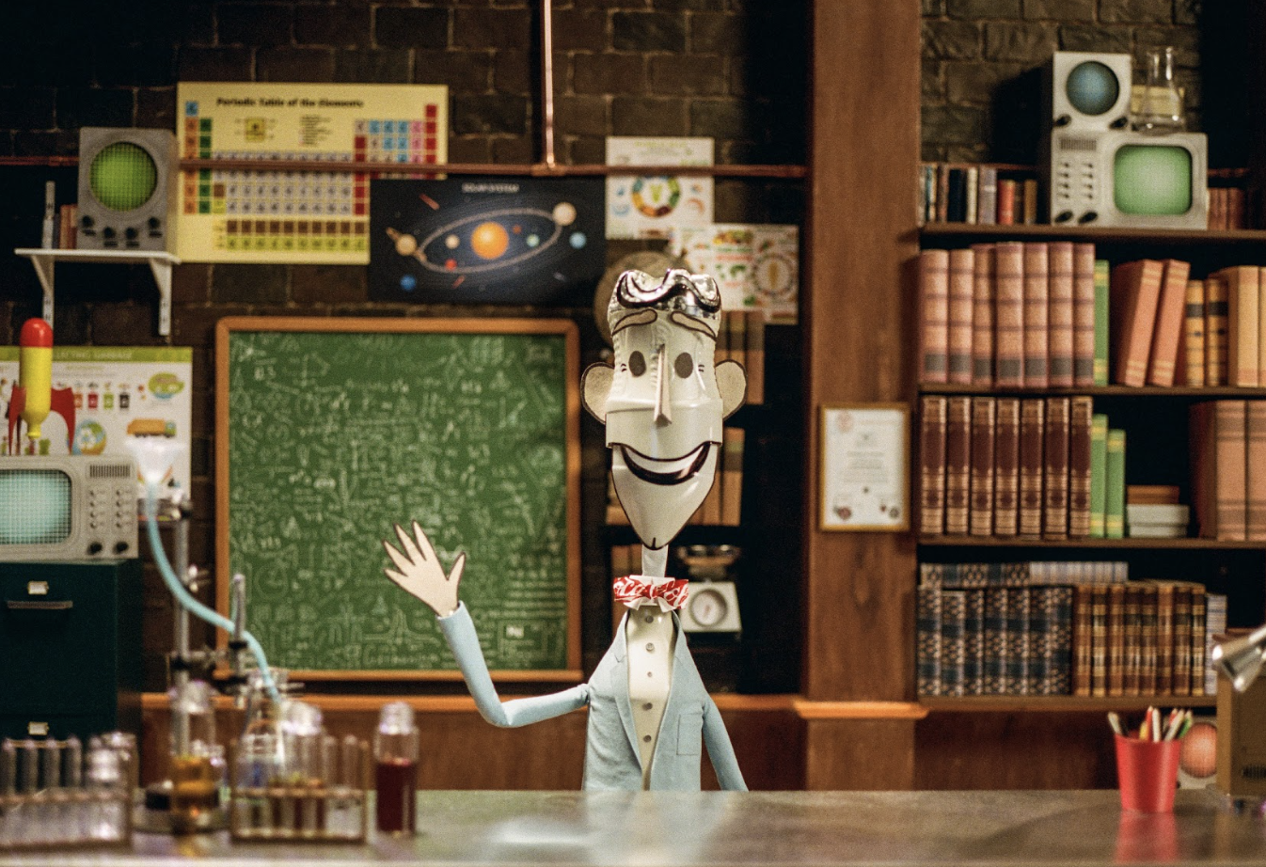
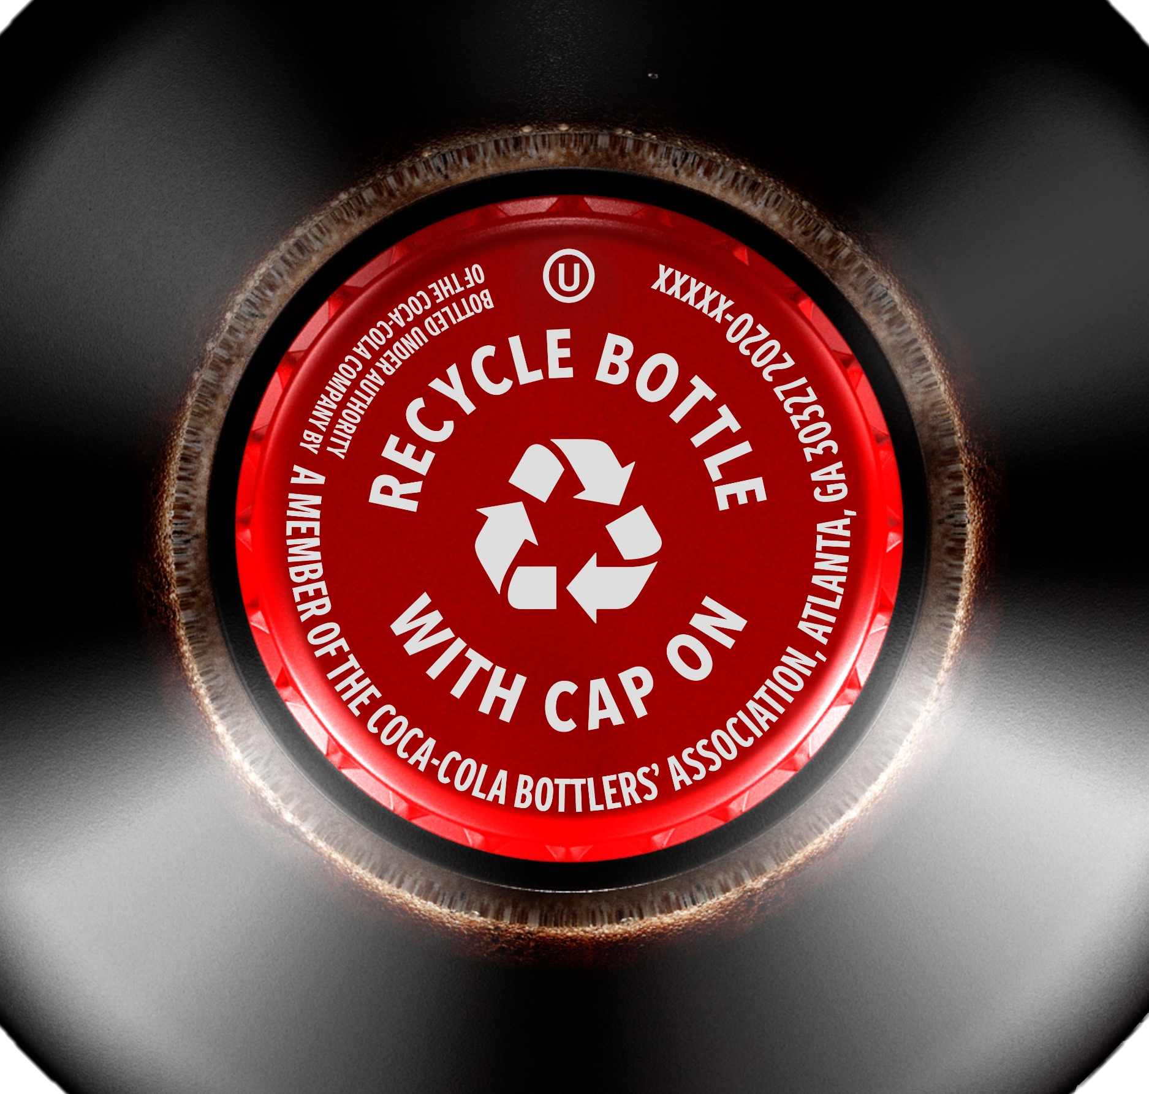
CONSUMER EDUCATION
Notes:
The goal for these consumer education efforts is for consumers to recycle these recyclable bottles so that they can be used again and again as raw material for more new bottles, supporting closed-loop recycling systems and circular economies for PET.
Campaigns
In 2022, we unveiled a partnership between The Coca-Cola Company and Bill Nye to illustrate the holistic recycling process in a stop-motion animated film. Our goal: to demystify the recycling process by educating consumers on the vital role they play, ultimately inspiring them to think, feel, and behave differently about recycling. The team drove awareness and excitement around the World Without Waste film through media outreach to trade, consumer lifestyle, news, entertainment, culture, science, tech and sustainability publications, generating 105 placements and more than 2 billion impressions.
We tested how aware consumers were of the Bill Nye campaign and whether a campaign like this one encouraged consumers to recycle more. While total awareness of the campaign was low compared to awareness of long-standing initiatives (14% vs. ~20% for WWW, for example), it had a strong impact on consumer behavior. We saw positive impacts on consumers’ wanting to recycle more, strong increases in their views of TCCC, their intent to purchase our products, and their advocacy levels.​
In 2021, we launched a multi-mullion dollar marketing campaign focused on our sustainable packaging strategy. The campaign’s “Recycle and Re-Enjoy It” concept reinforces the idea of a circular economy by conveying that plastic is a valuable commodity simply designed to be used again and again. The campaign’s creative has been used to various Coca-Cola events and customer to continue carrying this important message.
On-Package Messaging
We want to inspire everyone to join us in reducing waste, so we’re encouraging people to recycle their bottles and cans with the largest on-package messaging effort ever by The Coca-Cola Company. There are four touchpoints of recycling messaging on our packages, including on the cap and a few messages on the label.
Nearly every sparkling brand contains a "RECYCLE ME See you again soon!" message on both primary and secondary packaging.
As part of our commitment to the American Beverage Association “Every Bottle Back” initiative, we have implemented on-cap recycling messaging on all our PET bottles . This message will inform our consumers of the power of recycling at the point of consumption.
How2Recycle is a standardized labeling system that communicates recycling instructions to the public. It can be found on thousands of products in stores today, including some of our brands like Honest, Minute Maid, DASANI & Coca-Cola, to help consumers recycle more and better. You can find it on our packaging giving guidance such as, ‘empty and replace caps’ for our PET bottles, or taking clean and dry shrink film case packaging back to store with other films/grocery bags. Many of our customers today are suggesting use of these labels on package, to eliminate consumer recycling confusion.

Slide 6
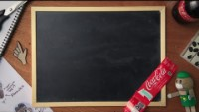
CONSUMER EDUCATION BILL NYE DEMYSTIFY RECYCLING

Slide 7
REUSE-RETURNABLE AND REFILLABLE
Notes:
ANTON

Slide 8
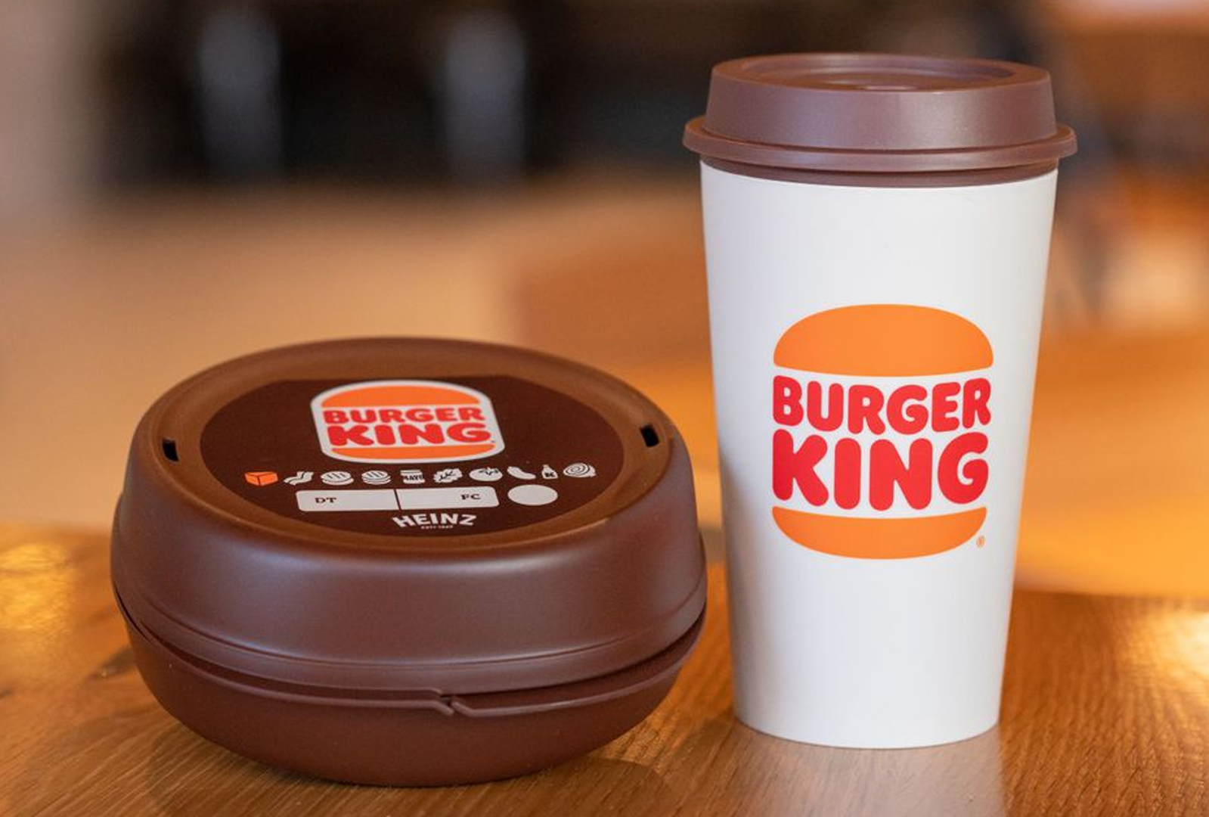
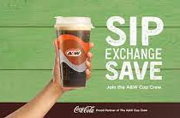
REUSE AND REFILL INITIATIVES 2022
Burger King Reusable Packaging
New Jersey(5 restaurants)
A&W Canada Exchangeable cup
Vancouver, Canada
Returnable Glass Bottle Pilot
El Paso, Texas
Notes:
Burger King Pilot x 5 restaurants in New Jersey (January 2022 – June 2023
Beverage containers more popular than the sandwich packaging
Slow return/reuse Rate
Consumers keeping cups as souvenirs
A& W circular exchangeable cup program (Canada)
High Level of reuse
Requires scale to breakeven
Over 7000 disposable cups did not go to landfill
RFID Technology with validfil ( freestyle)
Controlled Pour App for easy use Wi-Fi enabled

Slide 9
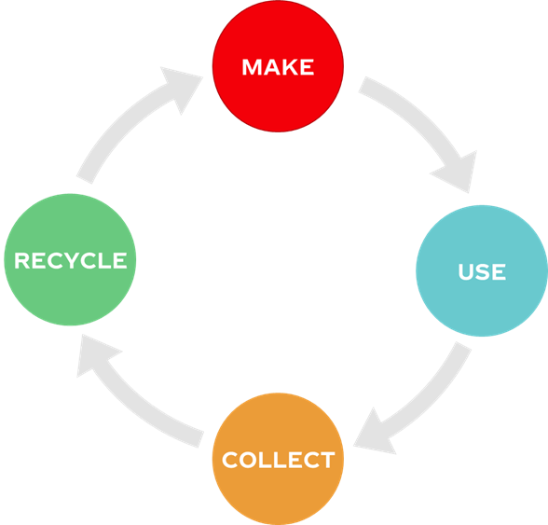
COLLECTION EFFORTS
Notes:
ANTON

Slide 10
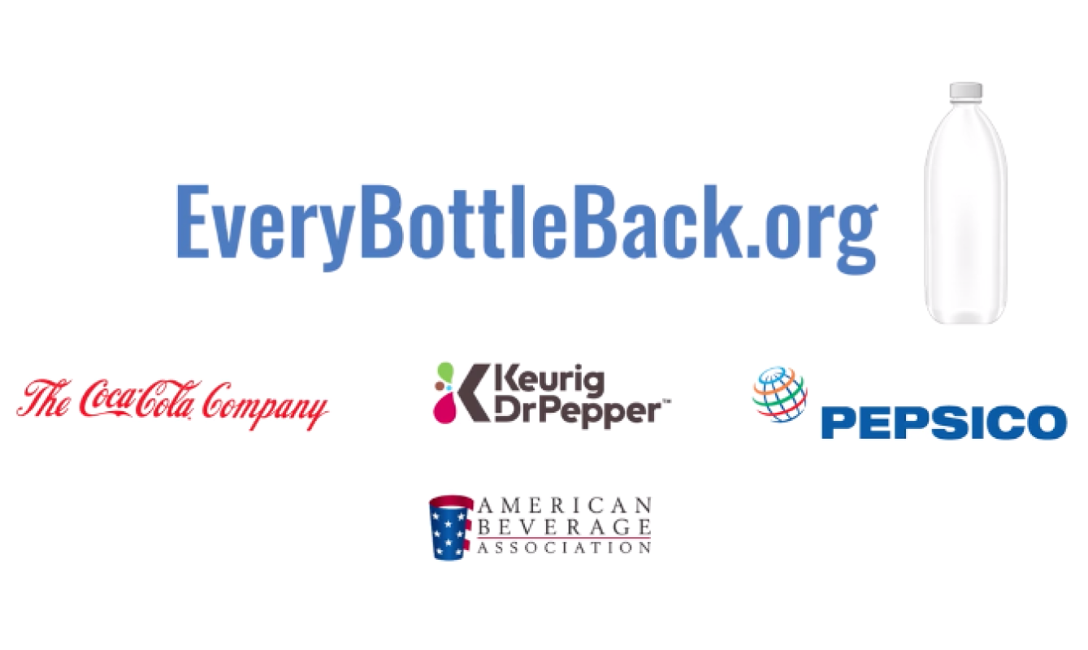
EVERY BOTTLE BACK – INDUSTRY EFFORT
In 2019, we announced our partnership to support Every Bottle Back, an industry-wide initiative and American Beverage Association commitment.
Every Bottle Back is focused on reducing the beverage industry’s plastic footprint by improving the collection of the industry’s recyclable plastic bottles, so that they can be remade into new bottles.
This effort is supported by environmental and sustainability leaders across the country including Closed Loop Partners, The Recycling Partnership, and World Wildlife Fund.
Through the initiative, America’s leading beverage companies are investing the equivalent of nearly a half-billion dollars.
Since its founding, Every Bottle Back has invested $12.5 million in 11 communities across the country to help more than 300,000 households recycle nearly 693 million more pounds of PET over a 10-year period.
https://www.innovationnaturally.org/every-bottle-back/
Notes:
JOANNA
The North American system is focused on the strategic use of the rPET we purchase. We are leveraging the potential for rPET to drive consumer preference and reputation through a 100% rPET bottle where it is technically and economically feasible. Our priorities are 100% rPET across our water portfolio and 100% rPET for Coca-Cola TM + in geographically relevant markets. We will promote these 100% rPET bottles through in-market PR and brand communications starting next month for both the Dasani 100% national roll out and Sprite Green to Clear. We will be tracking the performance of these innovations and will report back.
We are also taking actions to educate consumers at the point of consumption on recycling and working with partners to build more opportunities to recycle.
In February, we launched the Character 2.0 story with our Recycle & Re-Enjoy Campaign. This campaign was featured at the Final Four in New Orleans.
In April, reverse vending machines arrived backstage at Walt Disney World Resort theme parks in four locations! Cast members can use these machines to recycle empty plastic bottles and aluminum cans. For each item recycled, The Coca-Cola Company will donate 25 cents to the Disney Conservation Fund, up to $25,000 total. Collected bottles and cans will be processed and turned into new bottles and cans.

Slide 11
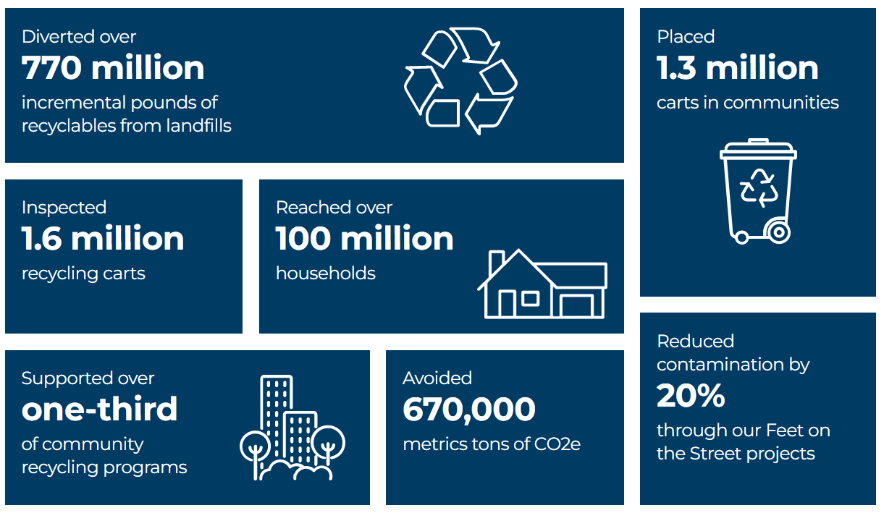
INVESTMENT IN THE RECYCLING PARTNERSHIP
National Nonprofit The Recycling Partnership Has Awarded Gwinnett County a $100,000 Grant to Deliver 8,400 Recycling Carts and Provide Recycling Education to Nearly 200,000 Households in Unincorporated Gwinnett
The City of Norcross and The Recycling Partnership launch citywide cart-tagging campaign to dramatically improve curbside residential recycling, part of a $15,000 grant
“Do You Recycle? Challenge” Launches in Atlanta to Increase Recycling Participation and Quality of Recyclables from Multifamily Properties
The Recycling Partnership Honors Atlanta Multifamily Communities for Improving Recycling
https://recyclingpartnership.org/the-recycling-partnerships-impact-report-2022/
Notes:
With close to 1,500 multifamily properties representing approximately 140,000 households, Atlanta is a prime location for a pilot Challenge to increase recycling participation and improve the quality of recyclables being diverted from landfills. The Do You Recycle? Challenge, launched today by The Recycling Partnership, Live Thrive, Atlanta Housing, Livable Buckhead, Georgia Recycling Coalition, Atlanta Recycles, The Atlanta Apartment Association, and The City of Atlanta Office of Resilience, will aim to engage 100 multifamily buildings providing training and education over the next 12 months. The Do You Recycle? Challenge will scale the success of a pilot The Recycling Partnership conducted earlier this year with the Atlanta property portfolios of AMLI Residential and Gables Residential which reached nearly 5,000 residents across 10 buildings.

Slide 12
INVESTMENT IN CLOSED LOOP PARTNERSHIP
https://www.closedlooppartners.com/impact-report-2021/
Notes:
Closed Loop Infrastructure Fund
Established in 2014 and funded by the world’s largest retailers, consumer goods companies and corporate foundations, we finance recycling and circular economy infrastructure. The Closed Loop Infrastructure Fund invests across circular supply chains and measures the following social and environmental outcomes:
WHAT IS THE CHALLENGE? Insufficient infrastructure, outdated technologies and collection gaps that have led to hundreds of millions of tons of valuable commodity materials being discarded to disposal, rather than circulated back into products and packaging across the U.S. HOW ARE WE SOLVING IT? Our Closed Loop Infrastructure Fund provides flexible capital to fund replicable, scalable and sustainable recycling and circular economy infrastructure projects across collection, sortation, processing and new technologies.

Slide 13
SERDC RECYCLING INFRASTRUCTURE GRANT
Grantee | Households | Total Funded
Clyde, NC | 565 | $3,334.00
Canton, NC | 1,900 | $11,000.00
Marion, SC | 965 | $7,000.00
Weaverville, NC | 2,200 | $13,156.25
Southern Shores(2021) | 2,500 | $1,700.00
Louisville, KY(2021) | 28,000 | $350,000.00
Waynesville, NC(2021) | 4, 500 | $26,025.00
 |  | $412,215.25

Slide 14
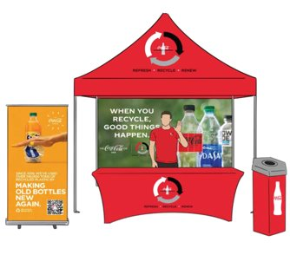
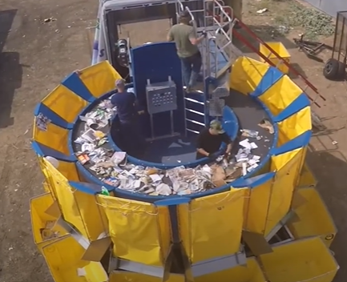
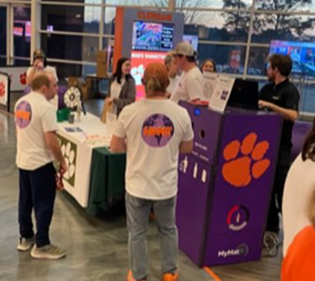
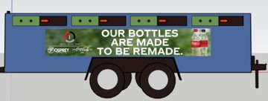
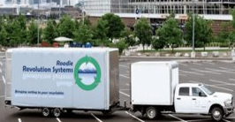


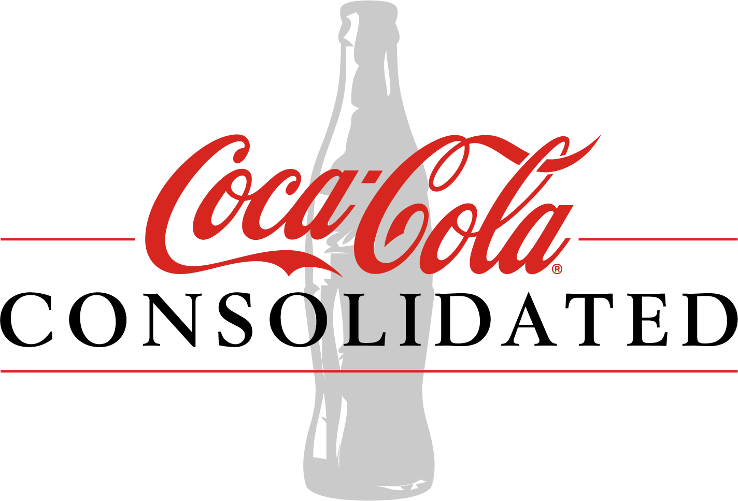
COLLECTION AND RECOVERY BY COCA-COLA BOTTLERS
ZERO WASTE EVENTS - ROADIE​
​
PILOT NEW SORTING BINS​
​
EDUCATE CONSUMERS & COLLECT MATERIAL ON-SITE
ALIGENT ON SUSTAINABILITY INITIATIVES
Collect & Sort ​On-Site, Get Every Bottle & Can Back
Machine Senses & Sorts ​
Collection Trailers
Notes:
Videos
Consumer Facing
Housekeeping Training
POS
QR Codes/Informative
Truck Backs
Local Community Partnerships
Education Centers (Envision)
​Mobile Sustainability Van
Sustainability Tent

Slide 15
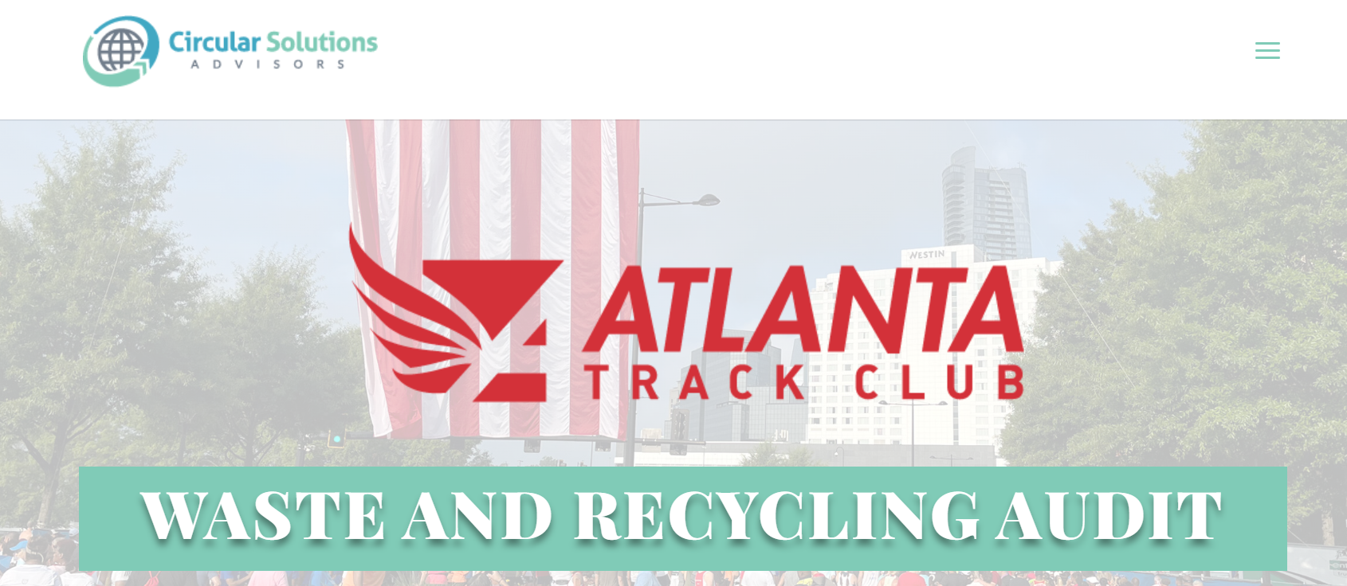
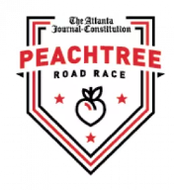

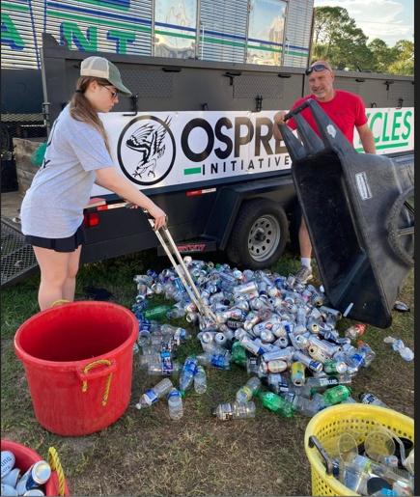
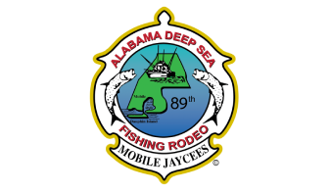
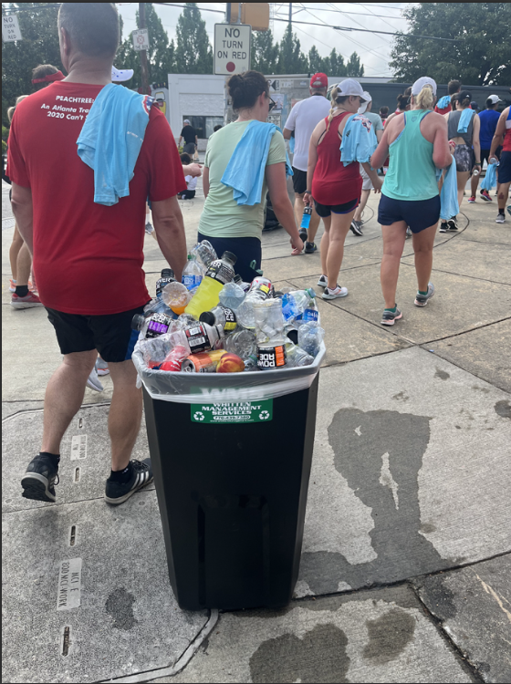
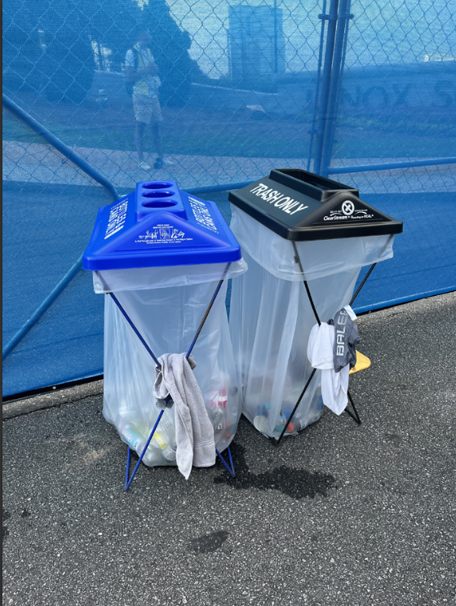
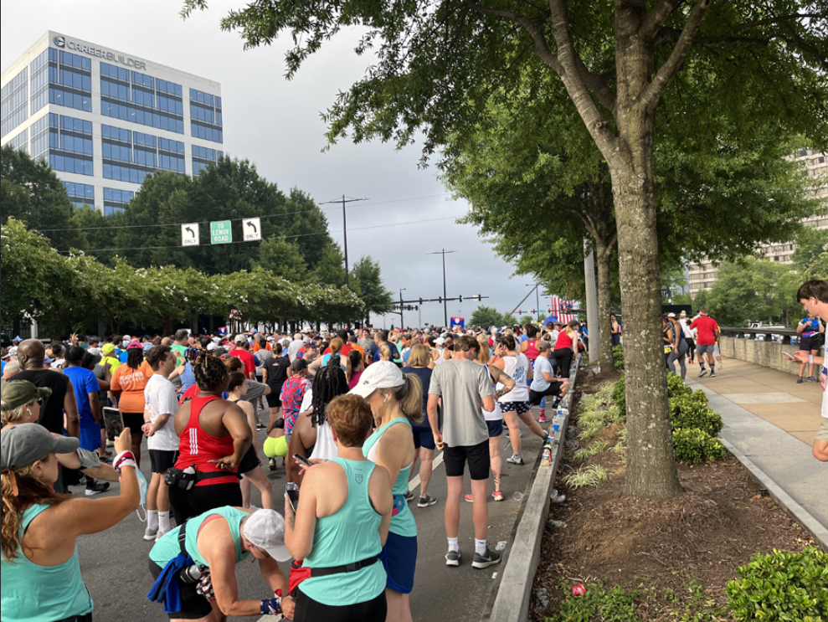
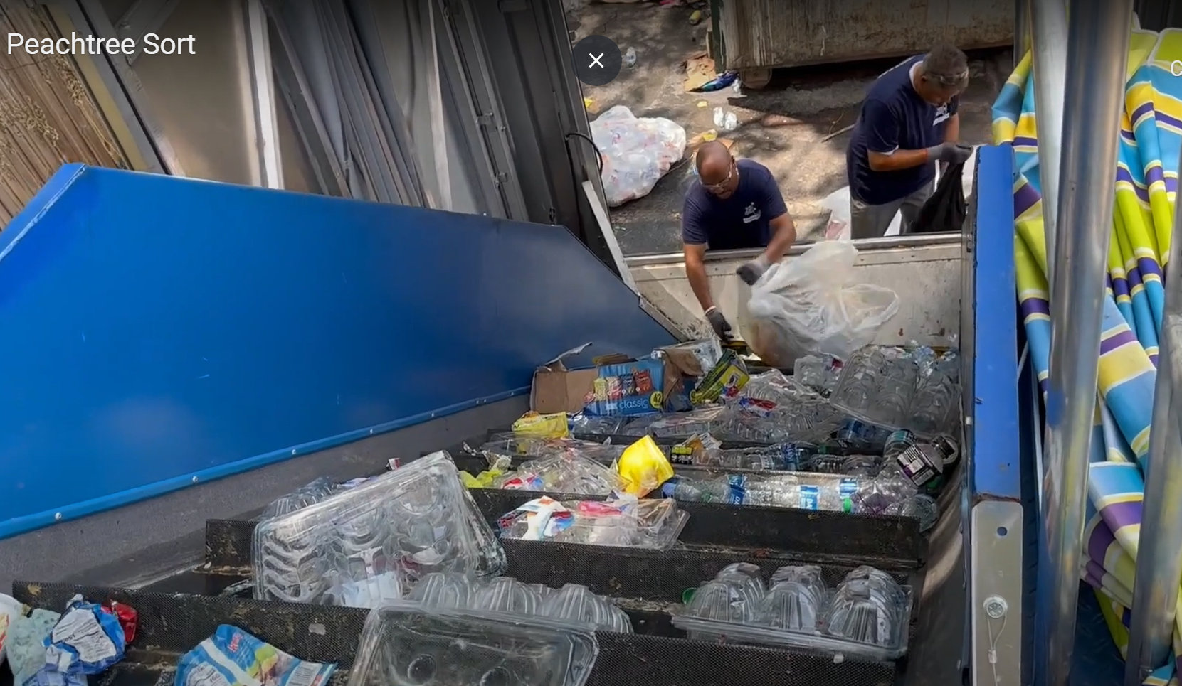
COCA-COLA UNITED COLLECTION EFFORTS IN GEORGIA
7 tons recyclables
4,139 cans
1,110 bottles
Notes:
Coca-Cola united partnered with Circular solutions and atlanta track club to make this years peachtree road race very sustainable.
Consolidated and Coca-Cola Southwest Beverages have become best in class examples of the customer/partner capture efforts we are scaling in select locations where we are not pursuing collection policy.
Consolidated focused on education and collection through various partnerships to collect & sort on-site at the Coca-Cola 600.
Southwest has invested in local MRFs to gain access to cleaner PET and provide those bales to Petstar for conversion back to rPET pellets.

Slide 16
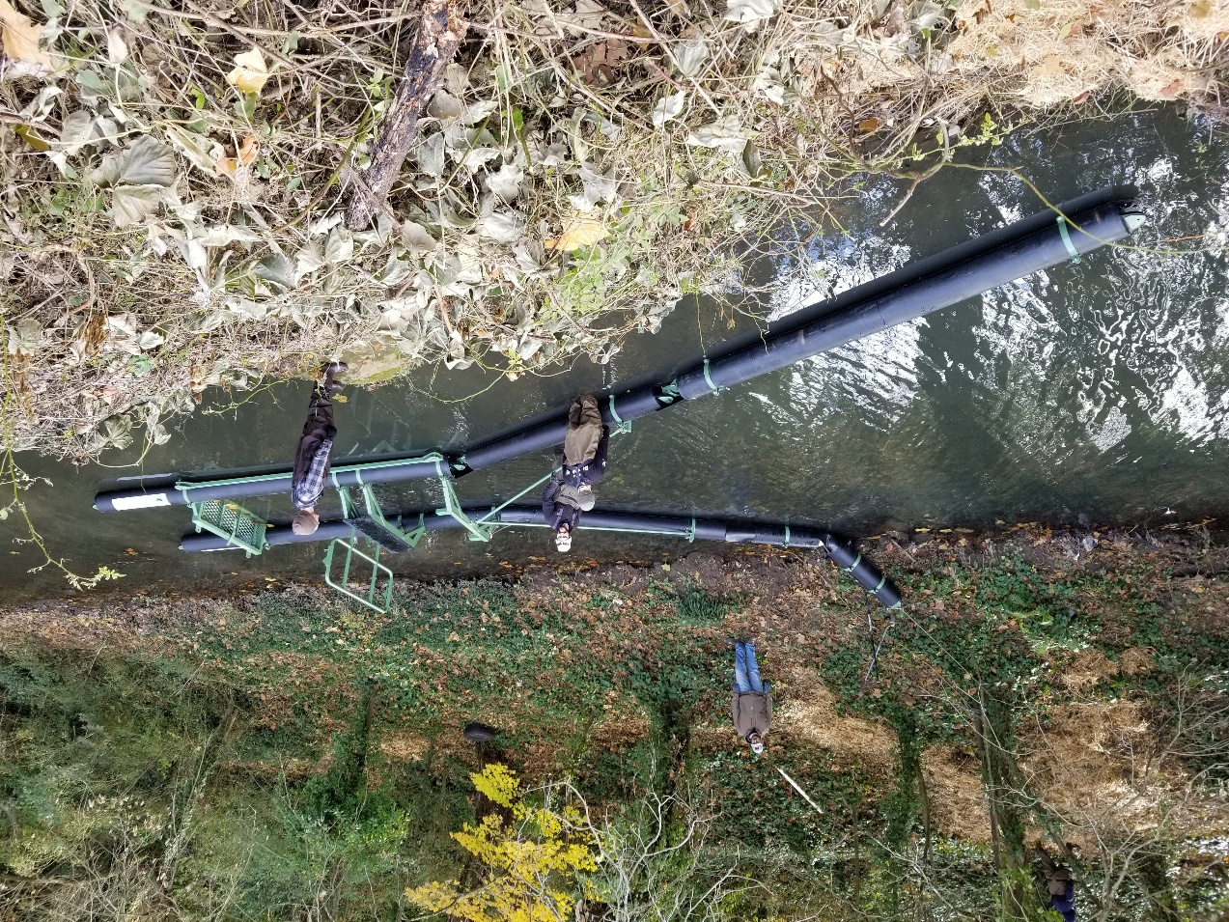
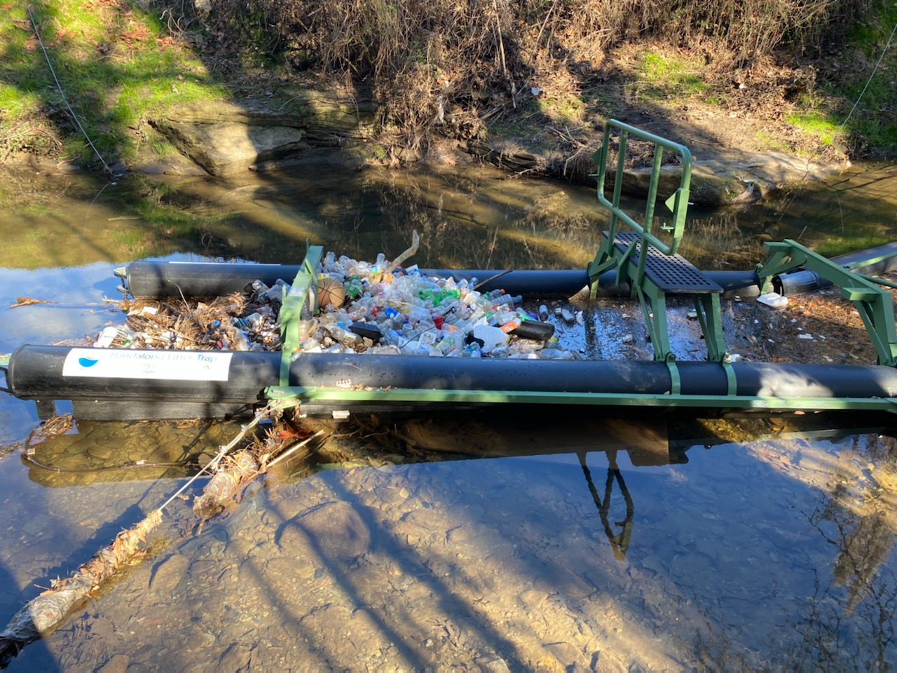
TRASH CATCHMENT SYSTEMS
Four Litter Gitters and one Bandalong, have been installed at five locations within the Proctor Creek Watershed to reduce litter pollution from urban stormwater runoff in Atlanta, Georgia
This technology is removing trash, providing local green jobs on Atlanta’s westside, and creating educational opportunities for residents
Notes:
Originating near downtown Atlanta, the Proctor Creek watershed is heavily urbanized resulting in large swaths of impervious groundcover. The watershed is subject to significant impacts related to stormwater, illegal trash dumping, aging sewer infrastructure, industrial pollution, and eroded stream banks. Urban stormwater flowing down Proctor Creek deposits large volumes of litter on the creek’s banks and transports more as it empties into the Chattahoochee River. The Proctor Creek watershed is home to some of Atlanta’s most historically disadvantaged communities, who have been organizing and working to improve their neighborhoods and environment.

Slide 17
THANK YOU

