Slide 1
THE USE OF GLASS CULLET IN FIBER GLASS INSULATION
North American Insulation Manufacturers Association
Notes:
Good Morning
I am representing NAIMA.
First I have a question, How many people have fiberglass insulation in you home, Apt. or condo?
Keep you hands up…..102
How many of you know that the fiber glass insulation industry wants more glass and that it is the #1 product made from recycled glass in GA?

Slide 2
WHO IS NAIMA?
The North American Insulation Manufacturers Association (“NAIMA”) is the trade association for North American manufacturers of fiber glass and rock and slag wool (mineral wool) insulation
NAIMA promotes the energy savings and energy efficiency achieved through the use of fiber glass and mineral wool insulation

Slide 3
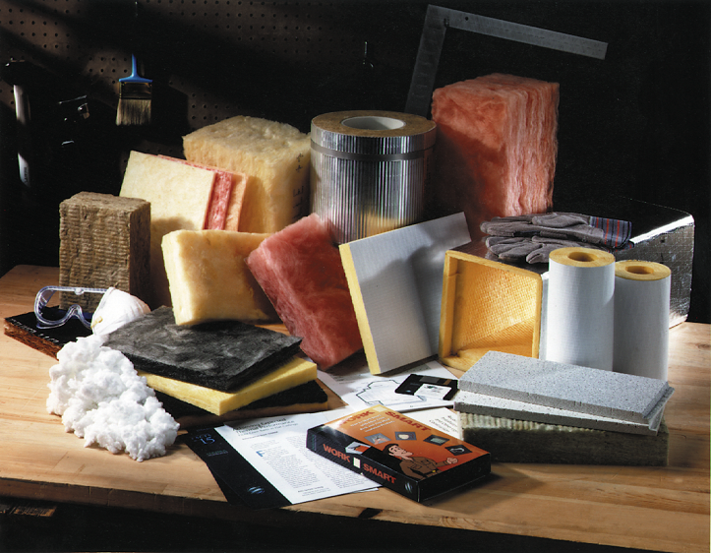
Typical Glass, Rock & Slag Insulation Wool Products
Batts
Duct Board
Pipe
Original Equipment Manufacturer
Loosefill
Acoustic & Ceiling Tile

Slide 4
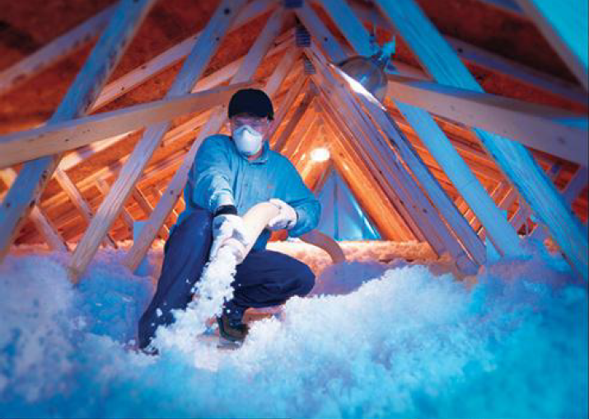

Slide 5
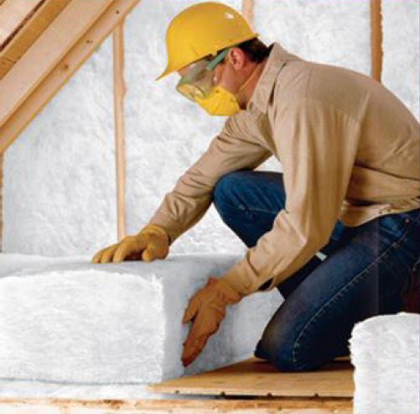
Respiratory protection is not recommended for batt installation because exposures are well below 1 f/cc

Slide 6
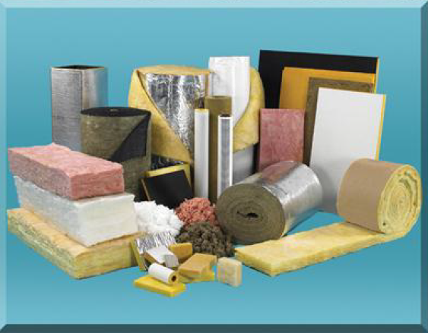

Slide 7
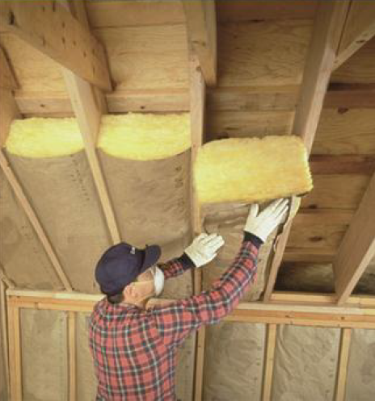
Respiratory protection is not recommended for batt installation because exposures are well below 1 f/cc

Slide 8
Respiratory protection is not recommended for board installation because exposures are well below 1 f/cc

Slide 9
FIBER GLASS INSULATION INGREDIENTS
Soda Ash
Borax
Limestone
Sand
Coating/Binder (not all products)
Glass Cullet can make up to 35-65 percent !

Slide 10
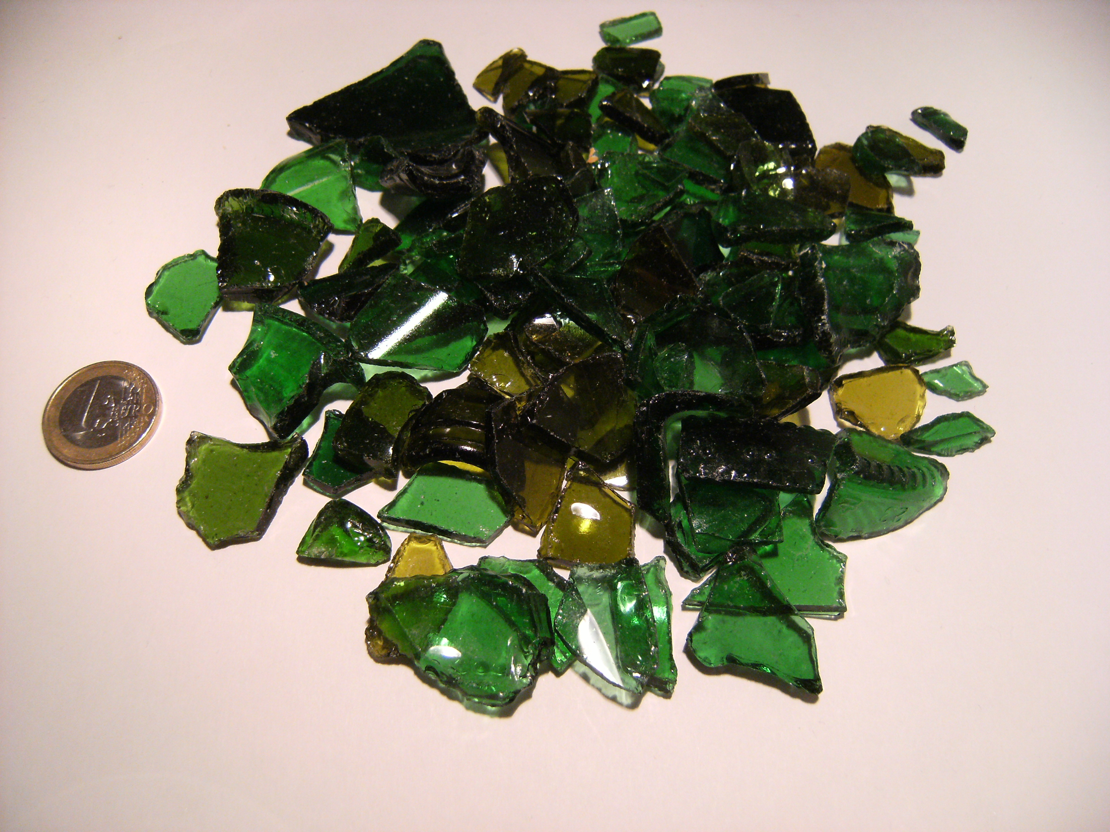
Glass Cullet Supply Issues
Past Practices
Waste Companies found collecting glass unprofitable
Attempts were made to re-write their contracts with local governments by demanding that glass collection be removed from the contract
Suggested/stated there is not a market for glass cullet
NAIMA is actively stepping in to set the record straight
This Photo by Unknown Author is licensed under CC BY-SA

Slide 11
There is a Market for Glass Cullet……..It just takes some collaborations

Slide 12
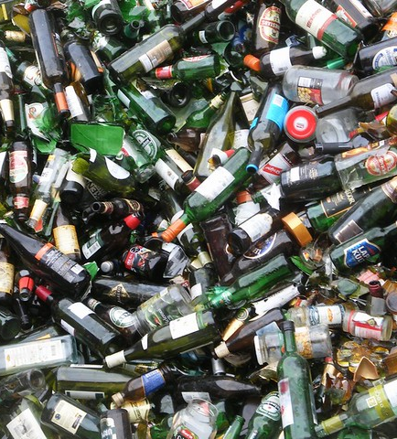
Recycling Data Summary
The most recent survey showed that in 2021, NAIMA member companies in the United States and Canada used more than 3.3 billion pounds of recycled glass
The data showed that in 2021, facilities in the United States used more than 2.2 billion pounds of recycled glass
Extends the life span of fiber glass furnaces by 30%
Since 1992, when NAIMA started collecting recycling data, 71.2 billion pounds of recycled material have been diverted from the waste stream
NAIMA tracks the use of pre- and post-consumer glass cullet

Slide 13
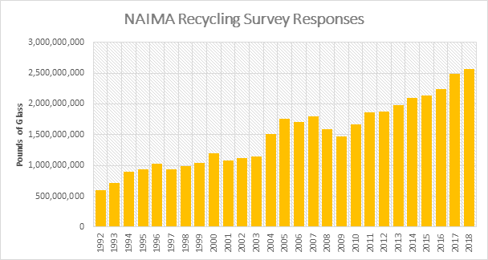

Slide 14
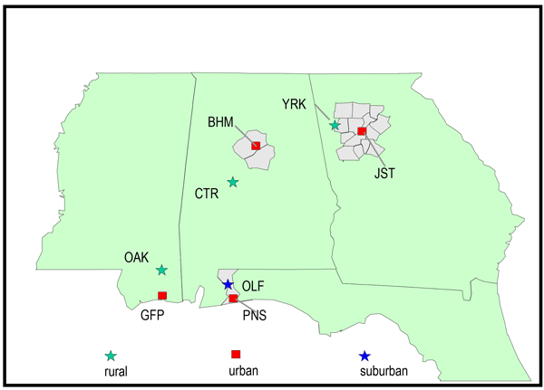
Southeastern United States
Southeast Region Glass Cullet Use:
2019 – 413,063,800 pounds of glass cullet used in the Southeastern United States
The yearly average of these plants would be approximately 428,838,382 million pounds
These combined operations employ over 950 workers
These combined operations provide 3,080 indirect employment opportunities throughout the Southeast

Slide 15
Fiber Glass Plants in the Southeast United States
Fiber Glass Plants In Georgia
Owens Corning – Fairburn, Georgia
Johns Manville – Winder, Georgia
CertainTeed – Athens, Georgia
Other Plants in the Southeast
Knauf – Lanett, Alabama
Owens Corning – Lakeland, Florida
The Georgia plants employ approximately 760 workers
These plants provide approximately 2,700 indirect employment opportunities in the State of Georgia, some of which are in the cullet industry

Slide 16
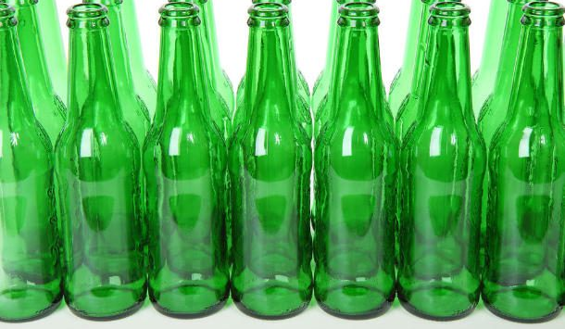
Recycling Data Summary
Fiber glass insulation is the second largest user of glass cullet
Fiber glass insulation is the largest user of glass cullet in Georgia
Fiber glass insulation manufacturers are the highest users of mixed bottle cullet (a mix of flint, amber, and green) and, as such, are responsible for recycling more of this material than any other source
This Photo by Unknown Author is licensed under CC BY-SA

Slide 17
Sustainable Benefits of Insulation
Insulation makes buildings more energy efficient
Insulation keeps buildings cool in the summer and warm in the winter
Energy efficient buildings save money and lower utility bills
A pound of fiber glass insulation saves 12 times as much energy in its first year in place as the energy used to produce it
Reduced energy consumption translates into reduction of air pollutants
The same study concludes that insulation’s reduction of emissions greatly improves public health
The Harvard School of Public Health has published studies that show specific correlation between insulation and reduction of greenhouse gases

Slide 18
Glass Cullet Challenges
Supply is not always consistent
Contaminants in glass cullet can wreak havoc with the manufacturing process
Paper and plastic labels, caps, cork, and other debris
The Myth has to be demystified!
This Photo by Unknown Author is licensed under CC BY-SA-NC

Slide 19
What We Are Doing to Change the False Narrative about “No Markets for Glass”

Slide 20
Road Map for Glass Recovery for Insulation Manufacturers in Georgia
Educate Stakeholders
1
Protect and Grow Glass Recycling
2
Focus on Expansion and Modernization
3

Slide 21
Educating Stakeholders
Increase Glass Cullet
Creating Strategy
Recognition
Public Relations
Presenting/attending at Recycling/Industry Conferences
Creating new targets for 2022/2023
Educating local MRF’s and Major National Company
Connecting Glass Processors, Haulers
Identifying Multiple Municipal Targets
Branding opportunities on equipment
Letters of Appreciation Issued to Municipalities
Social Media - #Recycle Right Campaign
5 + Positive Glass Recycling Articles

Slide 24
Protect and Grow Glass Recycling
Increase Glass Cullet
Leverage Current Initiatives
Connect the Supply Chain
Identify Grant Opportunities
Increased communications channels among municipalities, MRF’s, haulers and processors with common goal
Use collection solution that work!
Increased recovery in Lawrenceville, Savannah, Atlanta, Gwinnett County, Alpharetta, Columbus, Valdosta and the Atlanta Airport
The Recycling Partnership’s Multi-family Recycling Program
Glass Recycling Coalition and Foundation Initiatives
EPD – Georgia,
Glass Recycling Coalition
Official comments by NAIMA to EPA on future grants

Slide 25
Expansion and Modernization
Equipment Capability
Next Gen MRF
New Glass Recycling
Tracking MRF RFP’s
Engagement with Technological Advancements with MRF Equipment (Machinex, Van Dyke)
Influencing future glass recovery systems
Celebrating future Mega-MRF’s
Identifying new operating companies focusing on glass (The Upcycling Company, Rippleglass)
Influence collection locations
Tracking where major MRF’s will be located and include glass recovery (2 in FL in 2023)

Slide 26
Road Map for Glass Recovery and Insulation in Georgia
Educate Stakeholders
Protect and Grow Recycling Program
Expansion and Modernization
Presentations at Conferences
Increase Glass Cullet
Equipment Capability
Presented/attended - Seven Recycling Conferences
Seven+ new targets for 2022/2023
Increased recovery in Athens, Lawrenceville, Savannah, Atlanta Gwinnett County, Alpharetta, Columbus, Valdosta and the Atlanta Airport
Engagement with Technological Advancements with MRF Equipment (Machinex, Van Dyke)
Creating Strategy
Leverage Current Initiatives
Next Gen MRF
Educating 4 Major local MRF’s and Major National Company
Connecting Glass Processors. Haulers
IdentifyingMultiple Municipal Targets
The Recycling Partnership’s Multi-family Recycling Program
Glass Recycling Coalition and Foundation Initiatives
Influencing future glass recovery systems
Influencing future MRF’s (WM)
Recognition
Connect the Supply Chain
New Glass Recycling
Branding opportunities on equipment
Letters of Appreciation Issued to municipalities
Increased communications channels among municipalities, MRF’s, haulers and processors with common goal
Identifying new operating companies focusing on glass (The Upcylcing Company)
Influence collection locations
Public Relations
Identify Grant Opportunities EPA Rulemaking Comments
Tracking MRF RFP’s
Social Media - #Recycle Right Campaign
5 + Positive Glass Recycling Articles
EPD – Georgia, Glass Recycling Coalition
Official comments by NAIMA to EPA on future grants
Tracking where Major MRF’s will be located and include glass recovery (2 in FL in 2023)
Future WM locations (6-8)

Slide 27
My Call to Action to you is “Shatter the Glass Market Myth”

Slide 28
Abbey Patterson abbey.m.Patterson@gmail.com 678-640-2500

Slide 30
Contact
Angus E. Crane
North American Insulation
Manufacturers Association
P.O. 1906
Alexandria, VA 22315
(703) 300-3128
www.insulationinstitute.org

Slide 31
Benefits of Glass Cullet
By using glass cullet, raw materials (sand, soda ash, etc.) use will be reduced
Energy in producing the raw materials will be decreased
The life of the furnaces will increase up to 30 percent due to decreased melting temperatures and a less corrosive batch
Reports have shown that compared to 100 percent raw materials, using 30 percent glass cullet reduces silica use by 60 percent, soda ash by 40 percent, and saves 10 percent in energy costs
This Photo by Unknown Author is licensed under CC BY-SA

Slide 35
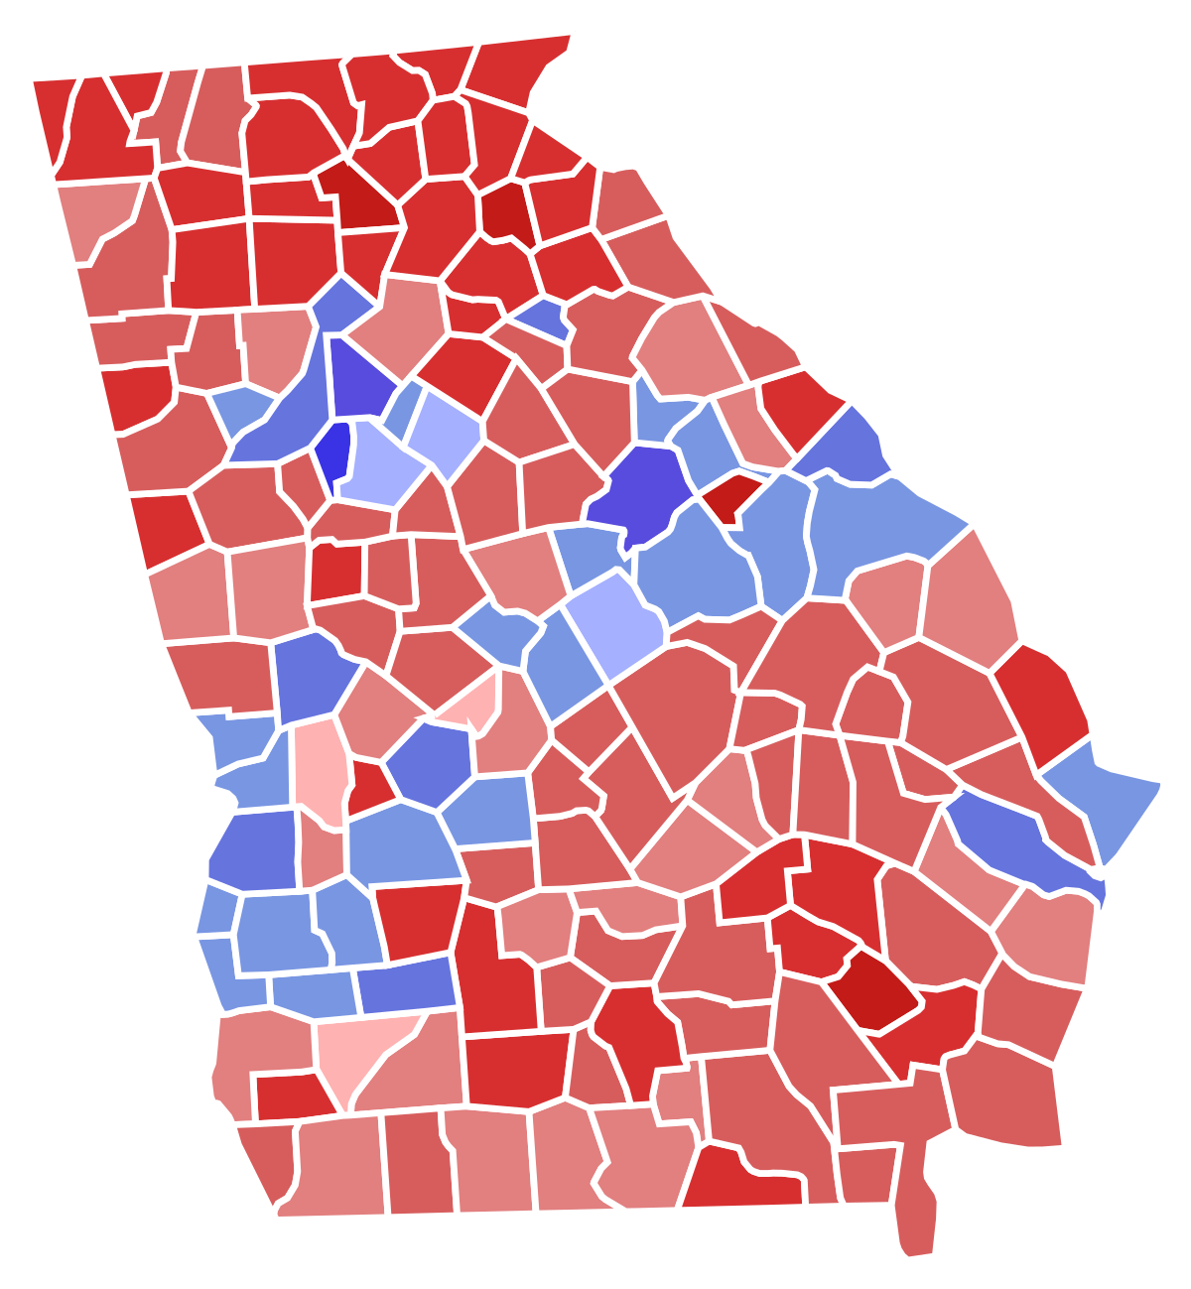
The Story of Gwinnet County Georgia
Waste management companies persuaded Gwinnett County to remove glass from the recycling stream; the county was told there was not a market for glass cullet in Georgia
Georgia Glass Cullet Use:
2017 – 285,483,495 million pounds of glass cullet used in Georgia
The yearly average of these plants would be approximately 278,808,912 million pounds
Most Georgia manufacturers could use more glass cullet
In addition to the Georgia plants, other fiber glass insulation plants operate near the Georgia border in Alabama – Knauf Insulation, and Lakeland, Florida – Owens Corning
This Photo by Unknown Author is licensed under CC BY-SA

Slide 36
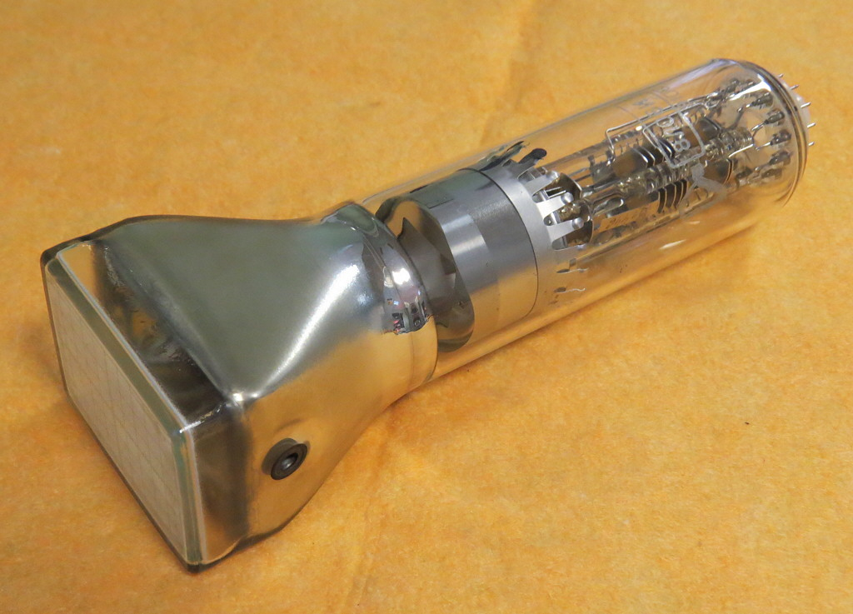
Never Intentionally Add
Cathode Ray Tubes (CRTs)
Microwave ovens
Television screens or components
Computer screens
Other electronics
Antimony Trioxide
Pyrex
Florescent tubes

Slide 37
References
California Integrated Waste Management Board, Market Status Report, Container & Plate Glass (CIWMB.ca.gov/markets/StatusReport.Glass.html)
Berkeley National Laboratory, Energy Efficiency Improvement and Cost Saving Opportunities for the Glass Industry: An Energy Star guide for Energy and Plant Managers, March 2008, pp. 67-68.
Jonathan I. Levy, Yurika Nishioka and John D. Spengler, “The public health benefits of insulation retrofits in existing housing in the United States,” Environmental Health: A Global Access Science Source, April 2003, pp.1-16.
Yurika Nishioka, Jonathan I. Levy, Gregory A. Norris, Andrew Wilson, Patrick Hofstetter, and John D. Spengler, “Integrating Risk Assessment and Life Cycle Assessment: A Case Study of Insulation,” Risk Analysis, Vol. 22, No. 5, 2002, pp. 1003-1017.
Jonathan I. Levy, May K. Woo, and Yann Tambouret, “Energy savings and emissions reductions associated with increased insulation for new homes in the United States,” Building and Environment, 96 (2016), 72-79. Jonathan I. Levy, May K. Woo, Stefani L. Penn, Mohammad Omary, Yann Tambouret, Chloe S. Kim, and Saravanan Arunachalam, “Carbon reductions and health co-benefits from US residential energy efficiency measures,” Environ. Res. Lett., 11 (2016) 034017. Stefani L. Penn, Saravanan Arunachalam, Matthew Woody, Wendy Heiger-Bernays, Yorghos Tripodis, and Jonathan I. Levy, “Estimating State-Specific contributions to PM_{2.5}-andO₃-Related Health Burden from Residential Combustion and Electricity Generating Unit Emissions in the United States,” Environ Health Perspect, 125:324-332 (2017).

Slide 38
Advocacy on Behalf of Glass Recycling
Testimony and written comments before City of Houston
These joints efforts were successful
State of Georgia
Fiber glass insulation is the largest user of cullet in Georgia
Participation in Georgia Recycling Coalition forum was an important educational tool
City of Fayetteville, Arkansas
Again, joint efforts were successful in preserving City’s curbside collection program
State of Massachusetts
Support for bottle bill
More challenges ahead

Slide 39
RECYCLING DATA
Year | Lbs of Glass
1992 | 600,849,000
1993 | 718,249,000
1994 | 897,537,000
1995 | 936,311,000
1996 | 1,027,595,000
1997 | 937,288,000
1998 | 989,568,000
1999 | 1,044,587,000
2000 | 1,203,863,661
2001 | 1,079,784,119
2002 | 1,115,822,845
2003 | 1,142,622,670
2004 | 1,512,092,639
2005 | 1,759,038,782
2006 | 1,708,021,893
2007 | 1,793,901,250
2008 | 1,590,912,003
2009 | 1,470,390,240
2010 | 1,665,277,304
2011 | 1,862,459,057
2012 | 1,874,522,926
2013 | 1,985,597,368
2014 | 2,093,108,691
2015 | 2,139,599,142
2016 | 2,240,085,136
2017 | 2,486,496,404
2018 | 2,572,448,315
Total | 40,448,028,445

Slide 40
Glass Cullet Market
Fiber glass could use a much higher recycled content if it were available
Cullet is easier and most cost effective to melt
Clean cullet is the issue
Fiber glass insulation manufacturers are committed to the use of glass cullet
Glass cullet is defined as glass product or portions of product usually suitable for addition to raw batch. ASTM C162-05 (2015). NAIMA has further identified the parameters for glass cullet acceptable for use in the manufacture of fiber glass insulation.

Slide 41
Allowable Contamination Levels
0 – 0.2% Max. Organics
0 – 0.2% Max. Inorganics
0 – 0.1% Mirror Glass
0.1 – 0.3% Max. Magnetic
0.005 – 0.01% Nonmagnetic Metals
0 – 0.05% Leaded Oxide
Trace Elements Only – Elemental Heavy Metal Glass
0.0 – 0.2% Refractories

Slide 42
NAIMA’s Recycling Survey
Since 1992, NAIMA has conducted an annual survey of member companies to determine the volume of glass cullet used by NAIMA’s members
Glass cullet numbers are collected for both U.S. and Canadian fiber glass insulation companies
This presentation focuses on glass cullet used in North America
Specific focus will also be on the southeastern portion of the United States

