Slide 1
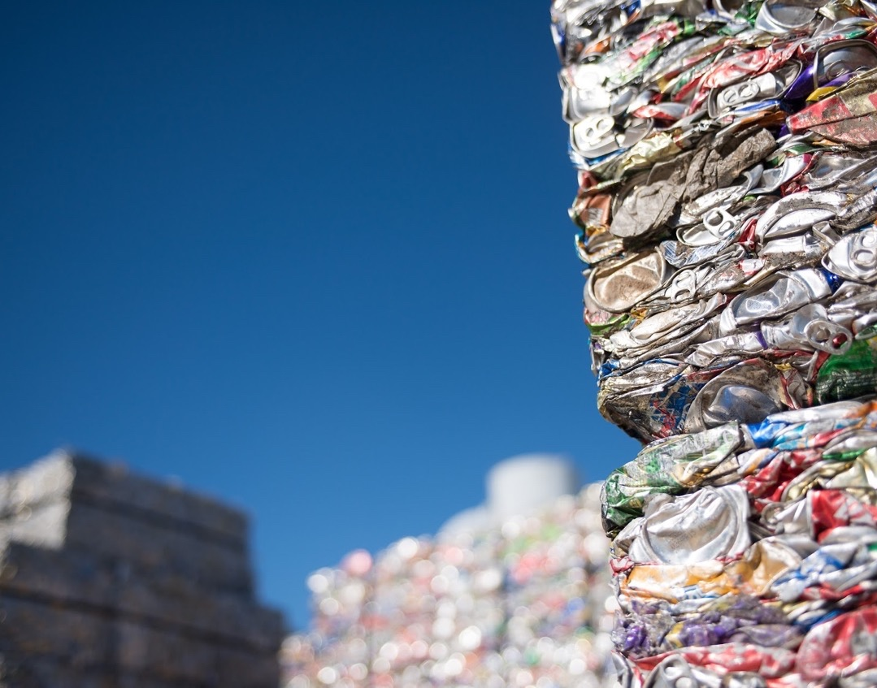
Aluminum -
Opportunity Awaits
Nick Mize
Director, Metal Procurement & Recycling

Slide 2
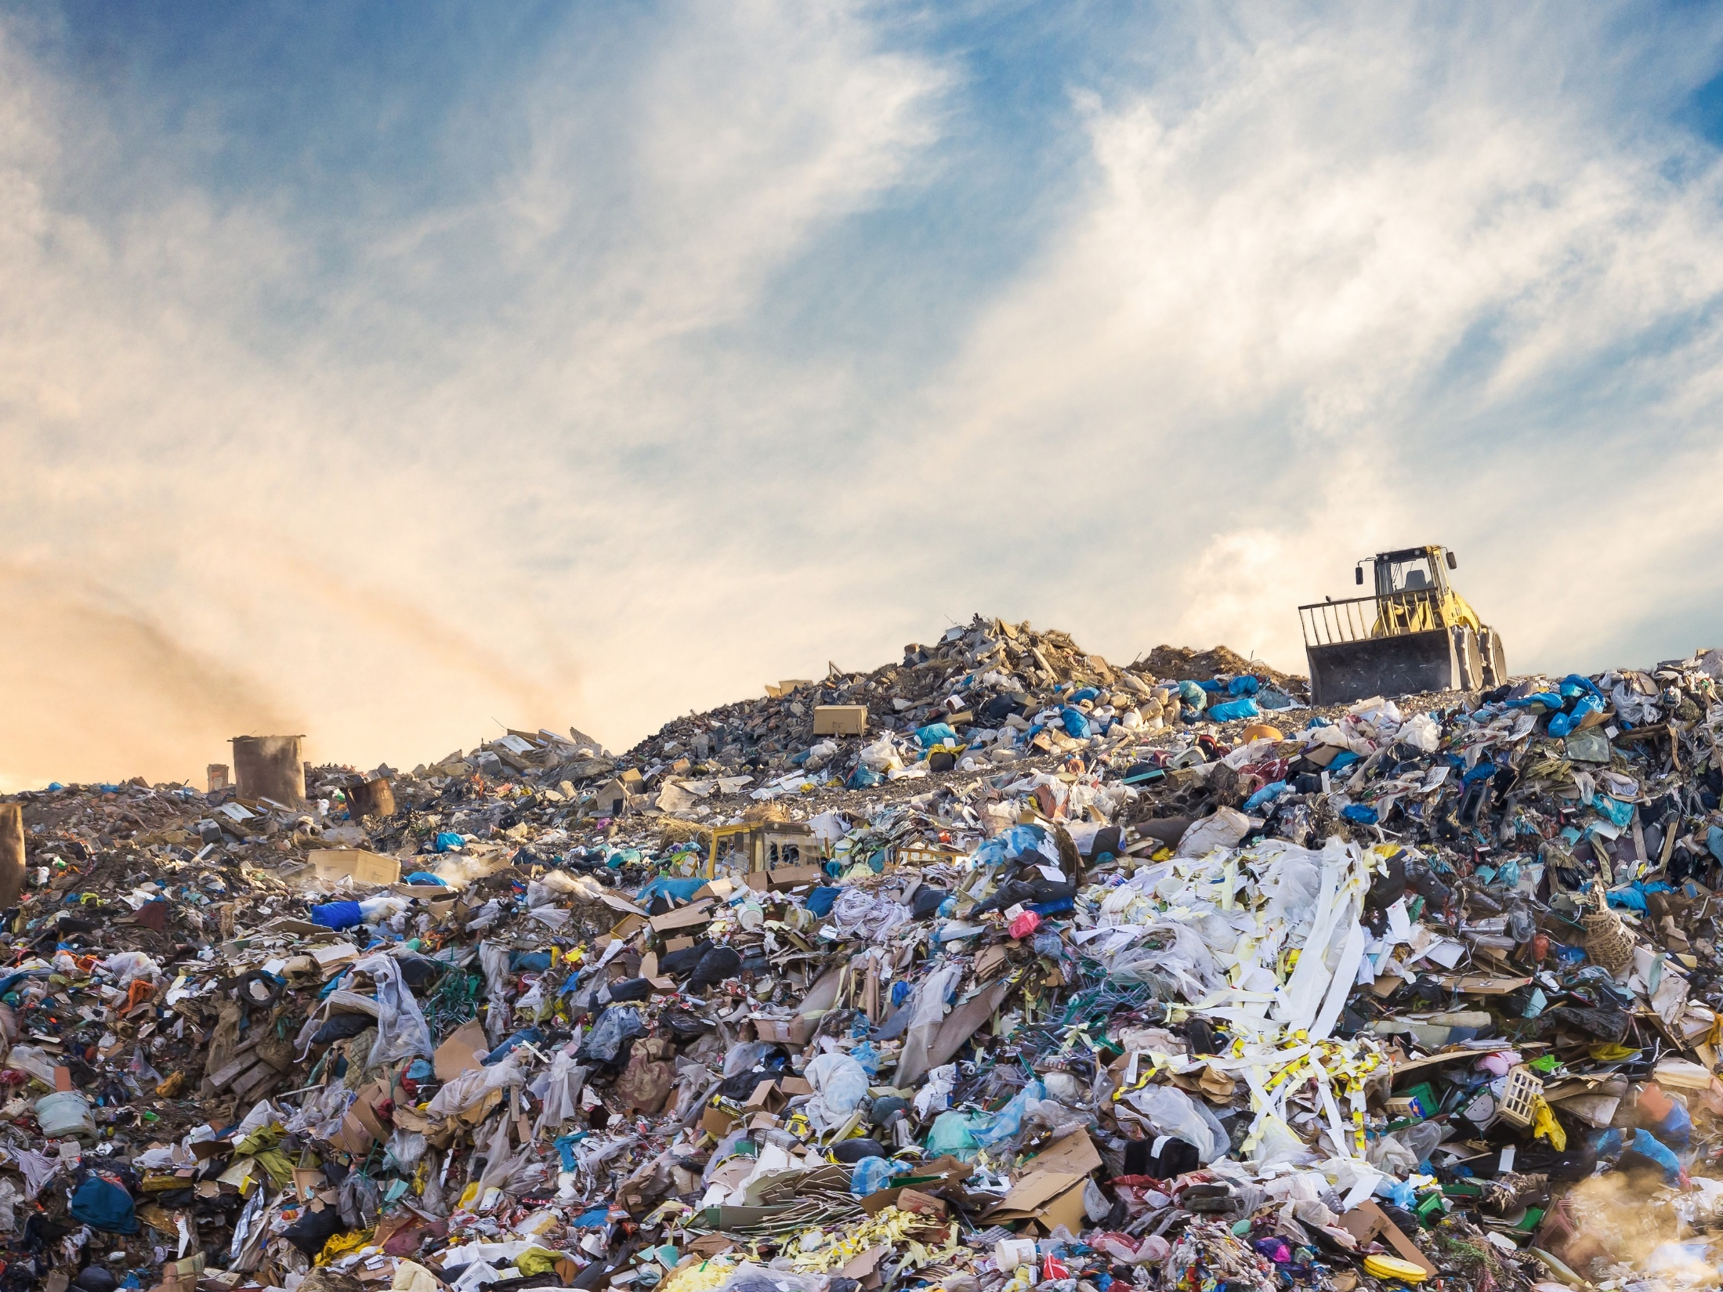
$70M
$800M

Slide 3
Intro to Novelis
Sustainability
Driving Demand
Impacting Inputs
Scrap Supply
Current Challenges
Key Takeaways

Slide 4
World’s largest aluminum recycler
8 Recycling Facilities
33% FY2011
$500M
CAPEX
61% FY2019
70 Billion

Slide 5
Sustainability is Driving demand

Slide 6
Sustainability is Impacting Inputs
CHIPS
73%

Slide 7
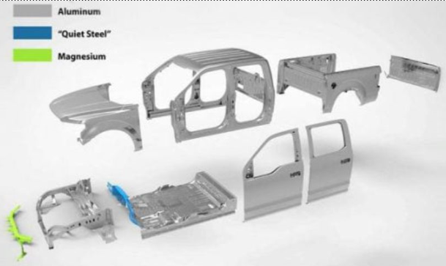
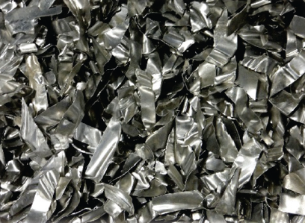
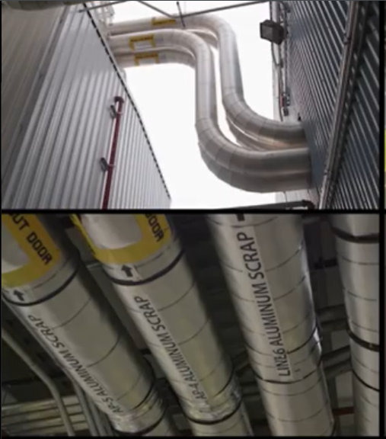
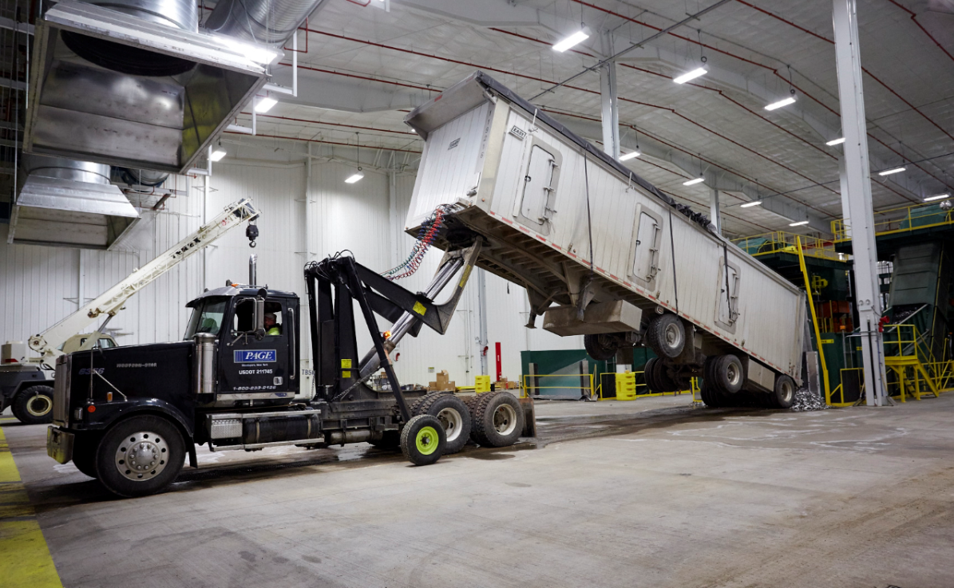

Slide 8
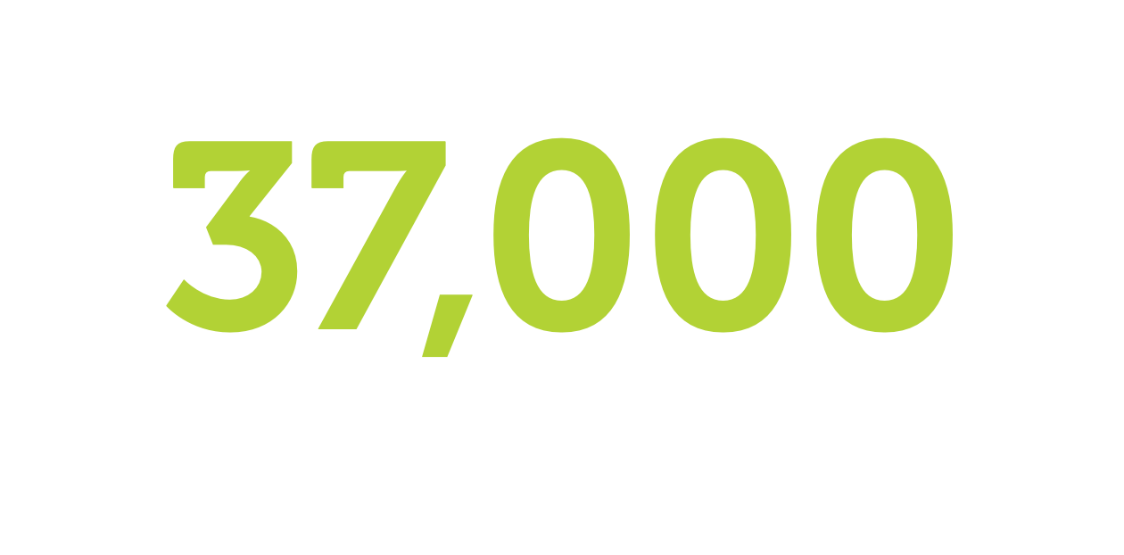

Slide 9
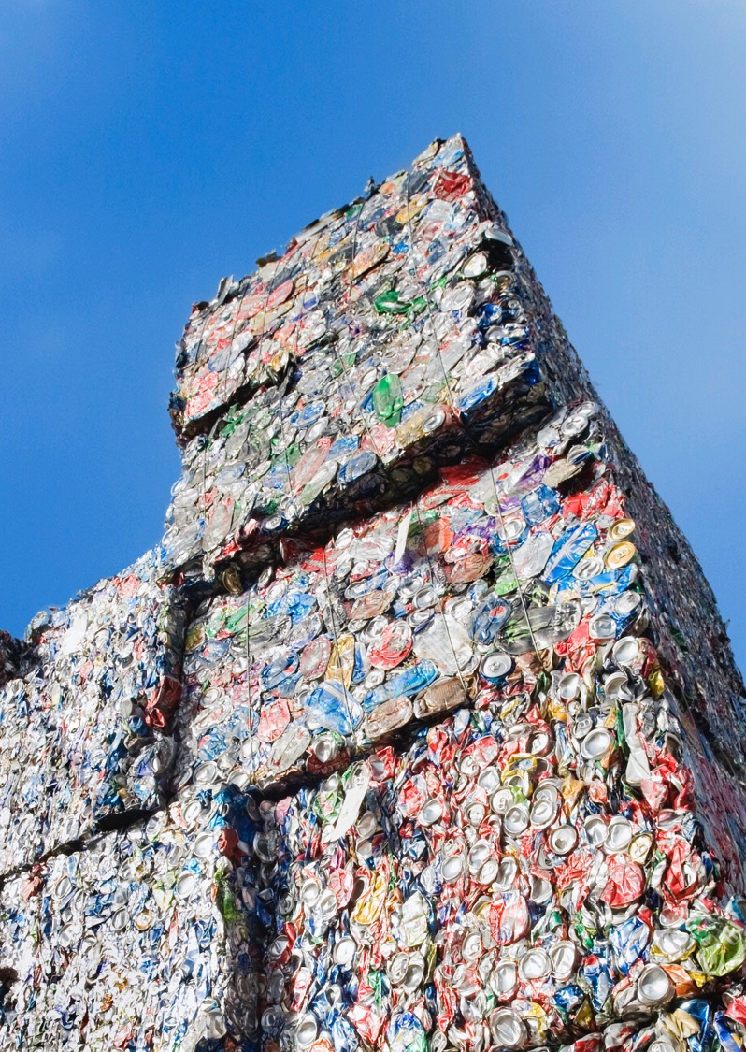
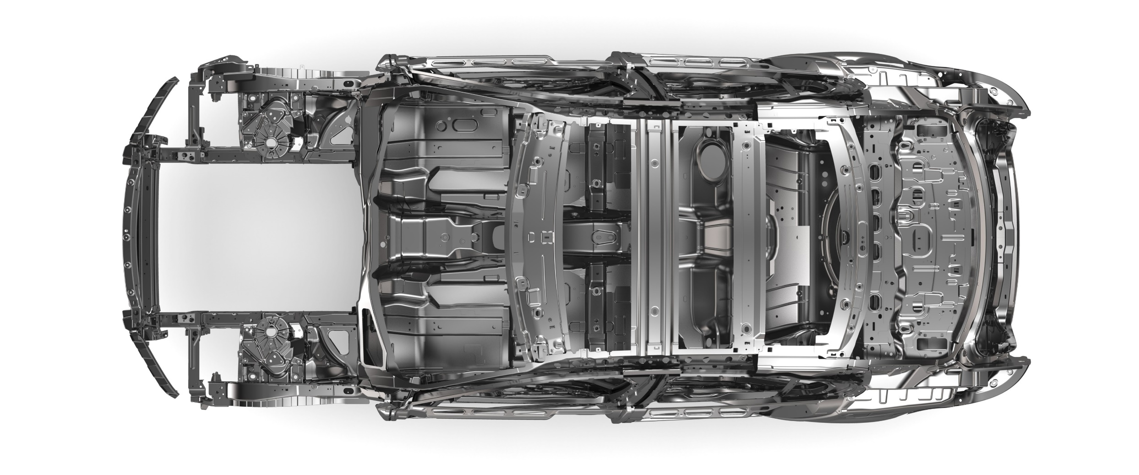
Scrap Supply

Slide 10
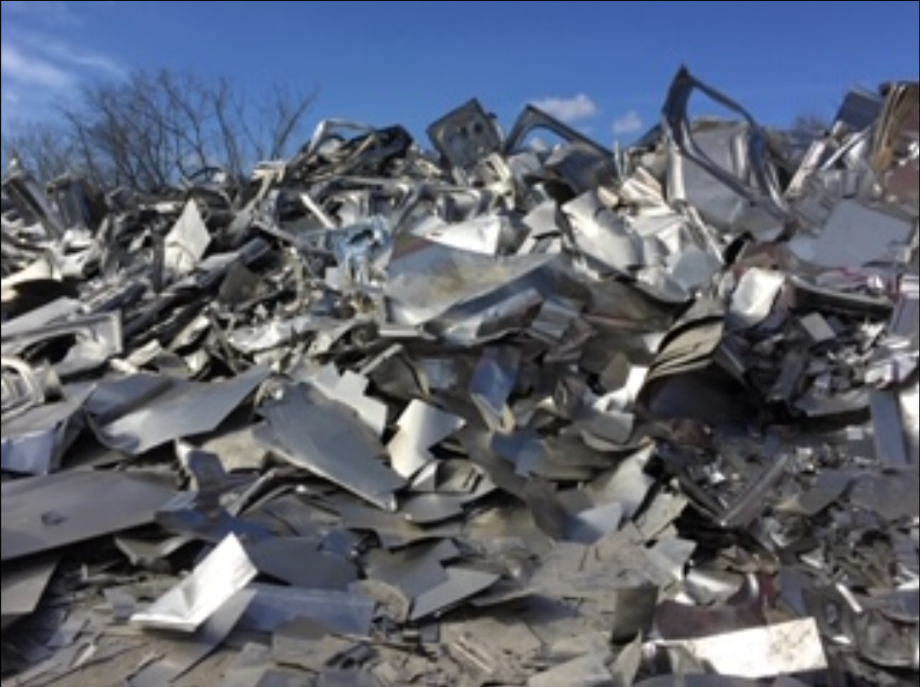
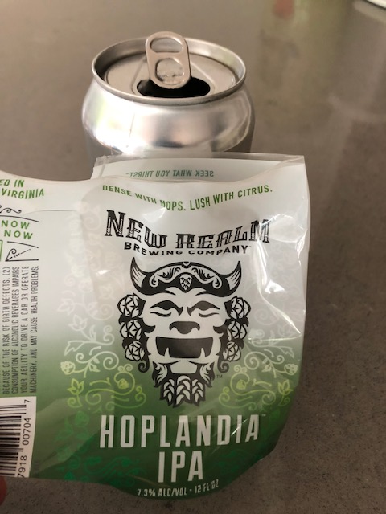
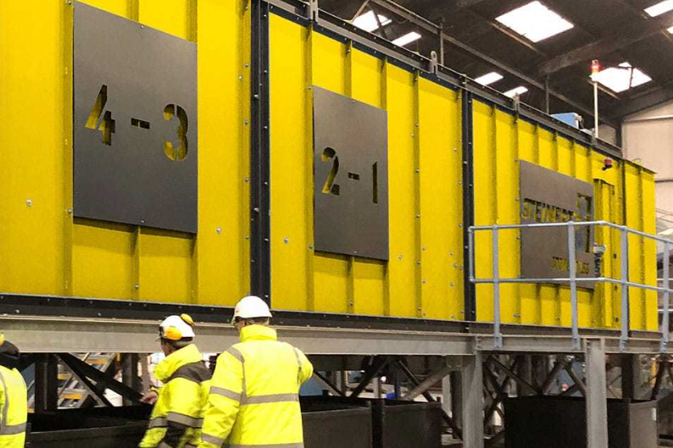
Current Challenges
Mixed Auto & End of Life
Contamination

Slide 11
CURRENT CHALLENGES
Recycling Rate
50%
25%

Slide 12
Recycle for Good
3 Million Cans Funds a Habitat for Humanity Home
“You’re making dreams come true.”
– Ms. Mercedes Wheat

Slide 13
Key Takeaways
Demand for aluminum products strong, driven by sustainability efforts
Expected to continue with further plastic and steel substitution
Need to improve recycling rate in the US
Protect against increasing contamination
Segregation of mixed alloy scrap and sorting end-of-life scrap key to success

Slide 14
$70M
$800M
= 800 Houses
= 17,000 Houses

Slide 15
Follow us at: novelis.com
facebook.com/NovelisInc
twitter.com/Novelis
linkedin.com/company/Novelis

