Slide 1
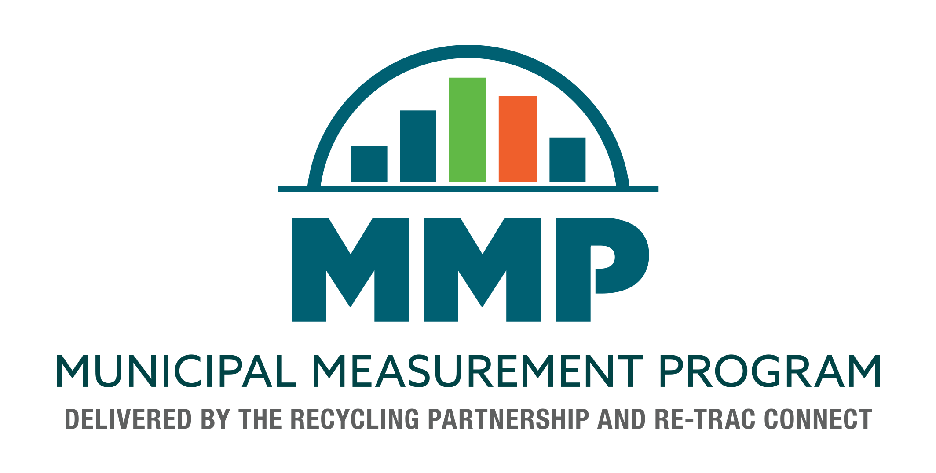
Notes:
The Municipal Measurement Program (MMP) is a free Program Assessment and Planning Tool, brought to you by The Recycling Partnership and Re-TRAC Connect.
The Program has been designed specifically for municipalities to deliver insights and actionable recommendations to municipal waste management agencies.
Re-TRAC Connect is a web-based software platform offering a suite of services to help organizations efficiently collect, manage, and analyze all types of recycling and waste data from all types of reporting entities. Re-TRAC has thousands of municipalities already using the system to manage and report program information.
The Recycling Partnership is a national non-profit organization and a force for improving recycling across the United States. The Recycling Partnership provide grants, technical assistance, and tools to invest in communities, support measurable sustainability, and improve recycling systems across the nation.
Re-TRAC and The Recycling Partnership both recognized that municipalities needed better measurement and decision-making tools and that each organization is uniquely positioned to bring the MMP to life. It just made great sense for us to work together and we’re really excited to promote, manage, and enhance the MMP over time!

Slide 2
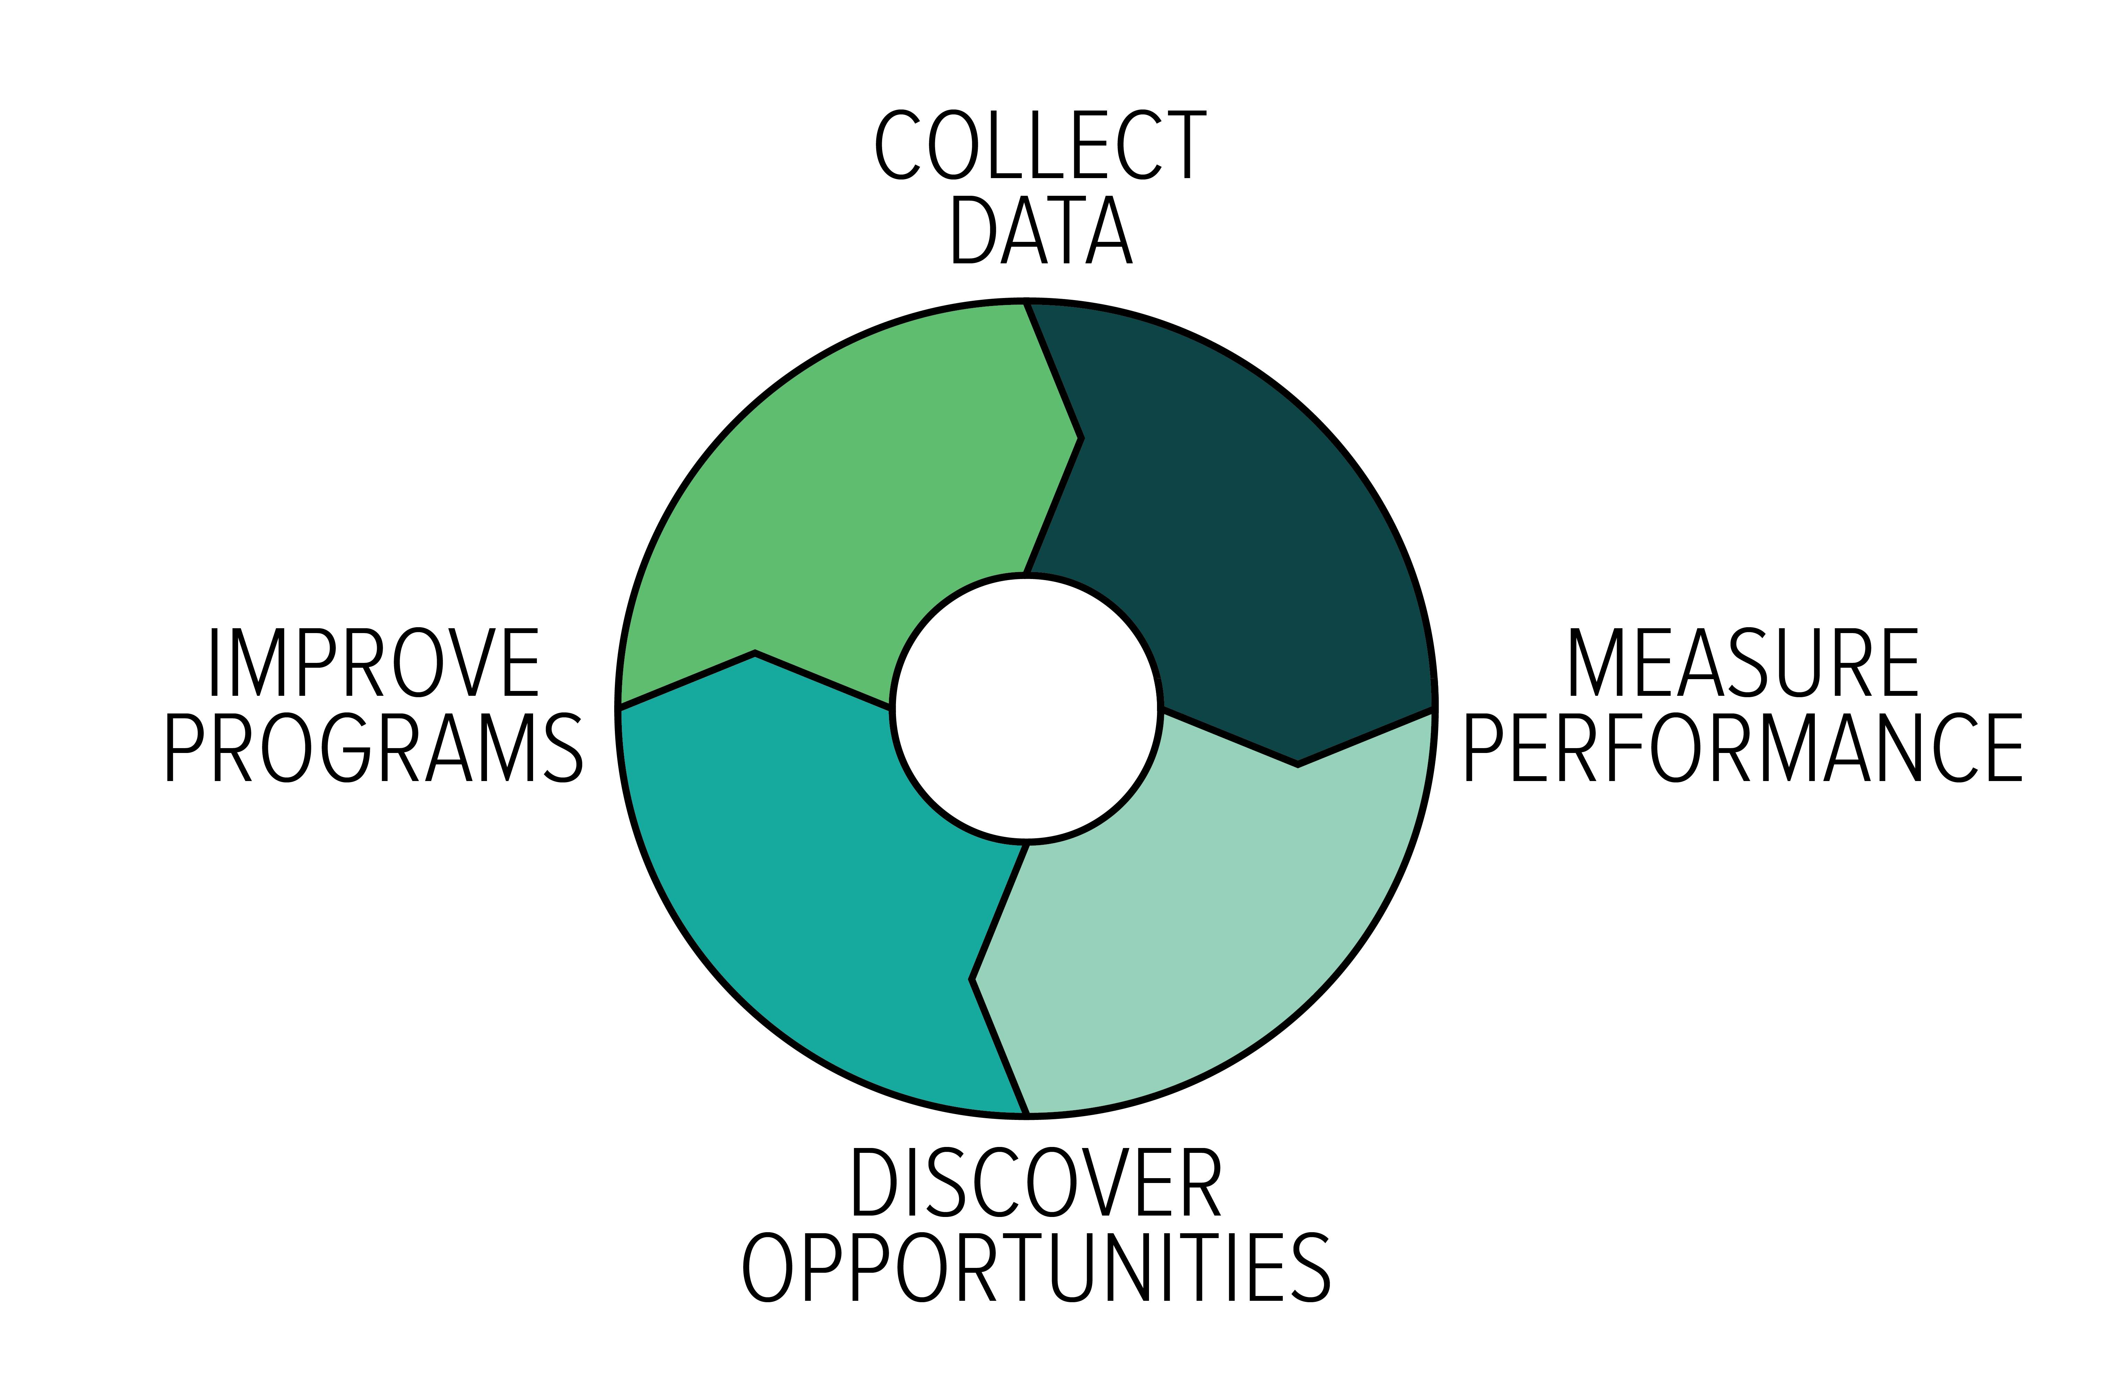
MMP Vision
STANDARDIZE MEASUREMENT
TURN DATA INTO INTELLIGENCE
TRANSFORM RECYCLING SYSTEMS
Notes:
So why did Re-TRAC and The Recycling Partnership create the MMP? For starters, the industry needs a standardized system for measuring municipal program performance so one of the goals of creating the MMP is to create the first large-scale database of municipal materials management program information in North America.

Slide 3
What’s In It For Municipalities?
Participation is easy & free
Standardized program assessment surveys
Sophisticated program performance reports
Benchmarking
Program recommendations
Centralized data to easily monitor year-over-year performance

Slide 4
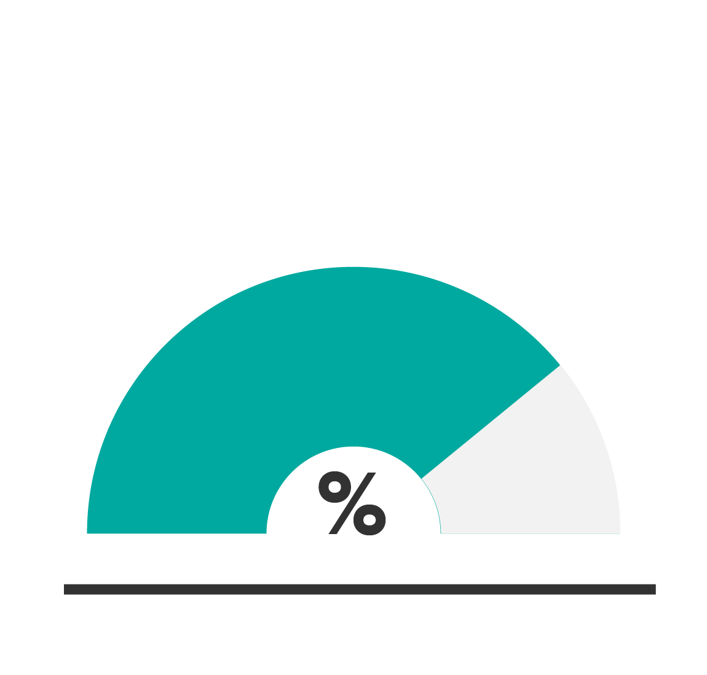
How It Works
Participation is Easy & Free!
APPLY
COMPLETE SURVEYS
GENERATE REPORTS
Notes:
The MMP is completely free for municipalities and based on preliminary data, completing the program assessment surveys takes an average of 90 minutes to complete once the municipality has assembled their information.

Slide 5
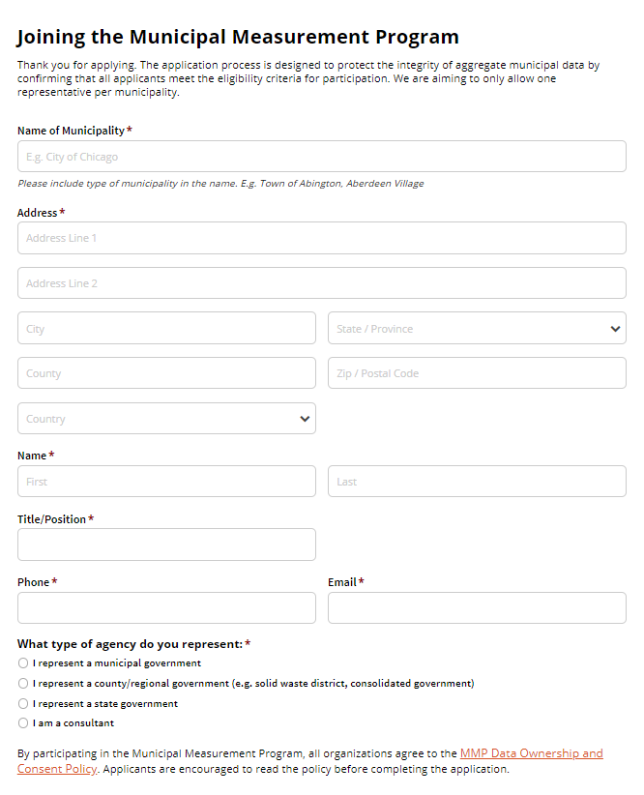
How To Join
Simple application
Specifically for municipalities
Authority to represent their municipality
Prevents duplicates
Notes:
To join, municipalities must complete a simple application form. The application process is designed ensure that participants have the authority to represent their municipality (such as a recycling coordinator). It also ensures that for each municipality, only one representative is accepted into the program thereby avoiding duplicate data entries. All of this serves to protect the integrity of the MMP database.

Slide 6
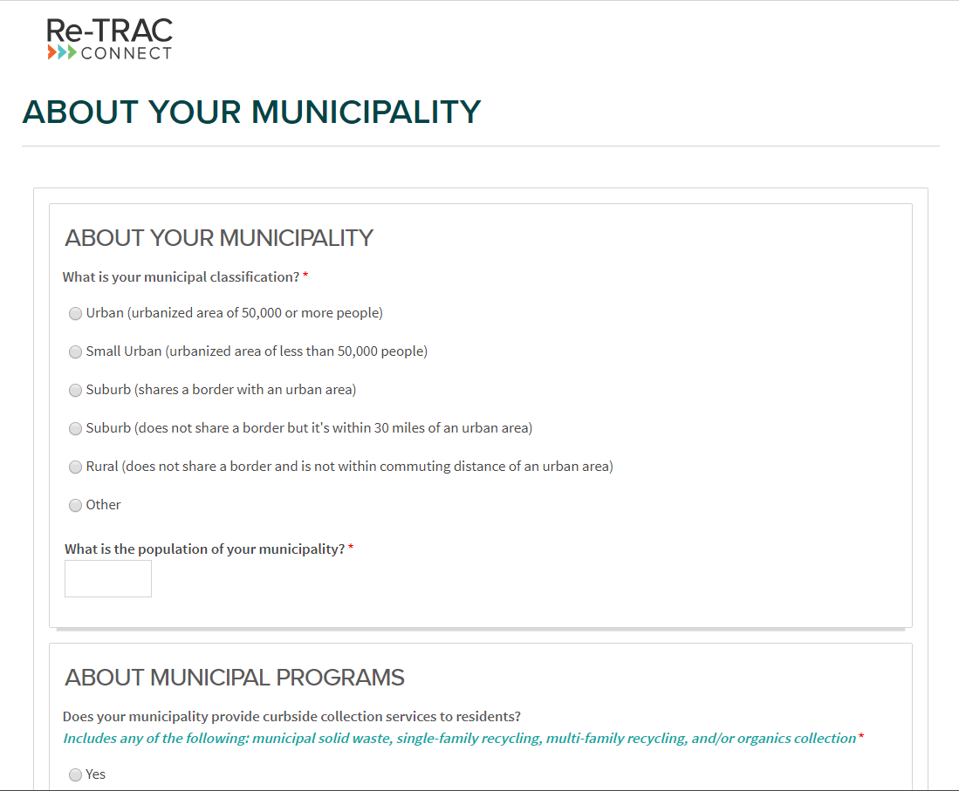
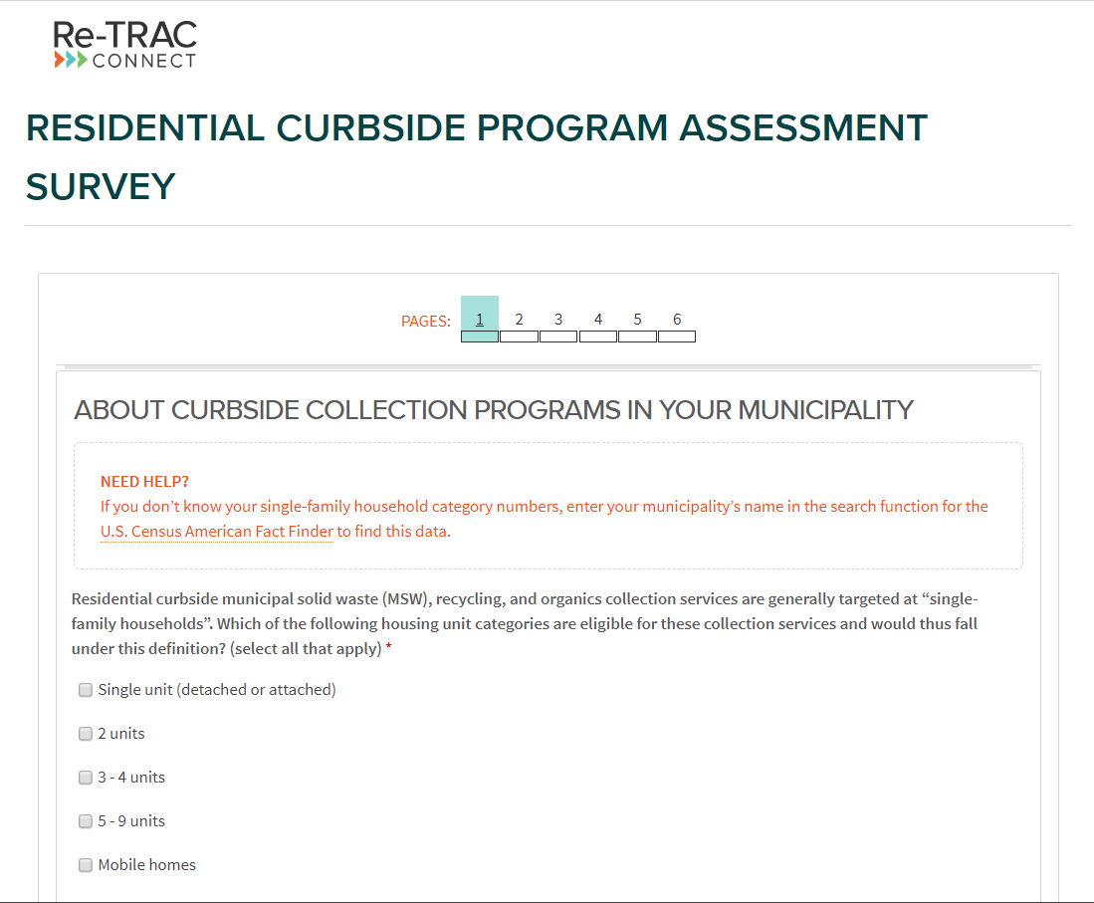
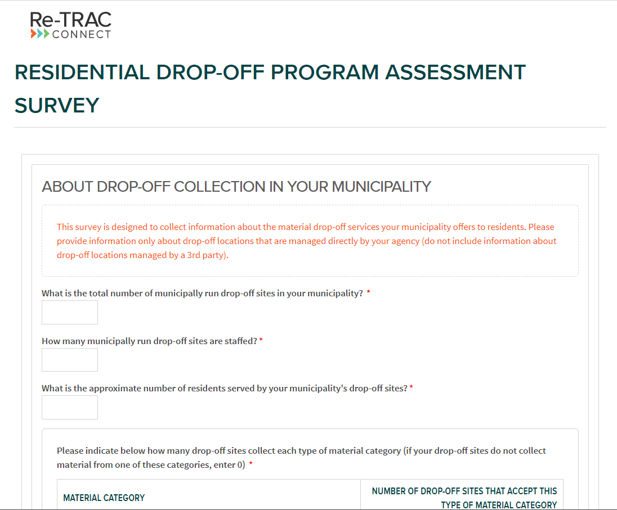
Completing The Surveys
Notes:
The MMP’s program assessment surveys have been designed to streamline your reporting experience. Depending on how to respond to certain questions, additional questions, sections, and even surveys may become available to you - and questions that don’t apply to your municipality will be hidden.
Every municipality will fill out The About Your Municipality survey. It collects general demographic information about your municipality and high-level information about the types of waste and recycling programs available to residents in your municipality.

Slide 7
Importance of Data Verification
Recycling Partnership staff will:
Review all submitted survey responses and check numeric data.
Contact municipalities when numerical responses need further clarification.
“Sign off” on survey responses by marking them as “Verified”.
Coordinate data verification with State and Regional agencies using the MMP for official reporting.
Notes:
Data verification is an important part of the MMP. It ensures that the data submitted to the program has been reviewed by a 3rd party before it’s accepted into the greater MMP database. Fortunately, this critically important role will be served by The Recycling Partnership.

Slide 8
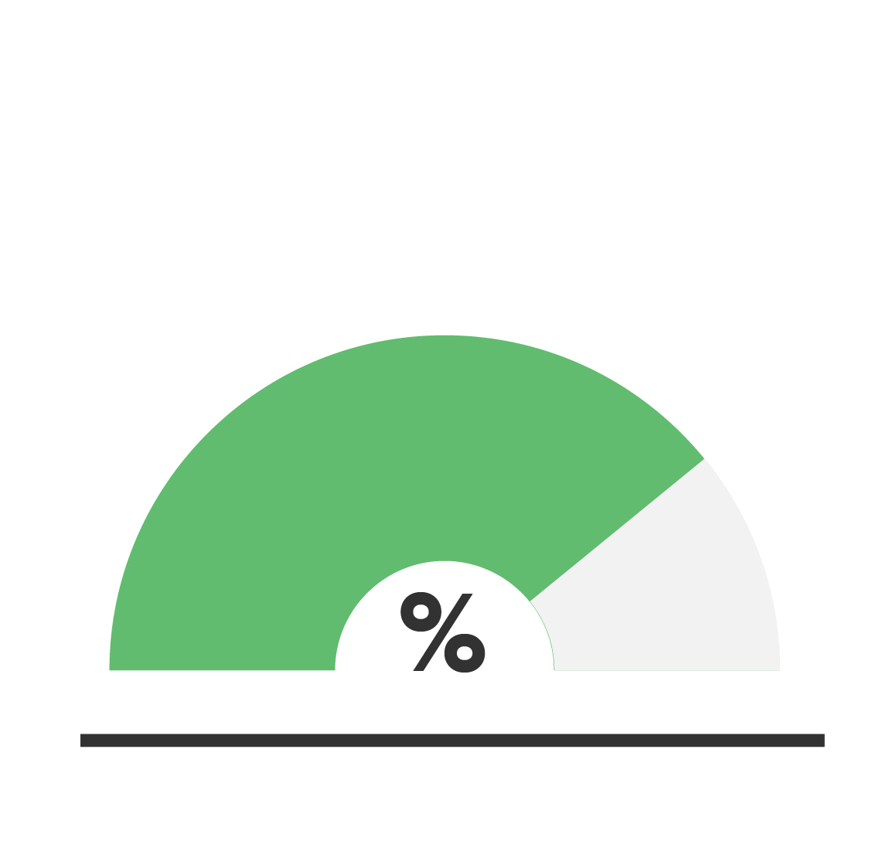
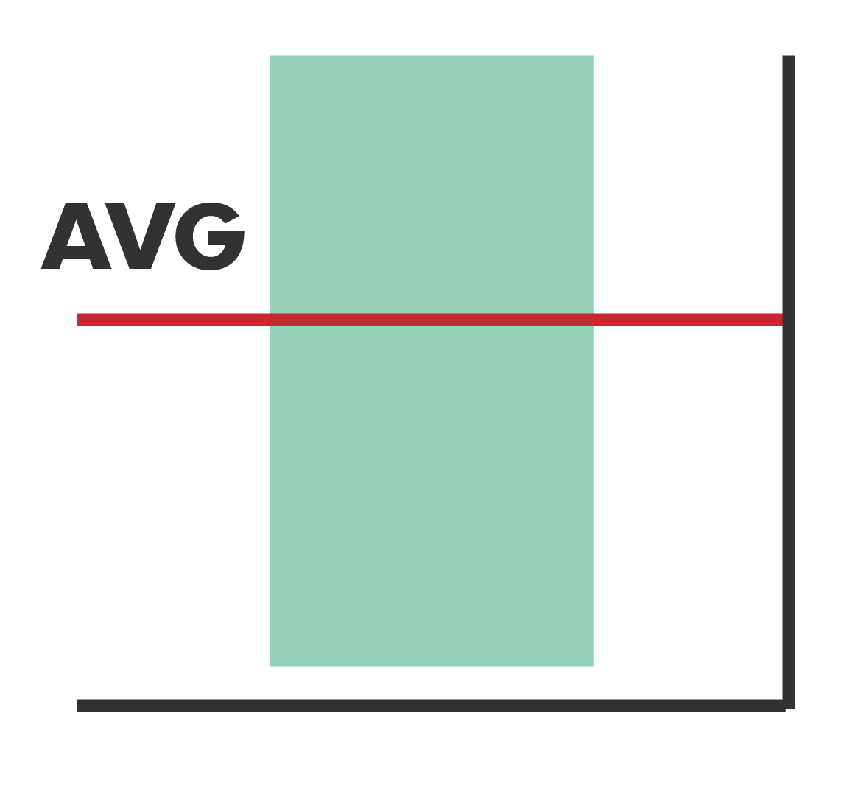
Introducing The MMP Reports
Program Summary
Economic Benefits
of Recycling
Program Recommendations
Curbside
Diversion Rate
Drop-Off
Diversion Rate
Lbs Per
Household
Lbs Per Household Benchmark
Notes:
Once you have completed the program assessment surveys, you’ll unlock the seven analytical reports designed to analyze your municipal program performance. Let’s take a few minutes to introduce you to the program performance, benchmarking, and recommendations reports.

Slide 9
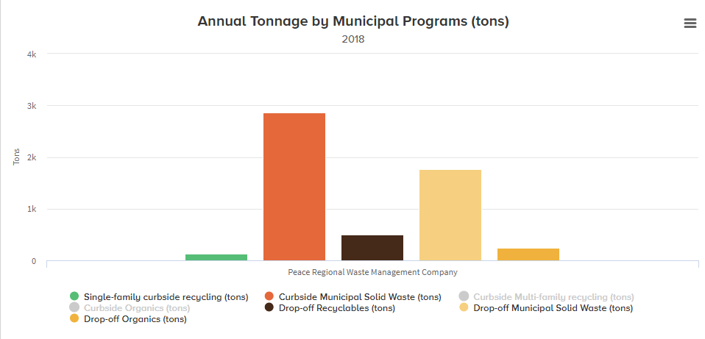
Generating Reports
Tonnage by Program
Notes:
Each report will be as simple as clicking the ‘Generate’ button and Re-TRAC Connect will do the rest!
The Tonnage by Program report will measure the total tons captured by a municipality's residential curbside and drop-off collection programs all in one chart.

Slide 10
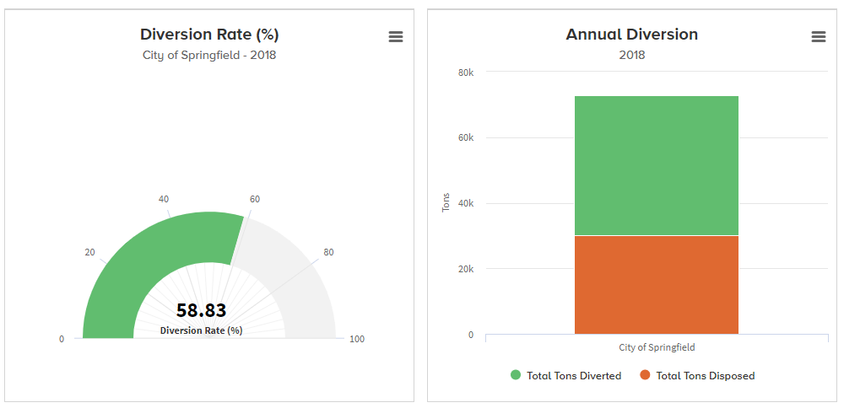
Generating Reports
Annual Curbside Diversion Rate Report
DIVERSION IS CALCULATED AS
Single-family Recycling Tons + Multi-family Recycling Tons + Organics Recycling Tons
MSW Tons + Single-family Recycling Tons + Multi-family Recycling Tons + Organics Recycling Tons
Notes:
You’ll also gain access to the annual curbside diversion rate report which displays your municipality's diversion rate alongside the total tons diverted and total tons disposed via your curbside programs. This report calculates diversion as curbside recycling + multifamily recycling + organics collection divided by all curbside tonnage including MSW.

Slide 11
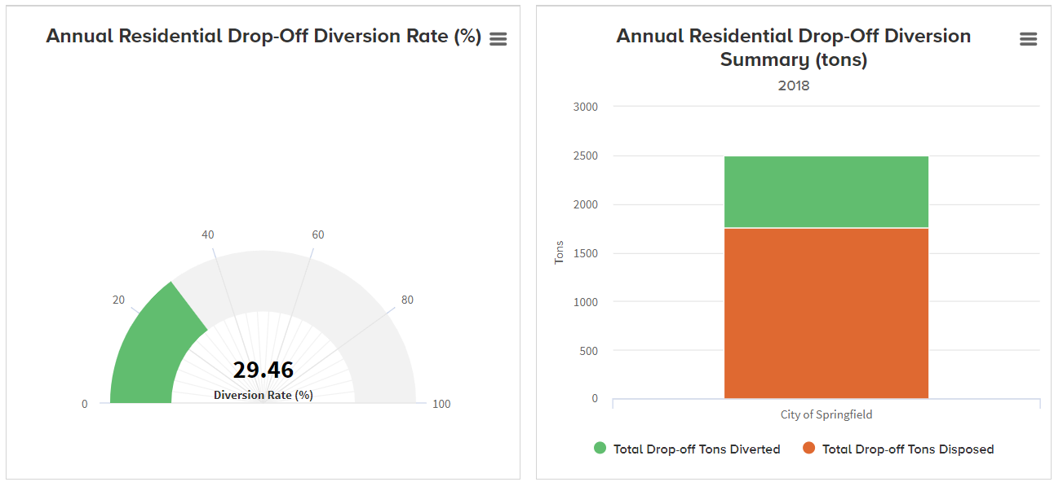
Generating Reports
Annual Drop-Off Diversion Rate Report
DIVERSION IS CALCULATED AS
Recyclable Tons + Organics Tons
MSW Tons + Recyclable Tons + Organics Tons
Notes:
The annual drop-off diversion rate report works just the same as the curbside diversion rate report except it calculates diversion as total tons recycling + total tons organics divided by all drop-off tonnage including solid waste.

Slide 12
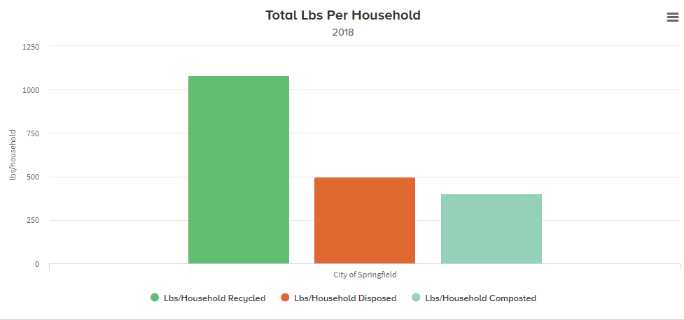
Generating Reports
Total Pounds Per Household Report
Notes:
With the LBS per household report, diversion and disposal weights are normalized, measuring the average pounds of material recycled, composted and disposed by each household in your municipality.

Slide 13
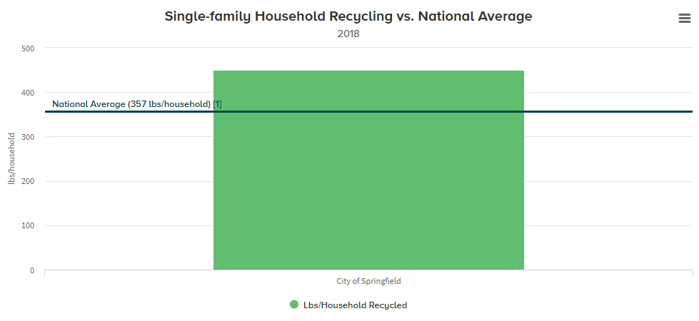
Generating Reports
Benchmark Report
Notes:
Have you ever wondered how your municipality’s recycling performance compares to the rest of the country? By generating the benchmark report, you’ll be able to compare the average pounds of recycling generated by each single-family household in your municipality to the national average.

Slide 14
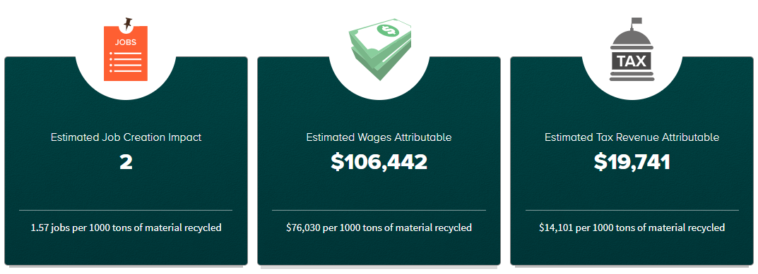
Generating Reports
Economic Benefits of Recycling Report
Notes:
This report is based on the U.S. EPA’s Recycling Economic Information Report or “REI Report”. The EPA created the REI Report to increase the understanding of the economic implications of material reuse and recycling. By recovering valuable materials, recycling creates jobs, builds infrastructure and contributes to the U.S. economy. You can generate this report to see how the your municipality’s recycling efforts translate into job creation, estimated wages and tax revenues.

Slide 15
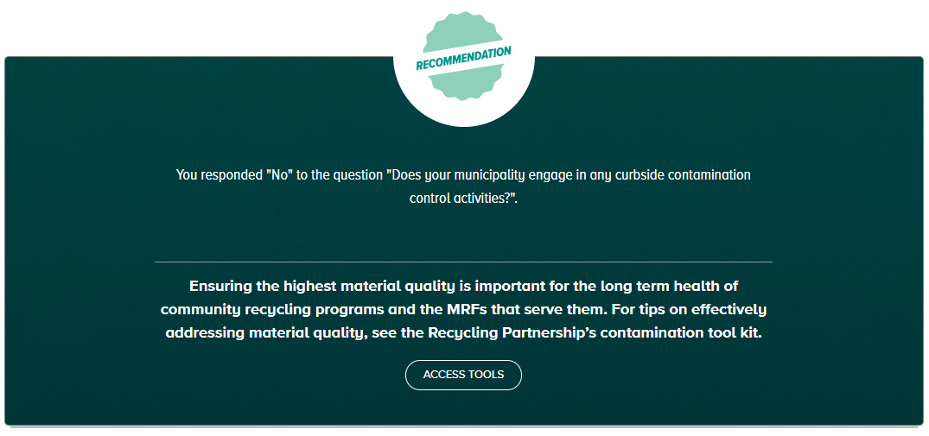
Generating Reports
Recommendations Report
Notes:
One of the most exciting features included in the MMP is the program recommendations report. The report analyzes the data submitted via the program assessment surveys and based on those responses, presents a set of program recommendations tailored specifically to the municipality. The recommendations report will introduce municipalities to a suite of effective tools and resources developed by The Recycling Partnership.

Slide 16
Profile: City of Monroe, GA
Population: 13,858
Single-family households: 5,630
Multi-family households: 510
Curbside MSW, recycling, and organics collection
Notes:
A small urban city with a population of 13,858
5,630 single-family and 510 multi-family households
Operates curbside MSW, recycling, and organics collection services

Slide 17
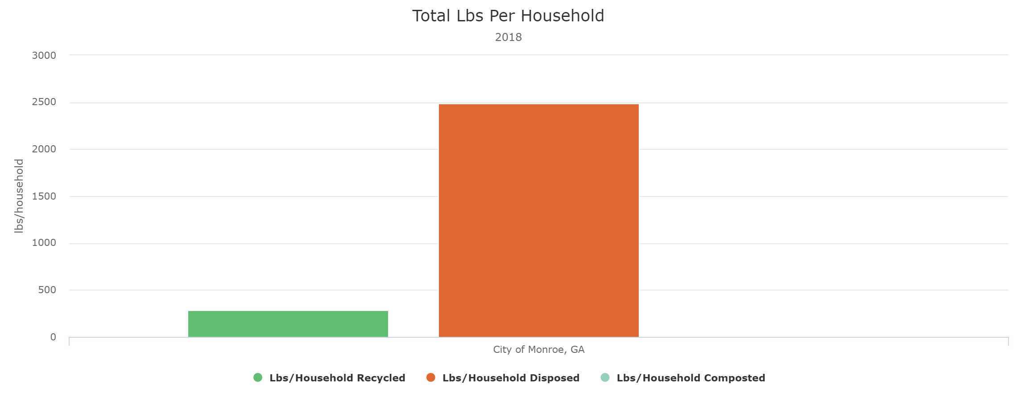
Profile: City of Monroe, GA
Notes:
City of Monroe’s Total Lbs/HH

Slide 18
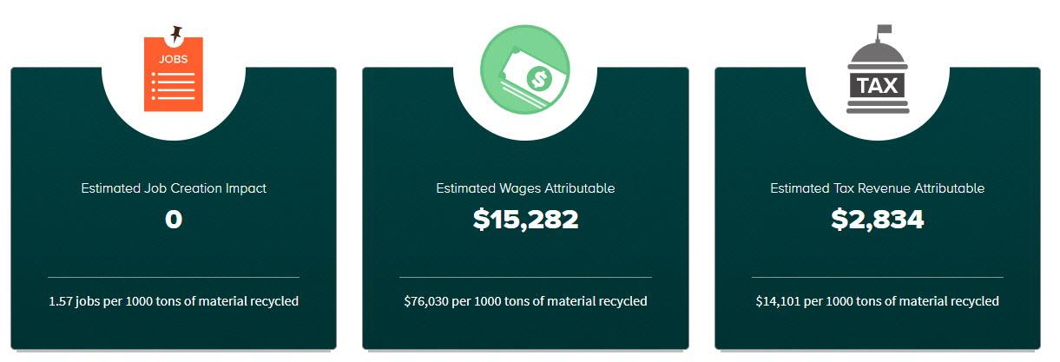
Profile: City of Monroe, GA
Notes:
City of Monroe’s Economic Benefit of Recycling report

Slide 19
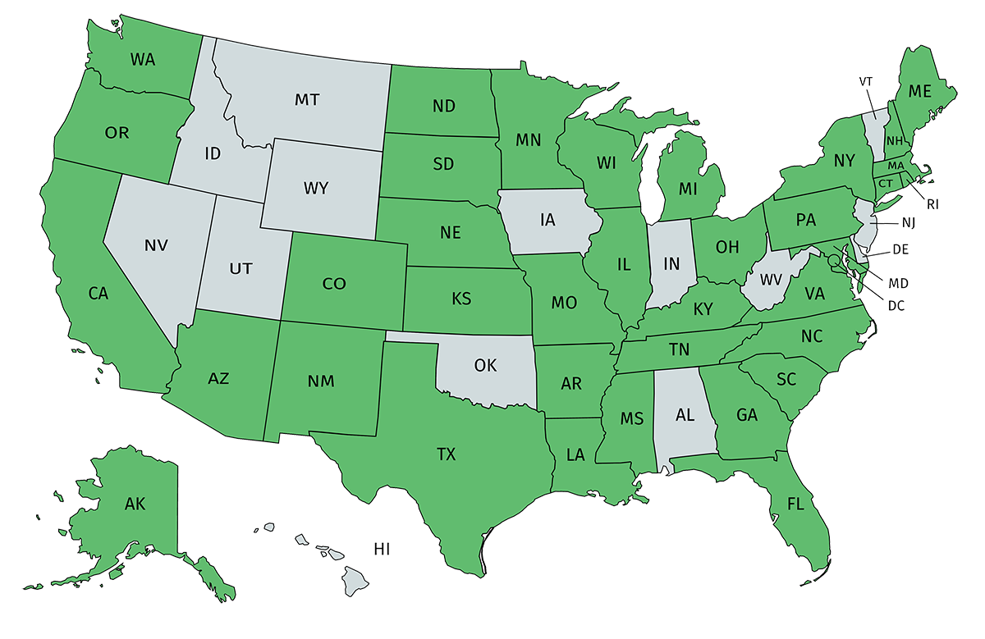
Municipal Participation To Date
MMP launched January of 2019
Over 140 communities already participating
Notes:
At least one municipality is participating in each of the 36 states highlighted on the map.

Slide 20
2018 Reporting Deadline: December 1st, 2019
Visit municipalmeasurement.com to apply today
Notes:
Fill out all questions in all applicable surveys and mark complete to ensure your data is included in annual aggregates.

