Slide 1
Modern Recycling Love apologies to david bowie
Athens-Clarke County Solid Waste Department
Plus, the f-words

Slide 2
Innovations at Athens-Clarke County Solid Waste Department
Dude Solutions Mobile 311
Uses – Collections and Administration
Capabilities – Improved Recycling Collection
Contamination Education Campaign
Random Tech Assists

Slide 3
Cloud-based, GPS-enabled data management and tracking software
Drivers use tablets to:
Receive updated work orders
Record conditions in real time
Relay photo evidence to admin staff*
Costs
$7,000 (approx.) up-front costs for tablets, mounting hardware, cases.
$9,900 annual to Dude Solutions
$988/month to Verizon

Slide 4
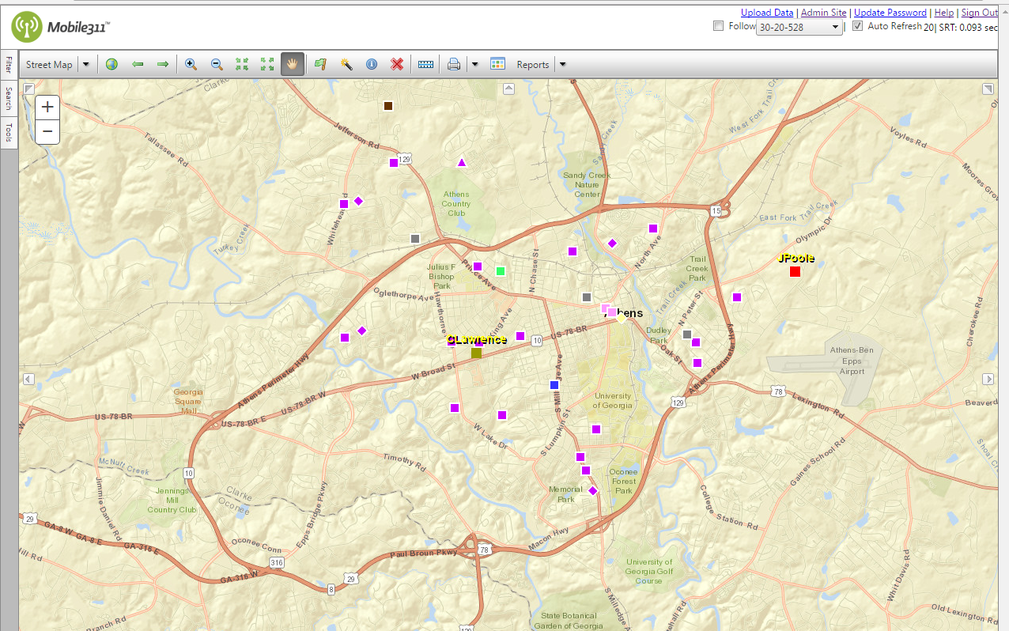
Uses – Collections
ACC Solid Waste has approximately 10,000 residential customers.
Automated residential – 10,000 customers
Commercial roll cart – trash and recycling
Leaf and Limb county-wide
Roll-offs (20, 30, 40-yard open tops) and recycling drop sites
Downtown businesses and multi-family residential

Slide 5
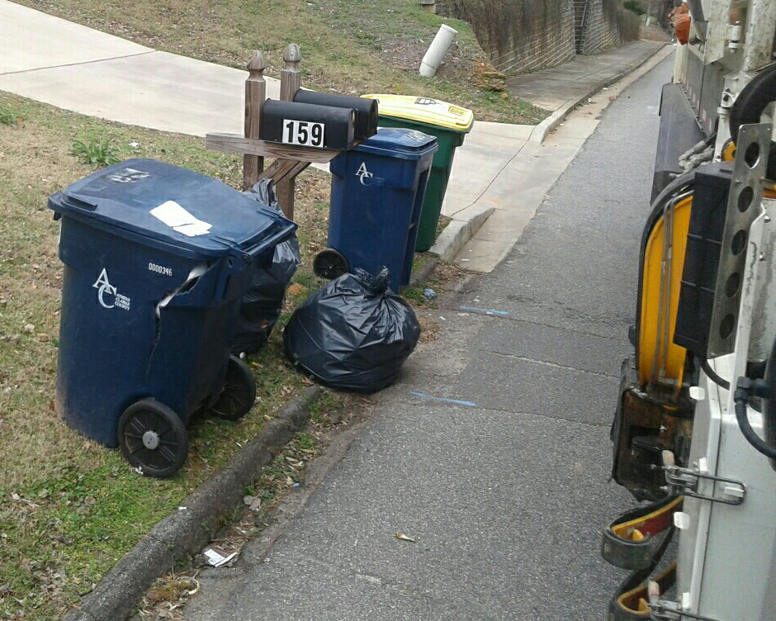
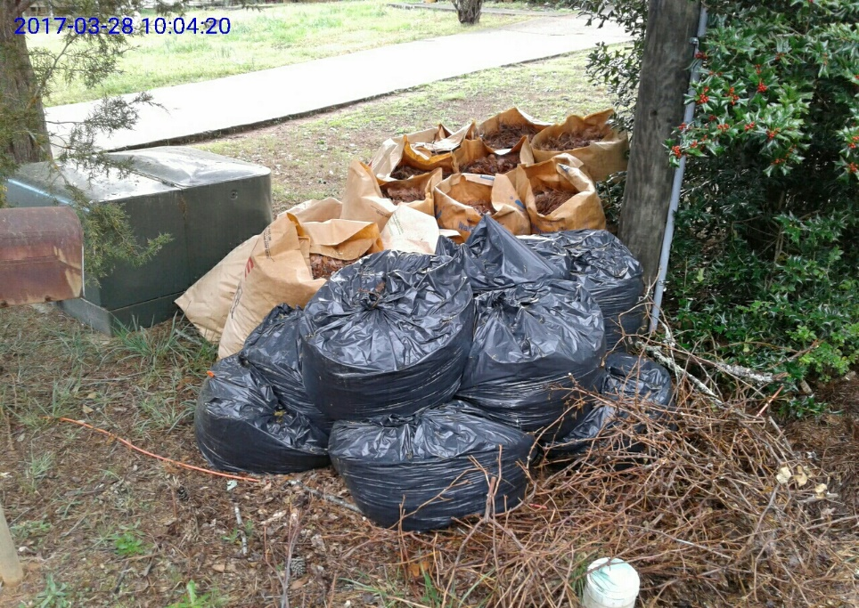
Administrative – Instant tracking of:
Inventory
Missed collections
Customer complaints
Overflow
Blocked carts/dumpsters
Cart not out

Slide 6
Customer: “You missed my recycling!”
ACC: “Is your house light green with some stone work in progress?”
Customer: “Uh, yes.”
ACC: “Your recycling container is filled with trash. And don’t put those pallets in your leaf and limb pile.”

Slide 7
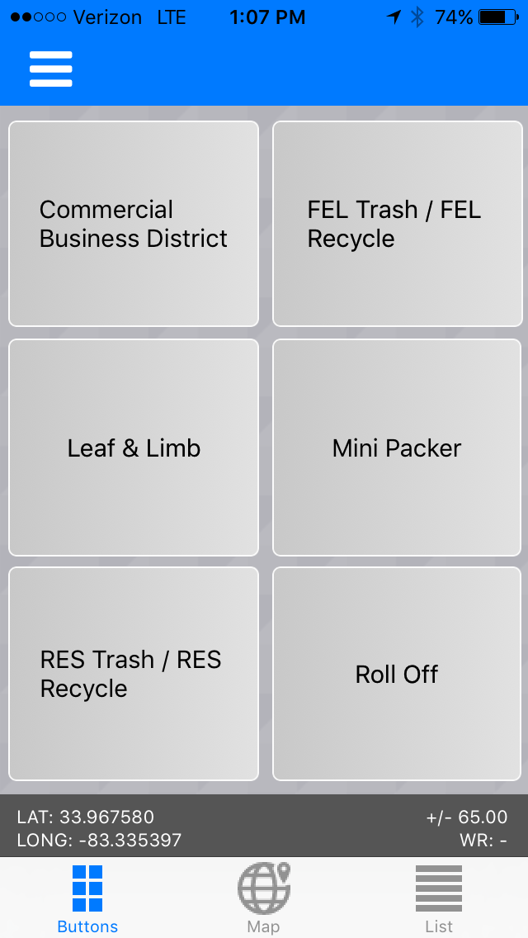
There’s an App for that!
We added a tab to report Irma-related damage

Slide 8
Identifying the repeat offenders.
Customer Service visit to:
educate the customer
fix the issue

Slide 9
What’s next?
Targeted education based on mapped reports of contamination
“(Mobile 311) is the best thing we’ve done in the 28 years I’ve been here.”
Dallas Bordon, famously grumpy billing tech/office Clemson fan

Slide 10
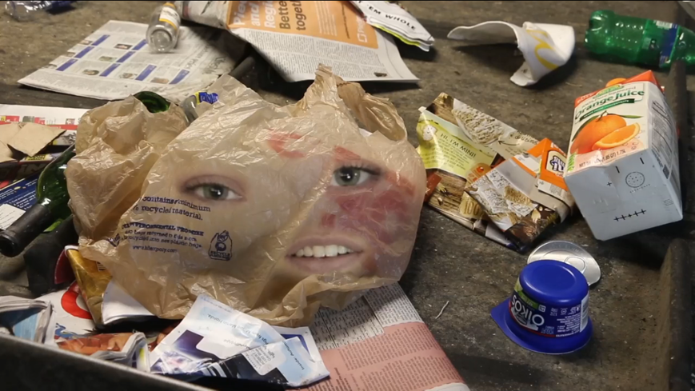
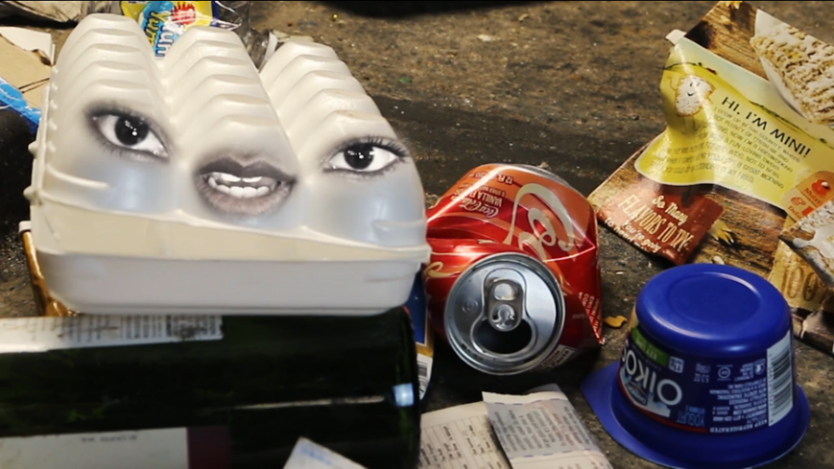
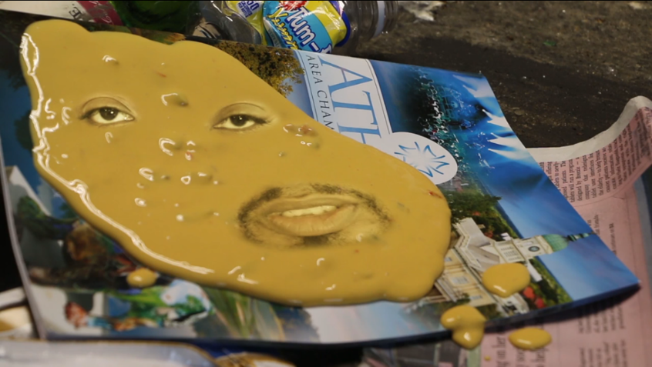
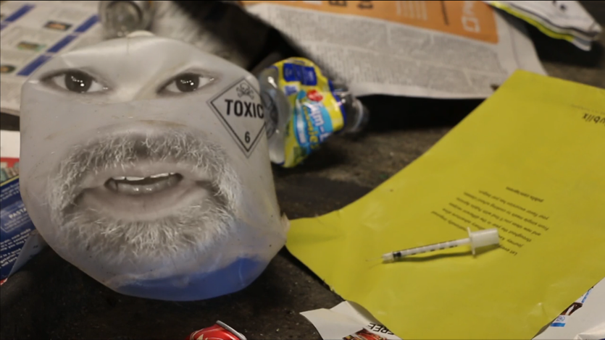
Four-letter F-words

Slide 12
Four-letter F-words

Slide 14
Four-letter F-words

Slide 16
Four-letter F-words

Slide 18
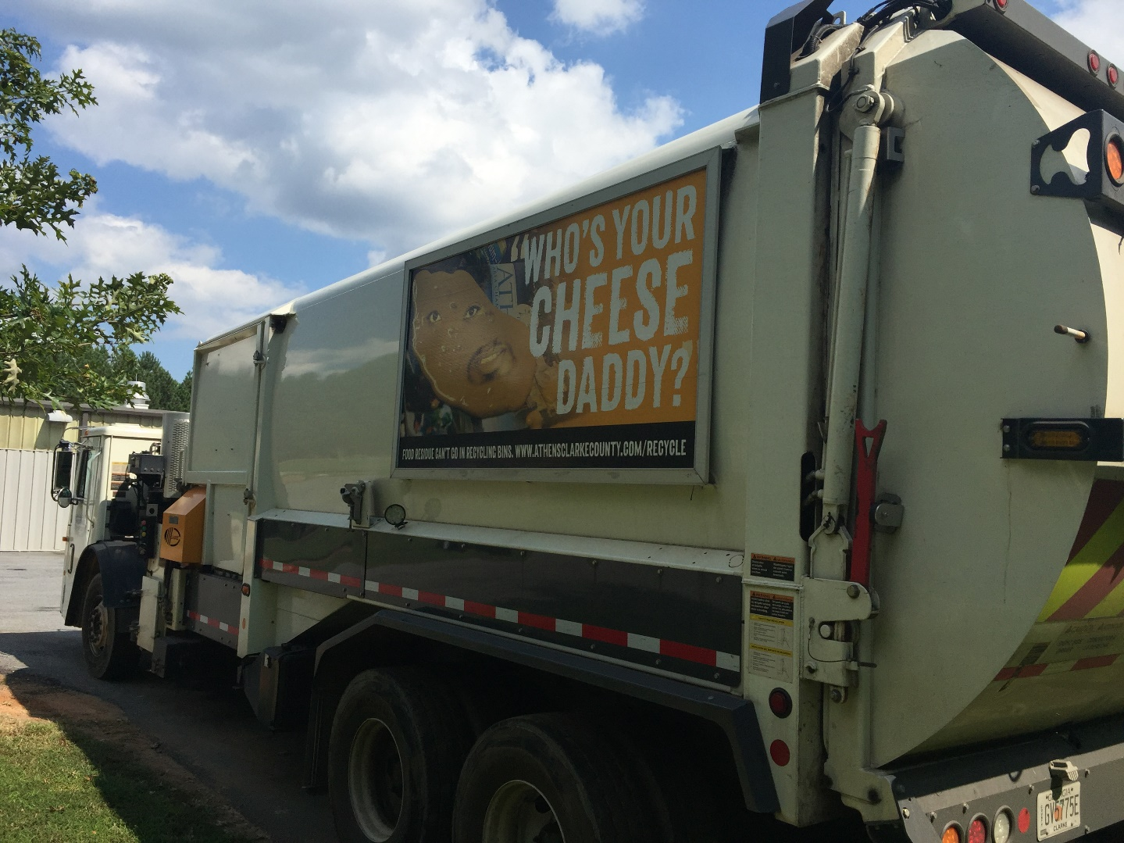

Slide 19
Joe Dunlop Waste Reduction Administrator Athens-Clarke County Solid Waste Department Joe.Dunlop@AthensClarkeCounty.com 706-621-0101

