Slide 1
Safe Battery Collecting and recycling
November 2023
Josef Bittner

Slide 2
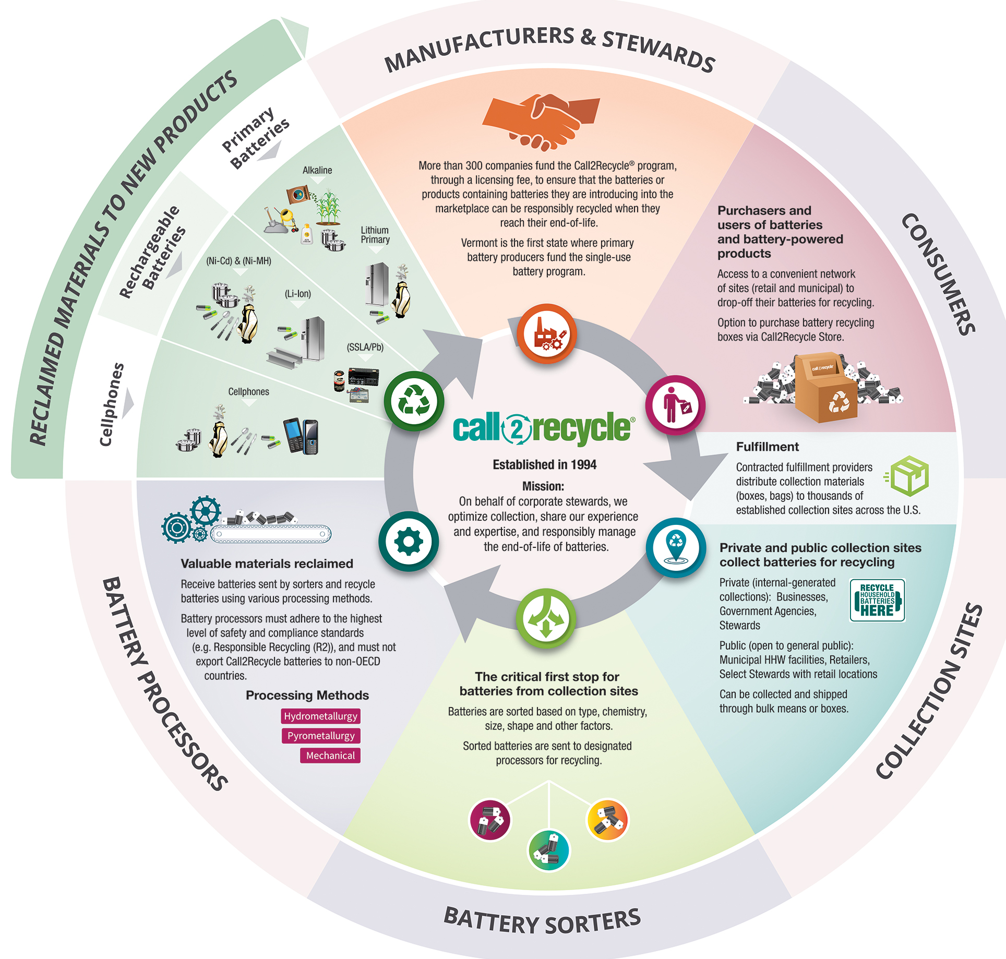
Founded in 1994 by industry to address the emergence of EPR legislation.
Non-profit stewardship organization that administers its collection and recycling program, Call2Recycle®, across the U.S.
In the U.S., funded primarily by rechargeable battery stewards and, more recently, fee-based services.
In the U.S., we’re primarily a voluntary program except in certain states (e.g., Vermont, Minnesota, New York, Washington, D.C.) where collections of some (but not always all) chemistries is mandated.
Maryland requires Ni-Cd and small sealed-lead acid battery manufacturers to fund take-back.
Call2Recycle

Slide 3
Terminal Protection
TERMINAL PROTECTION REQUIRED
Rechargeable Batteries
ALL Lithium Ion (Li-Ion)
ALL Small Sealed Lead Acid (SSLA/Pb)
Greater than 12V:
Nickel Cadmium (Ni-Cd)
Nickel Metal Hydride (Ni-MH
Nickel Zinc (Ni-Zn)
Primary Batteries
ALL lithium, including coin and button cells
Alkaline over 12V
Carbon Zinc over 12V
Cell Phones

Slide 4
Terminal Protection
TERMINAL PROTECTION NOT REQUIRED
Rechargeable Batteries
12V or less:
Nickel Cadmium (Ni-Cd)
Nickel Metal Hydride (Ni-MH
Nickel Zinc (Ni-Zn)
Primary Batteries
Alkaline 12V or less
Carbon Zinc 12V or less

Slide 5
Lithium-Based Batteries

Slide 6
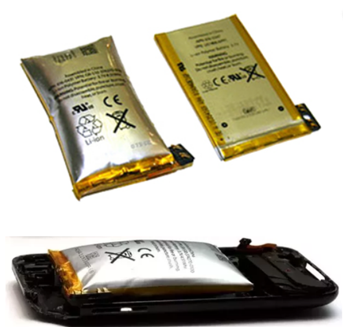
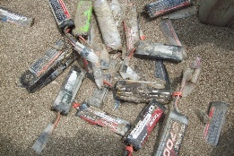
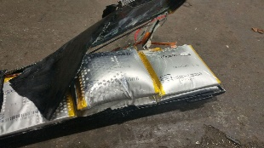
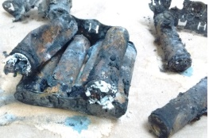
Proper Handling of Batteries – Damaged, Defective, Recalled
Do NOT place damaged Lithium Ion or Lithium primary batteries in normal collection bins. Immediately place in absorbent, non-flammable material (sand or cat litter) in a cool, dry area.

Slide 7
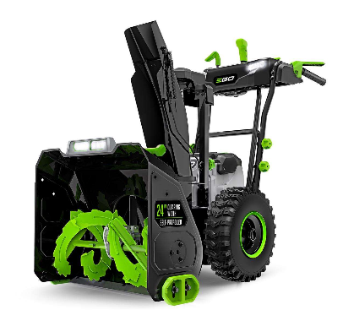
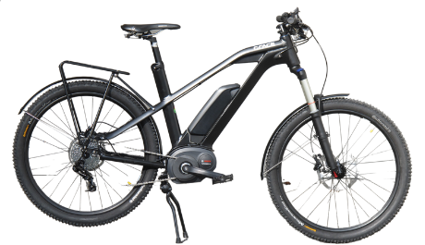
Growing number of products are being “electrified”.
The batteries powering these devices are often referred to High-Energy Batteries (i.e., lithium-ion batteries over 300 watt-hours).
Amp-Hours (AH) X Volts (V) = Watt-Hours (Wh)
Typically, batteries over 300 watt-hours MUST be shipped as “hazardous material”.
High-Energy Batteries

Slide 8
Josef Bittner Regional Program Manager jbittner@call2recycle.org 678-218-4590 Corporate headquarters: 1000 Parkwood Circle, Suite 200 Atlanta, GA 30339

