Slide 1
Innovative Technology to Boost Recycling
GRC 2023
Georgia Institute of Technology
ECGO
10/23/23
Malte Weiland (Georgia Tech)
Ryan Walden (ECGO)

Slide 3
Overview

Slide 4
Background

Slide 5
Background

Slide 6
Background

Slide 7
Setup

Slide 8
Setup
Outreach Strategy
Face-to-face
RA Trainings
Ecoreps support

Slide 9
Why are we building ECGO?
🌎
💻
💰
🎮
Notes:
Quick
We believe anyone at the click of a button should be able to get recycling rules for any item based on their location
In order to get there, we need to cross significant hurdles in the digitization of recycling programs In addition we want to increase the accessibility and relevance of rewards for recycling correctly, so that individuals are directly compensated for their participation in the circular economy
Last but not least, in order to retain consistently high engagement, we need to gamify recycling education and build a digital culture of sustainability so we can capture people’s attention and promote them to spread awareness about the benefits of recycling
So how does it work?

Slide 10
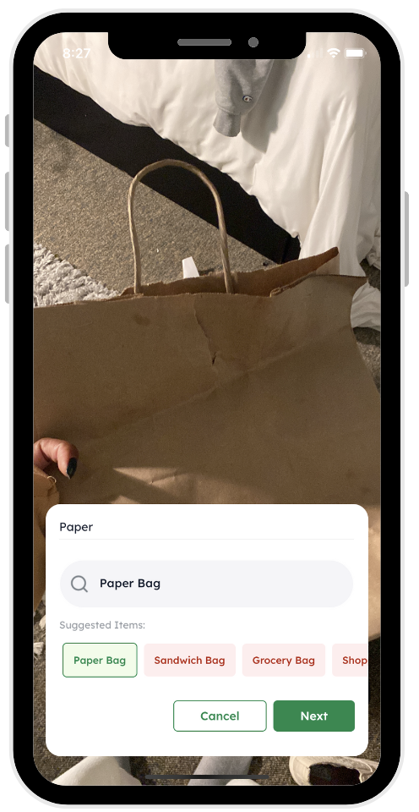
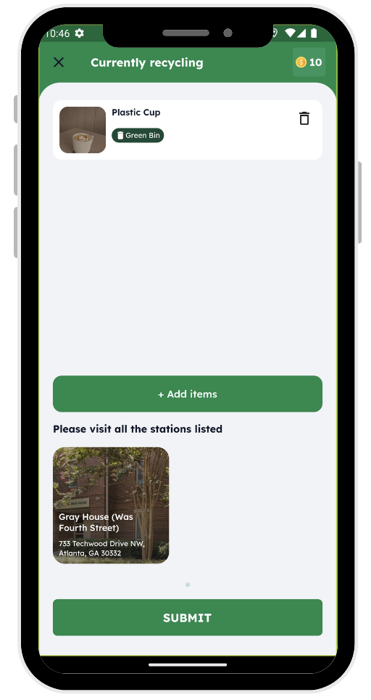
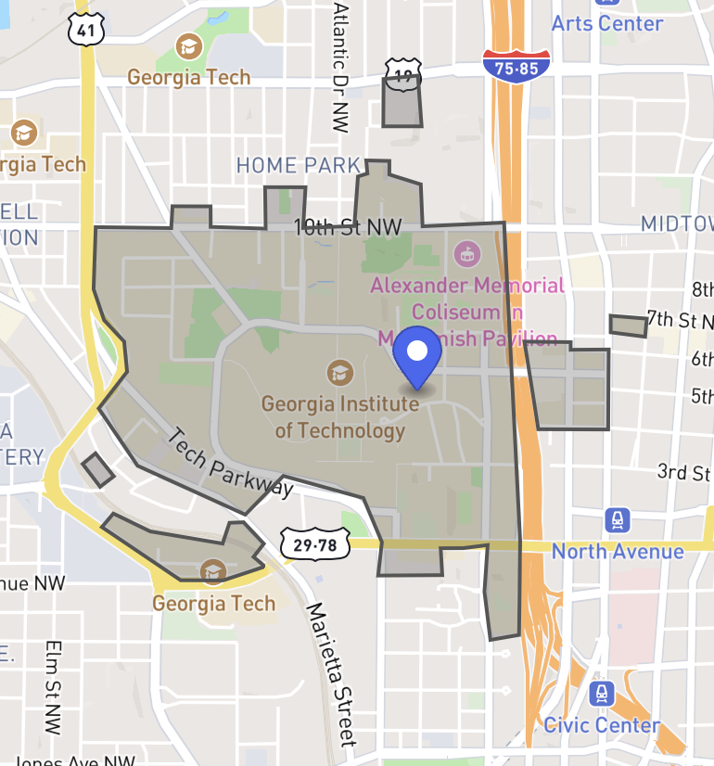
Snap Anything, Anywhere
🌎
Notes:
Medium slow
Using the ECGO mobile app, users can take a picture of any item and we tell them if that item is recyclable, what color or type of bin it should be put in, and where they can find that bin closest to their current location. With the click of a few buttons, this Georgia Tech student is able to get the right directions instantly specific to their campus.
The campus recycling coordinator is able to set up their program and track their student’s engagement using our admin portal.

Slide 11
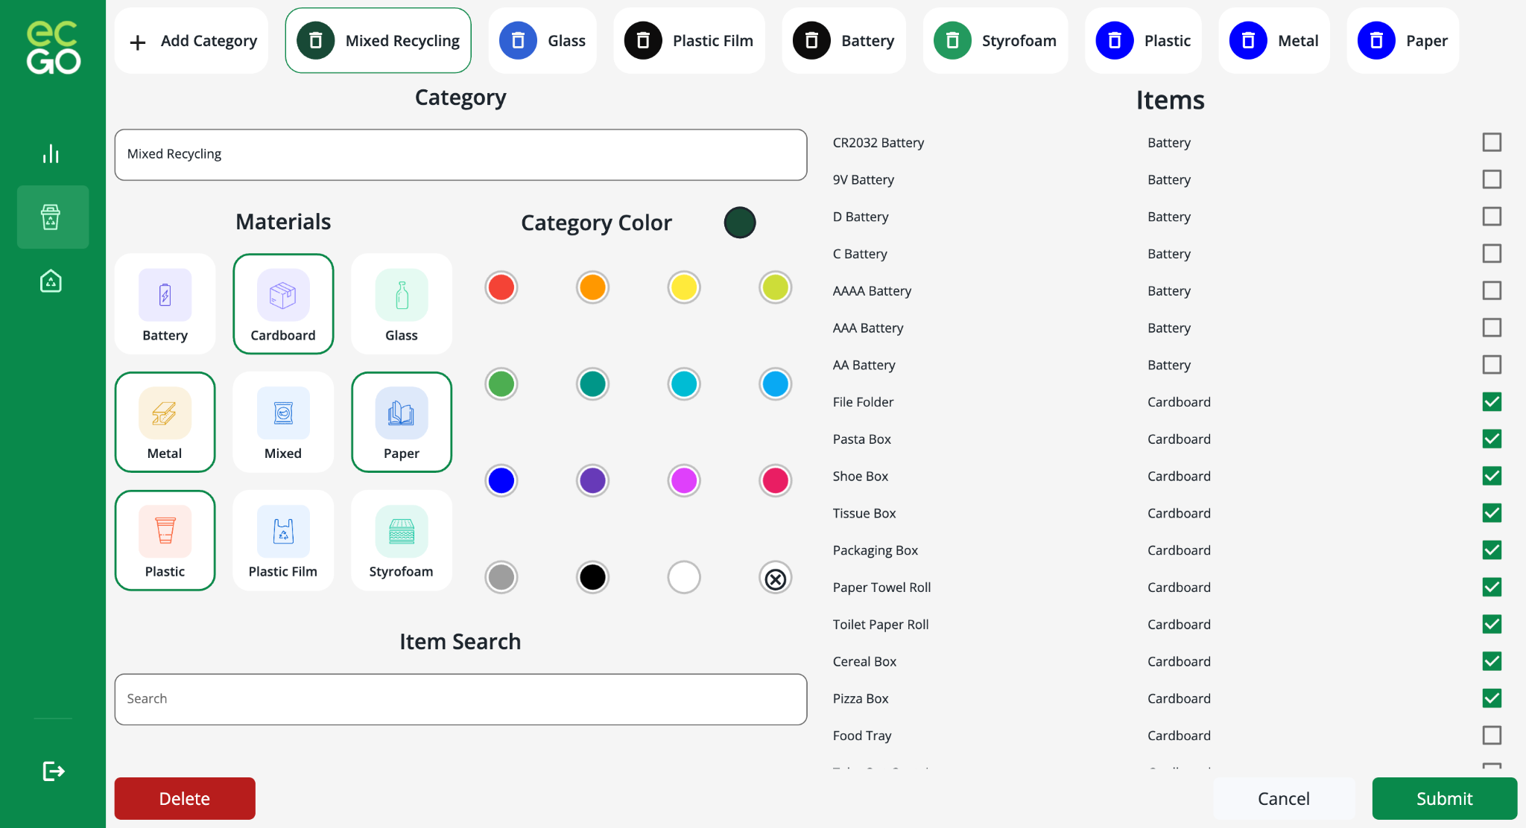
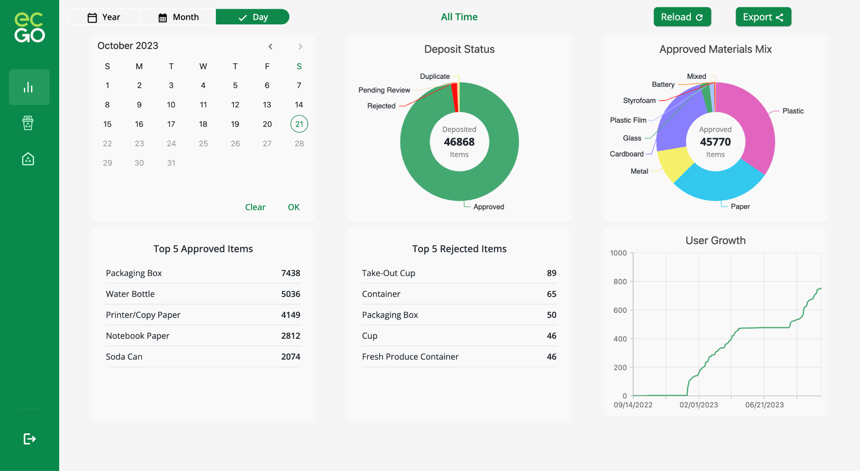
Recycle Correctly Every Time
💻
ECGO Recycling Coordinator Portal
Digitize Your Program
Define Campus Geofence(s)
Bin Categories
Recycling Stations
Track Your Data
Total Deposits
Total Active Users
Material Mix
Top Items
Notes:
After dozens of hours of interviews with recycling coordinators across the US, we designed and built a simple platform that can get your recycling program fully digitized in a matter of minutes.
Once your program is up and running, you can track the total number of deposits, the number of active users making those deposits on your campus, and the top items and materials being submitted through the ECGO mobile app.

Slide 12
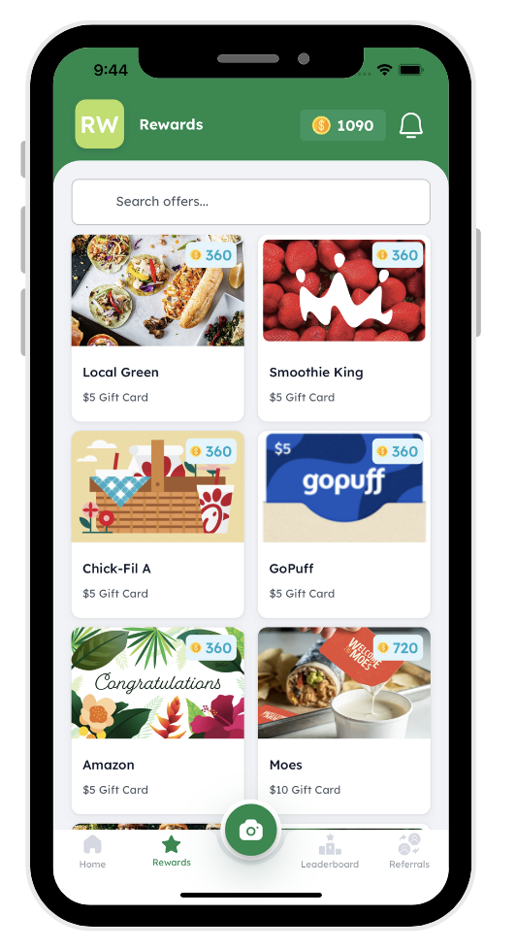
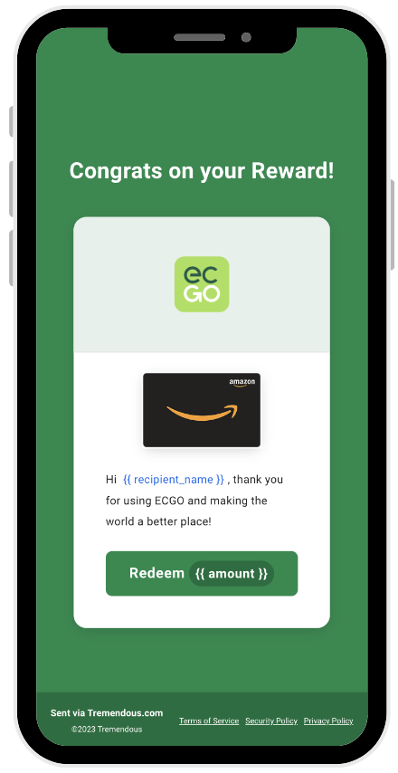
Get Rewarded!
💰
Notes:
Similar to traditional recycling incentive programs, ECGO rewards users when they recycle correctly. What makes ECGO special is that our rewards process is fully digital and thereby instantaneous. Through the use of virtual gift cards, ECGO can encourage users to redeem their points at sustainable businesses or even donate their points to climate change charities.

Slide 13
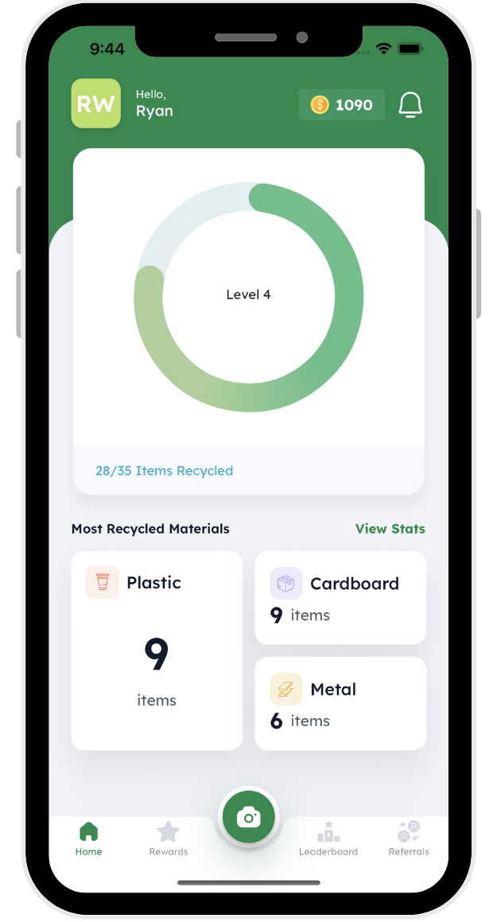
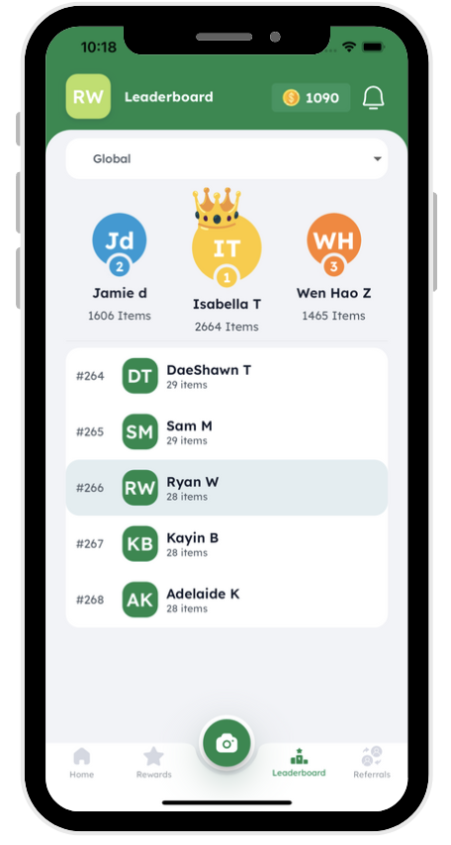
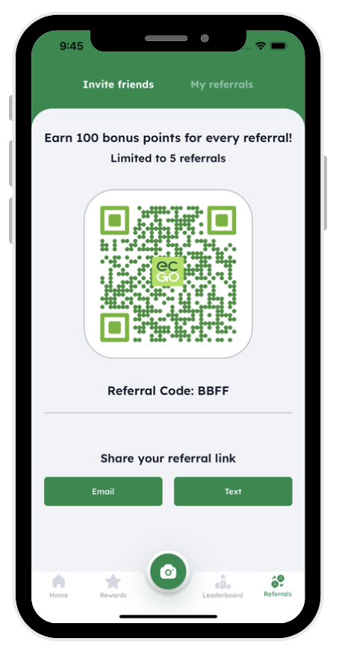
Grow Awareness & Engagement
🎮
Notes:
But ECGO doesn’t just stop at rewards. We believe that a healthy recycling program is one that creates a culture of sustainability on your campus. ECGO users can view their recycling history and material stats to better understand what items and materials they dispose of the most. As users make more deposits, they climb the leaderboard where they can compete with other users both on their campus and globally. In addition, we encourage users to invite their friends to ECGO by rewarding them whenever they use referral links.
So now for the real question: does anyone actually use the app?

Slide 14
GT Spring Housing Pilot
01/08/2023 - 05/31/2023
723 Accounts Created (10% Housing Adoption)
458 Active Users (63% Conversion)
30,000+ Deposits
34 Deposits per Active User each month
Only 2% of Deposits Rejected
Dirty/Contamination
Fraud/Duplicates
Notes:
Well I’m very excited to share our results from our Spring housing pilot with Georgia Tech. Over the course of the Spring semester we brought on 723 new users, accounting for about 10% of the on campus housing population. Of those users, 458 used the app to take pictures of their waste and get rewarded for recycling correctly. This small group of active users was highly engaged with over 30 thousand deposits made through the ECGO app. On average, that means active users were recycling at least an item a day using ECGO. And of those 30,000 deposits only 2% were rejected by our review team. Usually rejections occurred when items were too dirty or not accepted by the GT recycling standards. In very rare cases, students would “test” the system by submitting images of the same item multiple times, or images of items which were not ready for disposal.
In addition to some great stats, we also heard some inspiring feedback from our users.

Slide 15
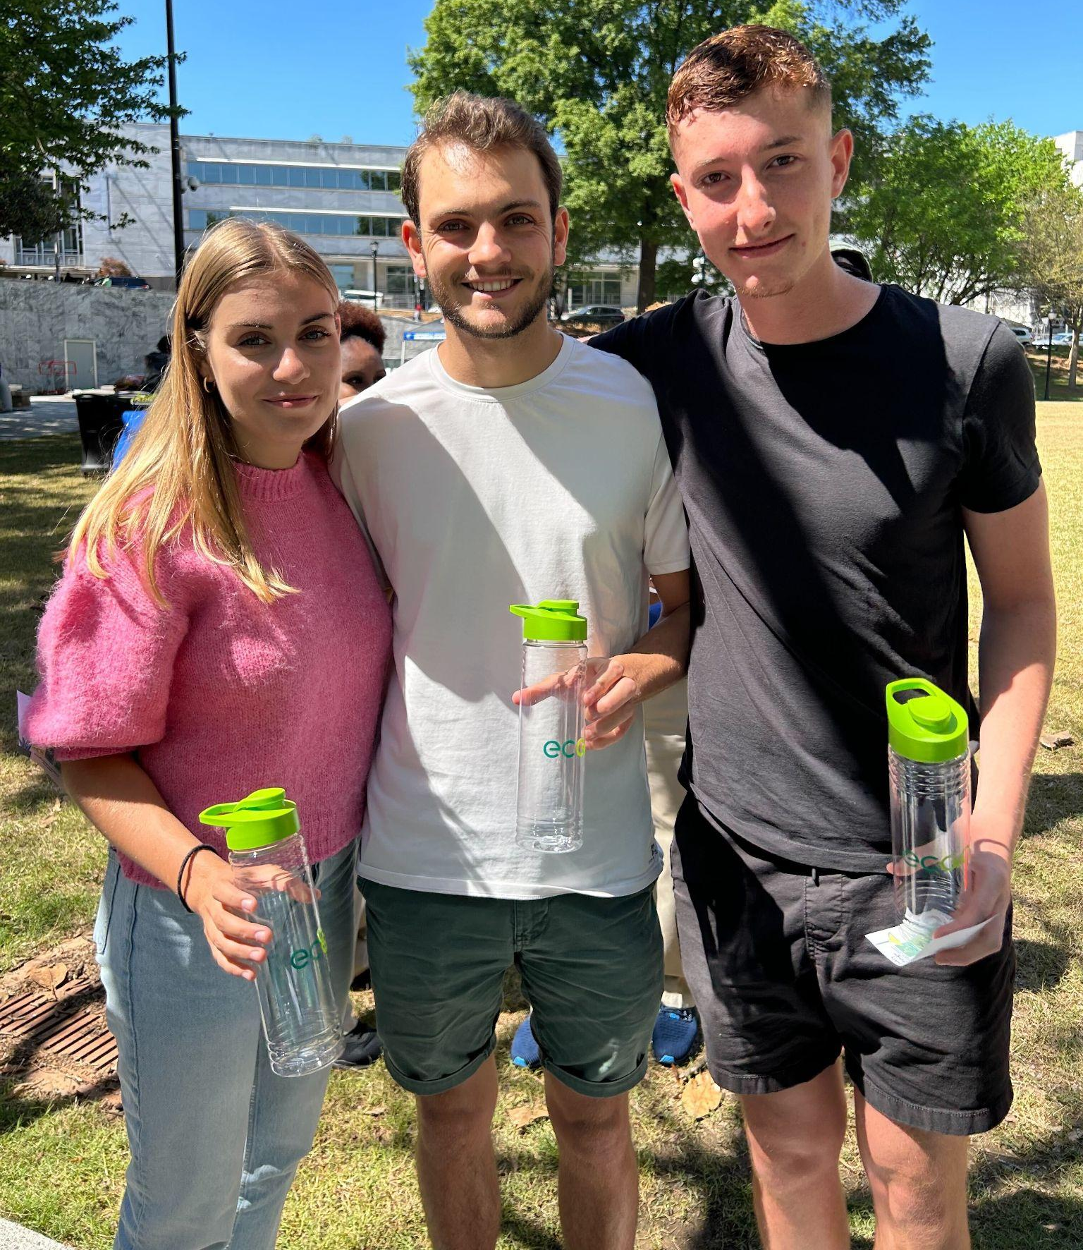
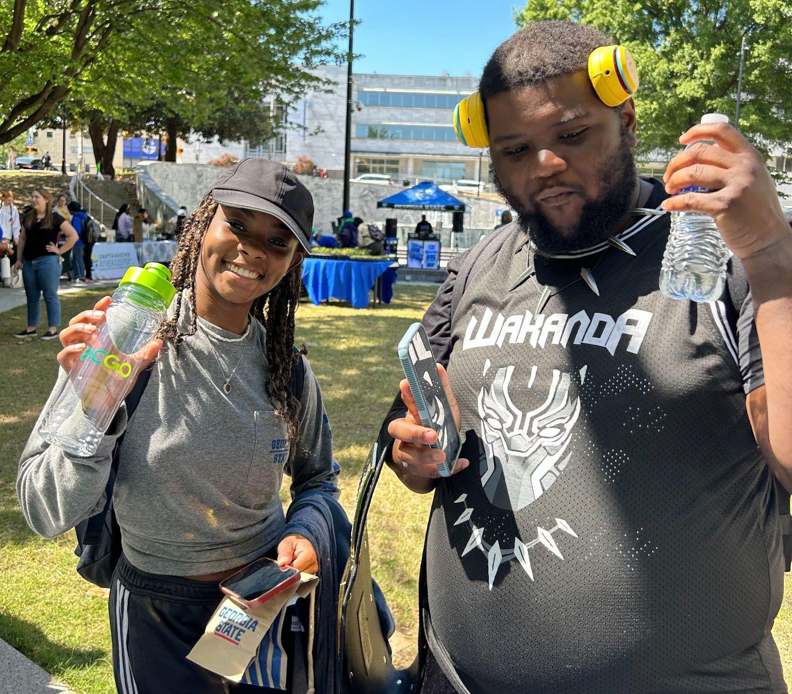
User Feedback
88%
I find myself picking up litter on campus. I know it’s worth 10 cents on ECGO!
-Gabrielle (Sophomore)
Increased Confidence at the Recycling Bin after ECGO
73%
The app encouraged me to recycle and the app made me realize the things that I use on a daily basis are actually recyclable. It made me realize how much value is in my waste.
- Danielle (Senior)
Feel that their daily recycling habits have improved since using ECGO
Notes:
Over several user surveys conducted from January through May, we found that 88% of respondents said their confidence increased at the recycling bin after using ECGO and 73% reported that they felt their daily recycling habits improved since they began using ECGO.
Furthermore, we learned some users have gone above and beyond. Gabrielle, a sophomore student at Georgia Tech, said he found himself picking up litter on campus because he knew it was worth 10 cents on ECGO. And Danielle , a senior student at tech said the app made her realize their were many items she used on a daily basis she had no clue were recyclable.

Slide 16
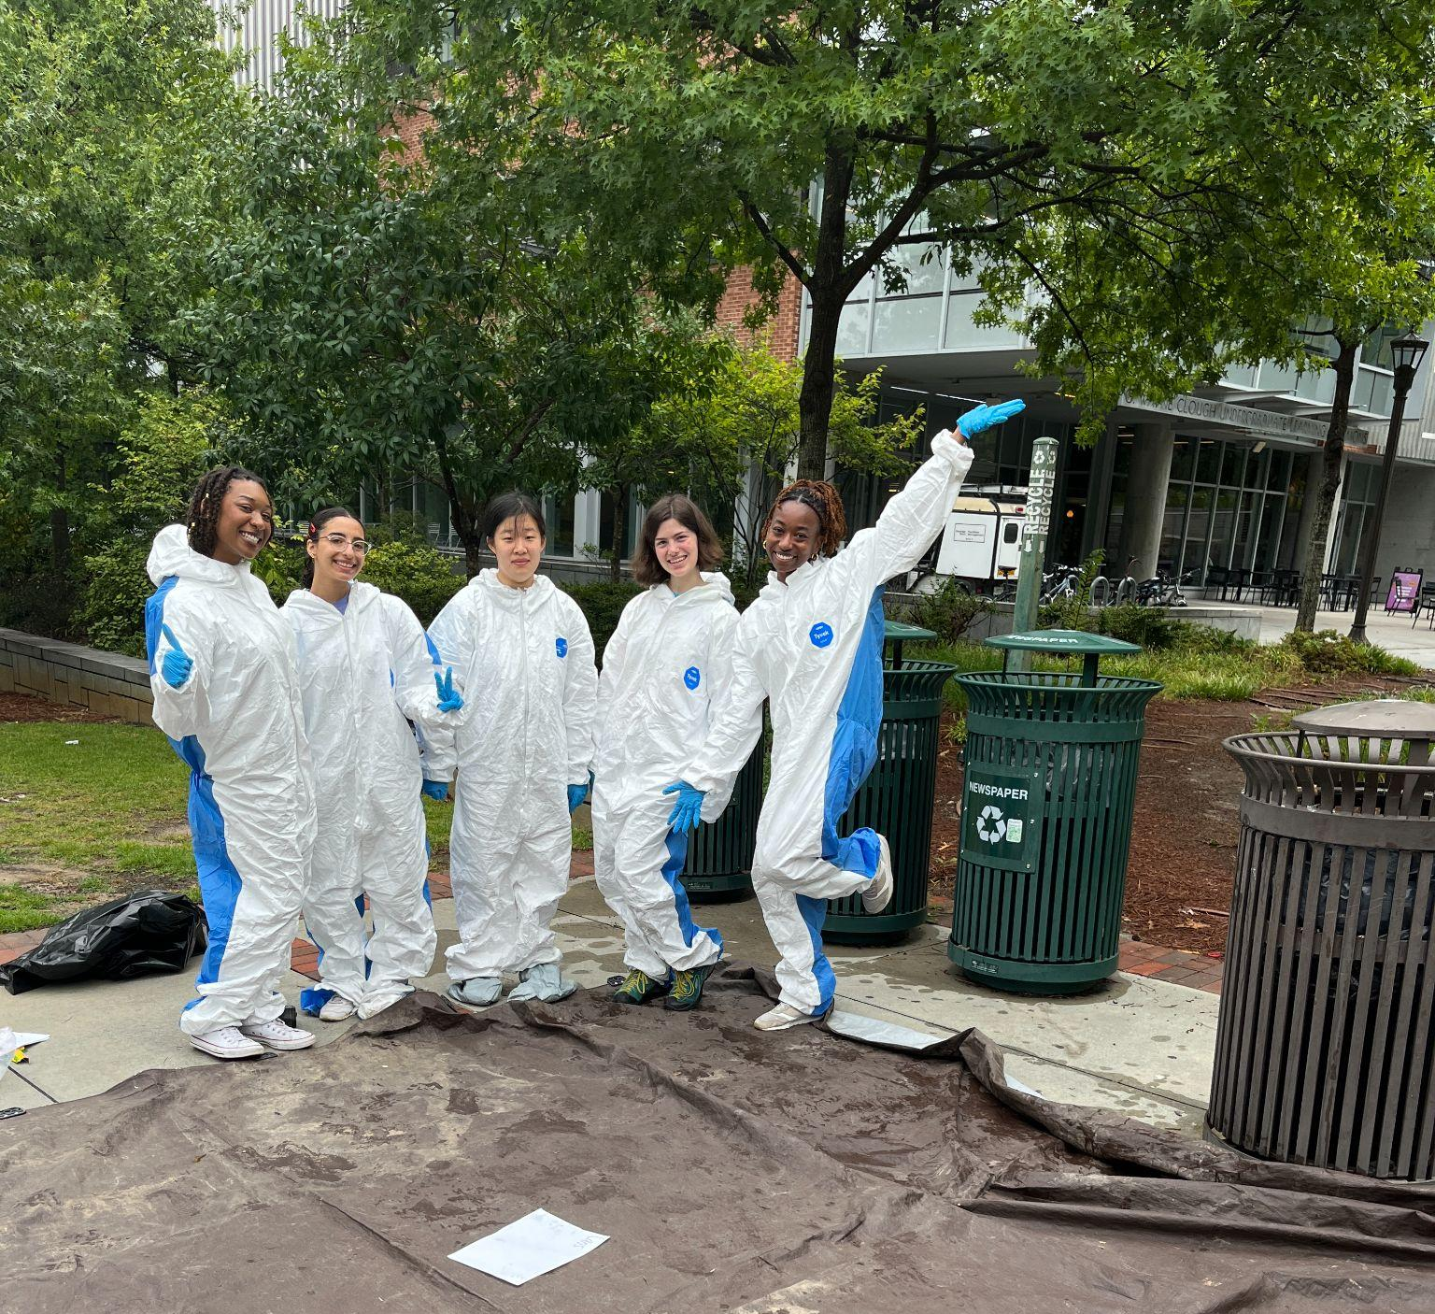
GT Fall Semester Goals
08/21/2023 - 12/31/2023
Increase Total Users
10% Undergraduate Adoption
Over 2000 Students
Increase Active Users Conversion
80% Conversion
Tracking ECGO’s Impact
Improve Contamination Rates
37% in Clough
55% in Residence Halls
Notes:
Today, we are continuing our work at Georgia Tech with a focus on growth and impact. Based on our latest forecasts, we will surpass 10% of all undergraduate students signed up on ECGO before the new year. Through analysis of in app event data from the housing pilot, we found the opportunity to increase active user conversion from 63% to over 80% and our product team is working to implement the necessary changes as I speak. By far, our most important measure of success is how we are affecting the GT waste stream. At ECGO, we might love software but we don’t mind getting dirty. At the beginning of the semester, we performed waste audits across campus to measure diversion and contamination rates and found some areas that needed serious improvement. Since ECGO knows exactly where students are recycling on campus, we will be testing to see if places where student use ECGO more will have higher diversion and lower contamination by the end of the semester.

Slide 17
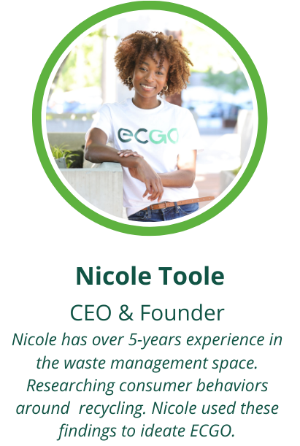
ECGO Team
Notes:
My co-founder Nicole unfortunately could not join us today since she is in San Francisco this week speaking at the VERGE climate tech conference. Nicole is an ambitious leader who puts in the work to make her vision a reality. She’s earned 5 years of experience studying the waste management industry and striving towards a modern solution to increasing recycling engagement and education. I teamed up with Nicole just last summer to advise her on how to build ECGO. After working alongside her for a few months, I quickly became inspired by the mission and have since devoted my focus towards building the solution that the industry needs. With me, I bring 5 years of experience building AI driven software for multi-billion dollar corporations like Home Depot and Expedia Group. Our team may be young, but we are highly devoted to solving this problem and are looking forward to continuing to grow our app at Georgia Tech, and starting our next housing pilot program with UC Berkeley in January.

Slide 18
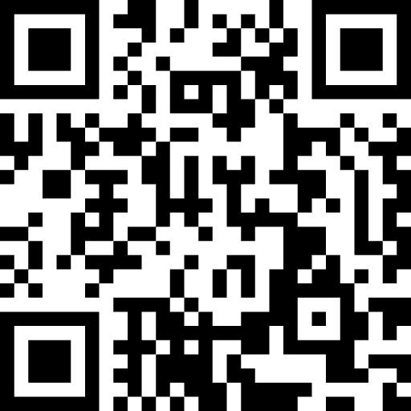
Questions?
Contact Us:
malte.weiland@aux.gatech.edu
ryan@ecgo.co

