Slide 1
An Introduction to the
Hefty ReNew™ Program
Notes:
Add new tagline

Slide 2
The Hefty ReNew™ Program
Vision
Advance development of a circular economy by enabling responsible end-of-life solutions for post-consumer plastic waste
Educate and engage consumers in diverting plastics from landfills
Simplify collection and reduce contamination at Materials Recovery Facilities (MRFs)
Convert plastics to higher value resources following the EPA hierarchy
TODAY
Strategy
Notes:
Speaker Notes:
Understanding the challenges with Hard-to-recycle plastics, Hefty® jumped at the opportunity to be part of the solution.
It is important to note- this program does not replace curbside program. The same items that were included in curbside programs will still go into the curbside bin. Using the Hefty® ReNew® bags, plastics that normally aren’t part of curbside are now recovered and used as alternative energy solutions.
Keep – no changes needed

Slide 3
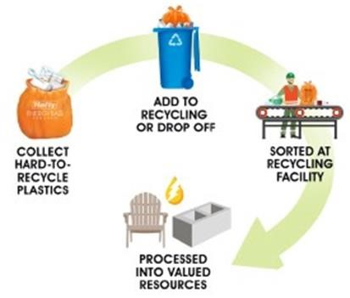
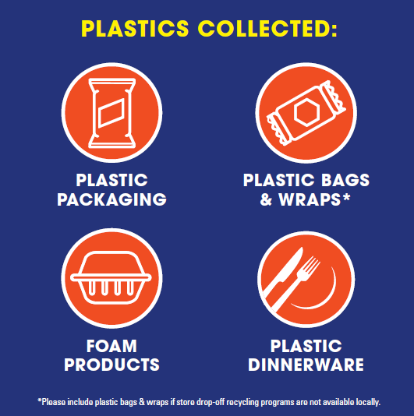
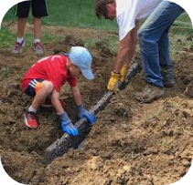
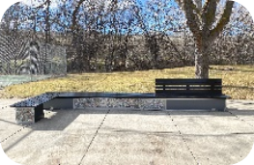
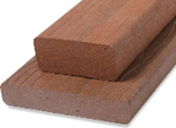
What is the Hefty ReNew™ Program?
How the Program Works:
Giving H2R Plastics a Second Life
What Are Hard to Recycle Plastics?
What a Second Life Can Look Like….
Drainage Materials
Park Bench
Sustainable Building Materials
#1
Program Engages an Attractive Consumer Demographic
waste bag item
at current top grocery retailer in stores carrying the item*
Notes:
Describe how program works: residents buy Hefty ReNew bags at local retailer. Collect H2R plastics in the orange bag. On recycling day, add the orange bag to their recycling bin. The hauler takes it with the contents of the recycling cart/bin to the MRF where it goes on the sorting line. There the full bags are pulled off the line and stored until there are enough bags to bale. When there are enough bales to fill a truckload, we arrange for pick up and delivery to the end market where the H2R’s are turned into valuable resources, or a second life.
H2R are #4-7 plastics in most markets. However, here in Cincy, #5 PP is excluded from the program because Rumpke has an end market for PP in addition to PET and HDPE.
Our end markets turn the plastics into drainage materials, park benches, building materials, etc.
When this is not possible, materials may be used to replace some of the coal that fuels the kilns used in cement manufacturing. An independent life cycle assessment found that these solutions are environmentally better than simply sending hard-to-recycle plastics to landfills.
Dow team will talk more about this later.
The benefit to the retailer is that Hefty ReNew is 100% incremental to the trash bag business. We’ve conducted store tests with two different retailers. In both retailers, Hefty RENew was the #1 trash bag item.
And finally… the program attracts a desirable demographic… gen Z AND millennials

Slide 4
We work to get all legs of stool aligned

Slide 5
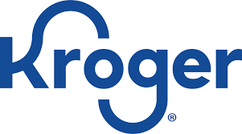
The Hefty Renew™ Program is expanding in 2023-2024… available to 2.2M HH w/ curbside access
BOISE
Q2 2018
OMAHA
Q4 2016
Cincinnati Q4’23
Ohio Valley
Q2 2024
ADA CO.
Q3 2019
LINCOLN
Q3 2019
Drop-off only
Chattanooga
Q4 2022
COBB CO.
Q4 2018
2500+ TONS of plastics diverted since program inception!
ATLANTA
Q3 2021
5
Notes:
With our existing markets, including Chattanooga, as of June we have diverted over 2400 tons of plastics from landfills since the program began.
In partnership with Rumpke Recycling, we are expanding into the Cincy market in Nov ‘23 and the rest of the Rumpke markets in Ohio beginning mid-2024. With this expansion, the HRP will be available to 2.2 M HH… nearly double the number of existing number of HH w/ access to curbside recycling.

Slide 6
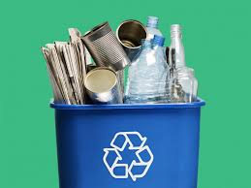
Hefty ReNew: Unique Program Pillars
EDUCATION
62% of people worry their lack of recycling knowledge causes them to recycle incorrectly
The Hefty team invests in tools via advertising, in store, website, mailers, education kits, events, etc. to educate program participants improving overall recycling knowledge.
COMMUNITY
We work with local communities: MRFs, Haulers, Local Gov’t, Retailers, Special interest groups
The program is integrated into current systems (retail and recycling) vs. adding more emissions by creating our own infrastructure
ACCOUNTABILITY/
TRANSPARENCY
End markets collaborate with Hefty on LCA testing to ensure sound, ecofriendly practices.
Amounts collected are documented and shared with program participants & partners
Hefty ensures bales are shipped only to approved end markets
Notes:
The program has 3 key pillars:
Consumer education- we know there is lots of confusion about recycling. We invest in a number of tools to not only educate consumers about the program, but about recycling in general.
Community- and in this instance, we mean the recycling stakeholders in a market. We MUST work together with the local MRFs, haulers, city governments, retailers, and ideally special interest groups.
Accountabiity/Transparency- our end markets collaborate with Dow and Hefty on our LCA testing to ensure that materials collected in Hefty ReNew bags are going to end markets that meet our strict criteria

Slide 7
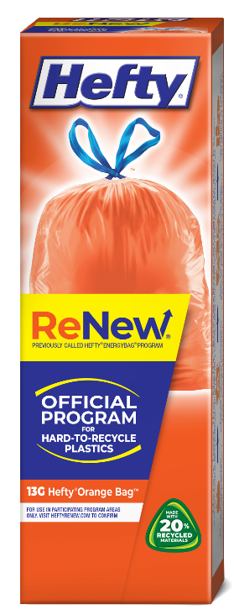
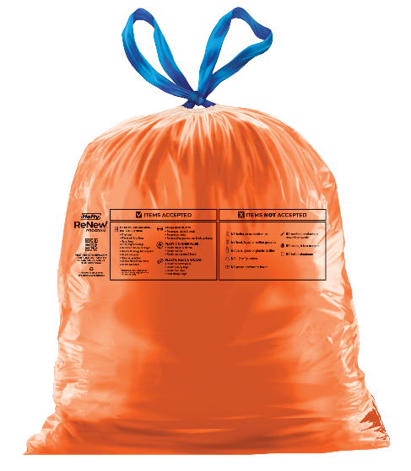
Product Details
Hefty ReNew™ Program branding launched in April 2023
Formerly Hefty® EnergyBag®
New name is preferred by consumers, partners and better reflects what the program does: collect plastic and turn it into new things!
Orange bag makes it easy for MRFs to spot bags on the line and pull them off to be baled and sent to our end market
Each orange bag is:
Printed with acceptable items
Made with 20% recycled materials
Features a new drawstring
Educational Panels on Pack
What goes in the bag information
How the program works
QR code connects consumers to website
Notes:
We rebranded the EB program to ReNew in April because the new name better reflects what happens to the collected materials… they get turned into new things!
(SHOW carton and bag)
With education as a key pillar of the program, you can see that we use every chance we get to explain how the program works and what plastics can go in the bag. These graphics will be updated with new messaging for the Cincinnati launch.
Note- new printing on most recent samples.

Slide 8
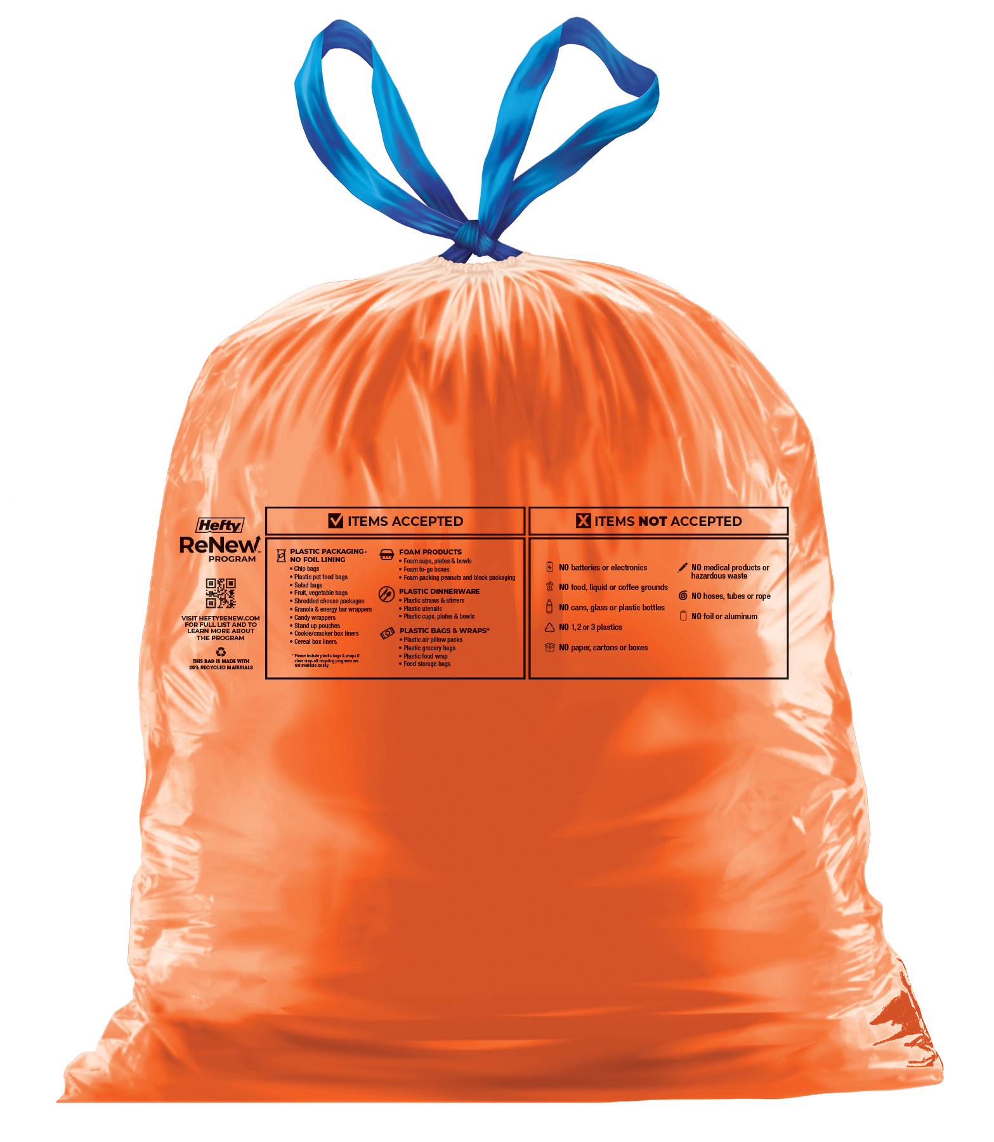
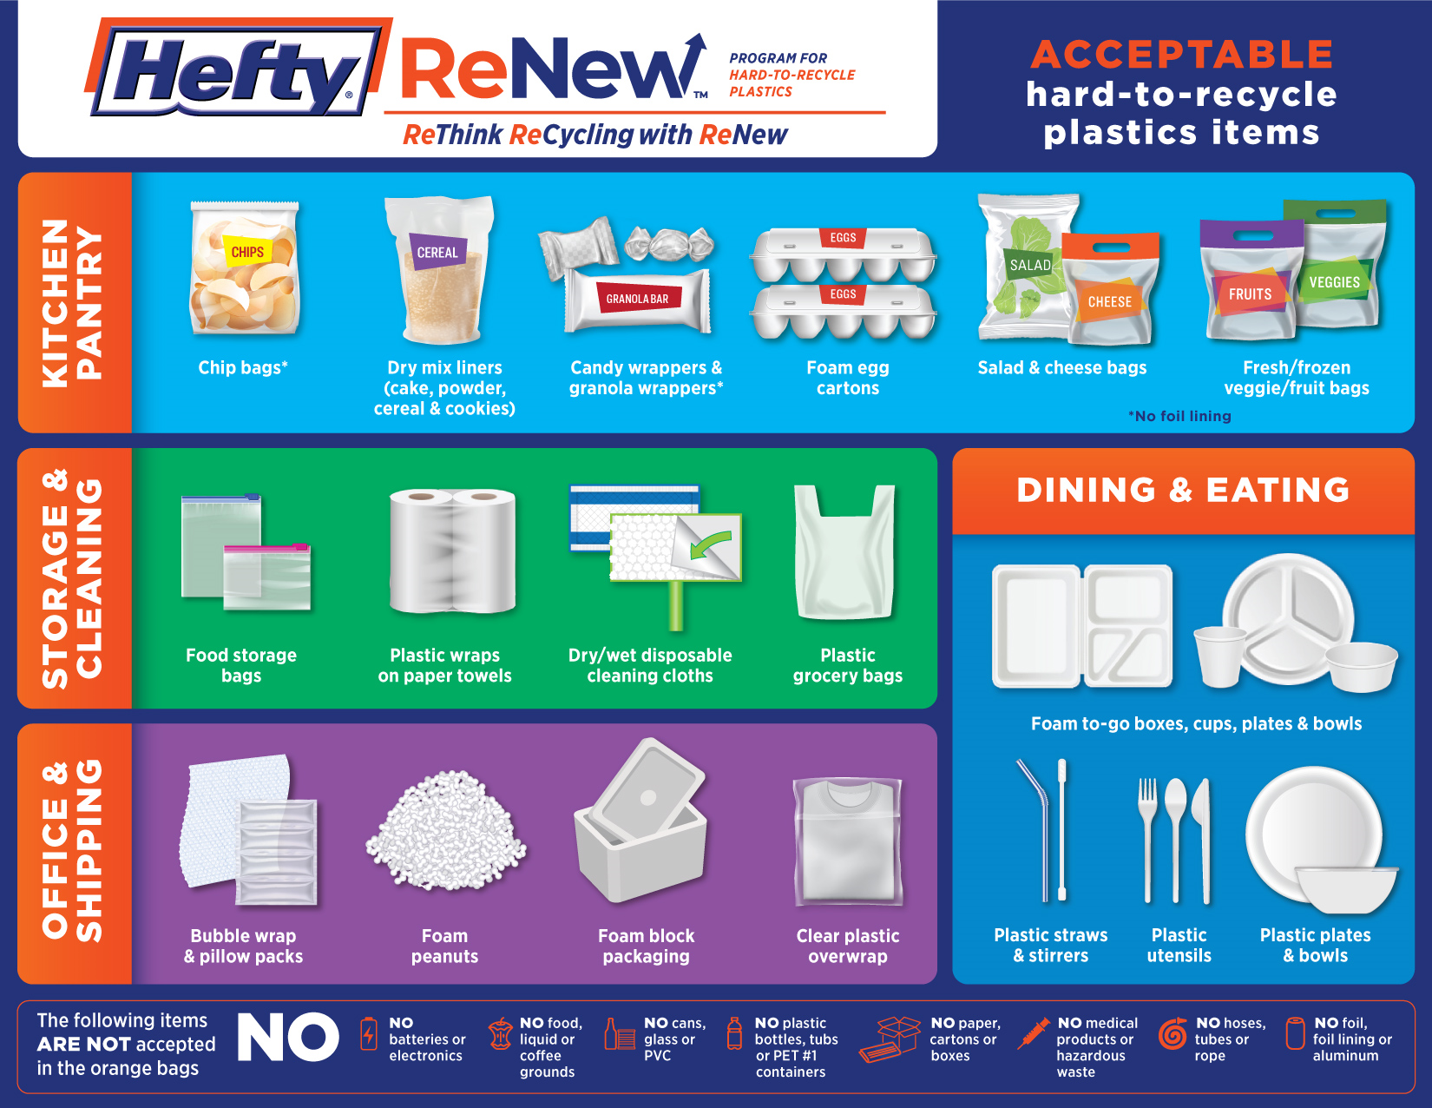
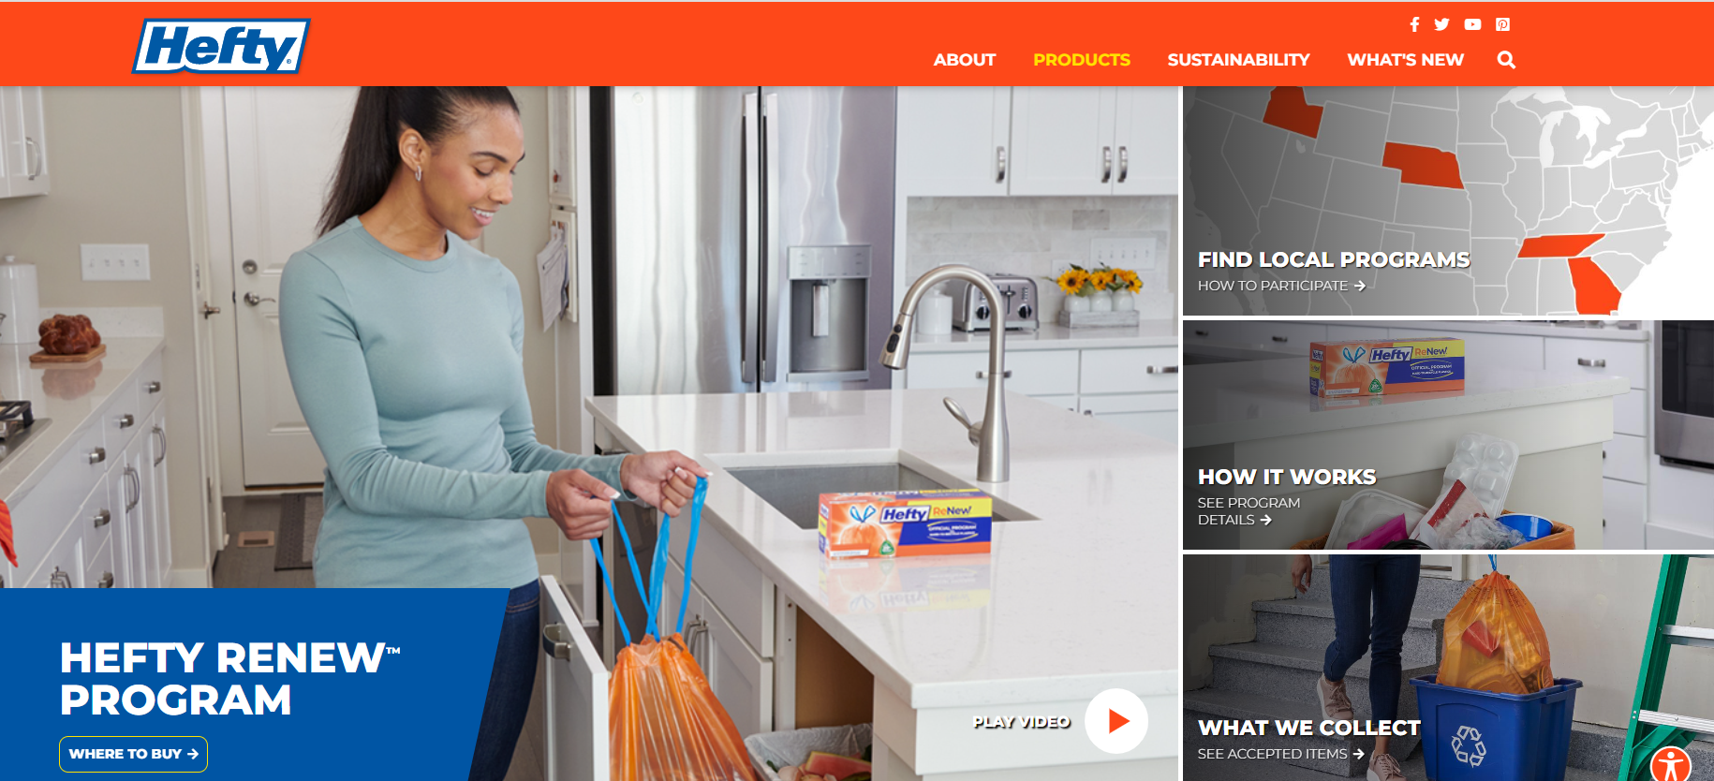
Items collected in the Hefty ReNew™ Program
List of accepted items can be found:
On HeftyReNew.com
Printed on each orange bag
Printed on cartons, with corresponding QR code
Notes:
We use our website and digital assets to list what can as well as what CANNOT go in the bag. Swiffer items are currently listed under plastic packaging on our website, however… by the time we launch in Cincinnati they will be in a new category, cleaning and storage, along with some of our own Hefty products.

Slide 9
Geographic Reach: Current End Markets
Meadville, PA
Omaha, NE
York, PA
Morgan, UT
Los Angeles, CA
Dorchester, SC
Kiln Fuel
Advanced Recycling
Atlanta, GA
New Products
Note: Hefty retains ownership of materials from time of collection until they reach the qualified end market

Slide 10
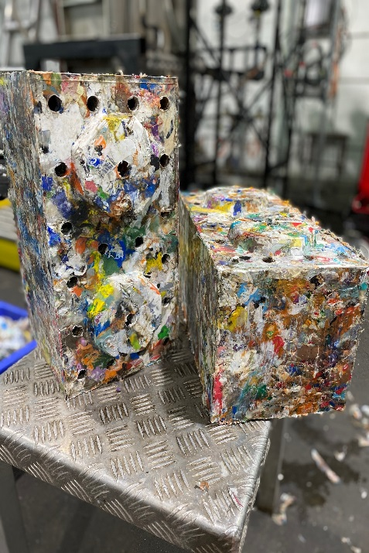
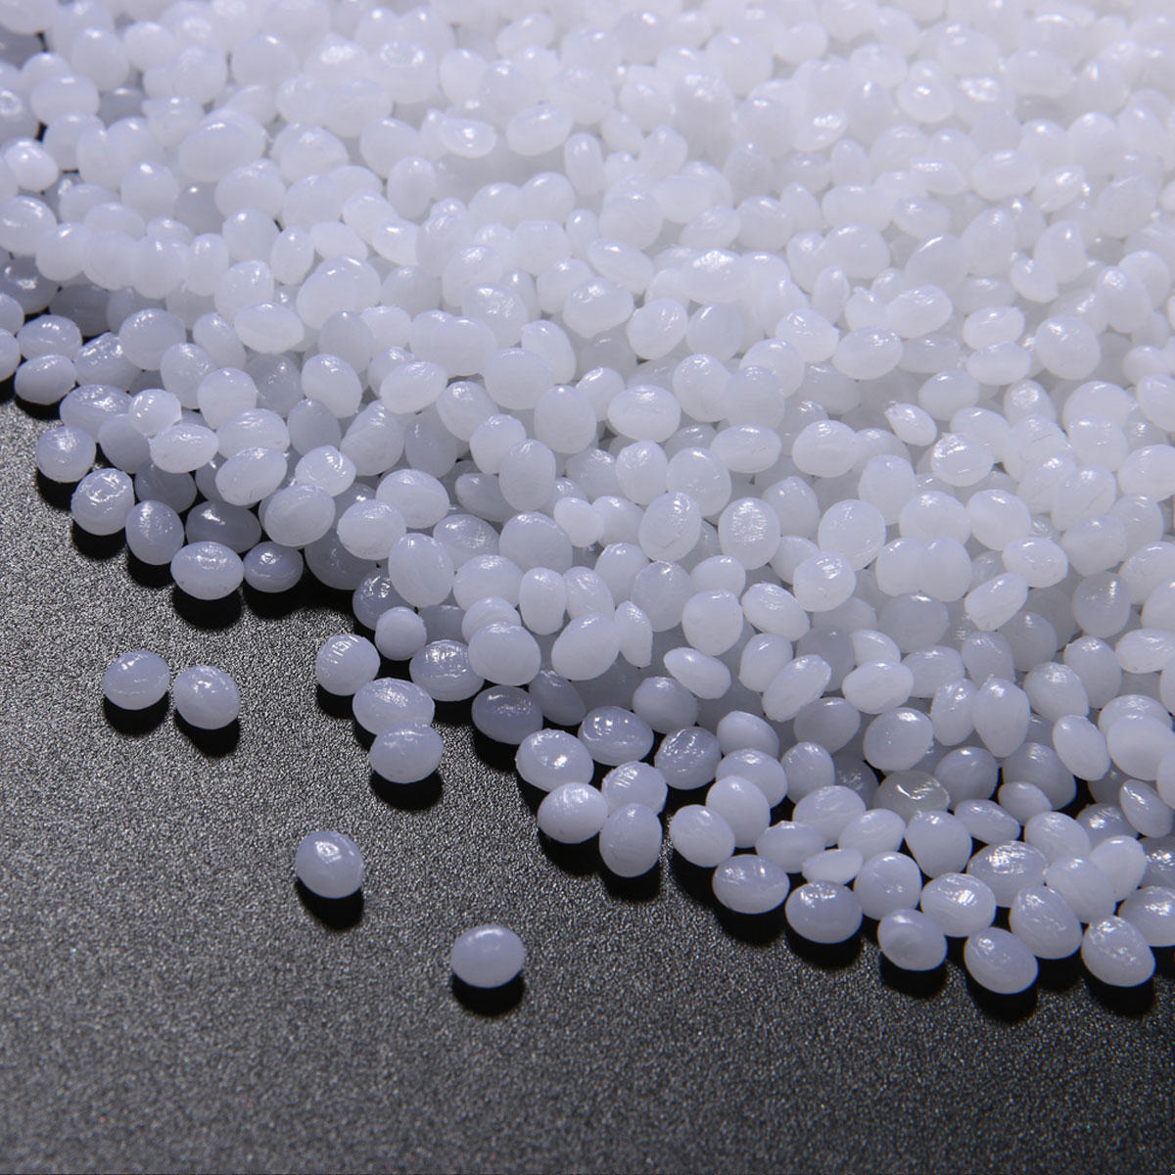
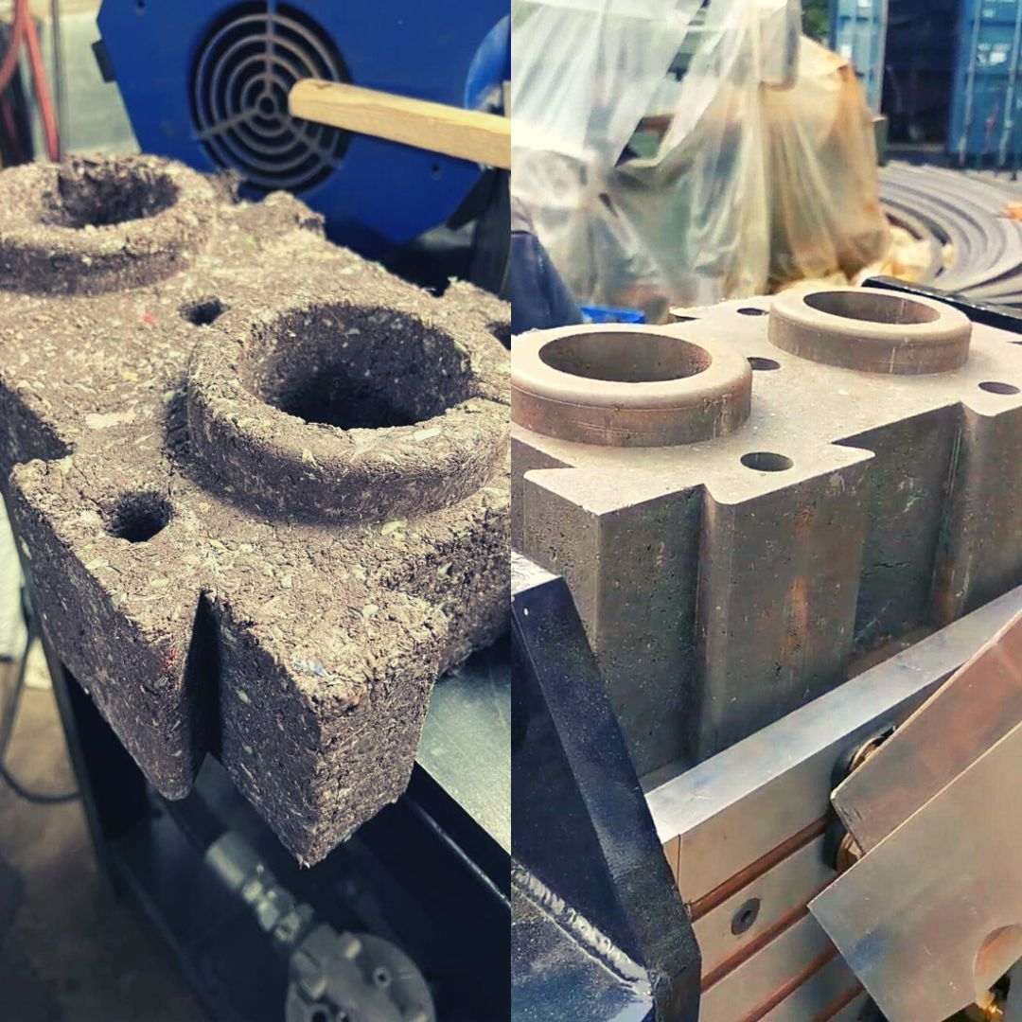
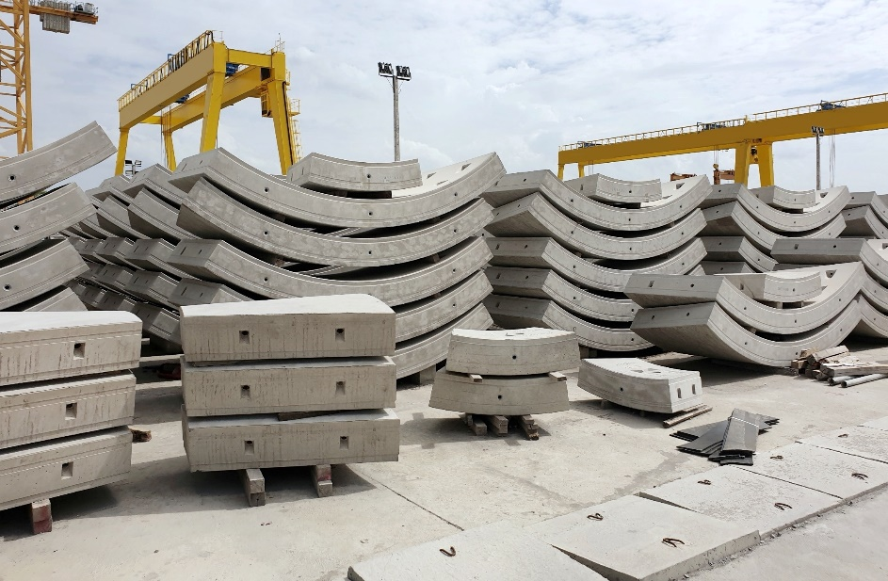
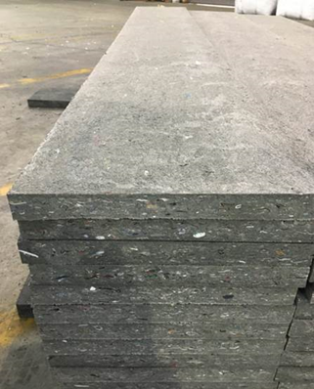
End Market Opportunities
Supporting the end-use pipeline
Mechanical Recycling
Advanced Recycling
Alternative Fuel
Plastic building materials, composite wood products, etc.
Plastic to Plastic
Kiln feed for cement production, combustible solid fuels, co-generation

Slide 11
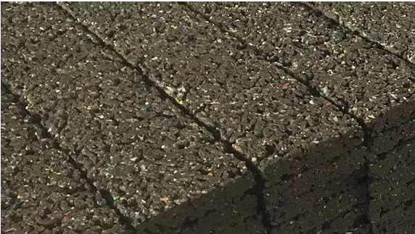
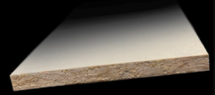
Mechanical Recycling
gravel, blocks, composite / lumber, roofing products, water drainage, infrastructure, other durable products
Jen use some of these on the prior slide

Slide 12
End Market Forecast
 | 2016 Act | 2021 Act | 2022 Act | 2023 YTD | 2024 Fcst | 2025 Fcst
Mechanical | 0% | 5% | 51% | 60% | 60% | 60%
Adv. Recycling | 0% | 5% | 6% | 0% | 20% | 30%
Alternative Fuels | 100% | 90% | 43% | 40% | 20% | 10%

Slide 13
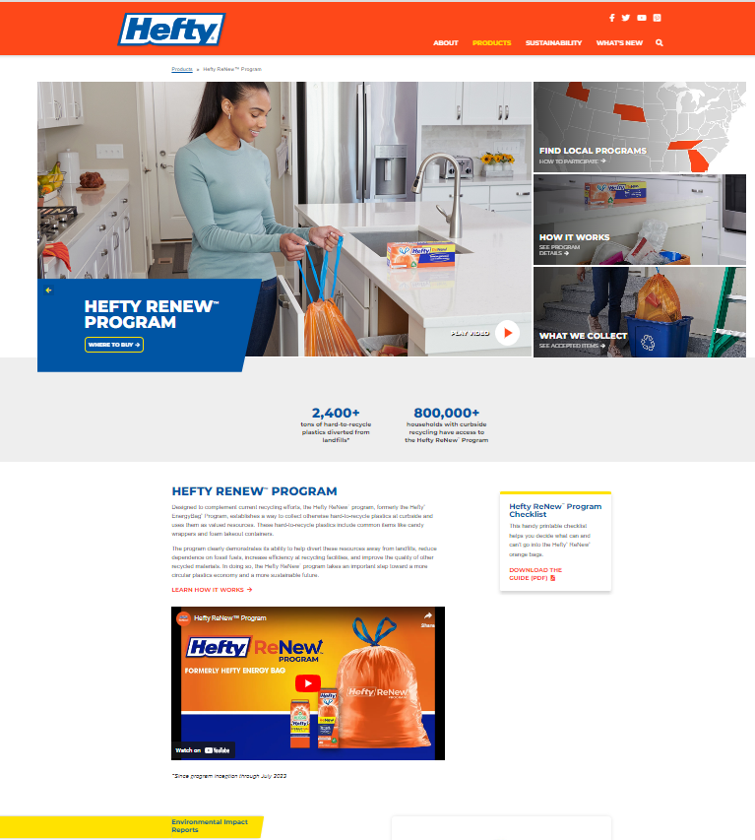
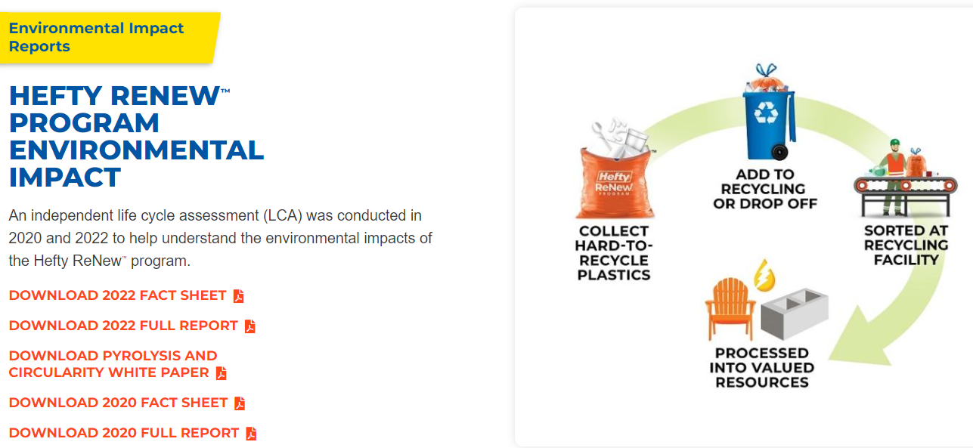
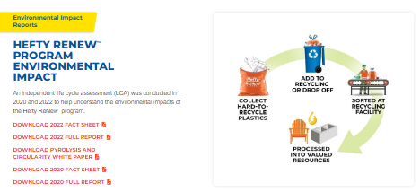
Life Cycle Assessments Drive Program Decisions
13

Slide 14
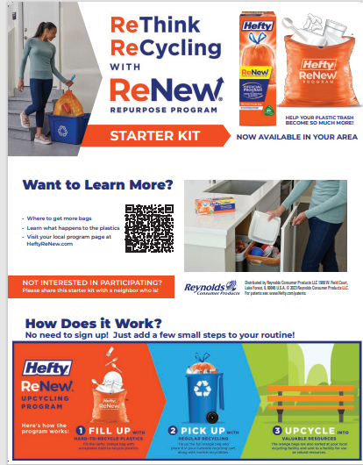
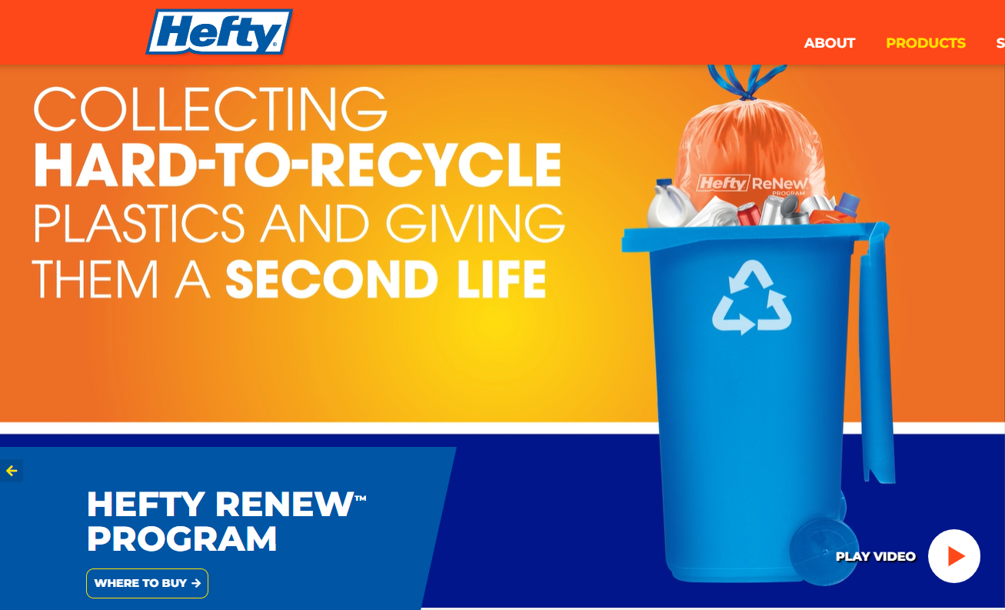
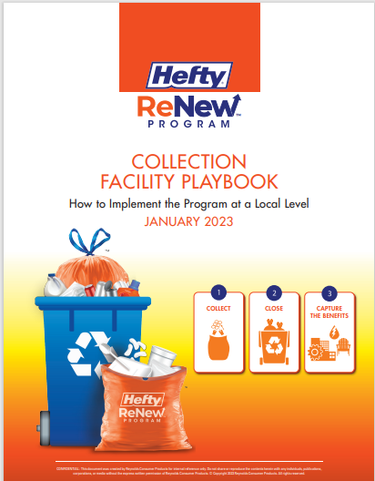
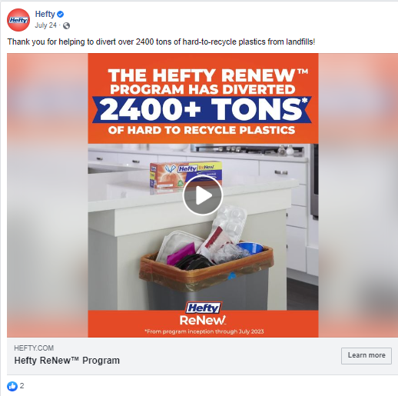
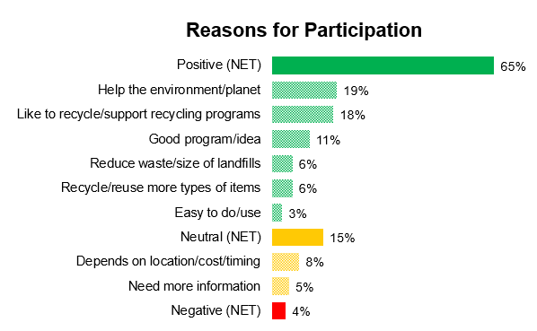
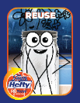
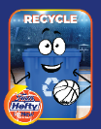
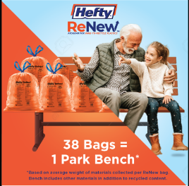
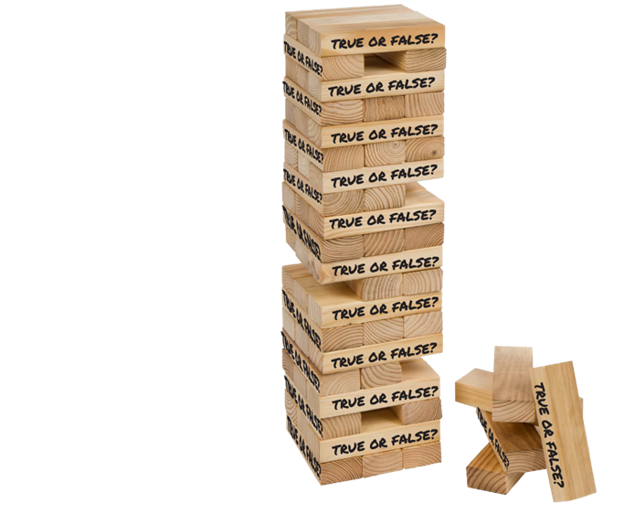
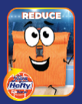
New Market Support & Education
FREE STARTER KITS
ONLINE CONTENT
*How it works *What goes in the bag
*Where to buy *Where to learn more
*Educational videos * LCA * FAQs
*Complete list of accepted items
*Customer Service for questions
PUBLIC RELATIONS
COMMUNITY MANAGEMENT
*Research Driven Insights
*On demand digital hub (assets + FAQs)
*Brand Reputation Management
*Proactive conversation analysis
*Monitor inquiries (Consumer + Press)
ADVERTISING
EDUCATION TOOLKIT
*Zip code targeted
*Focus on program impact
*Recycling tips *Activities (adult/kids)
*Program information
*Take home reminders
Notes:
Consumer education when we launch in a market is key to our positive perception.
Free Starter kits are available to anyone who asks for one… which will be a call to action in our advertising when we launch in Cincy.
We are currently working with our PR firm and Rumpke communications team to develop a very comprehensive earned media plan. You will note that we have a crisis management plan in place to proactively prepare for any issues.
Our advertising creates awareness for the program, how it works and where to find out more information. Our media planning is a challenge because we must use zip code targeting… we do not want to advertise in areas where residents cannot participate in the program.
Online content refers to our educational videos, educational tool kits for adults and children, and particularly our LCA, which is publicly available- Life Cycle Assessment conducted @ 2 years to quantify program’s environmental impact and benefits, guides program optimizations, and informs our expansion strategy. It also demonstrates Hefty’s commitment to transparency and helps educate key stakeholders: consumers, retailers, MRFS, communities, NGOs
Finally, we manage OUR community by monitoring conversations in social media.
LCA is a standardized method used to quantify the environmental impacts throughout the full life cycle of a product or process​
Many environmental impact categories can be measured; GWP is generally accepted and will be central to findings​

Slide 15
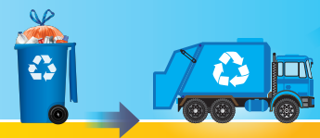
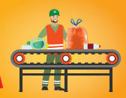
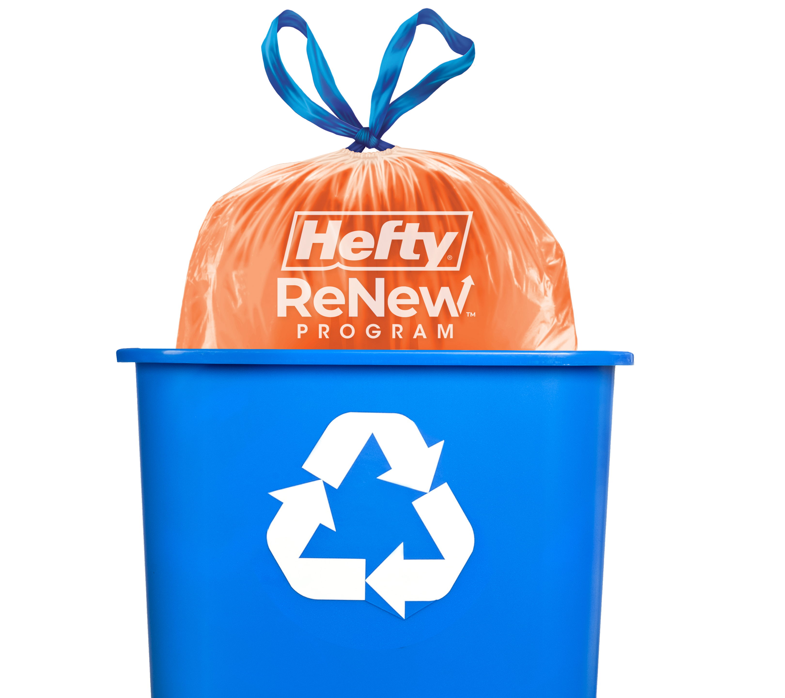
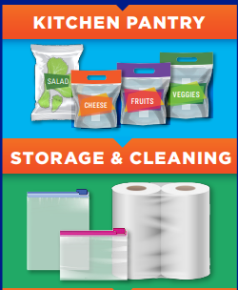
Collection is Key to Innovation
Simple collection mechanism
Current recycling pickup systems
Minimal burden or additional costs for MRFs
Hard to recycle materials are collected in one bag instead of loose in carts and bins which contaminate the recycling stream
Hefty ReNew™ program takes material NOT accepted in current recycling programs BUT uses the same carts and hauling trucks

Slide 16
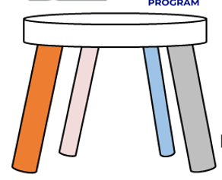
Program Value to the MRF & Communities
Program Improves Collection Quality and Value
Program Process Fits Easily into MRF Processes
Working Together to Benefit the Whole Community
Improves the value of all collected materials
The Hefty Renew™ program does not take away from current materials
Printed guidelines on bag, box and marketing reduce loose contamination
Reduces litter and contamination, increases landfill diversion
Orange Bag is designed and tested to perform through collection, compaction and processing
Orange bags easily identified and sorted at MRF
Bags can be baled on site for end markets with shipping paid by Hefty Renew™ team and partners
Connects to end markets for hard to recycle materials
Enhances communication and recycling education investments
Consumers “trust in recycling” doubled after pilot program
Retailers, government, and community leaders working together

Slide 17
QUESTIONS ?

Slide 18
Paul Benvenuti (813) 505-3087
Paul.Benvenuti@reynoldsbrands.com
Catherine Chertudi (208) 861-4601
cachertudi@outlook.com
Lynnette Hinch (224) 441-7179
Lynnette.Hinch@reynoldsbrands.com
Notes:
Add Header and Tag Line and Contacts

Slide 19
APPENDIX

Slide 20
Program Perceptions
90%
Program Satisfaction
who start the program plan to continue
Satisfied
85%
2/5
are using less plastic since starting the program
CURRENT MARKETS*
Likelihood to Recommend
Top Motivators to Participate
Positive environmental impact (27%)
Convenience (24%)
Price (22%)
Likely
91%
2/3
Impression
% Like a Lot/Somewhat
Likelihood to Participate
% Very/Somewhat Likely
Perceived Program Impact
find the program appealing
Strong/Moderate
Millennials
(72%) ↑
vs. Boomers (53%)
PRE-LAUNCH MARKETS**
63%
70%
1/2
of NON-recyclers find the program appealing and would be willing to try it!
Gen X (79%) ↑
vs. Boomers (60%)
Source: *Harris Poll, January 2023, n=602, **Harris Pre-Launch Survey (Chattanooga & Dayton) November 2022, n=360
Notes:
We conduct consumer surveys 2x/year to understand consumer perceptions of the program. As you can see, 90% of consumers who start the program intend to continue participating and 2 out of 5 are actually using less plastic as a result. We recently conducted a survey in two markets where we intend to launch, one of which is Dayton Ohio. As you can see, not only is the program appealing, but HALF of the non-recyclers are willing to try it!

Slide 21
The Hefty ReNew® Offering
Bag costs help support ongoing program operations and expenses
20% Recycled Materials​
Bright orange bag easily identifiable​
Printing on bag lists acceptable & unacceptable items​
Packaged in 100% recycled paperboard carton
Bag Manufacturing Cost
Recycling Facility and Partner Fees
Freight Costs for Collected Plastics
Consumer Education & Marketing Spend
End Market Processing Costs
Retailer Margin
Reynolds Consumer Products Confidential
Notes:
Product offering.. On left.
But want to call your attention to the pie on the right… which represents the investments Hefty makes to bring this program to communities across the country. The pieces of this pie are not representative of the amount invested in each area, but the point is that this isn’t as easy as producing a product and putting it on the shelf! It’s a PROGRAM.
The label says “bag costs help support program operations and expenses”. Well they do help, but they by no means cover the costs.
Hefty is investing margin to support the program. We have an EDLP strategy due to the high costs of the program and the importance of keeping the price as low as possible for the consumer. Therefore we have to balance the investment we can make in marketing .
This is an investment spend for Hefty and will be for a number of years, but we have plan to get there. This is a strategic program and is a critical part of our ESG strategy and our publicly available ESG scorecard.
We do not promote with other Hefty items due to ReNew's unique position with no competitive brand offerings.
We do have an issue with shelf price relative to standard waste bags… and price is a barrier to participation. Due to all these costs, economics may look a little different than other products in the category.
Hefty ReNew bags are priced 75% higher on a per-bag basis vs. Hefty TK bags (not quite double the price)
Per Molly… pricing (justification for cost but no other cost to participate),
Anticipated SRP in cincy at Kroger…. … $9/20ct… pay $9 1 or 2x per year… MOLLY, collect recycling every week in Cincy? One box could last X months? Or X$ per year?

Slide 22
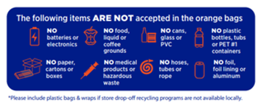
What can be accepted in the Hefty® ReNew® Bag?
All items must be clean, dry and free of foil lining
Candy wrappers
Cereal box liners
Chip Bags
Cookie/cracker box liners
Dry mix liners (cake, powder mixes)
Fresh/frozen vegetable & fruit bags
Foam egg cartons
Granola & energy bar wrappers
Plastic Pet food bags
Salad bags
Shredded cheese packages
Snack food bags
Stand up pouches
Bubble Wrap
Clear plastic overwraps (on shipped clothing, toys etc.)
Foam peanuts
Plastic air pillow packs
Dry and wet disposable cleaning cloths
Food storage bags
Plastic food wrap
Plastic grocery bags
Plastic wraps on paper towels and toilet paper
Foam cups
Foam to-go boxes
Plastic colored cups
Plastic straws and stirrers
Plastic utensils

Slide 23
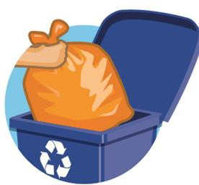
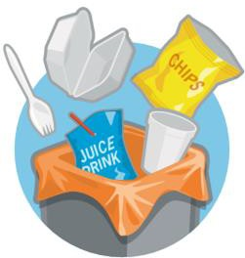
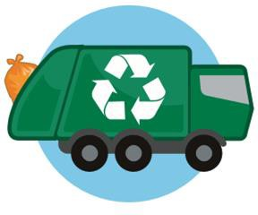
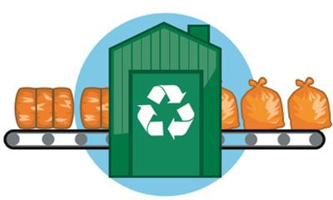
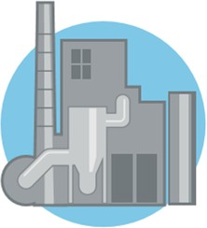
Full bags go into the curbside cart with recyclables
Picked up by local haulers as a part of normal service & schedule
Hard to recycle plastics get collected in the bag
Customers purchase Hefty® ReNew® product
Bags are sent to and pulled out at the front end of the local Material Recycling Facility (MRF)
Hefty® ReNew® orange bags and contents are converted to valuable resources
Sorted bags are baled and sent to approved end market conversion facilities
Notes:
Change layout

Slide 24
What have we accomplished?
#1 trashbag SKU at retail
89% consumers recommend ReNew Program
40% say they will use LESS plastic after participating
National footprint of end usages with positive Global Warming Potential
Reduced landfill costs
+2400 tons diverted from landfill
DOUBLED “trust in recycling” score after pilot participation
“Increased labor efficiency of 10-12% sorting EnergyBags” ​
(Western Resource Group)​
​
“Less screen cleaning time is required due to the amount of grocery bags contained within the EnergyBags.” ​
(WestRock Recycling, Atlanta)

Slide 25
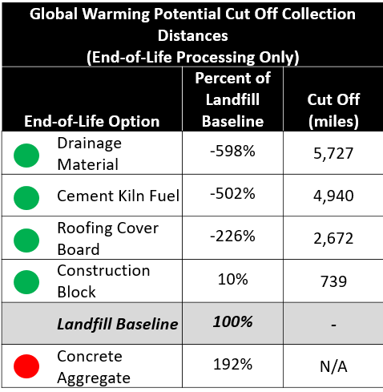
2022 LCA Expands Usage & Geography
Processing materials into roof cover board or drainage material have favorable GWP vs. Landfill and can travel +2k miles before exhausting GWP benefit
Processing materials into construction blocks is viable, but requires equipment to be located close to the program area
Processing materials into cement kiln fuel continues to be viable with favorable GWP vs. Landfill and national transport distance
Notes:
Why are we so excited about these 3 new mechanical uses? Because they not only drive positive PR but having more end markets also allow us to expand geographically. No longer restricted to have our program markets close to the end markets available.
(Roof cover board, drainage material, construction blocks and cement kilns)
The unfavorable GWP impact for concrete aggregate is due to the use of electricity, but as electricity grid changes regionally and throughout time, can be reassessed.
LCA scope constraints limited assessment of pyrolysis, or Advanced Recycling. Additional assessment of pyrolysis relative to other end markets will be available in next few months.
Now that we have end markets that allow us to ‘renew’ hard to recycle plastics… the name EnergyBag no longer fits…
benefits- we can now go to any market because we can ship the processed materials almost anywhere in the US before we exhaust the GWP!
(currently limited by cost of freight v. cost of end market…)
GWP Global Warming Potential
Pyrolysis process is sensitive to ambient conditions and material quality with current operations; use only if near program area
Each Advanced recycling process breaks down plastic polymers to their chemical elements to enable new plastic product or plastic-derived chemicals to be developed.
revised to reflect limitations around scope constraints encouraged us to look at a different assessment of pyrolysis relative to other end markets. There will be another summary coming out in a few months.
In summary, pyrolysis can lower GHG emissions of plastics (reduce CO2 equivalent emissions) by more than 100% compared to typical end-of-life processes (when accounting for displaced demand for chemical products and energy.)

Slide 26
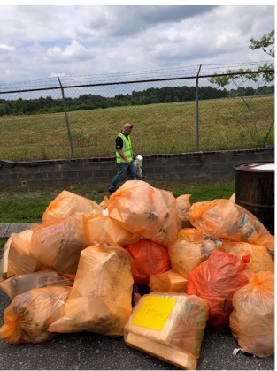
Hefty Audits Conducted June 2023 - Summary
An audit of 150 Hefty ReNew orange bags was conducted by MSW Consultants in June 2023 in each of the participating markets: Boise, ID; Chattanooga, TN; Omaha, NE; Cobb County, GA.
The average weight of the bags audited from all program locations was 1.9 pounds.
The overall contamination rate for non-targeted materials was 11.3%.
The materials of concern were #1 Thermoform PET, PET and Paper.
Citizens in participating communities understand the program requirements and embrace the opportunity to divert the targeted materials.
Contamination rates have declined since program launch in 2016.
The average weights of materials in the bags has increased since program launch.
Notes:
Voiceover? Or add bullet? Continuing education is important to maintain low contamination levels and to reduce the disposal of Paper products and #1 PET thermoforms in the orange bags.

Slide 27
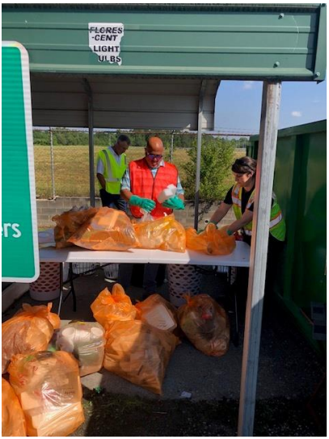
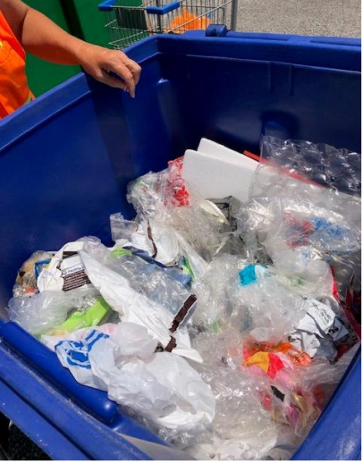
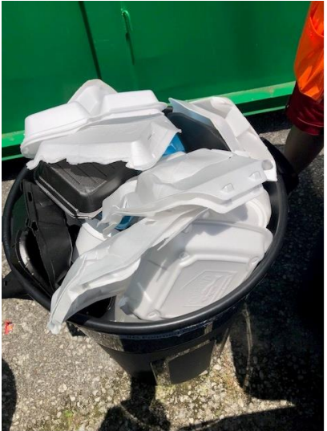
Material Categories and Definition
Material Category | Targeted
Orange Bags | Targeted
Bags/Wraps (PE) | Targeted
Other Flexibles (Multi-Material Laminates) | Targeted
#1 PET – Thermoforms | Non-Targeted
#1 PET – Bottles/Jars | Non-Targeted
#2 HDPE | Non-Targeted
#3 PVC | Non-Targeted
#4 LDPE | Targeted
#5 PP | Targeted
#6 PS Foam Polystyrene | Targeted
#6 PS Non-Foam Polystyrene | Targeted
#7 PLA and other | Targeted
Paper | Non-Targeted
Other Wastes | Non-Targeted
Notes:
Note that in the future we will NOT be targeting #5 PP

Slide 28
2023 Hefty ReNew Audit Composition by Material Type
 |  | Aggregate
Material Type | Material Category | Pounds | Percent
Targeted | Orange Bag | 38.23 | 3.31
Targeted | Bags/Wraps (PE) | 443.93 | 38.49
Targeted | Other Flexibles (Multi-material Laminates) | 203.82 | 17.67
Non-Targeted | #1 PET - Thermoforms | 48.54 | 4.21
Non-Targeted | #1 PET - Bottles/Jars | 15.98 | 1.39
Non-Targeted | #2 HDPE | 16.98 | 1.47
Non-Targeted | #3 PVC | 2.6 | 0.23
Targeted | #4 LDPE | 4.12 | 0.36
Targeted | #5 PP | 195.43 | 16.95
Targeted | #6 PS Foamed Polystyrene | 85.24 | 7.39
Targeted | #6 PS Non-Foamed Polystyrene | 40.4 | 3.50
Targeted | #7 PLA and Other | 11.89 | 1.03
Non-Targeted | Paper | 28.4 | 2.46
Non-Targeted | Other Wastes | 17.74 | 1.54
 | TOTALS | 1153.3 | 100.00
Material Type |  | Pounds | Percent
Targeted |  | 1023.05 | 88.71
Non-Targeted |  | 130.22 | 11.29
 | TOTALS | 1153.27 | 100.00
Average Weight of Bags |  | 1.9

Slide 29
How it Works - Video
29
Notes:
We have videos to introduce the program to municipalities and residents as well as MRFS. This audience for this video is intended to be consumers. This Any questions about this video – of would you prefer us to replay it

