Slide 1
Waste Reduction at the
University of Georgia
Waste Reduction Services, UGA Office of Sustainability
Georgia Recycling Coalition Conference - Fall 2023
Members of

Slide 2
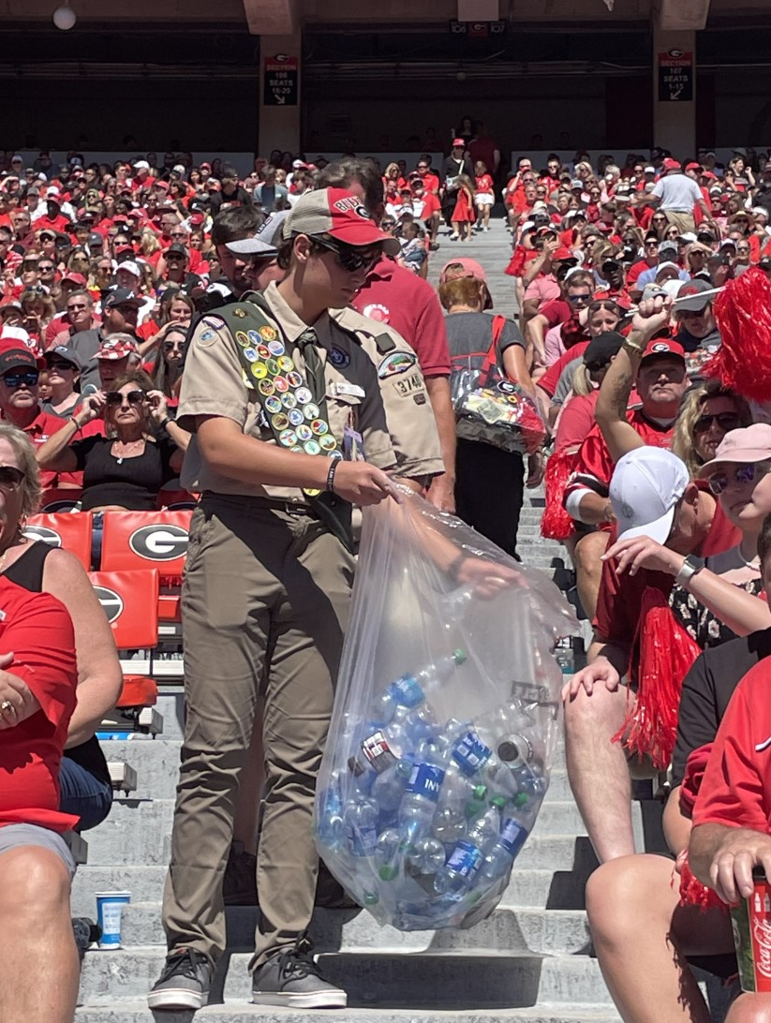
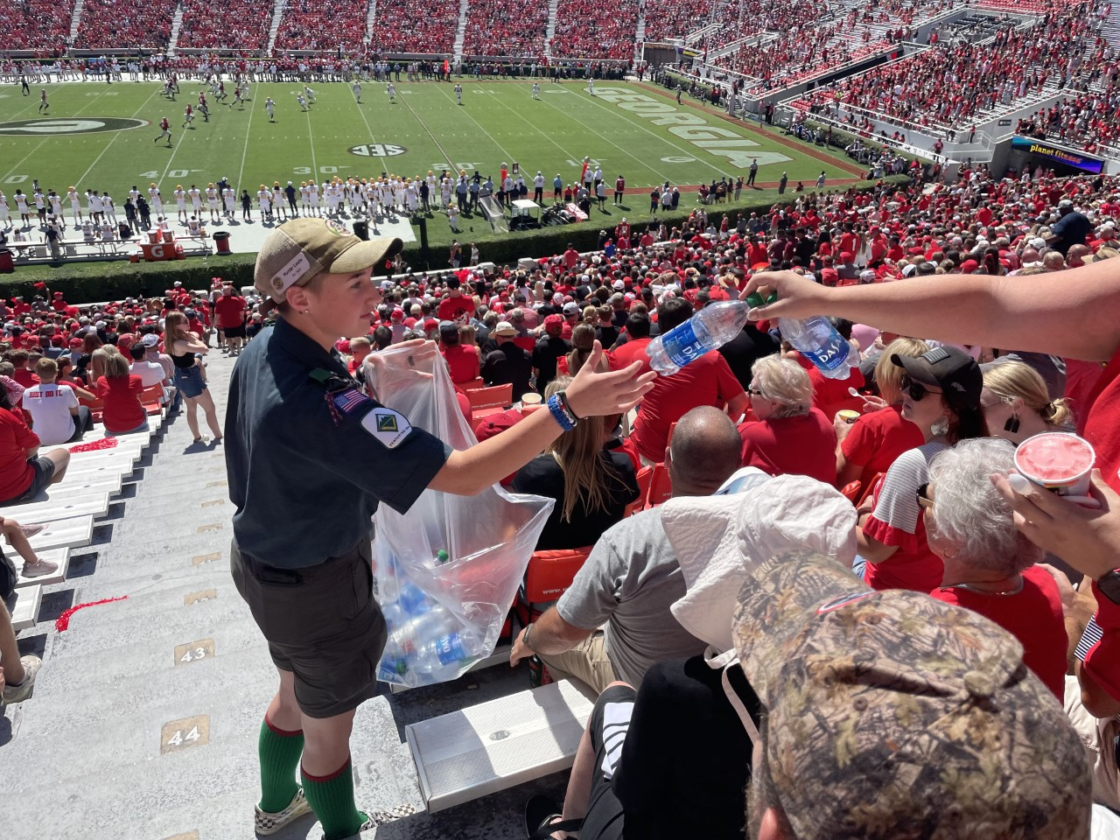
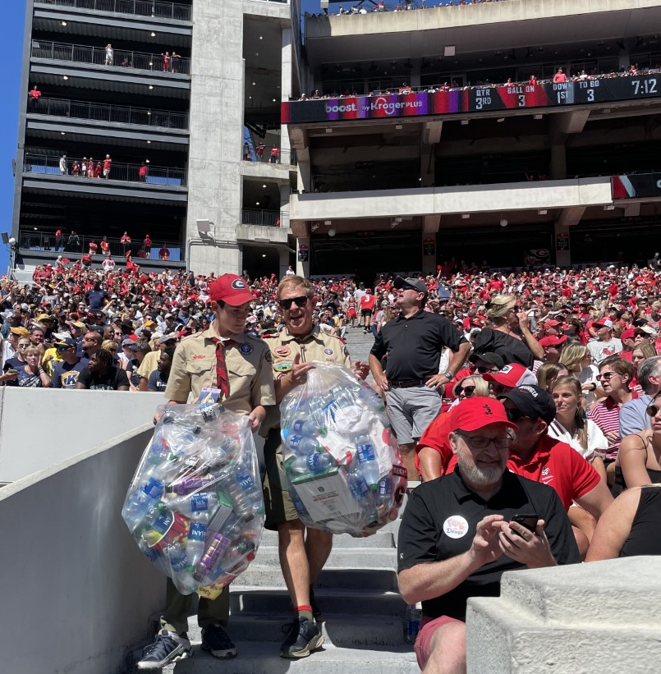
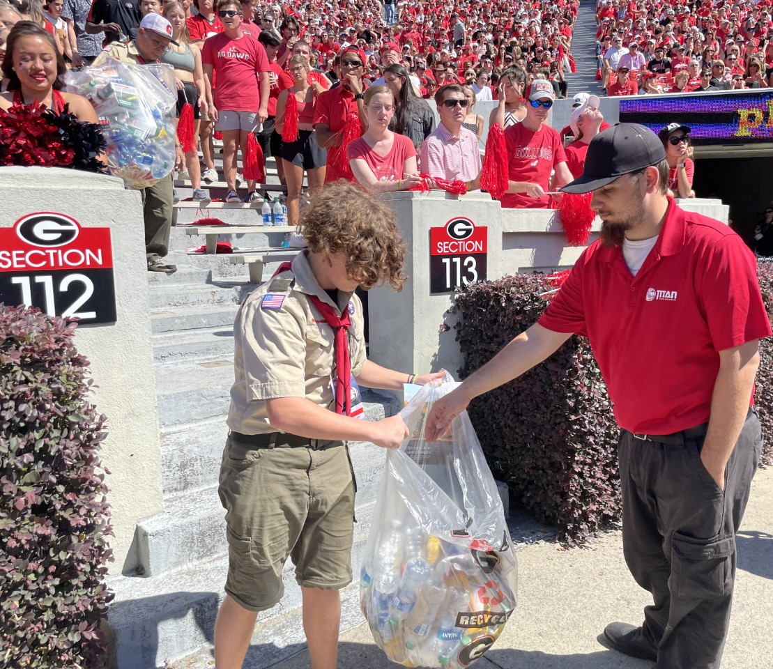
Notes:
MASON: 30 scouts from our local Northeast Georgia troops helped us collect empty bottles for recycling during the 3rd quarter of home football games. We are nowhere near the 90% or more “Zero Waste” diversion rate, but we strive to improve every game and every day, and their efforts have helped us divert 2-3 tons of recyclables from the landfill each home game (45,000 lbs per season), also shining a spotlight on recycling through the video board messaging and Public Address announcement.

Slide 3
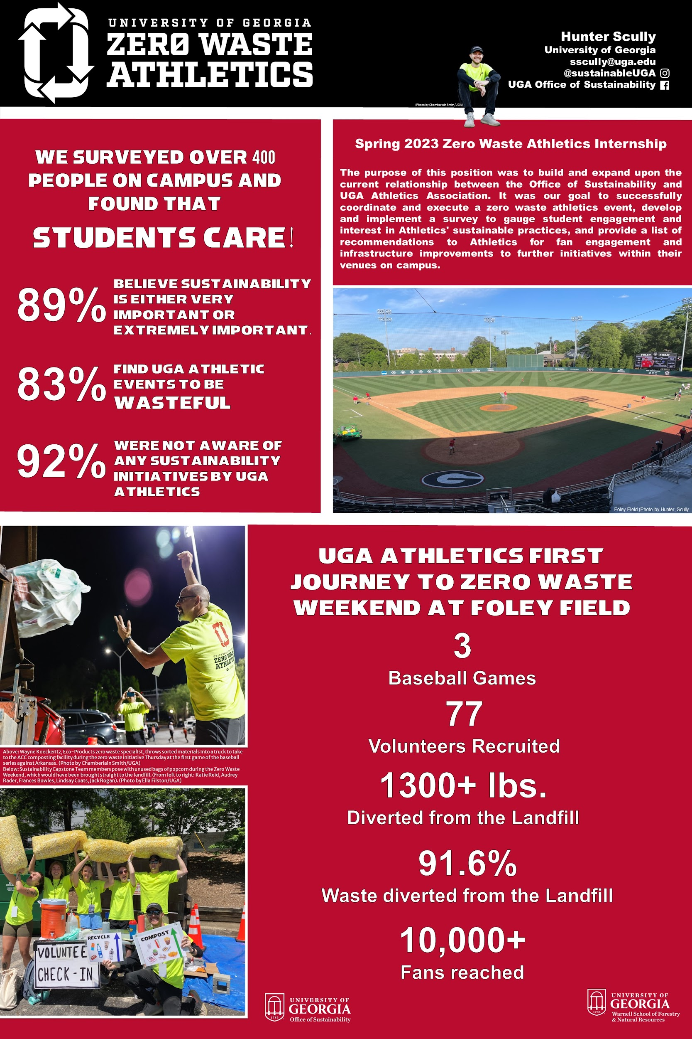
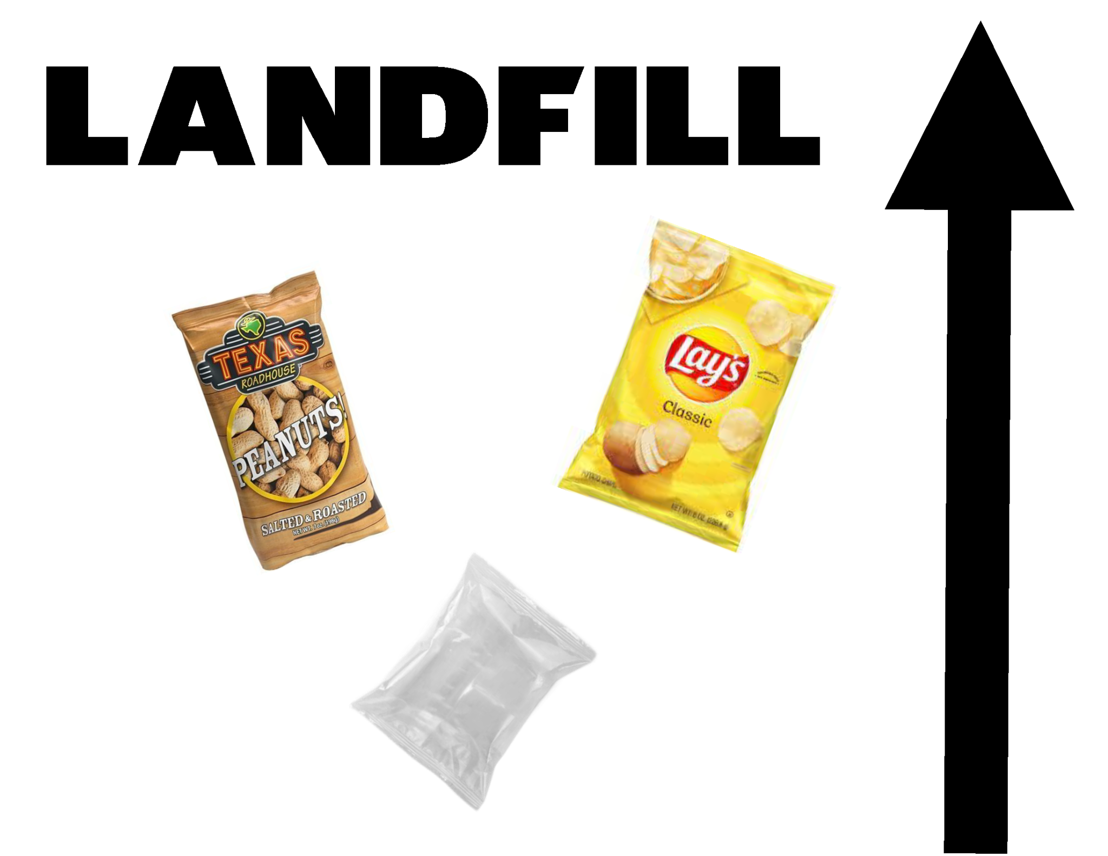
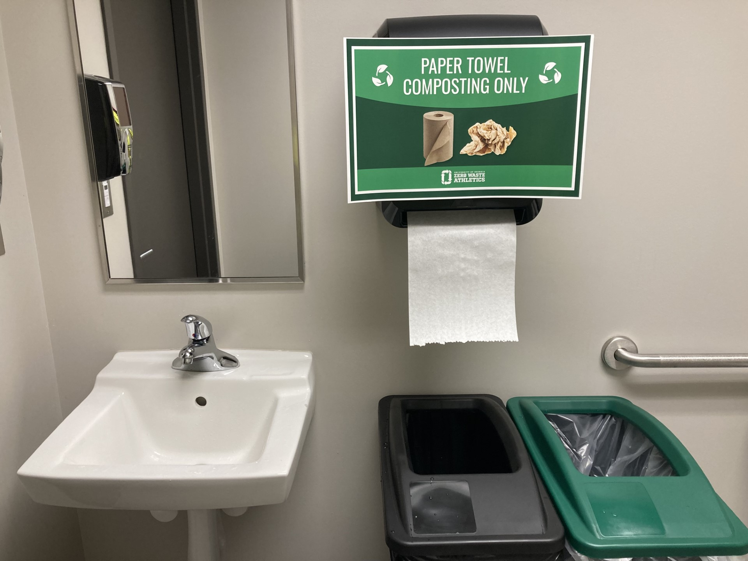

Slide 4
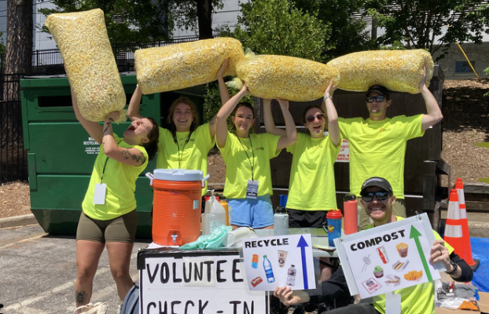
Zero Waste Baseball Series - April 2023
How we did it:
Researching Case Studies & Best Practices
Partnering with invested companies and organizations
Buy-in from UGA Athletic Association
Formation of zero waste team
Student / Fan Surveying
Sustainability ‘Student Green Fee’ Grant

Slide 5
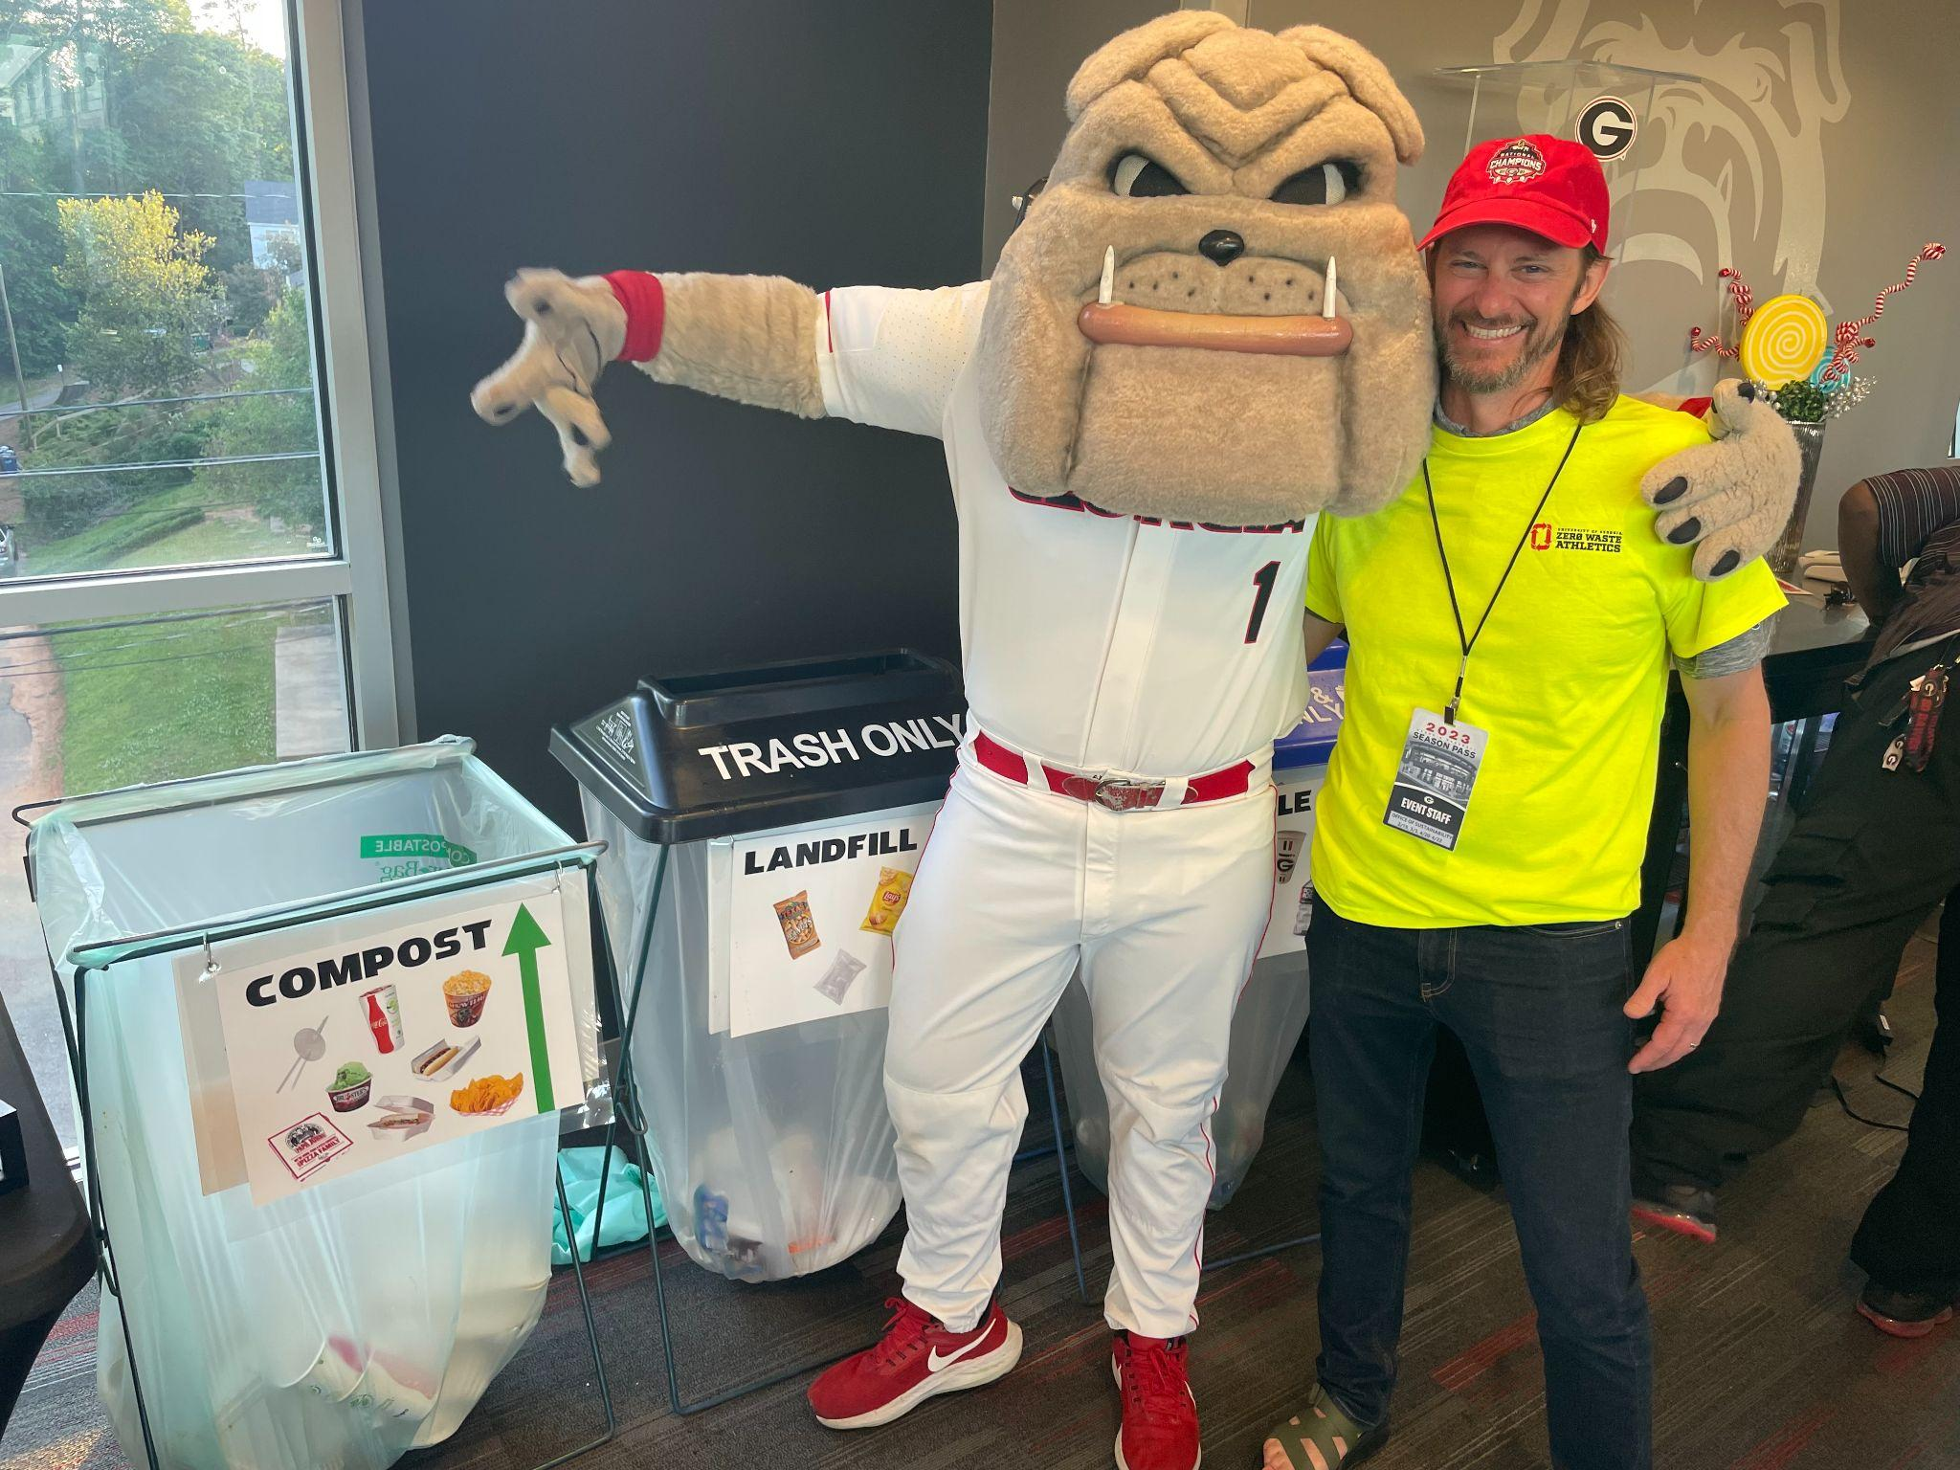
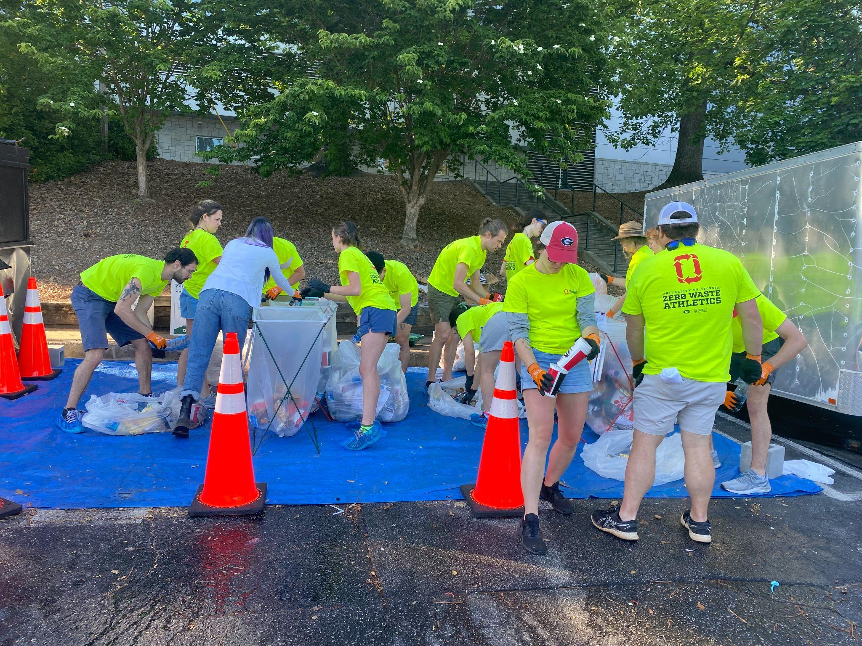
Zero Waste Baseball Series - April 2023
How we did it:
Volunteer Recruitment
Early Season Baseline Waste Audit
Meetings with: UGA AA (Facilities, Hospitality, Marketing, Aramark, Digital Media, Student-Athletes, Communications, Fan Engagement)
Sorting Materials
Coordination with ACC Solid Waste Department for collections, material guidance

Slide 7
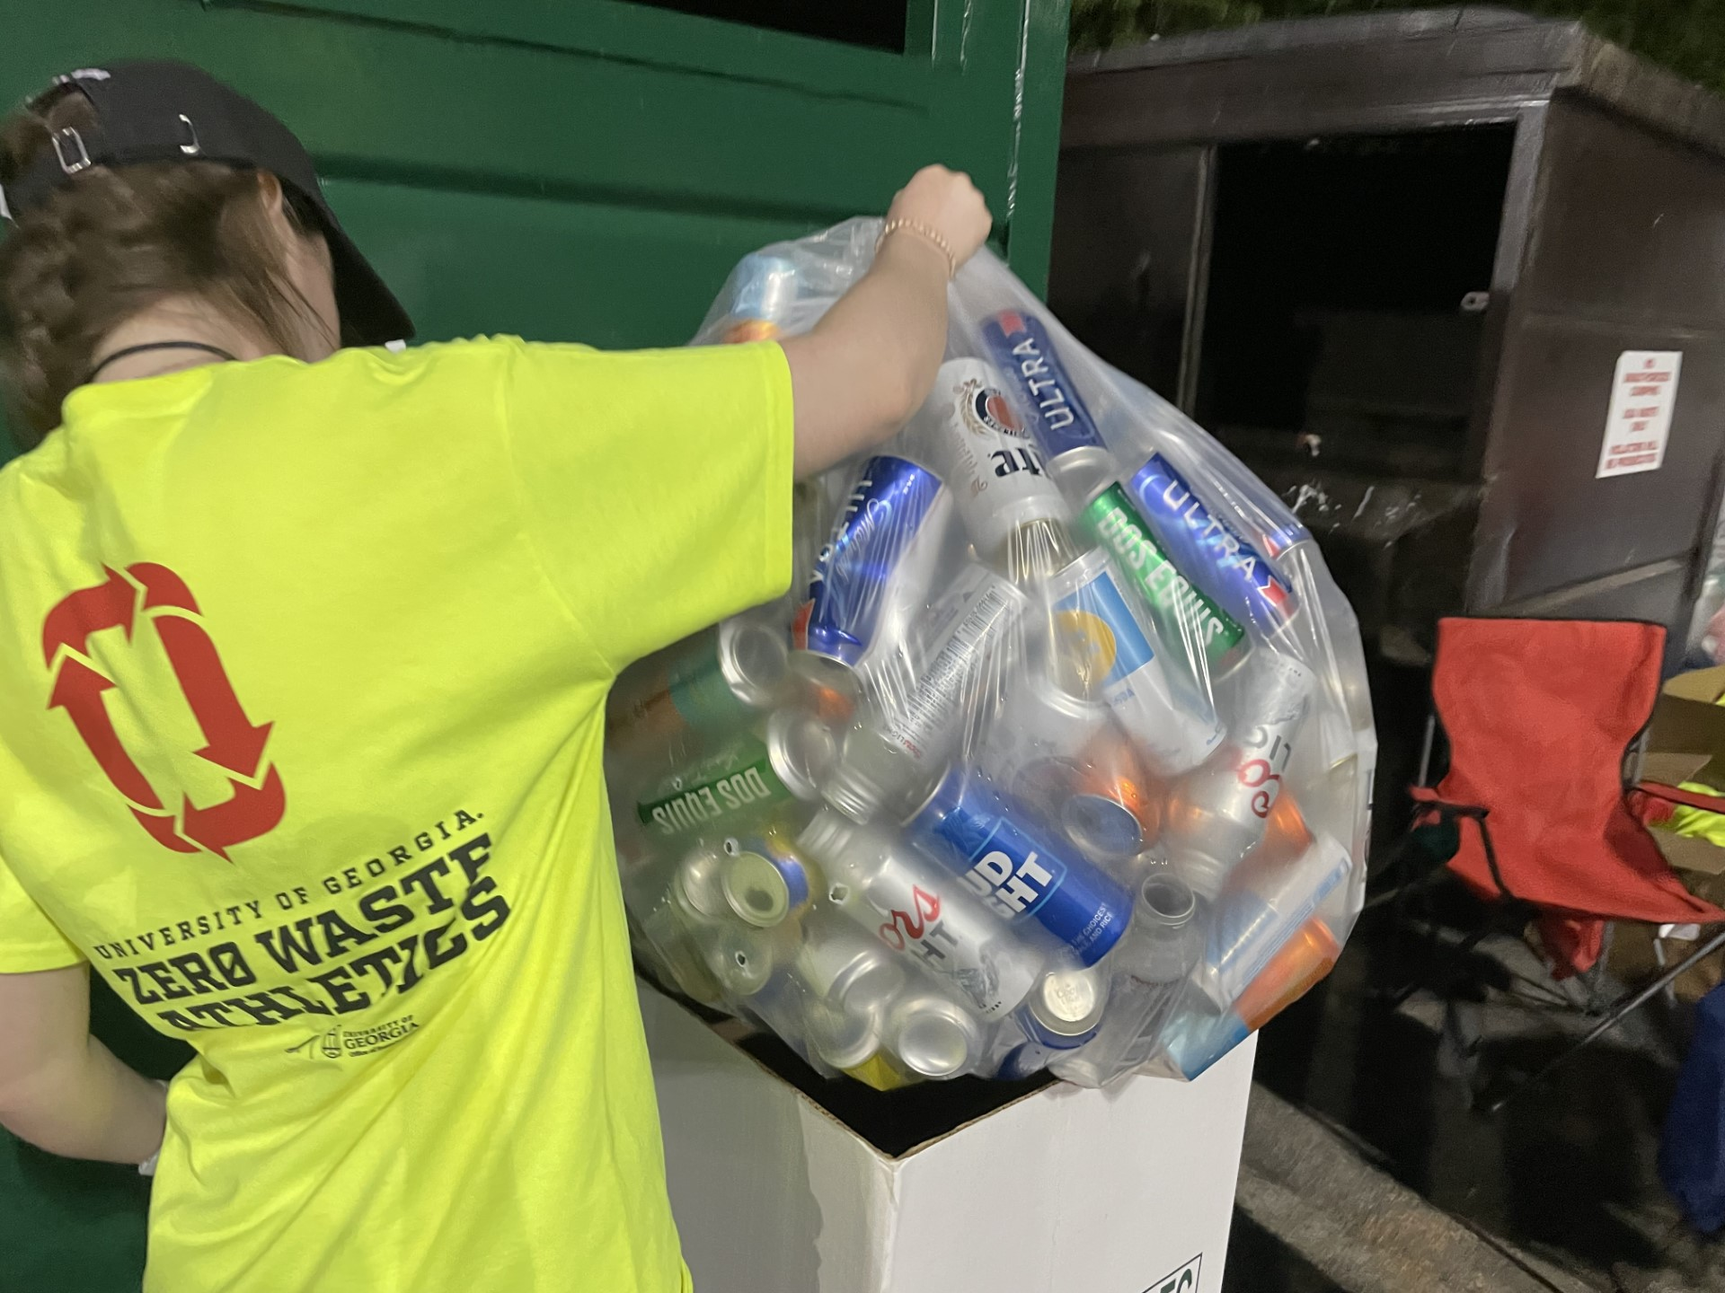
Why is this Important?
Huge Opportunities
Current home football waste approx. 20-45 tons/game → ~500,000 lbs. Total Per Season
Currently diverting around 10% from the ACC Landfill
Bin/Signage Shortcomings
Professors, Students, Departments, Organizations, and Sponsors WANT to engage and contribute
Opportunity to learn from peer universities

Slide 8
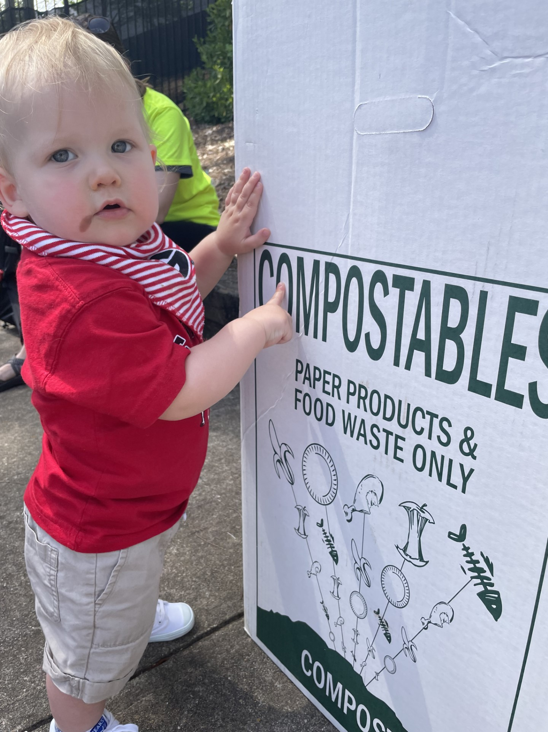
Why is this Important?
Key Survey Takeaways – Over 400 participants (ran 1 month)
92% were not aware of UGA AA sustainability initiatives
89% find sustainability to be either ‘very’ or ‘extremely’ important
89% would like to see change in venues regarding sustainability
83% find UGA Athletics events wasteful
Common requests for change by participants:
Better recycling signage and bins
Less single-use plastic items
Trash overflow exiting venues

Slide 9
Zero Waste Definition
TRUE stands for Total Resource Use and Efficiency
Facility certification through Green Business Certification Inc. (GBCI) and US Green Building Council (USGBC)
Defines Zero Waste as a minimum of 90% Diversion

Slide 10
Key ZW Baseball Series Stats
1,421 Total lbs.
3 home baseball games
77 volunteers recruited
1,302 lbs. diverted from landfill
91.6% diverted from landfill
10,000 fans reached
Fan/Media Engagement
Compost
Landfill
Recycle
775.6 lbs.
119.0 lbs.
526.6 lbs.

Slide 11
Key ZW Baseball Series Stats
1,421 Total lbs.
3 home baseball games
77 volunteers recruited
1,302 lbs. diverted from landfill
91.6% diverted from landfill
10,000 fans reached
Fan/Media Engagement
Compost
Landfill
Recycle
775.6 lbs.
119.0 lbs.
526.6 lbs.

Slide 12
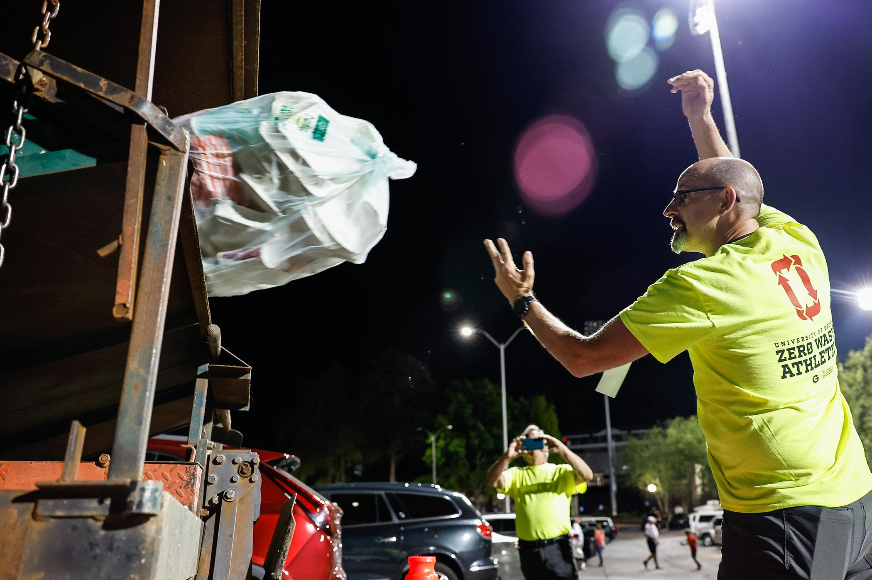
Lessons Learned
This is possible!
Continue to improve concessionaire-supplier relationship
Opportunities to improve concession items and save money
Number of volunteers could be reduced significantly
Other venues have realized 90%+ compliance with new bin signage after just a few games of “green team” education through stadium
Reduction in tipping fees by diverting to compost could offset additional investments
Notes:
Recruitment and coordination efforts were some of the most labor intensive of this entire project

Slide 13
"My capstone project pushed me in ways that I did not expect it to. Zero Waste to Foley field was truly one of the most rewarding projects I have ever worked on. Thanks to the hard work of our team and all of our partners, we were able to successfully divert 91.6% of waste away from landfills and to compost and recycling facilities . As a finance major, I had no idea I would be doing something so impactful coming to college. It was truly meaningful being able to give back to the university that has given so much to me these past four years."

Slide 14
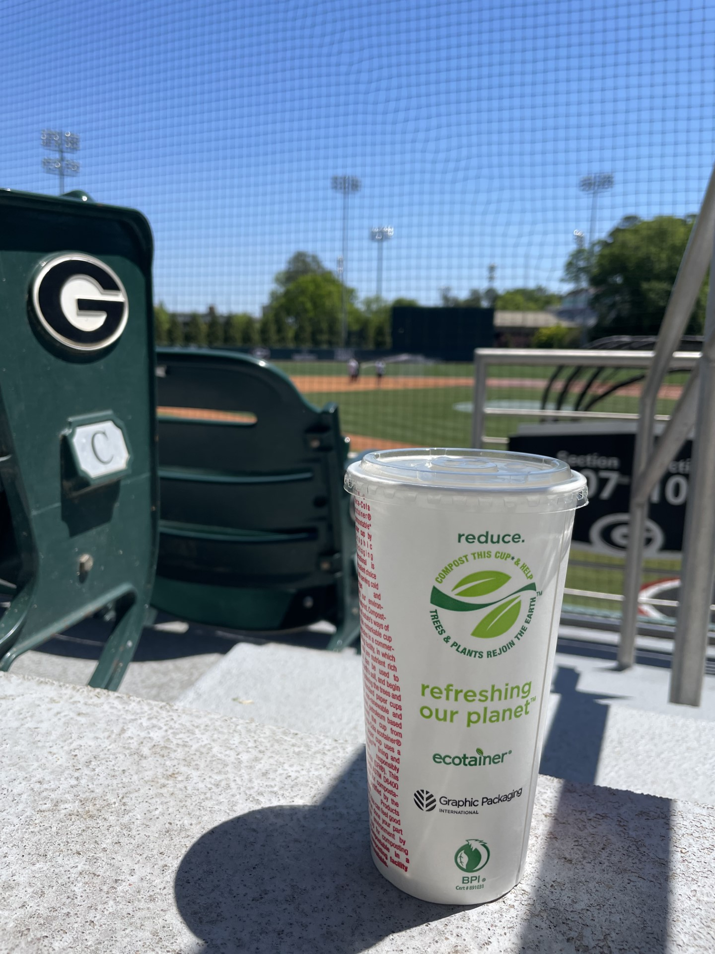
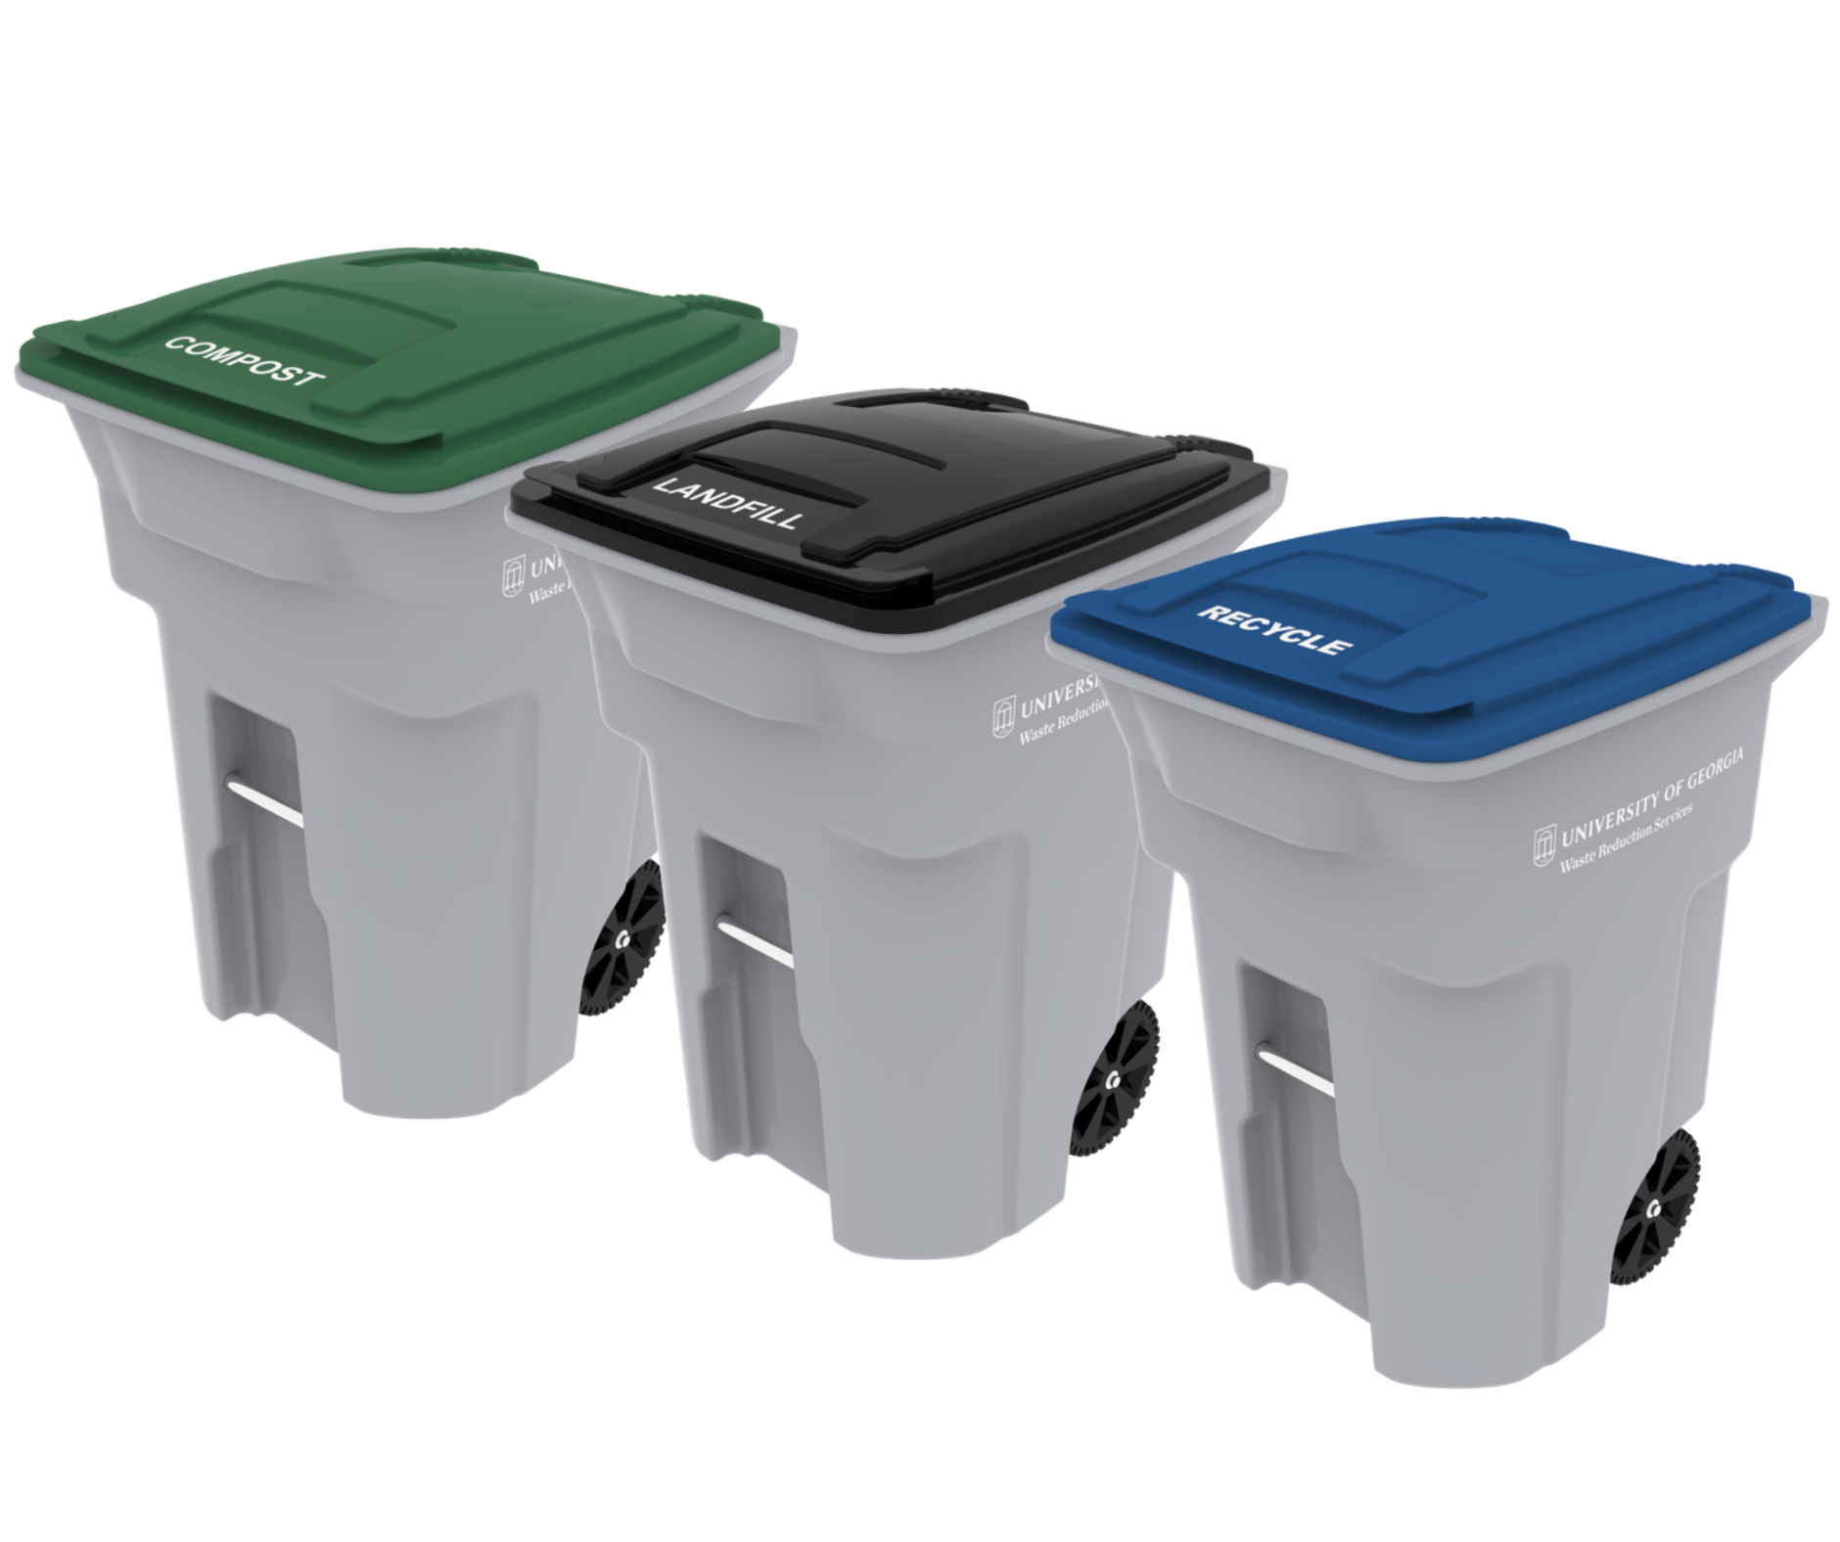
Recommended Next Steps
Zero Waste Soccer, Full Season
Interdisciplinary Certificate in Sustainability Fall capstone team
New bins & signage
Target concession items for permanent replacement
Sorting (organized through Fall Office of Sustainability Zero Waste Athletics Intern)
Campus-Wide Rollout of Consistent Infrastructure
Consistent Event containers, Rollcarts, Dumpsters
Cost Saving Opportunities
Compostable Coca-Cola ‘ecotainer’ cup and lid
Compostable straws
Nacho setup
Expand to Full Soccer-Softball Complex, Full Seasons
Implement lessons learned from Baseball Series and Soccer Season into Spring Softball Season

Slide 15
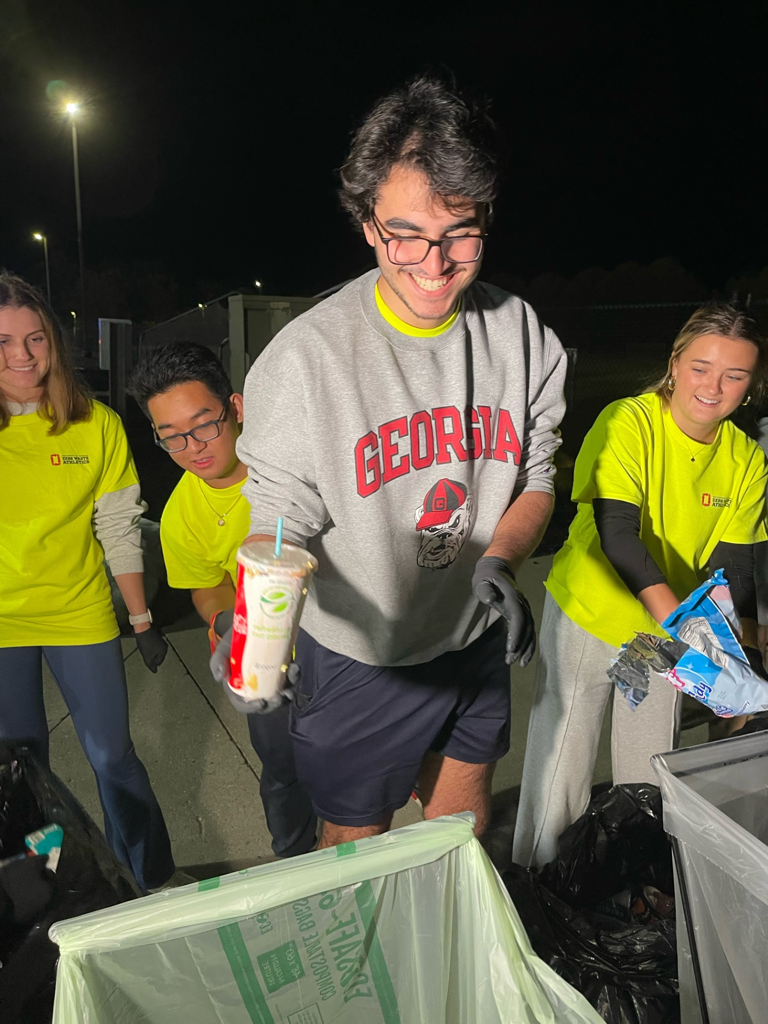
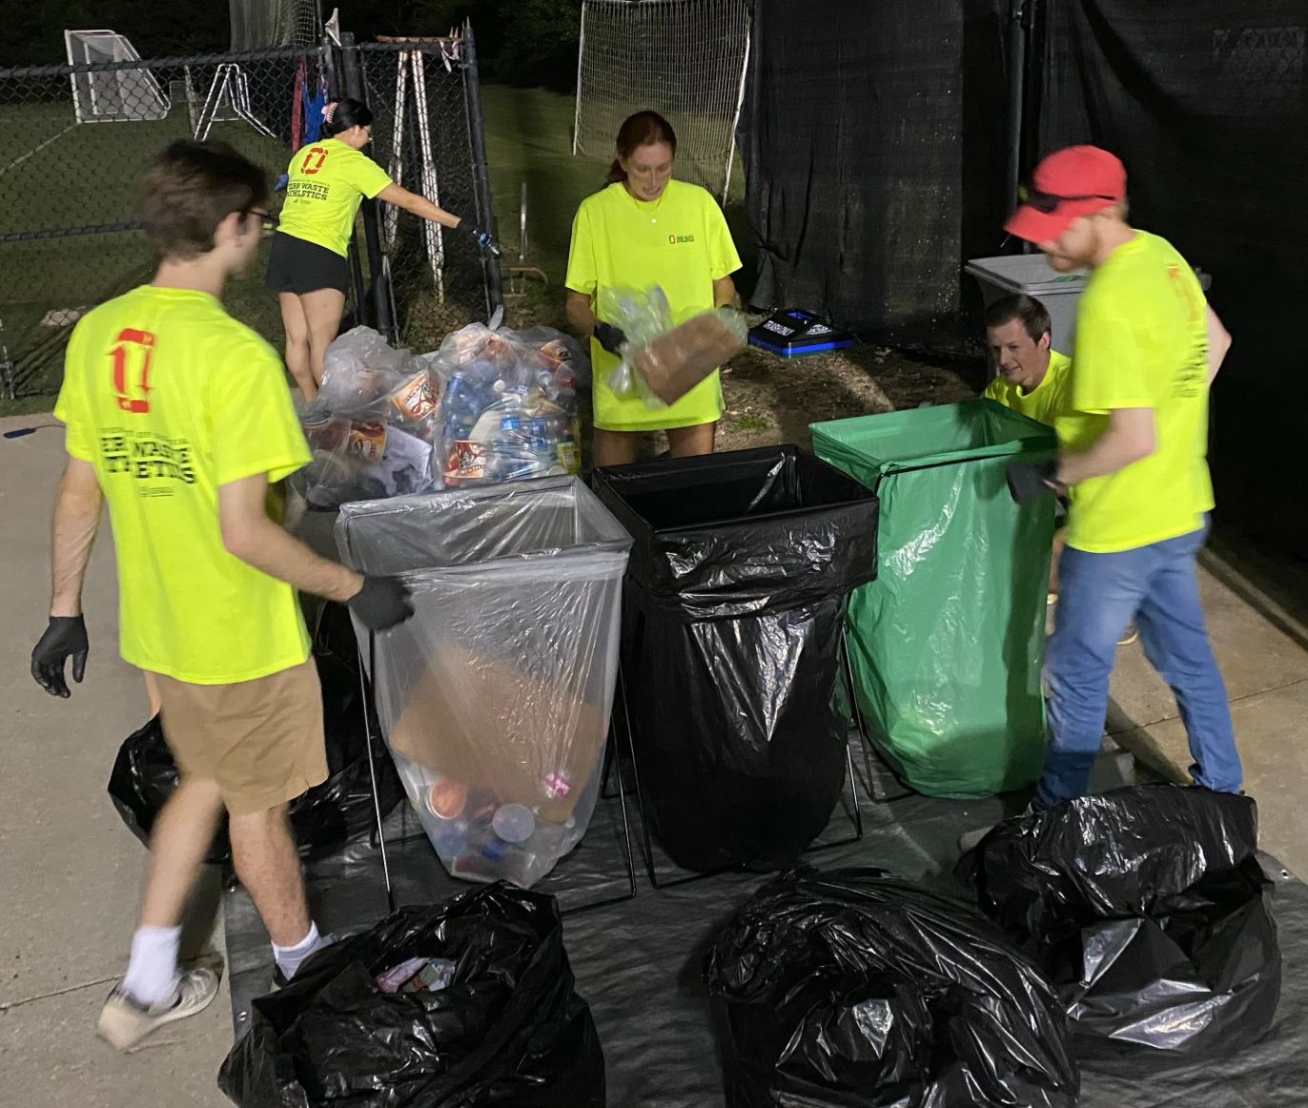
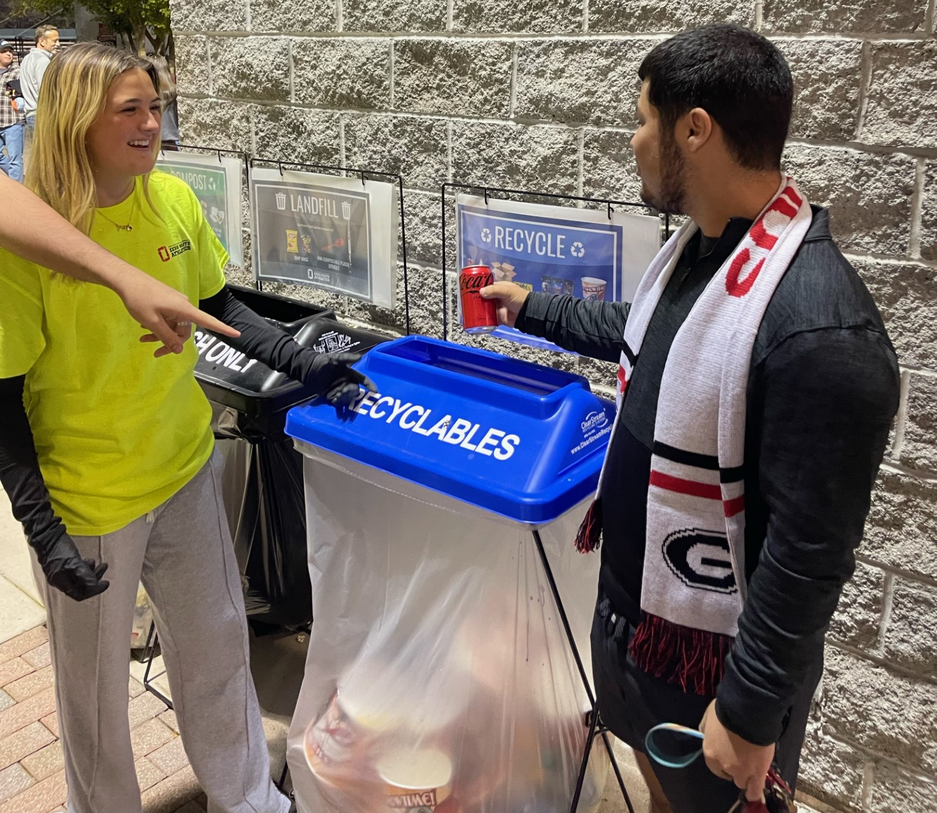
Zero Waste Soccer Season

Slide 16
Zero Waste Soccer Season
Diversion Rates from Audits this Season
vs Minnesota - 89.4%
vs Clemson - 90.9%
vs Florida - 86.3%
vs Kentucky - 90.2%

Slide 17
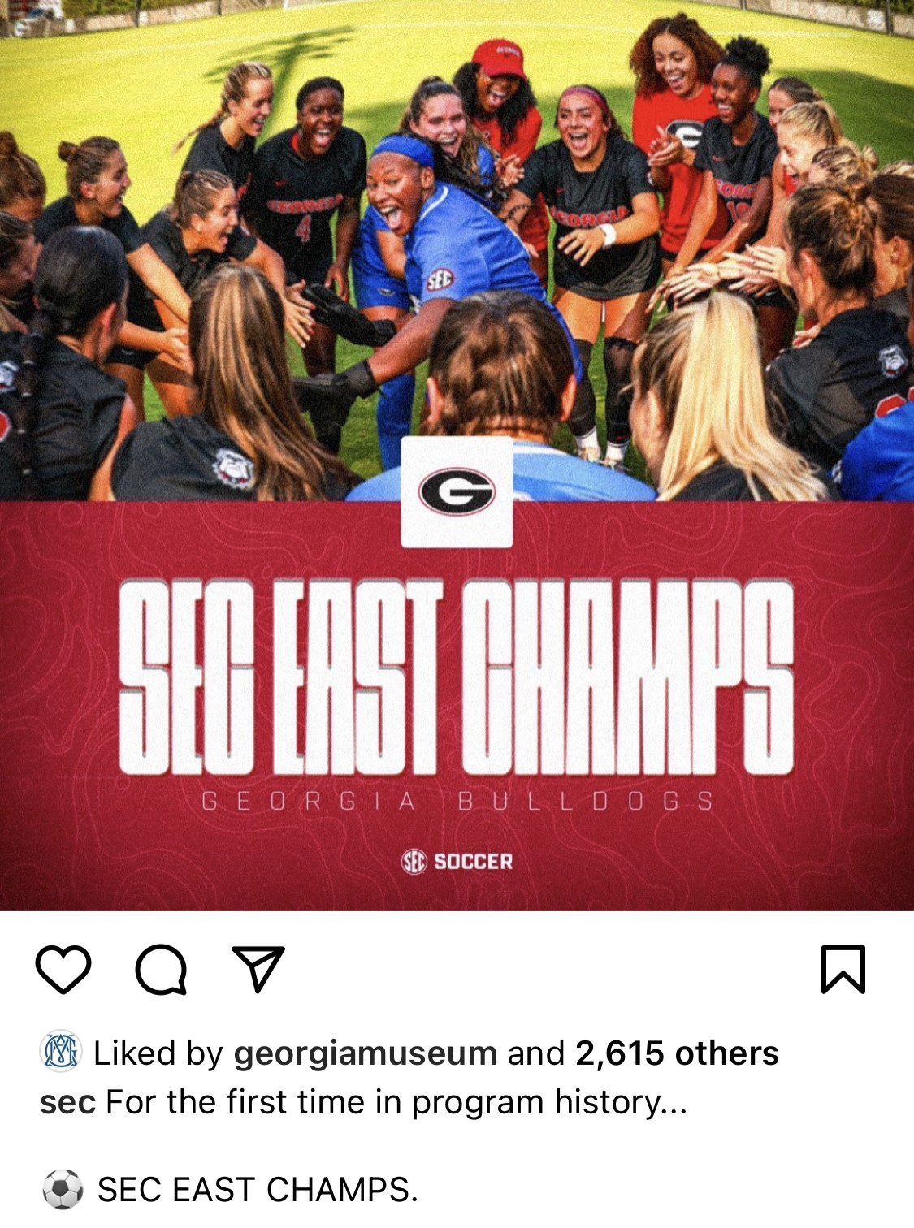
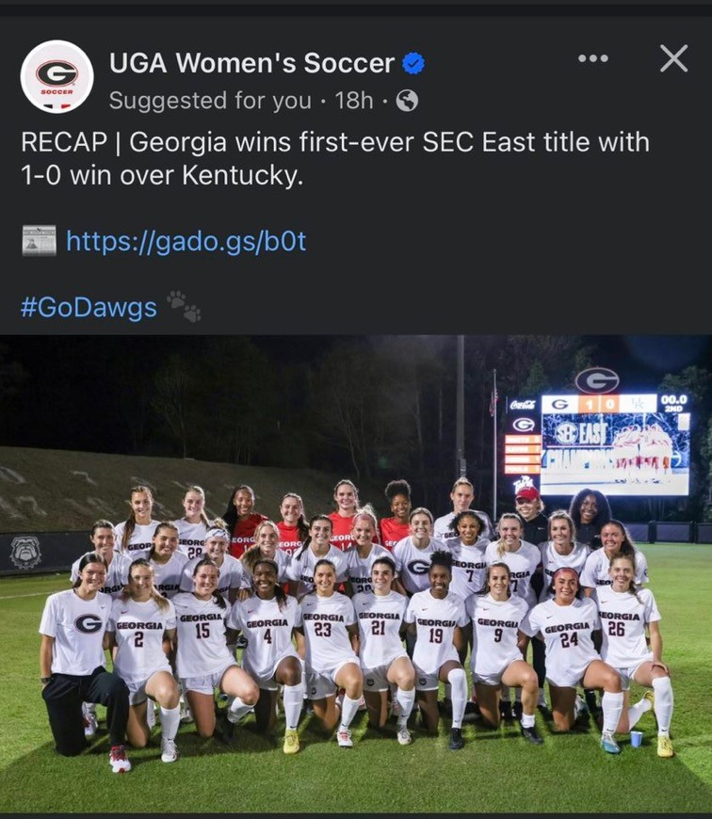
Zero Waste Soccer Season

Slide 18
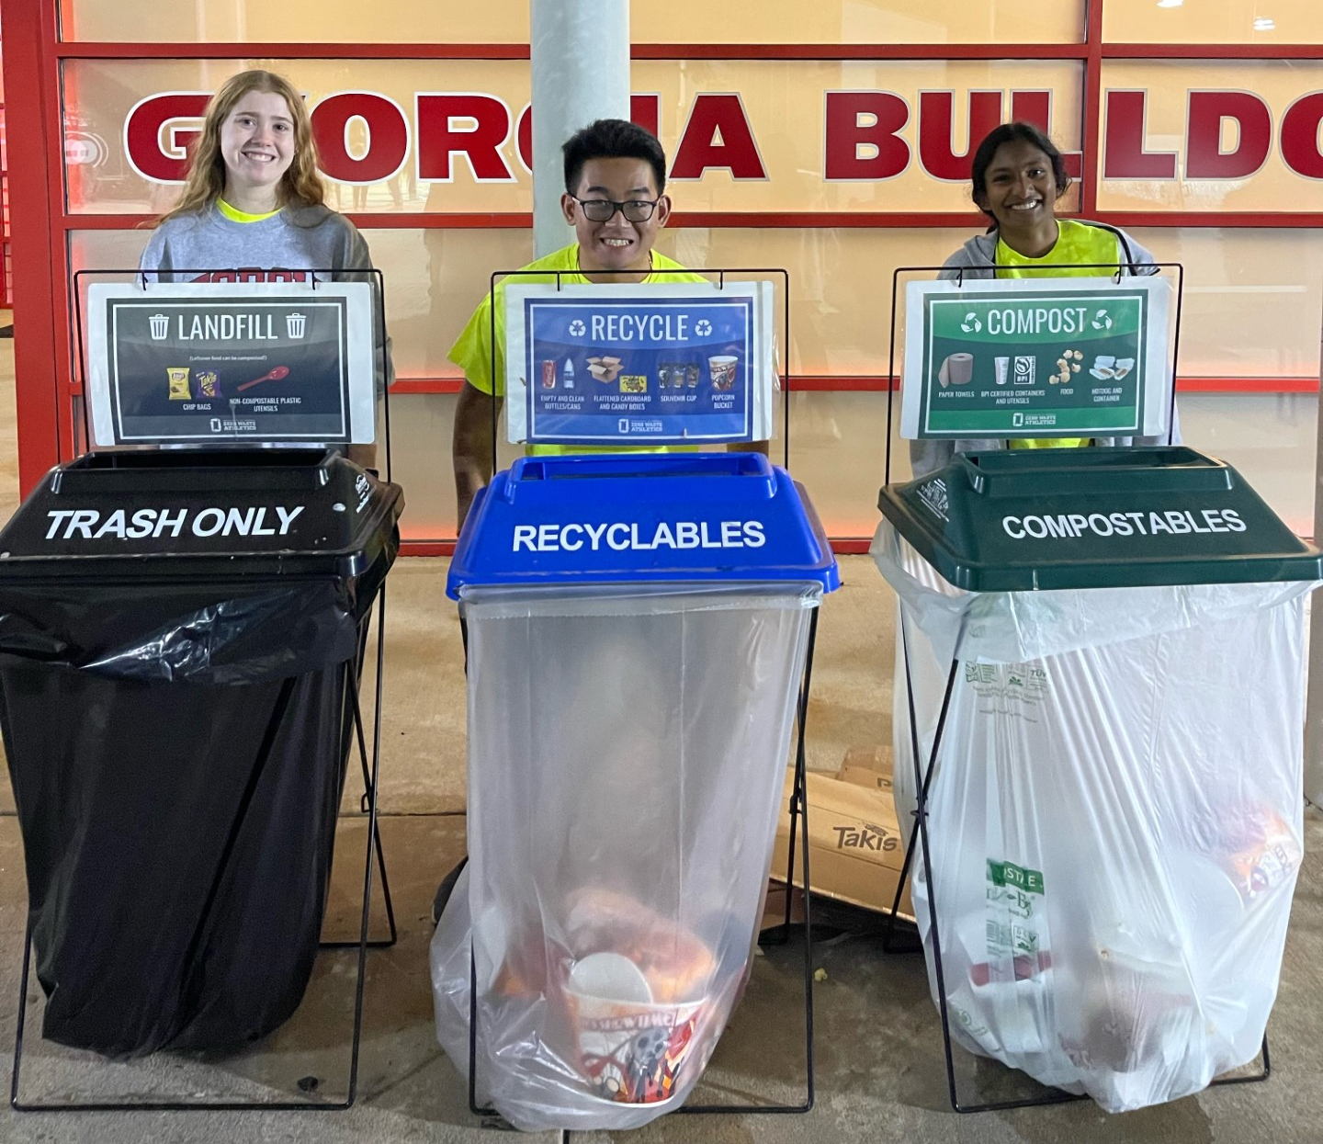

Slide 19
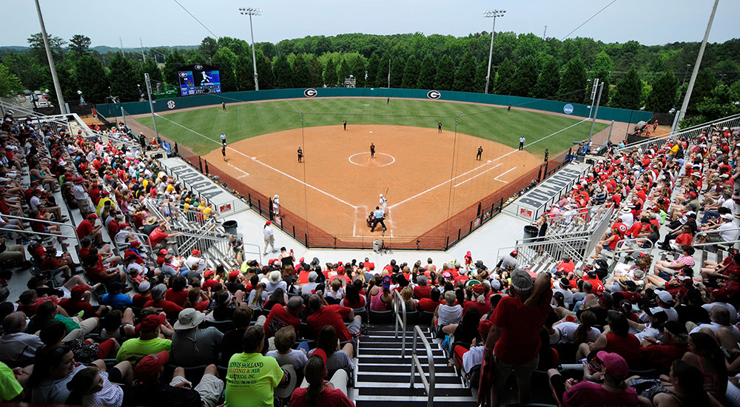
Next: Zero Waste Soccer-Softball Complex

Slide 20
Thank You!
Members of
Mason Towe
University of Georgia
Waste Reduction Services
Mason.Towe@uga.edu

