Slide 1
Battery collection & recycling grc’s 32nd annual Conference
October 2023
Mark Steadman

Slide 2
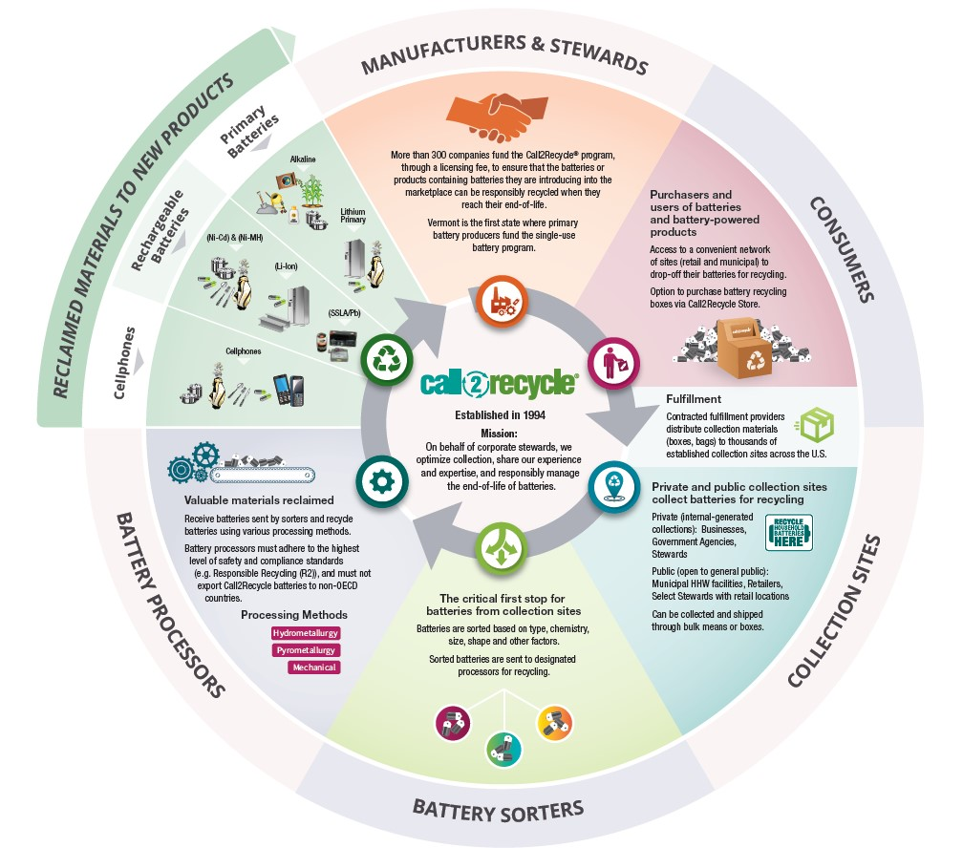
About
Call2Recycle

Slide 3
Climate action and other market forces are accelerating the adoption of batteries across all major sectors:
Batteries are EVERYWHERE!
Consumer Electronics
Outdoor Power Equipment
Smart Homes
Wearables
E-Transport
E-Bikes
EVs
Energy Storage
And….the list continues

Slide 4
Current State
2022 U.S. Battery Collections & Accessibility
84% of the U.S. population lives within 10-miles of an available Call2Recycle collection site
7.9+ Million Pounds
 | Single-Use (29%)
 | Li-Ion (38%)
 | Ni-MH (3%)
 | Ni-Cd (13%)
 | SSLA/Pb (17%)
150+ million pounds collected and recycled since inception

Slide 5
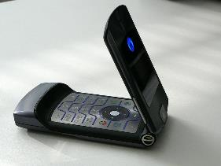
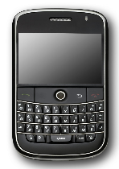
Then…
72% of the batteries collected by Call2Recycle were Nickel Cadmium

Slide 6
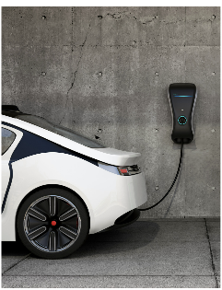
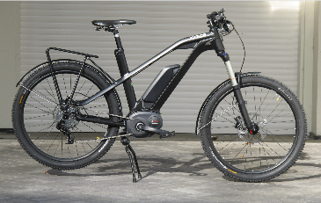
Now…
➲ 50% of the rechargeable batteries collected by Call2Recycle are Lithium Ion

Slide 7
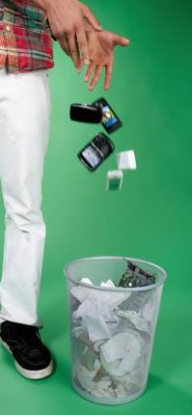
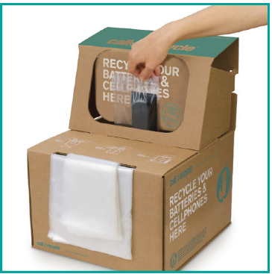
While Much Has Changed
The Same Question Remains
How Do We Change From This…
To This

Slide 8
What & How Batteries are Collected

Slide 9
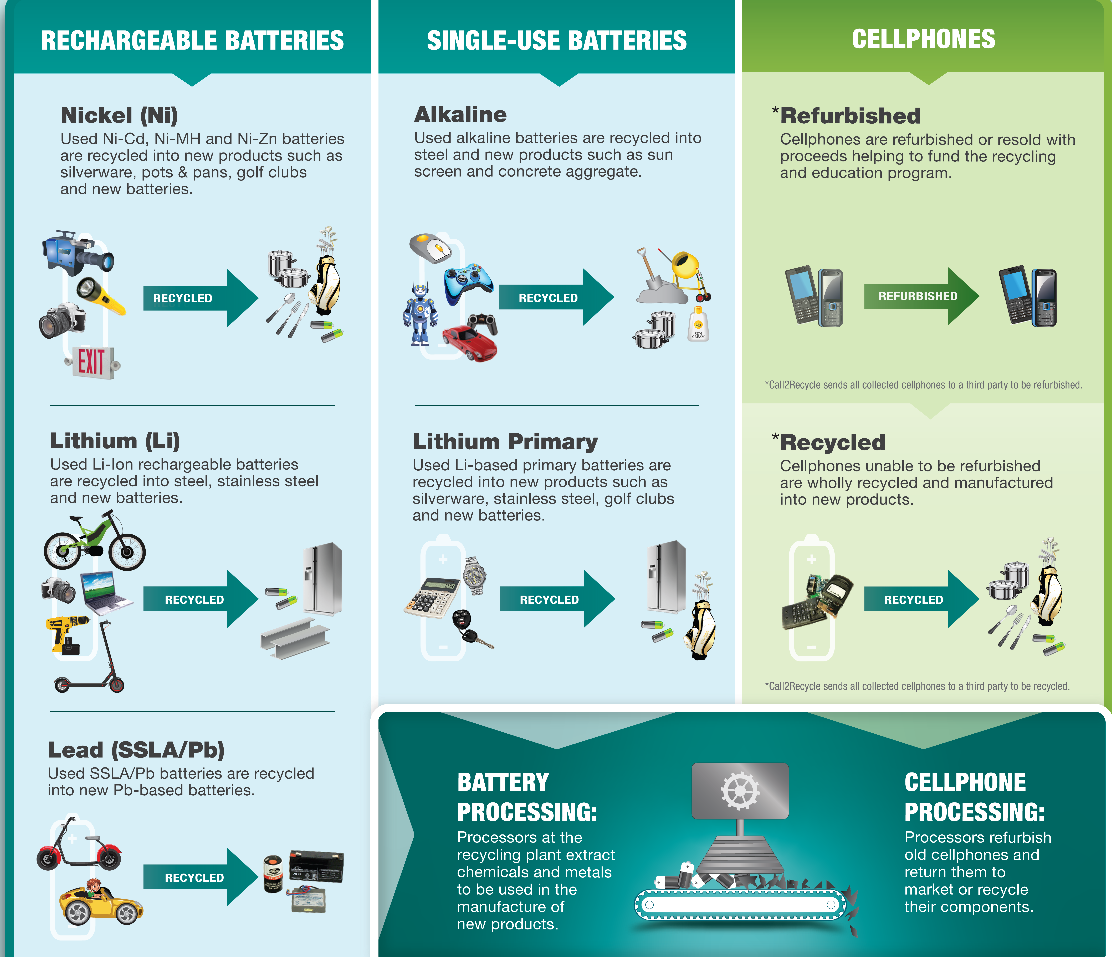
What Happens to the Batteries?

Slide 10
Current State
Battery Collection & Recycling
A Battery is a Battery is a Battery
If You Build It, Will They Come?
Education & Awareness Can’t Be A One-time Event
Educate the Youth – Start Early
You Can’t Reach Or Satisfy Everyone
It’s No Longer Just About ‘Saving The Planet’ – It’s That Plus So Much More

Slide 11
Safety

Slide 12
Signage, Newsletters, Mailers, etc.
Safety materials – training, videos, etc.
Batteries Can and Should be Recycled
Batteries Require Special Handling (i.e. terminal protection)
Should NEVER be Thrown in the Trash or Curbside Bin
Notes:
Many batteries hold a residual charge even when they appear dead. When this battery comes into contact with other batteries or metal, a spark or excessive heat can occur, and cause fires.
Yet the public may not be aware.

Slide 13
Electrification Transformation
Call2Recycle’s goal with the massive battery growth – across ALL sectors - is to make the safe disposal and responsible management as seamless as we have for consumer batteries for the past 28 years.
Call2Recycle administers the first, voluntary industrywide e-bike battery recycling program in the U.S. - the first transportation sector united under one battery recycling solution.
Supported by more than 50 e-bike brands with more than 1,900+ collection sites trained and actively accepting e-bike batteries for recycling.
Facilitating pilots with OEMs to design programs to safely and compliantly get batteries to processors.
Call2Recycle’s battery logistics management software platform, GreenTraxEV, allows users to safely and compliantly get batteries from multiple end points to processors or re-purposers.

Slide 14
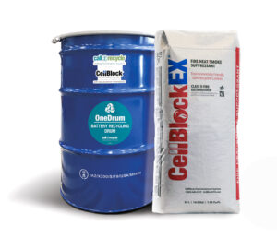
Say Goodbye to the hassle of sorting, bagging, and taping batteries.
Say Hello to
A safer solution for recycling mixed batteries
Product Spotlight
OneDrum
OneDrum™ allows the safe and efficient placement and transportation of large volumes of consumer single-use AND rechargeable batteries in one drum without sorting by chemistry, or individually bagging or taping any battery terminals (including coin cell batteries).

Slide 15
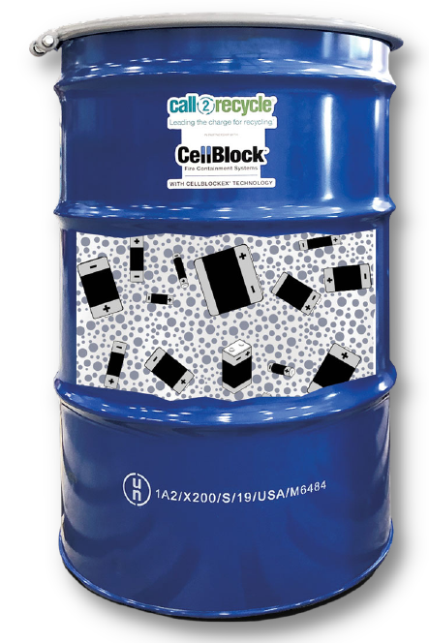
All-in-One Solution
Steel Drums
Includes packaging, labels, instructions, logistics, recycling, tracking, and reporting of consumer batteries.
Packing Group 1 55-gallon steel drums keep contents safe and secure during transit
Product Spotlight
OneDrum
CellBlockEX®
Special Permit
The innovative fire extinguishing agent made from recycled glass cushions batteries and protects against short circuits
Ships under a US DOT-issued Special Permit, exclusive to OneDrum, which fully satisfies US DOT’s requirements for transporting mixed batteries, while eliminating the need for 49 CFR training, special paperwork, or labeling.
Scan for more info

Slide 16
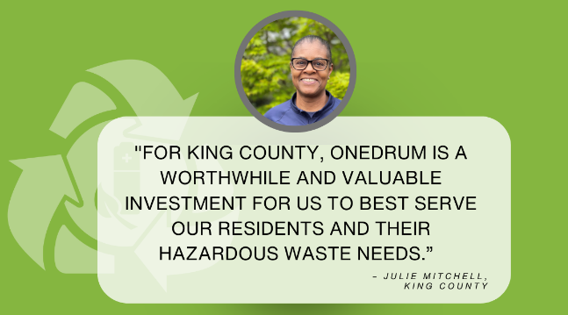
What Our Customers Say About OneDrum!
Product Spotlight
OneDrum

Slide 17
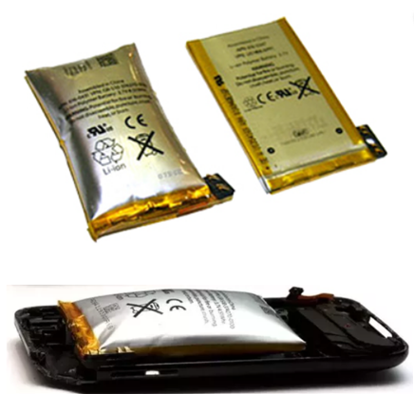
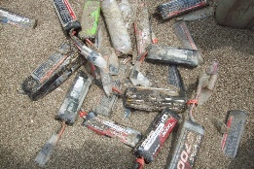
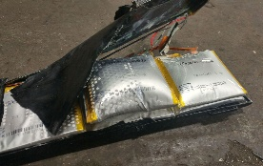
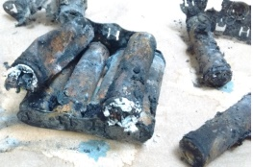
Proper Handling of Batteries – Damaged, Defective, Recalled
Damaged Lithium Ion or Lithium primary batteries CANNOT be placed in normal collection bins. Immediately place in absorbent, non-flammable material (sand or cat litter) in a cool, dry area.

Slide 18
Managing Batteries at YOUR Facility
Damaged, Defective or Recalled (DDR) Lithium-Ion Battery Management
Medium DDR Li-Ion Battery Recycling Pail
Large DDR Li-Ion Battery Recycling Pail
CellSafe DDR Li-Ion Recycling Kit
CellSafe DDR Li-Ion Recycling Kit
55-Gallon DDR Li-Ion Battery Drum

Slide 19
The Path Forward
While not all recycling is the same, working collectively to ‘simplify the task’ can optimize results.

Slide 20
Q&A

Slide 21
Mark Steadman msteadman@call2recycle.org Corporate headquarters: 1000 Parkwood Circle, Suite 200 Atlanta, GA 30339

