Slide 1
UPDATES ON OUR NEW BIL GRANT PROGRAMS and latest tools
Kim Charick
EPA Region 4 October 2023

Slide 2
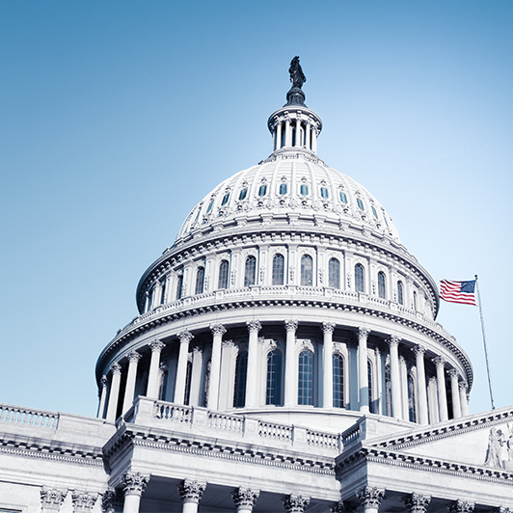
Congressional and Policy Drivers: EPA’s Materials Management Work
2020 Save Our Seas 2.0 Act: provides authority for grants, reports and a strategy on post-consumer materials management
EPA released the Draft National Strategy to Prevent Plastic Pollution in April 2023!
FY2020 Congress directed EPA to produce a national recycling strategy
EPA released the National Recycling Strategy: Part One of a Series on Building a Circular Economy in November 2021!
2021 Bipartisan Infrastructure Law: provides funding for solid waste infrastructure and education and outreach projects across the U.S.
$275 million in funding for the Solid Waste Infrastructure for Recycling Grant Program
$75 million in funding to support Recycling Education and outreach Grant Program
$25 million in funding to support battery recycling initiatives
More to come:
FY 2021 Appropriations asked EPA to collect data on recycling and single-use plastics and estimate the costs needed to modernize U.S. recycling infrastructure
Dec. 2020 Government Accountability Office (GAO) report includes actions for EPA to strengthen recycling and recommend future policies
Several other pieces of proposed legislation related to recycling

Slide 3
Support for building a circular economy

Slide 4
Recycling infrastructure and education & Outreach Grants
Solid Waste Infrastructure for Recycling (SWIFR)
Grants for Communities
Grants for States and Territories
Grants for Tribes and Intertribal Consortia
Recycling Education & Outreach (REO)

Slide 5
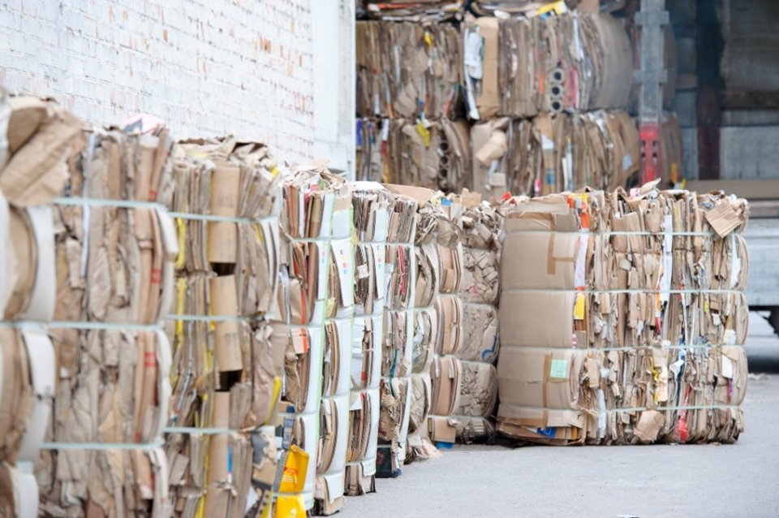
Recycling infrastructure Grants (SWIFR)
First Round of Awards – $100+ million in new BIL-funded awards to support recycling infrastructure in all states, territories, and the District of Columbia
$32.1 million awarded to all 50 states and 6 territories
$73 million awarded to communities, ranging from big cities to small rural communities.
Grant recipients to invest in a range of project types, including:
Purchase of new fleet of recycling collection vehicles to provide curbside pickup
Construction of recycling drop-off stations in rural areas
Updating statewide solid waste management or circular economy plans and performing waste characterization studies
Construction to establish new composting facilities or increase capacity at existing facilities.
76% of funding for communities will benefit disadvantaged communities

Slide 6
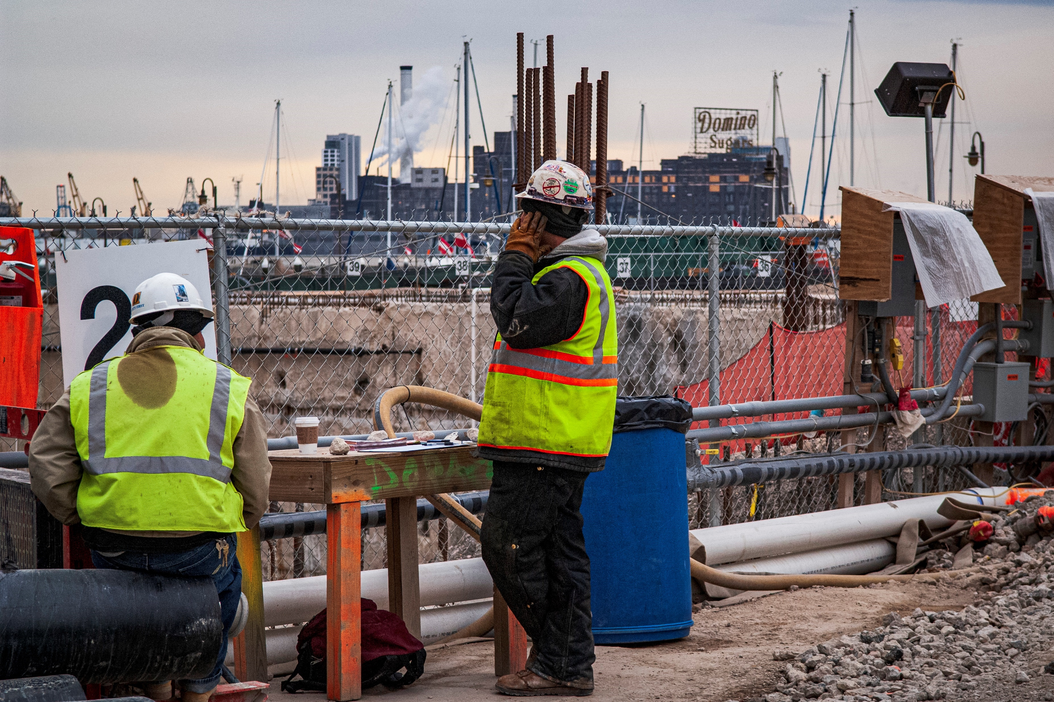
Recycling infrastructure Grants (SWIFR)
The SWIFR Grants are:
largest EPA investment in recycling infrastructure in over 30 years
most significant investments in support of the National Recycling Strategy
Other objectives include:
reducing greenhouse gas emissions and keeping valuable materials out of the landfill
Creating jobs in both rural and urban communities
Improving local waste management systems and strengthen supply chains

Slide 7
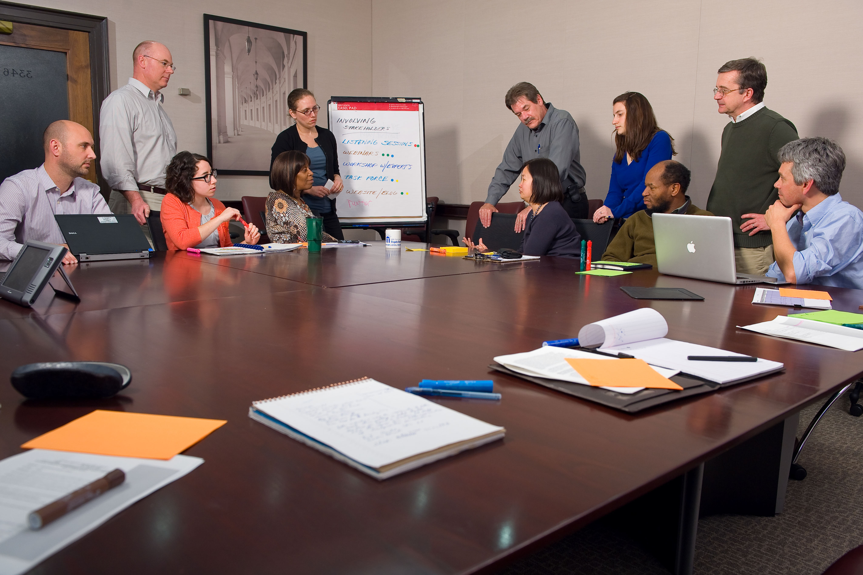
SWIFR Grants for States and territories: additional information
Fund projects to support planning, data improvement, and implementation needs for state and territorial government solid waste management programs
Every single U.S. state, the District of Columbia, and five U.S. territories opted into this program, demonstrating a real need for recycling funds beyond physical infrastructure and equipment
56 grants awarded non-competitively totaling $32.1 million. Individual grant amounts range between $370,000 and $760,000
Eligible activities include:
Planning: develop or update plans to advance post-consumer materials management
Data collection: develop, strengthen, and/or implement comprehensive data collection efforts that demonstrate progress towards EPA goals
Implementation: support the state-led implementation of plans to advance post-consumer materials management

Slide 8
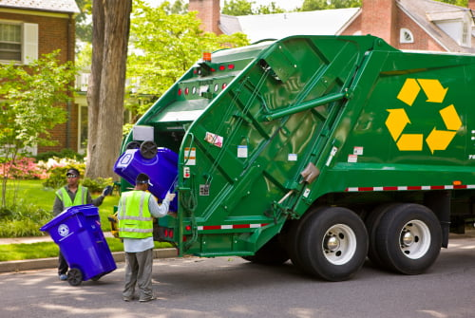
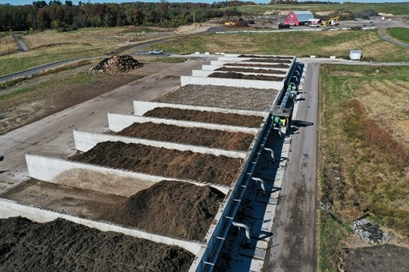
GRANTS For Communities: additional information
Improve local waste management systems, meeting Congress’s goal to create a stronger, more resilient, and cost-effective U.S. municipal solid waste recycling system.
25 total selections were made totaling $73,278,901. Individual awards range between $500,000 and $4,000,000.
Eligible entities include local governments, cities, counties, townships, villages, parishes, districts, and any other entity that provides proper documentation that they are considered political subdivisions of their respective state
Example selected projects include:
Purchasing a new fleet of recycling collection vehicles and bins to provide curbside pickup to communities that do not have access.
Constructing recycling drop-off stations in rural areas where curbside collection is not feasible.
Infrastructure improvements to materials recovery facilities, such as construction of new buildings or new equipment, such as optical sorters, balers, etc.
Construction to establish new composting facilities or increase capacity at existing facilities.

Slide 9
SWIFR Grants for Communities: Selected PROJECT TYPEs

Slide 10
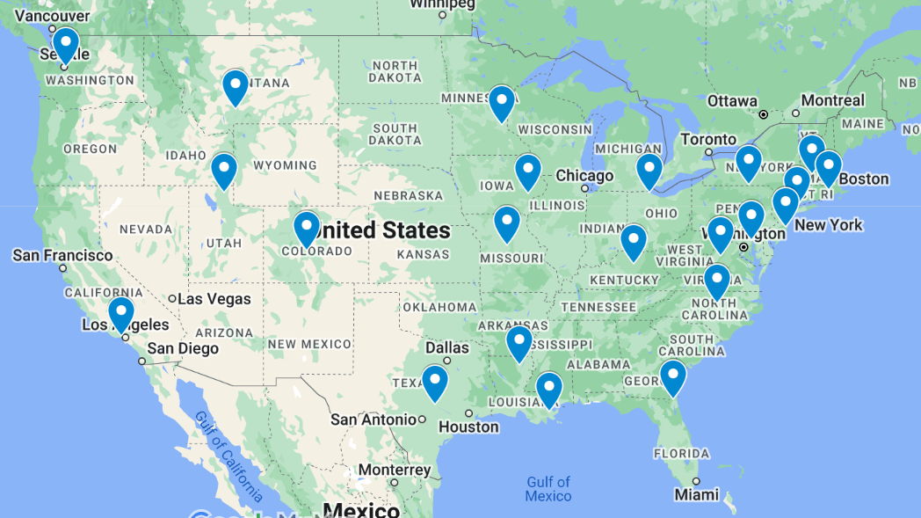
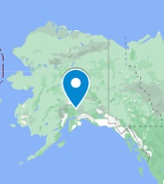
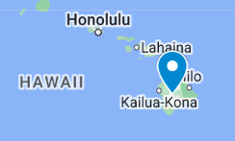
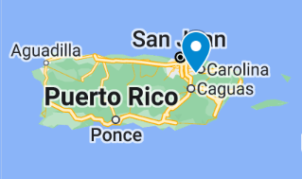
SWIFR grants for communities: 25 total SELECTIONS
https://www.epa.gov/infrastructure/recycling-grant-selectees-and-recipients

Slide 11
SWIFR Grants for COMMUNITIES - SELECTIONS
Region 1
Stamford, CT. Project Title: Food Scrap Collection / Compost Programs and Other Recycling
Greenfield, MA. Project Title: City of Greenfield Solid Waste Infrastructure for Recycling
Providence, RI. Project Title: Recycling and Food Waste Infrastructure Program
Region 2
Elmira, NY. Project Title: Construction of the Elmira Lake Street Composting Facility
County of Ocean, NJ. Project Title: Ocean County (NJ) MRF Improvements Project
Trujillo Alto, PR. Project Title: Expansion Project of the Recycling Program
Region 3
Baltimore, MD. Project Title: Bowley’s Lane Composting Facility
Shenandoah Valley, VA. Project Title: Expanded and Optimized Recycling Services in the Northern Shenandoah Valley
Region 4
Lexington, KY. Project Title: Lexington-Fayette Recycling Facility Improvement Initiative
Durham County, North Carolina. Project Title: Convenience for All: Renovation and Re-design of the Redwood Convenience Site in Eastern Durham County
Nassau County, Florida. Project Title: Nassau County Recycling Process Enrichment Program
Region 5
Toledo, OH. Project Title: Lucas County Materials Recovery Facility Development
Minneapolis, MN. Project Title: North Transfer Station Revitalization
Region 6
West Monroe, LA. Project Title: Recycling Infrastructure Expansion Project for West Monroe, LA
Austin, TX. Project Title: Austin Reuse Warehouse
New Orleans, LA. Project Title: New Orleans Recycling Expansion and Planning (NOREAP)
Region 7
Iowa City, IA. Project Title: Iowa City Compost Facility Improvements and Expansion
MO. Project Title: The East Central MO Recycling Project.
Region 8
Bozeman, MT. Project Title: Bozeman Sustainable Organics Management Program
Chaffee County, CO. Project Title: Chaffee County Colorado Transfer Station and Materials Recovery Facility
Logan, UT. Project Title: Development of the Logan Regional Green Waste Facility
Region 9
Los Angeles, CA. Project Title: Calabasas Anaerobic Digestion Facility Project
Hilo, HI. Project Title: Reuse infrastructure for a city-scale reusable food ware and refillable bottle system
Region 10
Seattle, WA. Project Title: Establishment of a Salvaged Wood Warehouse to Support Local Circular Wood Economy
Matanuska-Susitna Borough, AL. Project Title: Mat-Su Compost Program
https://www.epa.gov/infrastructure/recycling-grant-selectees-and-recipients

Slide 12
Upcoming selection Announcements
EPA intends to announce the results of the Recycling Education and Outreach Grants and the SWIFR Grants for Tribes and Intertribal Consortia later this year!
__________________________________________________________________________
Recycling Education and Outreach Grants:
Up to 25 recipients
~$30M in total funding ($250k - $2.0M per individual grant award)
SWIFR Grants for Tribes and Intertribal Consortia:
Up to 60 recipients
~$40M in total funding ($100k - $1.5M per individual grant award)

Slide 13
Region 4: Durham County
Project Title: Convenience for All: Renovation and Re-design of the Redwood Convenience Site in Eastern Durham County
Location: Durham County, North Carolina
Funding Requested: $3,313,200
Project Track: Track 1
Project Description: The project is for the renovation and re-design of the Redwood Convenience Site in Eastern Durham County. The renovation of the site will address the increase in resident use of the site, improve sustainability measures, and expand the site and its service offerings.
Other considerations:
Project is Shovel Ready
Top scoring application in the competition
Administrator’s hometown
This project will result in 2 jobs created as a direct result of the grant.

Slide 14
Region 4: Nassau County
Project Title: Nassau County Recycling Process Enrichment Program
Location: Nassau County, Florida
Funding Requested: $500,000
Project Track: Track 1
Project Description: If funding is offered through this grant, Nassau County will undertake a comprehensive optimization of the intake stream and outflow process at the County’s Convenience Recycling Center in Callahan and Recycling Collection Site in Yulee. Additionally, the County will implement a multifaceted public education county-wide campaign to increase
awareness about available recycling facilities; in addition to educating the public on the requirements for recycled materials and proper use of the facility.
Other considerations:
Project is shovel ready
Geographically diverse and top scoring application in Florida.

Slide 15
Region 4: Lexington-Fayette Urban County Government
Project Title: Lexington-Fayette Recycling Facility Improvement Initiative
Location: Lexington, KY
Funding Requested: $1,800,000
Project Track: Track 1
Project Description: Lexington-Fayette seeks to bolster their role in the regional materials management system by ensuring the municipally owned and operated Materials Recovery Facility (MRF) operates efficiently and reliably. By introducing new technology into strategic locations on the sorting line, the facility can collect more types of material from the surrounding region thereby reducing contamination, processing it efficiently and cost effectively, and producing feedstock to transport to local, regional, and statewide markets to contribute to the circular economy.
Other considerations:
This project is not anticipated to result in additional jobs created as a direct result of the grant.
The project benefits disadvantaged communities. “…the City of Lexington and Fayette County are comprised of 23 CEJST identified areas, with a population of 77,815 residents. The surrounding waste shed, Figure 2, is comprised of 99 CEJST identified areas, with a population of 103,501 residents.”

Slide 16
Excess Food Opportunities Map
Supports nationwide diversion of excess food from landfills.
The map displays the locations of nearly 950,000 potential excess food generators. These include:
correctional facilities, educational institutions, farmers markets, food banks, healthcare facilities, hospitality industry, food manufacturing and processing facilities, food wholesale and retail, restaurants and food services.
The map also displays the locations of communities with source separated organics programs, refrigerated warehousing and storage facilities, and about 6,500 potential recipients of excess food. These include:
anaerobic digestion facilities, composting facilities, food banks.
Found here: https://www.epa.gov/sustainable-management-food/excess-food-opportunities-map
Notes:
The interactive map identifies and displays facility-specific information about potential generators and recipients of excess food in the industrial, commercial and institutional sectors and provides estimates of excess food by generator type.

Slide 17
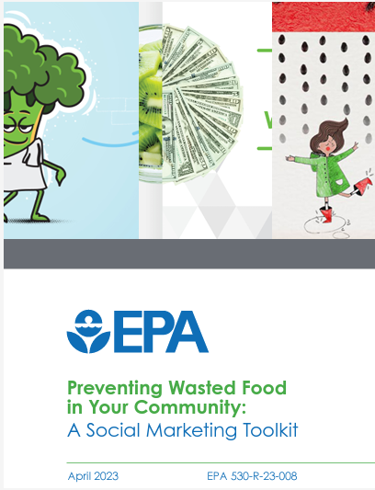
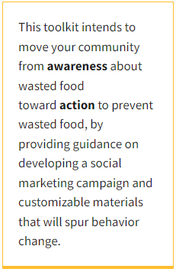
Preventing Food Waste in Your Community: A Social Marketing Toolkit
This tool can help entities who want to start a behavior change campaign to prevent food waste in their communities.
It is designed to be used by governments and NGOs to assist their constituents in reducing wasted food in the home.
Provides downloadable, customizable campaign materials
Found here: https://www.epa.gov/sustainable-management-food/forms/preventing-wasted-food-your-community-social-marketing-toolkit
Notes:
This is also a new resource for states, territories, local governments, tribes, and nongovernmental organizations who wish to create composting campaigns in their communities.

Slide 18
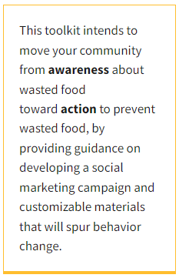
Composting Food Scraps in Your Community: A Social Marketing Toolkit
This new toolkit can help entities with the following:
(1) launch a new food scrap composting program,
(2) increase participation in an existing food scrap composting program, or
(3) reduce contamination in their compost collection stream. The toolkit is accompanied by composting campaign materials created by municipalities and organizations that are available for use and customization by any community.
Found here: https://www.epa.gov/sustainable-management-food/forms/composting-food-scraps-your-community-social-marketing-toolkit
Notes:
This is a new resource for states, territories, local governments, tribes, and nongovernmental organizations who wish to create composting campaigns in their communities.

Slide 19
Questions?

Slide 20
Thank you!
Contact Information:
Kim Charick
EPA Region 4
Charick.Kim@EPA.gov

