Slide 1
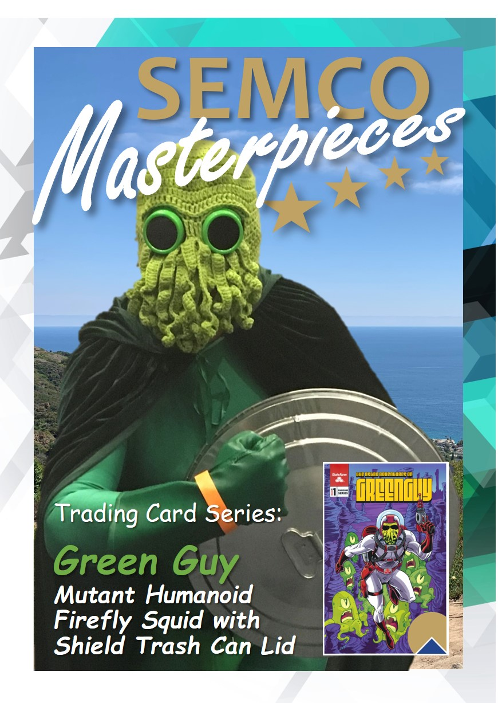
Ed·u·tain·ment: Education with an Entertainment Aspect for Diverse Audiences
Presentation | Georgia Recycling Coalition
By Professor Jon Michael Huls-Garcia
October 25, 2023

Slide 2
What’s Edutainment?
Learning and Having Fun Aren’t Mutually Exclusive
RecycleUSA: A Case Study
Summary

Slide 3
Georgia Recycling Coalition
SWEEP Board Director
National Recycling Coalition Co-founder
TRUE Zero Waste Mentor
Upcyclers’ Network Board Advisor
Santa Monica College Professor
Zero Waste USA Certified Associate
ZWIA Board Advisor
“Leadership is an action, not a position”

Slide 4
What’s Edutainment?
Edutainment is—education with the goal of making learning enjoyable

Slide 5
Origin
Derived word
Supports education with entertainment
People acquire & retain more info and knowledge
Performing hands on experiential activities
Informal and engaging

Slide 6
Developed brand of edutainment products composed of recycled content materials
Be the change you desire
Close the loop
Simulations
Products include:
jigsaw puzzles emphasizing ‘environmentality’,
a game simulating the recycling industry,
an online waste sorting simulator, What’s Waste, What’s Not, and
Story-telling
Improve reading, memorization, and creative & critical thinking
RecycledUSA
SEMCO

Slide 7
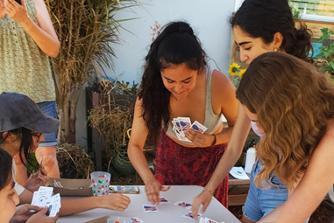
Proof Is In the Pudding
41% of gamers identify as female
70% of women in the US play games on a smartphone
Need to develop products that shift societal activities toward social togetherness and interactivity, and away from single person exclusivity

