Slide 1
Solid Waste Trust Fund & Grant program Updates
Lena Chambless, Program Manager​​
Georgia EPD, Land Protection Branch
Recovered Materials and Abatement Program

Slide 2
About us
The Recovered Materials and Abatement (RMA) Program is the newest program housed within the Land Protection Branch at Georgia EPD.

Slide 3
Recovered Materials & Abatement program
Tire management unit
Recovered Materials Unit
Lead-based paint Program
Asbestos Program
Regulates material recovery permitting and administers Solid Waste Trust Fund projects.
Regulates tire operations, responds to complaints of tire violations, and collects the Tire Management Fee
Administers the Georgia Lead-Based Paint Hazard Management Program to minimize the spread of lead dust and debris
Administers the Georgia Asbestos Removal and Encapsulation Program by regulating activities that disturb asbestos
Notes:
RMA program hosts a variety of regulatory programs…
In addition to the regulatory programs, the RMU also administers the SWTF

Slide 4
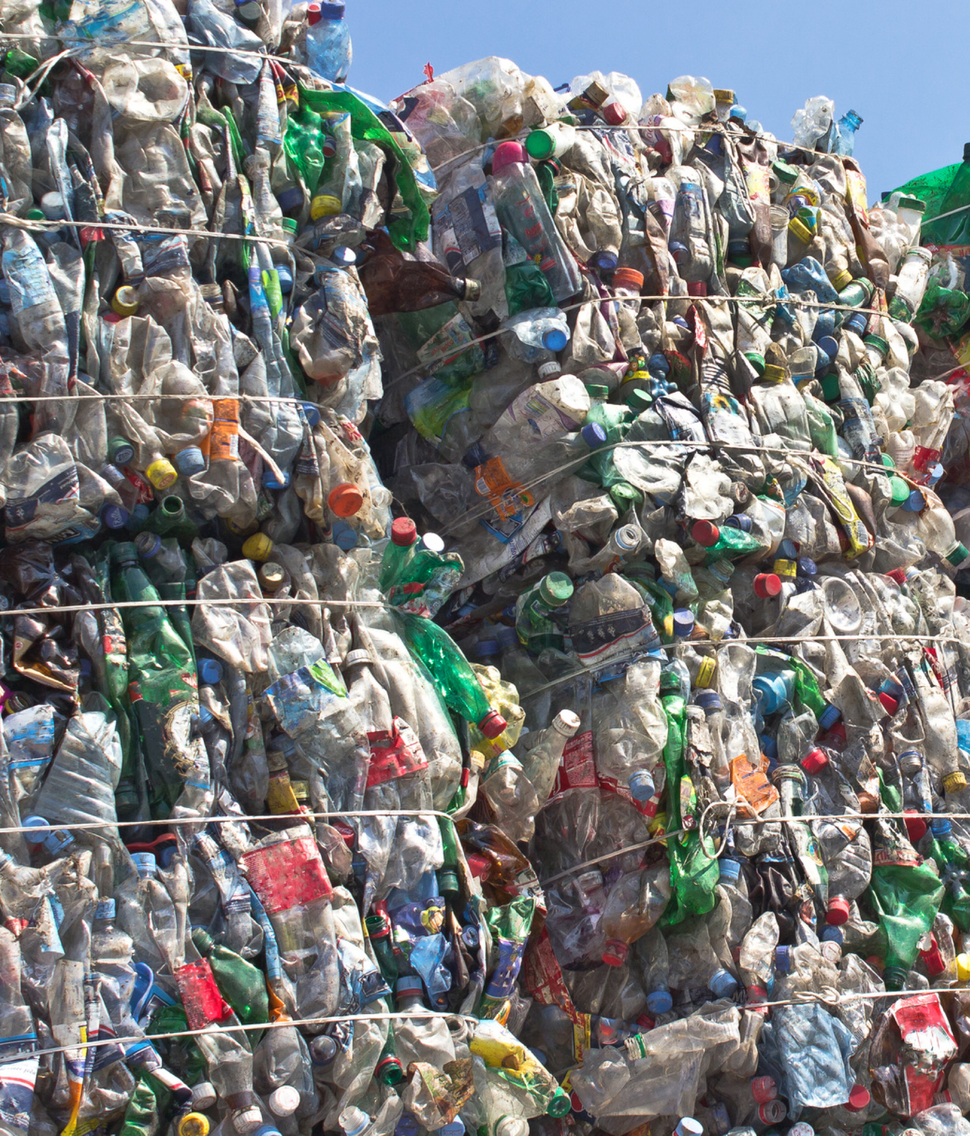
Solid Waste Trust Fund Fee Collection & administration
Funded by Georgia’s Tire Management Fee
The Tire Management Unit and EPD Finance coordinate the collection of the Tire Management Fee
Dedication of Fees
July 1, 2022, saw the dedication of all trust fund fees
Shift in fee collection
July 1, 2023, saw the tire management fee collection responsibility shift from retailers to distributors
SWTF Administration
The RMU administers all Solid Waste Trust Fund contracts and grants.
Notes:
The Tire Management Unit and EPD Finance coordinate the collection of the Tire Management Fee
The Recovered Materials Unit is the primary program tasked with administering these funds for the intended purpose
Since July 1 2022 EPD has received all Solid Waste Trust Fund dollars collected through the Tire Management Fee.

Slide 5
Support statewide recycling and waste diversion initiatives
Ensures the safe management of abandoned landfills
Facilitate the abatement and recycling of scrap tires
Fund EPD program operations
Solid Waste Trust Fund
Authorized Uses

Slide 6
SWTF Expenses by Authorized Uses
2012-2022
Notes:
In FY 2022, $7.6 million was collected, and Just above $3M was appropriated to EPD for use.

Slide 7
statewide recycling and waste diversion initiatives
$2M​
Recycling & Waste Diversion (RWD) Grant
$1 M
Tire Products
(Tire) Grant
$1M
Scrap Tire Abatement Reimbursement (STAR) Program & State-led Tire Abatements

Slide 8
Solid Waste Infrastructure for Recycling Grant (SWIFR)
The 2021 Bipartisan Infrastructure Law provides the largest EPA investment in recycling in 30 years to support National Recycling Strategy implementation and build a circular economy for all.
EPD is a recipient of EPA’s SWIFR Grant for State and Territories in the amount of $713K
EPD plans to conduct a statewide post-consumer materials data collection effort, resulting in a comprehensive report
Notes:
This tract was a non-competitive and was awarded to every state and territory.
We are so pleased to receive funding for this project.
Georgia has one the oldest studies in the country, placing 44th of 45 states that have conducted a study.
The last study of its kind took place in 2004. DCA conducted a waste characterization study and report that focused solely on landfilled materials .
This report was published in 2005.
The new data and report can be used by regional planning commissions, solid waste authorities, local governments, and industry

Slide 9
Solid Waste Infrastructure for Recycling Grant (SWIFR)
This project aims to identify opportunities and strategies that will advance post-consumer materials recovery through waste diversion, material recovery infrastructure, market development, and management planning
The RMA program plans to solicit an advertisement for a contractor for this project through the Georgia Procurement Registry in the months ahead.
Notes:
This tract was a non-competitive and was awarded to every state and territory.
We are so pleased to receive funding for this project.
Georgia has one the oldest studies in the country, placing 44th of 45 states that have conducted a study.
The last study of its kind took place in 2004. DCA conducted a waste characterization study and report that focused solely on landfilled materials .
This report was published in 2005.

Slide 10
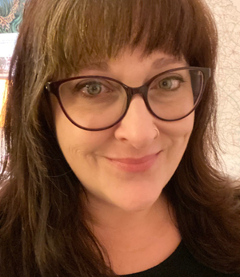
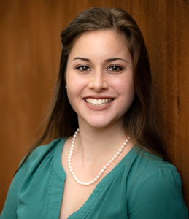
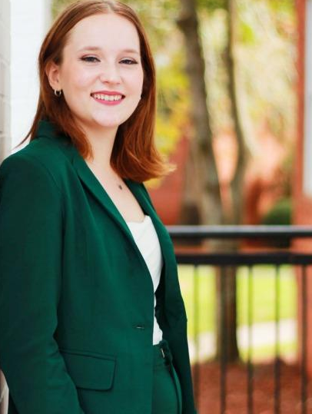
Solid Waste Trust Fund Grant Program Team
Lena Chambless
RMA Program Manager
Sarah Knapp,
LEED AP BD+C, ENV SP, RMU Manager
Cassie Rowicki, ECS I
Tire Products Grant Program
Hannah Tripp,
ECS I
STAR Program
SWTF.Grant@dnr.ga.gov
https://epd.georgia.gov/solid-waste-trust-fund-grant-program

Slide 11
Thank you

