Slide 1
Accelerating Plastic Circularity through Pyrolysis-based Advanced Recycling
32nd Annual GRC Conference October 23, 2023
Notes:
It’s an honor to have a chance to speak to you all today, 2 reasons // Nexus Circular is one of the most cutting-edge companies in the world of advanced recycling, so I’m excited to share our story with you all ounded and headquartered right here in Georgia And (2), I’m used to speaking and traveling across the US to share Nexus’s mission, but this just might be my shortest commute ever for a work event – I live just about 15 minutes up the road on the North side of SSI! backyard
when you live in a beautiful place like this /state GA Georgia, we can look around and see the beauty -- the mountains, coastlines, and everything between. Imagine we share a common interests – how can we preserve our state and really, our world, for generations to come? It’s by creating sustainable material ecosystems that can coexist in harmony with our environmental ecosystems. One of the most important tools in our arsenal to achieve that balance is this concept of circularity, which is what the GRC has asked me to speak about today.
the concept of "circularity" has gained prominence as a transformative approach to mitigate waste and promote sustainable practices. Circular systems prioritize the continual use, recycling, and regeneration of materials, with the aim of minimizing waste and extending the lifespan of products and resources.
This concept of circularity can apply to a multitude of materials, but today, I want to narrow our focus to explore circularity within the context of plastics. It offers a blueprint for transforming how we produce, consume, and manage these materials.
In the next few slides, I’ll walk you though some of the principles and practices of advanced recycling and how these innovative technologies will help unlock the circular future of plastics.

Slide 2

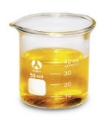
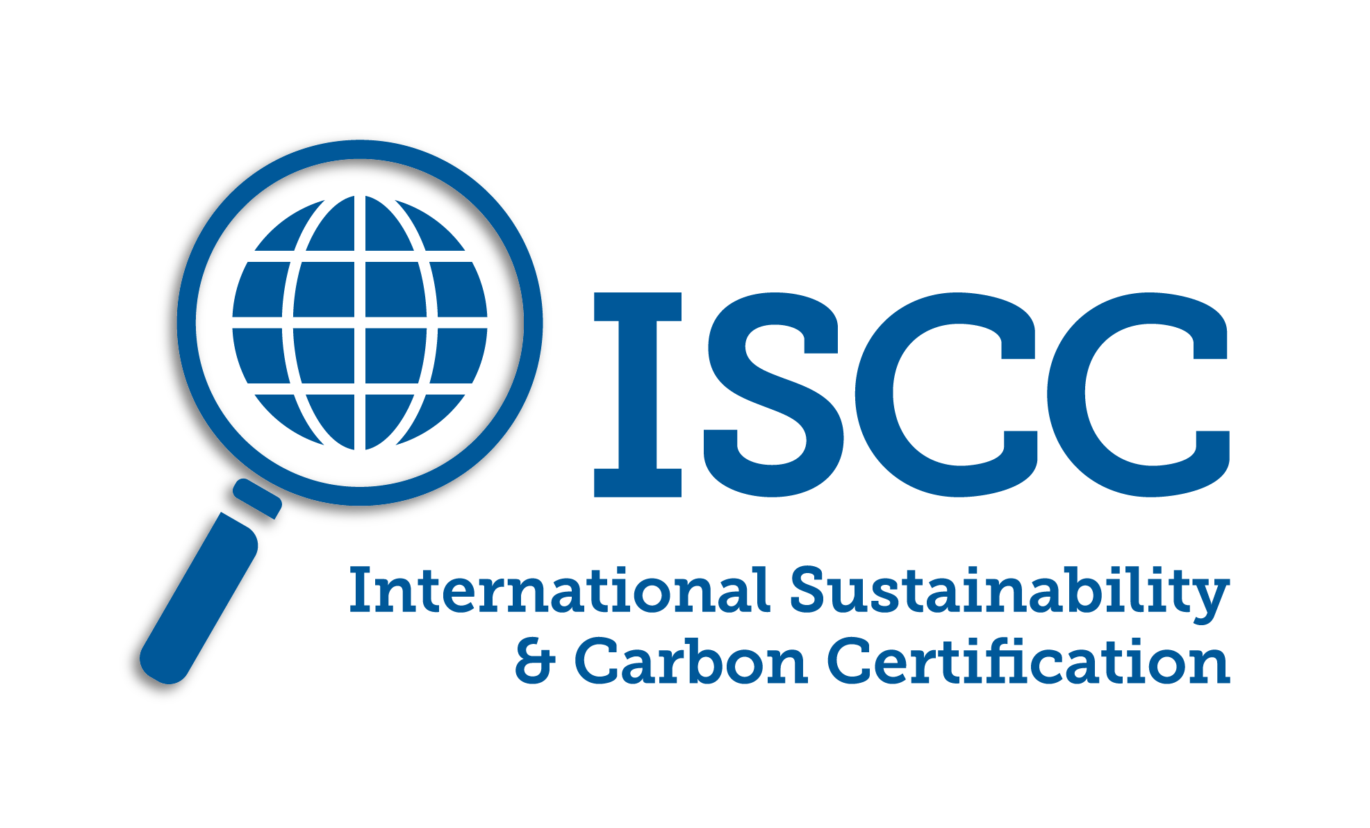

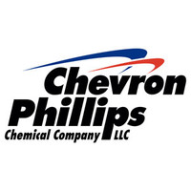


NEXUS CIRCULAR IS A COMMERCIAL LEADER IN PYROLYSIS-BASED ADVANCED RECYCLING
Delivering a comprehensive solution to reducing the accumulation of plastics in our environment
TECHNOLOGY AND END MARKETS
Hard-to-recycle landfill-bound plastic are converted into its original molecular building blocks. No burning or incineration of plastic. Low emissions process (synthetic minor source).
Pyrolysis oil is used to create new circular virgin-quality plastics, offsetting fossil-based naphtha resources.
Headquarters:
ATLANTA, GA
Technology:
Pyrolysis Oil:
82% Yield
Process Gas:
13% Yield
Inert Solid:
5% Yield
PYROLYSIS
OUTPUTS
Value Chain:
PLASTICS-TO-PLASTICS
Founded:
 | 2018-2022 | 2023 | 2024 | 2025
Atlanta, GA | 7 | 30 | 30 | 30
2nd Site in GA – Phase 1* |  | under construction | 180 | 180
2nd Site in GA – Phase 2 |  |  | under construction | 300
Total | 7 MM lbs | 30 MM lbs | 210 MM lbs | 510 MM lbs
FACILITES AND ANNUAL USED PLASTIC PROCESSING CAPACITY
2008
Commercialized:
2018
* Fully contracted and financed
INVESTORS
Notes:
Founded on the core principle that our planet's resources are finite, and it is our responsibility to safeguard them for future generations, Nexus Circular has emerged as a pioneer in the field of advanced recycling. We understand that the plastics conundrum is one of the most pressing environmental challenges of our time. Nexus’s mission is really to reshape the destiny of plastics by harnessing the power of advanced recycling and innovative solutions.

Slide 3

LIFE STAGES OF PYROLYSIS-BASED ADVANCED RECYCLING¹ TECHNOLOGY COMPANIES
Nexus is uniquely positioned with a leading technology and a proven commercial process
High yields
High quality oil
Optimized feedstock form
Consistent continuous production
Commercial
Very few companies
Early Stage Commercial
Handful of companies
Nexus has the only technology that:
Pilot / Demonstration Scale
Many companies
Lab Scale
¹ Closed Loop Report, Accelerating Circular Supply Chains for Plastics, April 2019 noted an average of 17 years from lab scale to commercial scale for advanced recycling technology companies
Notes:
Here you can see the progression of commercialization in the realm of pyrolysis-based advanced recycling technologies.
Starting with the bottom layer of the diagram: 'Lab Scale'. At this foundational level, we find a plethora of companies. Here, the focus is on early technology formulation and applied research. This is the stage where innovative ideas are born and tested in controlled environments.
Moving up, we reach the 'Pilot/Demonstration Scale'. Fewer companies progress to this stage, where ideas move from the lab to a more practical, real-world setting. It's here that prototypes are established and where the proof of concept becomes tangible.
Next, we have the 'Early Stage Commercial'. A handful of companies reach this pivotal point, characterized by the establishment of proof of concept facilities. It's at this juncture that businesses start to see the commercial viability of their technologies.
At the apex, we find the 'Commercial' level. This stage is occupied by a select few companies globally, and Nexus Circular stands as a prime example. Companies at this echelon boast high yields, produce high-quality oil, utilize a wide range of feedstocks, and maintain consistent, continuous production. Nexus Circular stands out, having ascended this ladder in just 10 years as we commercialized our technology in 2018 (vs the expected industry standard of 17 years), so while the total plastics currently, the technology is in its infancy, but this number will grow exponentially in the next 1-2 decades. we have been operating a commercial plant for 5 years and are expanding with strong strategic partners

Slide 4
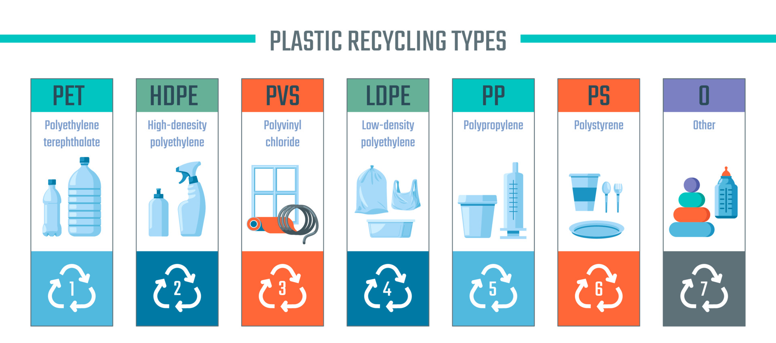
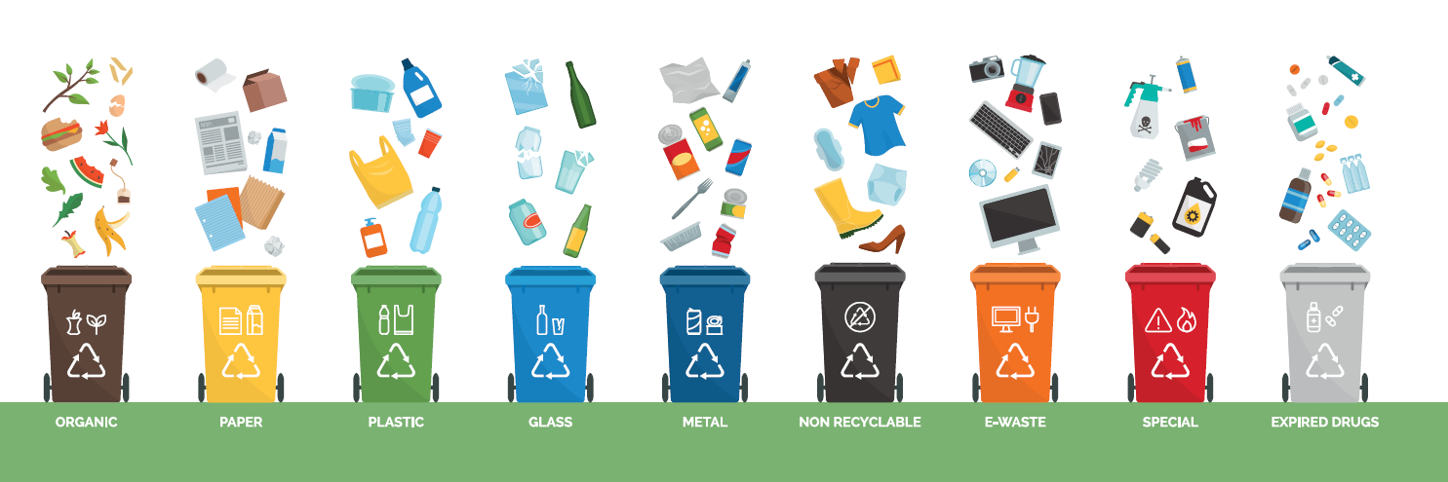
OVERVIEW OF PLASTIC TYPES AND RECYCLING TECHNOLOGIES
Advanced recycling technologies can address a wider range of plastic types and forms
MECHANICAL RECYCLING
~ 20% of plastics produced
ADVANCED RECYCLING – PYROLYSIS
~ 60% of plastics produced
NOT RECYCLED
~ 30% of plastics produced
PET
HDPE
LDPE
PP
PS
PVC
MIXED
Polyethylene
Terephthalate
High Density
Polyethylene
Low Density
Polyethylene
Polypropylene
Vinyl or PVC
ABS, PU, Nylon and
Miscellaneous
Polystyrene
1
2
4
5
6
3
7
ADVANCED RECYCLING – METHANOLYSIS
ADVANCED RECYCLING – SOLVENT PURIFICATION
Source : National Geographic, Planet or Plastic 2018 (7% PET, 15% HDPE, 17% LDPE, 23% PP, 7% PS, 16% PVC and 15% Mixed)
The percentages noted above reflect the total amount of each plastic type that has the potential to be recycled by the method noted. There are many factors that determine whether such plastics will actually be recycled or whether the particular products made from these plastics are in fact recyclable.
Notes:
To begin, it's essential to understand that not all plastics are created equal. There are seven distinct types of plastics, each with its unique characteristics and properties. However, the spotlight in the recycling world often falls on plastics labeled as #1 and #2, as these are particularly well-suited for mechanical recycling. These plastics are the ones you typically toss into your curbside recycling bin, representing approximately 22% of the plastics produced globally.
But not all plastics are equal contributors to sustainability efforts. Plastics marked as #3 and #7, often referred to as the "bad actors," pose significant recycling challenges and represent approximately 30% of plastics produced. The intricate chemical compositions and mixed materials within these plastics make them less amenable to recycling processes.
While mechanical recycling has its limitations due to the nature of these plastics, advanced recycling technologies are stepping in to bridge the gap. Nexus is a trailblazing company that employs pyrolysis to recycle some of those plastics that are less suitable for mechanical recycling, including #4, #5, and #6. these categories, together with HDPE, comprise around 60% of the plastics produced.
Mention the other types of advanced recycling solvent purification, a process suitable for plastics #1 (polyethylene) and #2 (polypropylene), which takes recycling to the next level by effectively breaking down and purifying these materials.

Slide 5
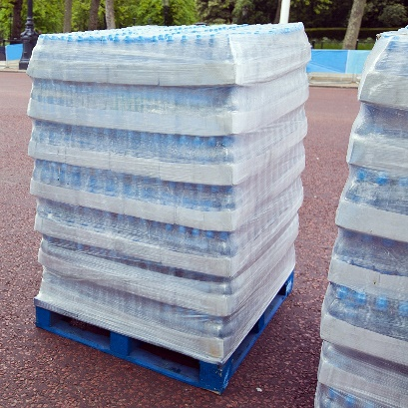
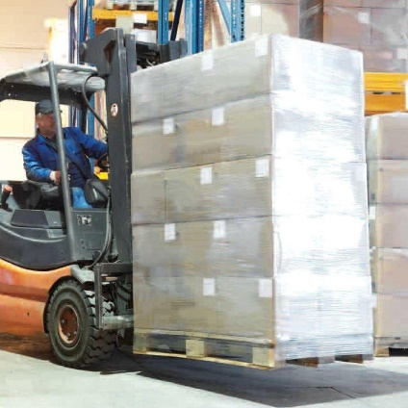
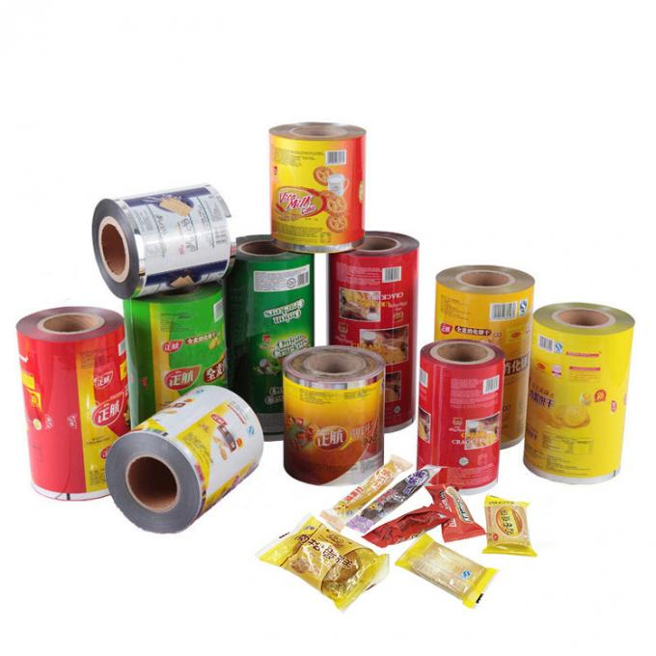
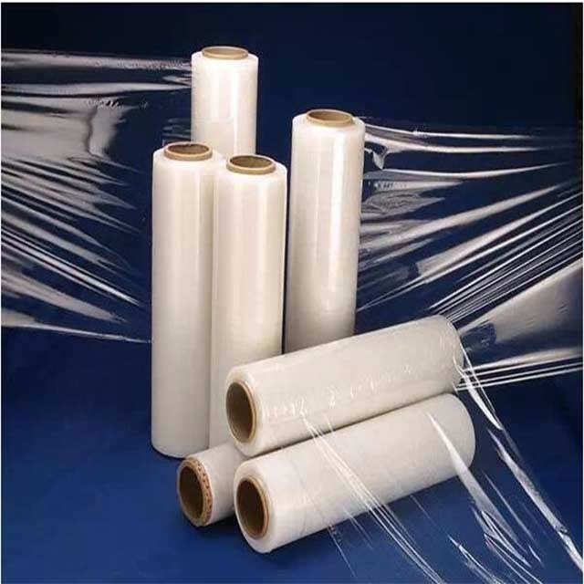
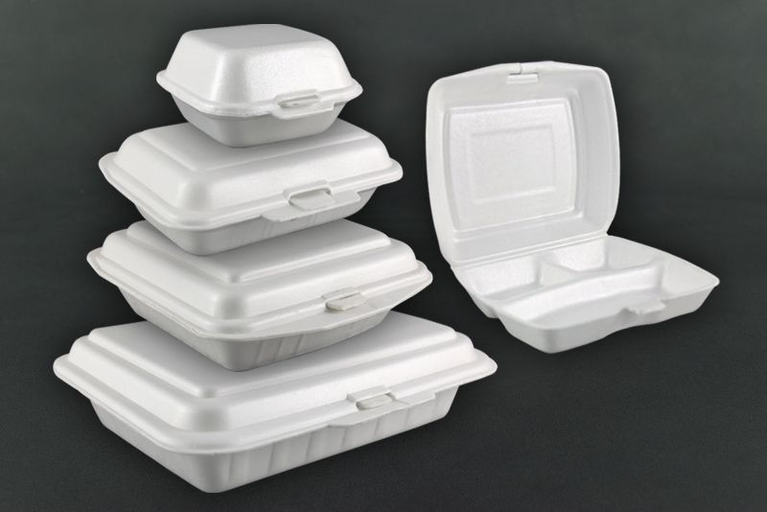
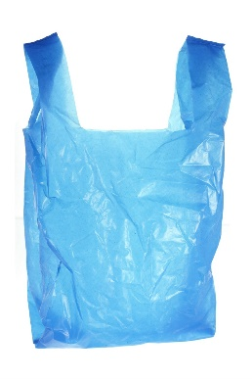
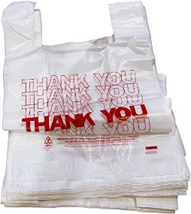
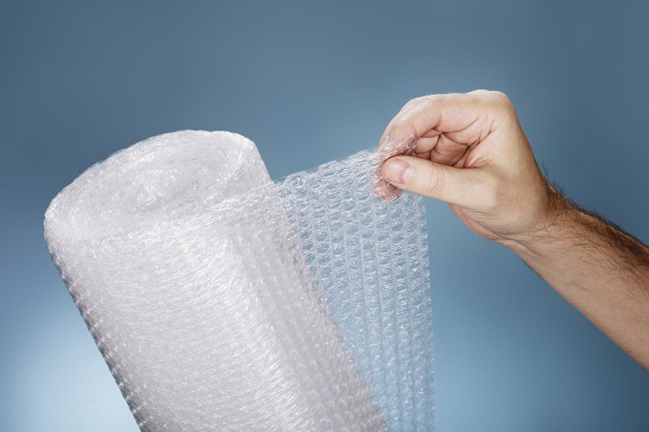
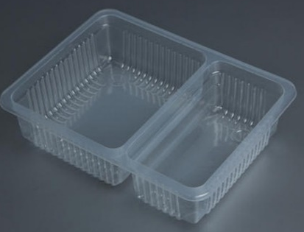
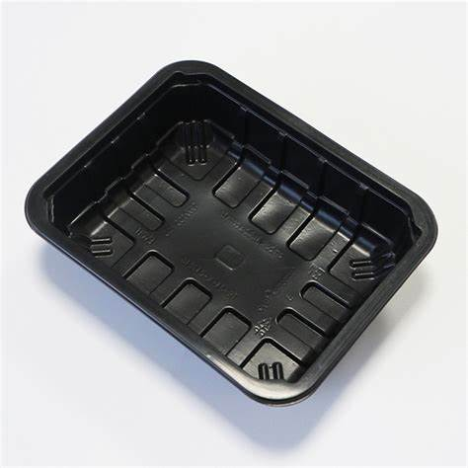
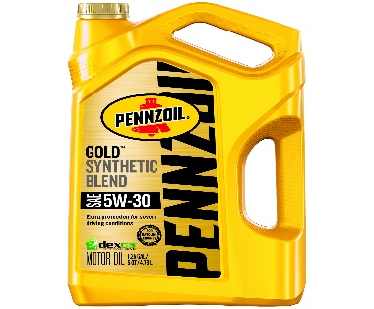
PE, PP AND PS PLASTICS ARE WELL-SUITED FOR PYROLYSIS-BASED ADVANCED RECYCLING
Nexus Circular’s unique process design directly handles abundant hard-to-recycle plastics, such as films and contaminated containers
(PE) Case Overwrap
(PE) Pallet Wrap
(PE) Plastic Wrap
(BOPP) Film / Metallized Film
(PS) Styrofoam Food Containers
(PE) Plastic Bags
(PE) Bubble Wrap
(PE and PP) Food Storage / Microwavable Trays
(PP) Nonwovens
(PE) Lubricant Bottles

Slide 6

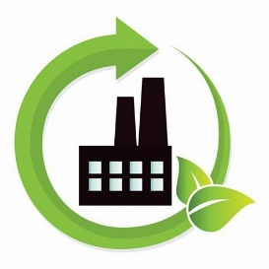
COMPARISON OF PYROLYSIS-BASED ADVANCED RECYCLING WITH MECHANICAL RECYCLING
Complementary roles in circular system
MECHANICAL RECYCLING
ADVANCED RECYCLING - PYROLYSIS
Bulky Rigids
PLASTIC FORMS AND TYPES
Films, Small Parts and Foams
Single streams, presorted by melt flow
REQUIREMENTS FOR PLASTIC INPUT
Mixed streams of PE, PP, and PS
Does not change chemical structure
Only changes form to a pellet
Change chemical structure at molecular level
Converts plastic to its original building blocks
EFFECT ON PLASTIC MOLECULE
Variable and inferior to virgin resin
QUALITY OF RECYCLED RESIN
Identical to virgin resin
Limited range as a partial offset to virgin
TYPES OF APPLICATIONS
Unlimited range - same range as virgin resin
1-3
NUMBER OF RECYCLING CYCLES
Infinite
Notes:
There are some critical distinctions between advanced recycling and mechanical recycling. These two approaches play pivotal and complementary roles in the our journey to circularity, and understanding their differences is key to selecting the right technology for the different streams of plastic.
Mechanical Recycling primarily deals with bulky rigids, roughly 20% of plastics produced. Advanced Recycling, on the other hand, focuses on films, small parts, and foams, which make up about 60% of plastics.
Mechanical Recycling demands single streams, pre-sorted by melt flow, for efficient processing. Pyrolysis is more adaptive to diverse plastic inputs and can accept mixed streams of polyolefins
In Mechanical recycling, the chemical structure of plastics remains unchanged. They're transformed into pellets while retaining the same molecular composition. Advanced recycling takes a transformative approach, changing the chemical structure at the molecular level, converting plastics back into their original building blocks.
Recycled resin obtained through mechanical recycling can exhibit variability and may be inferior to virgin resin. These materials often cannot be used back into food or hygiene applications. In contrast, advanced recycling produces recycled resin that is identical to virgin resin after the conversion process.
Mechanical recycling typically offers a limited range of applications, often serving as a partial offset to virgin resin in specific industries. Advanced recycling allows the potential for an unlimited range of applications, as the end resin mirrors the quality of virgin resin.
Another important distinction is the number of recycling cycles. Plastic materials can undergo mechanical recycling for just 1-2 cycles before quality diminishes for certain polymers. Pyrolysis breaks this limitation, enabling an infinite number of recycling cycles without compromising quality.
So, mechanical recycling serves a vital role in diverting a portion of plastics from landfills, but advanced recycling has emerged to fill the gap for some of the limitations of mechanical recycling. Advanced recycling widens the scope of recyclable plastics and also ensures that the quality and versatility of recycled resin matches that of virgin resin, offering the “infinite loop” that will be required for the circular future for plastics.

Slide 7
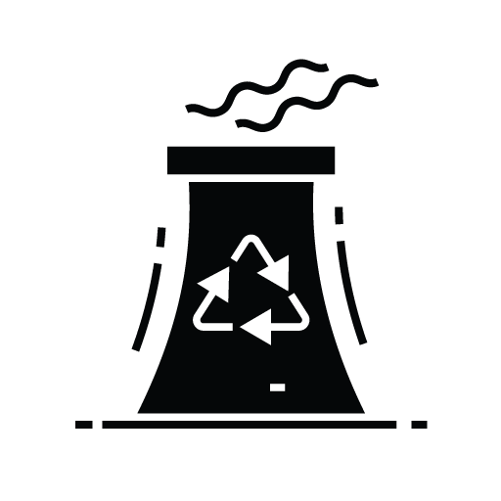

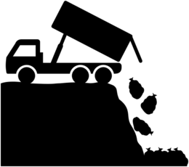
“HARD-TO-RECYCLE” PLASTICS HAVE 3 POSSIBLE END OF LIFE SCENARIOS
Advanced recycling complements mechanical recycling as the circular option to continuously restores the plastic molecule to productive use
WASTE PLASTIC HIERARCHY
Prevention and Reduction
ADVANCED RECYCLING:
Extends the plastic lifecycle infinitely
Converts low-value materials into new molecules
Plastic resource is continuously returned to the value chain
Reusable Containers
Mechanical Recycling
INCINERATION:
~ 9%
Recovers energy from burning of waste
Last resort for value creation from plastic
Plastic resource is consumed and permanently removed from the value chain
Advanced Recycling
~1%
Incineration
~ 14%
LANDFILL:
Considered marginally better than the worse-case-scenario which is leakage to environment
Plastic resource is lost from value chain
Landfill
~ 76%
Leakage to the Environment
Source: US EPA - Plastic Data
Notes:
The "waste hierarchy" is a framework that outlines a preferred order of actions to manage and reduce waste in an environmentally responsible manner. It is typically depicted as a pyramid with the most favorable waste management options at the top and the least favorable at the bottom. The waste hierarchy consists of the following levels, from top to bottom:
At the pinnacle, we have 'Prevention and Reduction’. Followed by “reuse” which are the most desired levels,, emphasizing the importance of eliminated the use of unnecessary materials and also of reducing single-use plastics.
'Mechanical Recycling’ which currently addresses around 9% of the total fate of plastics. This is the traditional method of recycling we're most familiar with.
'Advanced Recycling' is an exciting area, although it currently stands at about 1%. Here, the lifecycle of plastics can be extended infinitely by converting low-value materials into new molecules. This process ensures that the plastic resource is consistently reintroduced to the value chain.
'Incineration' accounts for approximately 14% of the solution. While it does recover energy from waste burning, it's considered a last-resort method for deriving value from plastics.
Most alarmingly, 'Landfill' takes up a whopping 76%. This method is just marginally better than the worst-case scenario, which is 'Leakage to the Environment'.

Slide 8

ADVANCED RECYCLING – PYROLYSIS EXPLAINED
Pyrolysis is a proven technology that has been used for 50+ years in the chemicals and plastics industries
INPUTS:
PROCESS:
PRODUCTS:
heat in the absence of oxygen converts plastic to its original molecular building blocks
2
5
4
6
HDPE
PP
LDPE
PS
1
3
7
PET
PVC
MIXED

Slide 9
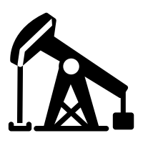
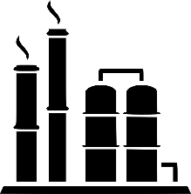
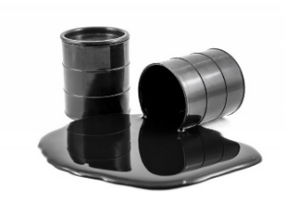
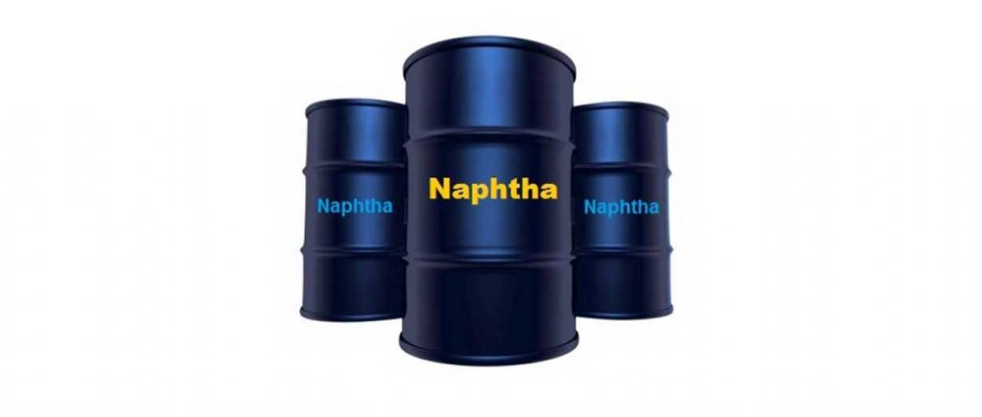
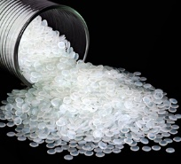
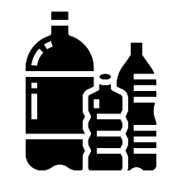
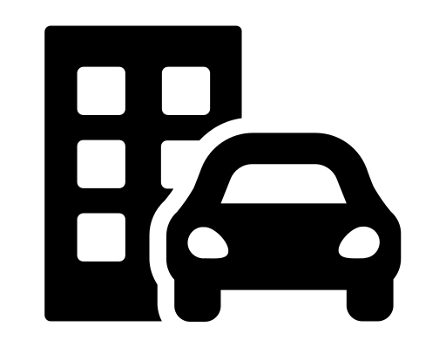




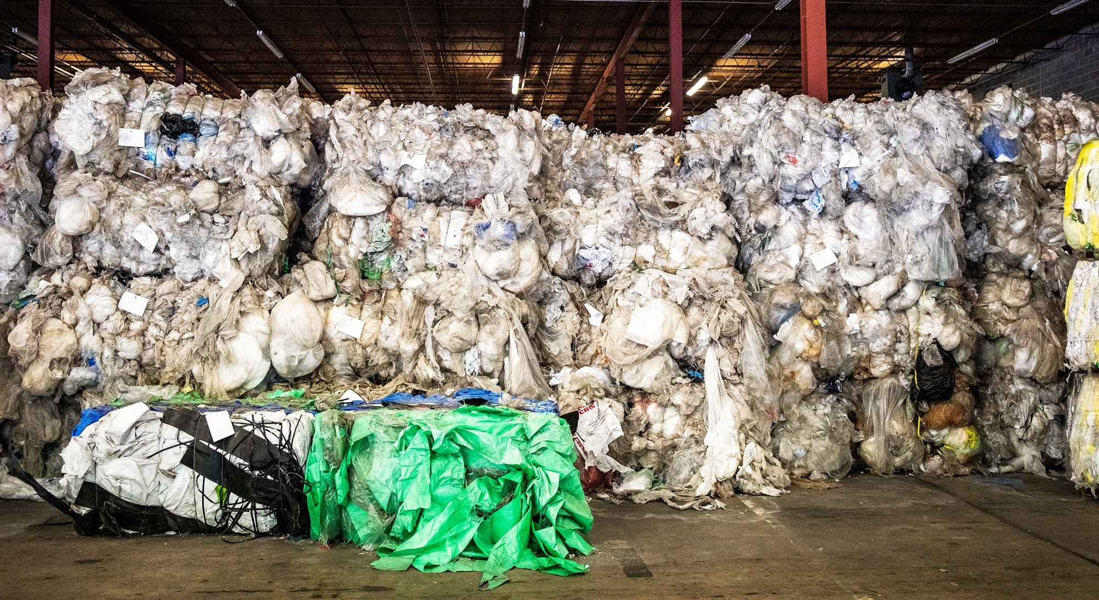

MATERIAL FLOWS FOR VIRGIN-QUALITY PLASTIC PRODUCTION
Pyrolysis oil from advanced recycling directly replaces fossil-based naphtha in plastic production
Unrecycled plastic is incinerated or landfilled, removing the plastic resource from the value chain.
Food Manufacturers, Automotive Supplier / OEM, etc
Plastic Packaging or Components
New fossil-based resources are then required to make new plastic.
Virgin Plastic Resin
End User
Fossil-Based
Naphtha
Used Plastic
Pyrolysis Oil
Plastic resources are continuously recycled and returned to the value chain, again and again.
Notes:
but I like that it specifically shows that pyrolysis oil directly replaces crude oil in plastic production
The next slide confirms Nexus circular solution

Slide 10

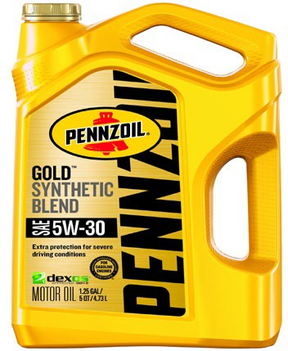
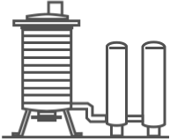
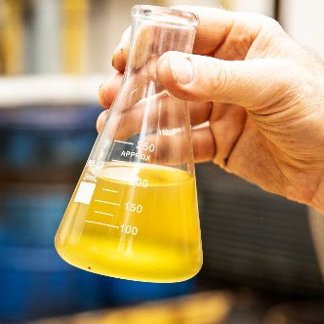

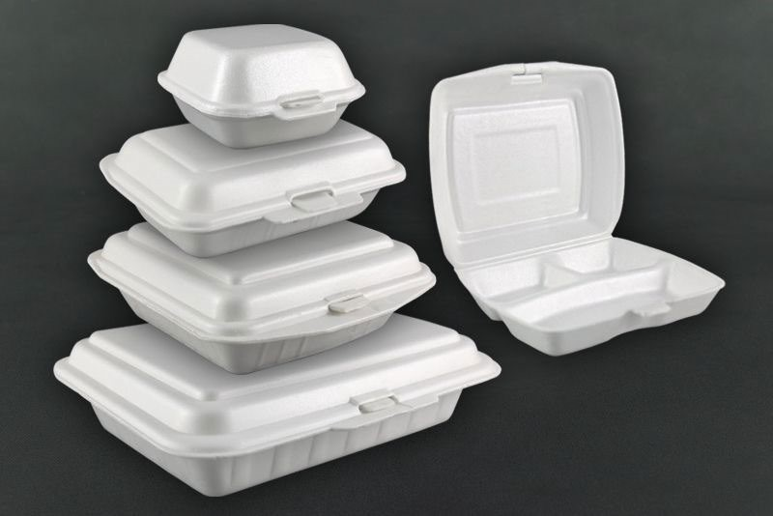


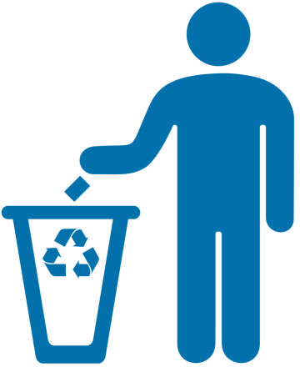
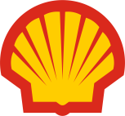
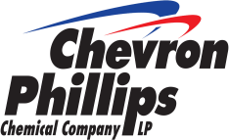


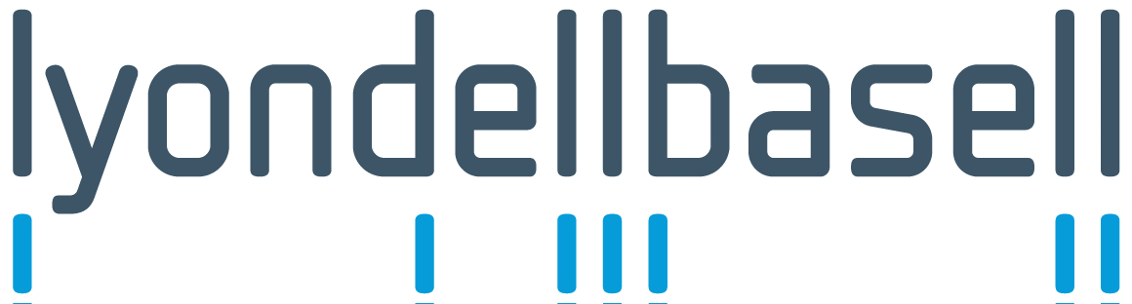
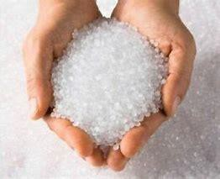
NEXUS CIRCULAR’S PYROLYSIS PROCESS IS CLEAN, CIRCULAR, COMMERCIAL AND ECONOMIC
Enabling the circular plastic economy where plastic resources are recycled and returned to the supply chain, again and again
2
SINGLE USE AND END OF LIFE PLASTICS: POLYETHYLENE, POLYPROPYLENE AND POLYSTRENE
PYROLYSIS TECHNOLOGY
PYROLYSIS OIL
CAN BE CONTINUOUSLY RECYCLED
7
PACKAGING WITH
RECYCLED CONTENT
ADVANCED RECYCLED VIRGIN RESINS
END USERS / CONSUMERS
PACKAGING / MANUFACTURING
CRACKER / PLASTIC RESIN PRODUCER
6
5
4
10

Slide 11

NEXUS IS A COMMERCIAL LEADER IN PYROLYSIS-BASED ADVANCED RECYCLING
Delivering a comprehensive circular solution to the growing plastic waste challenge and enabling the circular plastic economy
NEXUS ACCELERATES CIRCULARITY SO PEOPLE AND THE ENVIRONMENT THRIVE.
4/7
~60%
MM+
>50%
lbs
types of plastics
plastic
produced
of used plastic diverted annually from landfill
potential reduction in CO₂ footprint in virgin plastic production
Source: Figures reflect potential for pyrolysis-based advanced recycling and industry averages
Notes:
I offer here to close just a short summary of Nexus’s technology and impact.
As you participate in this conference, I invite you to visit our booth and learn more about the groundbreaking technologies that Nexus Circular has pioneered, and the transformative impact we are making in the realm of plastics circularity through pyrolysis. We are committed to sustainability, innovation, and a circular future, and we are excited to collaborate with like-minded individuals and organizations, right here in our own state, who share our vision.

Slide 12
Thank you! Questions? Christy Sapp Strategic Feedstock Sourcing Director csapp@nexuscircular.com

