Slide 1
KNAUF INSULATION AND GLASS RECYCLING

Slide 2
WHO WE ARE

Slide 3
A FAMILY-OWNED COMPANY
The Knauf Group, founded by two brothers in 1932, remains independently
owned.
+85 years of experience as a manufacturer of building materials and construction systems
+40,000 employees worldwide
+250 factories in more than 80 countries
Notes:
The Knauf Group was founded in 1932 by brothers Karl and Alfons when they bought a gypsum processing facility.
Knauf remains a family-owned company to this day.
We bring more than 85 years of experience to the building materials and construction system industry, along with an unwavering commitment to doing the right thing.
With close to 28,000 employees worldwide and factories in more than 80 countries, Knauf is here to help our customers achieve success.

Slide 4
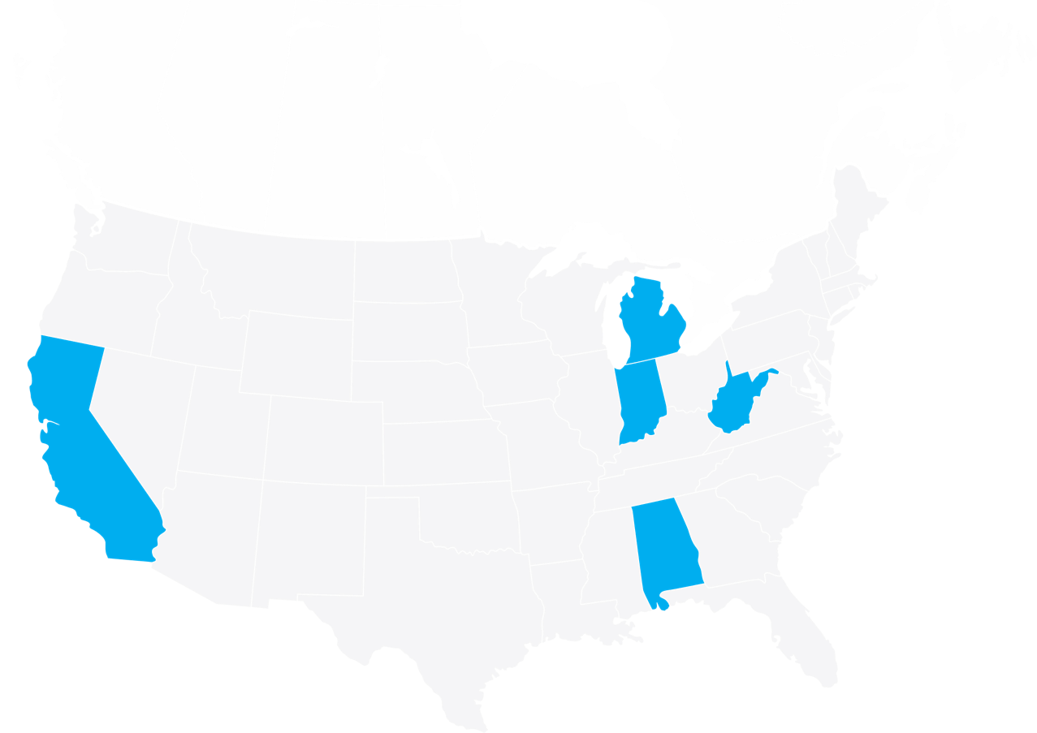
THE COMMUNITIES WE CALL HOME
Albion, MI
Shasta Lake, CA
Inwood, WV
Shelbyville, IN
Lanett, AL
Knauf Insulation Plants
McGregor, TX
Opening 2024

Slide 5
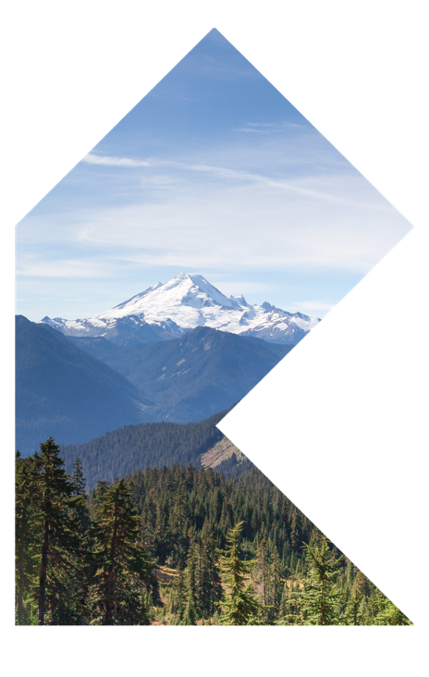
INNOVATING FOR TODAY—AND TOMORROW
Our rapidly changing world guides our decisions. We are committed to:
Increased sustainability and resource efficiency in the face of climate change
Driving innovation across every aspect of our business through technological advancements and digitalization
Meeting consumer demand for greater comfort, convenience and service

Slide 6
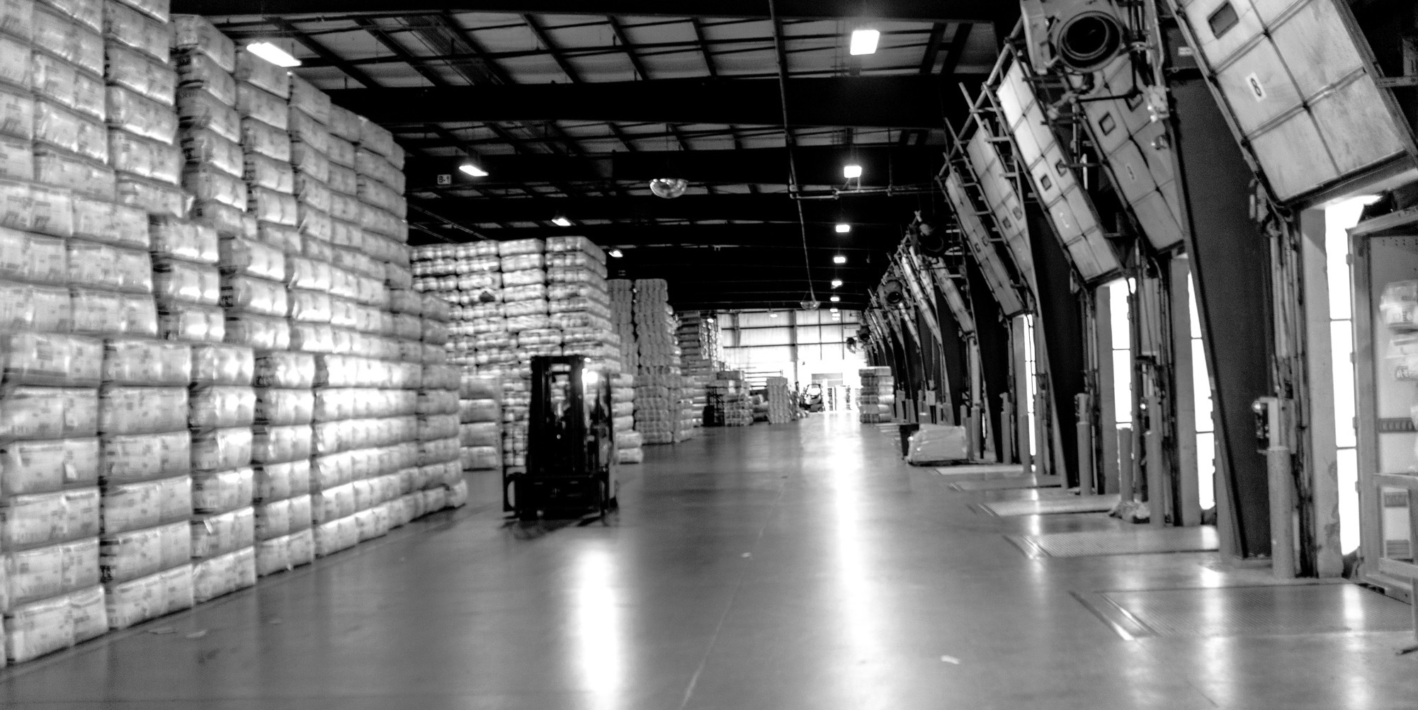
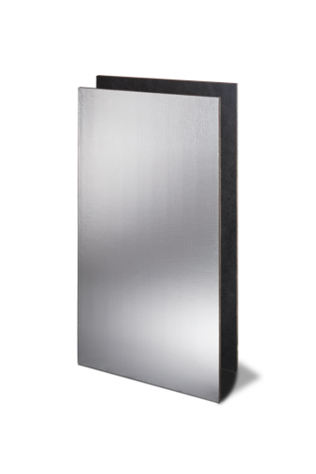
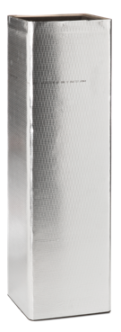
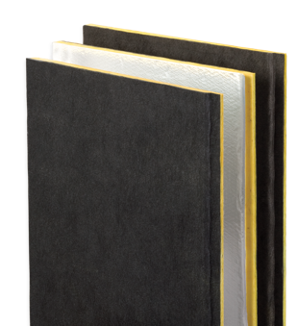
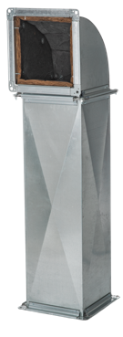
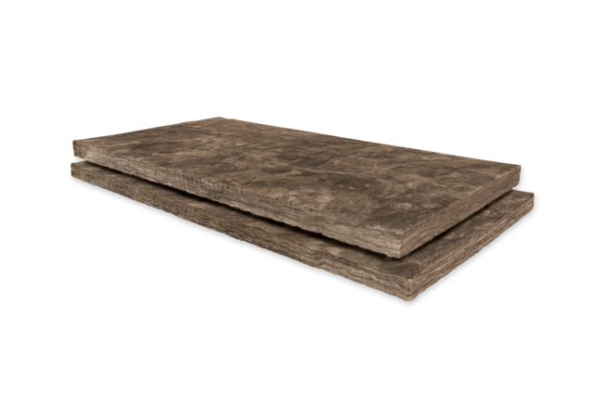
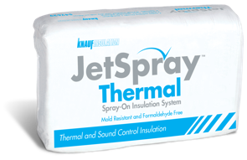
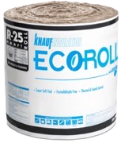
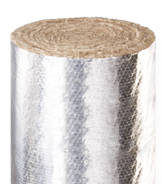
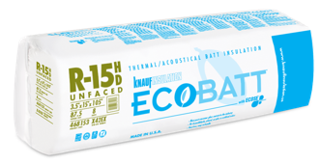
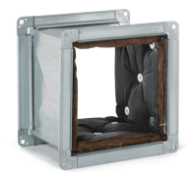
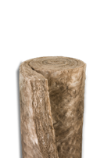
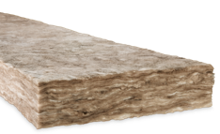
A FULL RANGE OF FIBERGLASS INSULATION SOLUTIONS
Residential
Commercial & Industrial
OEM

Slide 7
BENEFITS OF INSULATION
Thermal properties
Controls heat flow best through conduction
Reduces energy costs
Controls moisture/condensation
Helps to maintain a comfortable environment
Acoustical characteristics
Significantly reduces transmission of sound from other rooms or from the outside.
Fire resistant properties
Will not contribute to the spread of fire and has extremely low smoke toxicity.
Moisture/mold resistance
Does not support microbial growth and is not a good food source for mold.
Personnel protection
Notes:
Fiber glass is one of the world’s most useful man-made materials. It has been manufactured to make insulation for nearly 60 years and is the most commonly used insulation in the world for both residential and commercial construction. Fiber glass was first developed as a filter media for use in furnaces. It soon was developed into batt form for use in residential and commercial buildings to provide thermal and acoustical performance. It is also used as an insulator for pipe and equipment in industrial and commercial settings and for air handling systems in both residential and commercial structures.
Fiber glass insulation has many benefits. It has unparalleled temperature resistance that ranges from -20 degrees Fahrenheit to 1,000 degrees Fahrenheit to control heat flow to reduce energy costs. Fiber glass also controls sound transmission and moisture to help maintain a comfortable environment. And it’s fire, moisture and mold resistant.

Slide 8
GLASS REQUIREMENTS AND LOCAL COLLECTION

Slide 9
CULLET NEEDS
STABLE SUPPLY
CLEAN SUPPLY
FREE OF CERAMICS ORGANICS

Slide 10
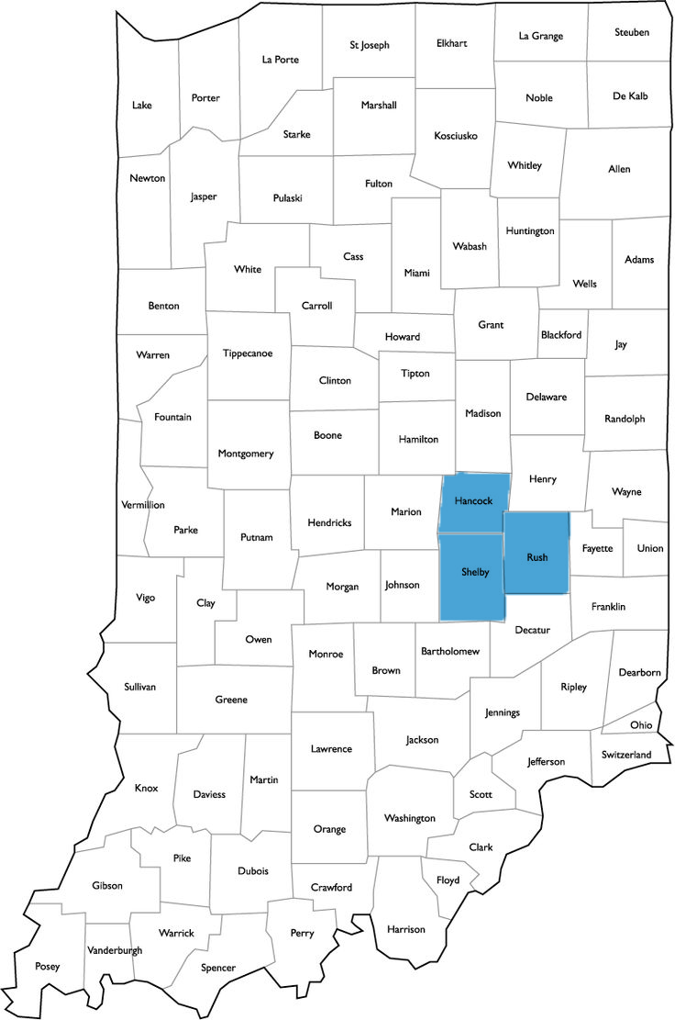
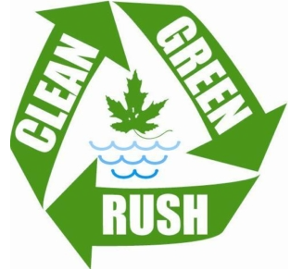
LOCAL PARTNERS

Slide 11
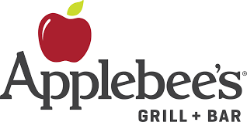
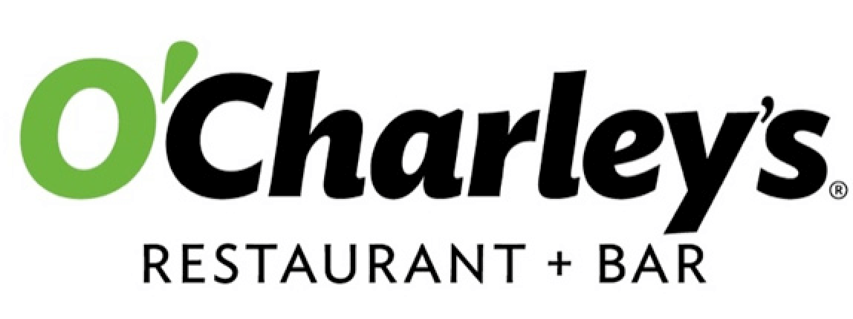
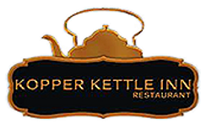
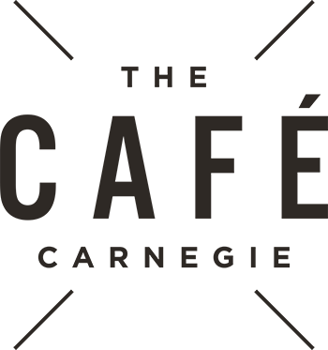
LOCAL COLLECTION
Shelbyville, IN
American Legion
Blue Agave
Eagles Lodge
Capones
Cadillac Jacks
Cancer Association
Kendall’s Tavern
Pudder’s
Cagney’s Pizza King
Moose Lodge 2118
Willie Farkle’s
Knight’s of Columbus
VFW Post 2695
Hana Sushi & Ramen
Cholula’s
San Jose Mexican
Maya’s Mexican Grill
Wings Etc.
Morristown, IN
Kopper Kettle
American Legion
Shirley, IN
Bens Bar
Greenfield, IN
Hancock County Jail
Purdue Extension
Hancock County FOP
Mozzies Pizza
Carnegies
Donrigo Mexican
Wing’s Etc.
O’Charley’s
Applebee’s

Slide 12
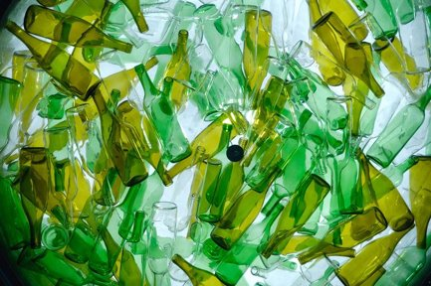
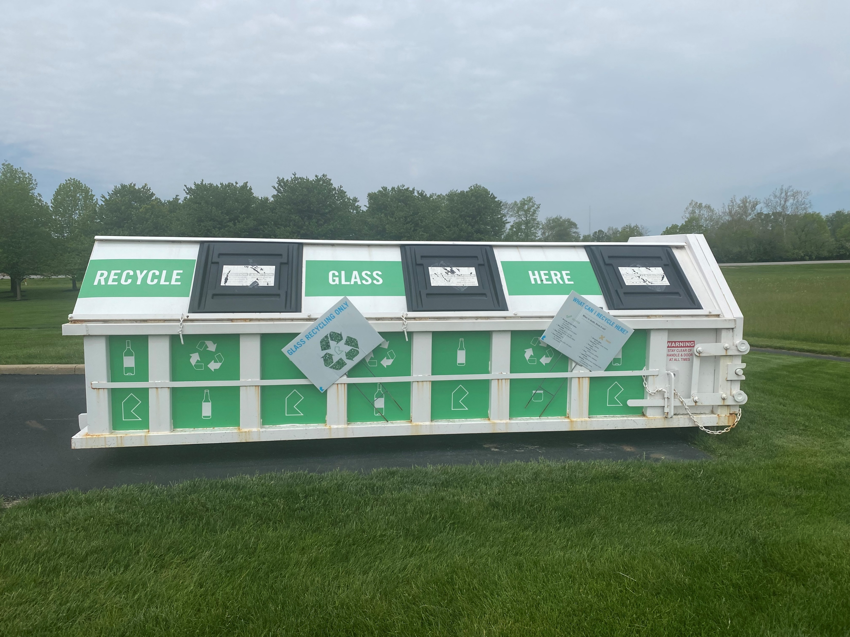
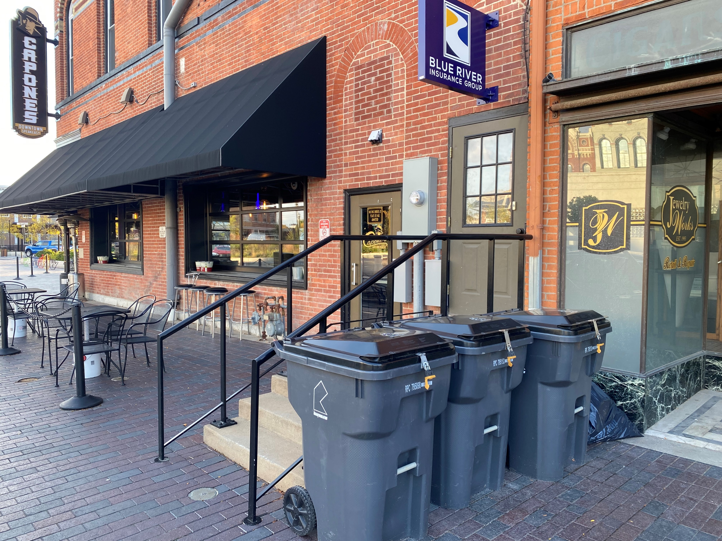
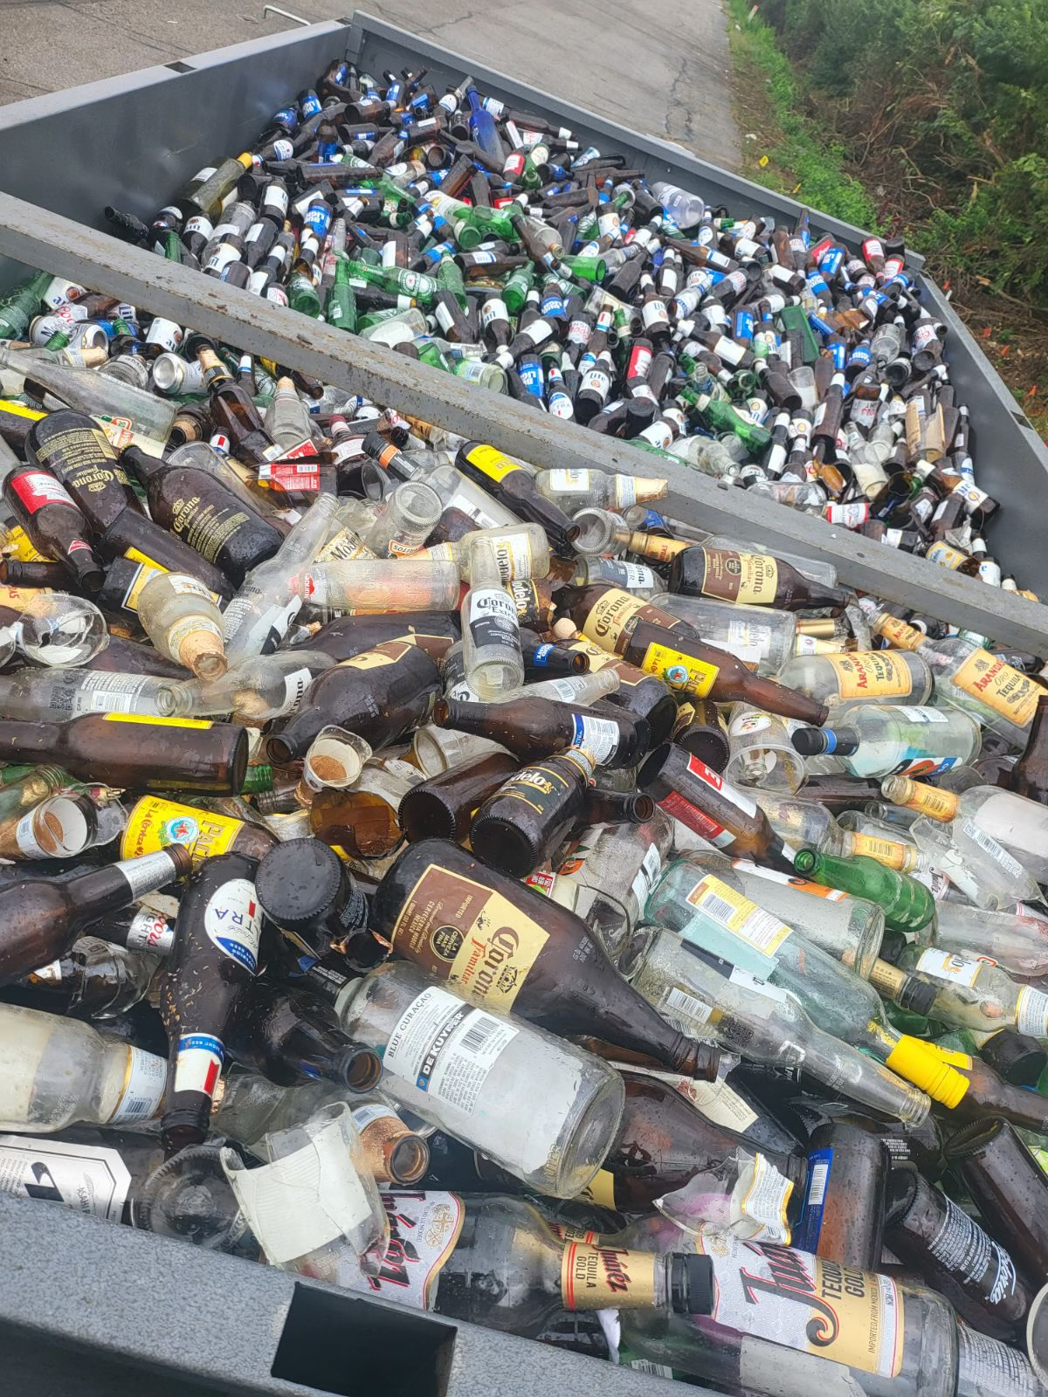
SMALL STEPS – BIG IMPACT

