Slide 1
Brightmark
We're on a mission to Reimagine Waste.
BRIGHTMARK.COM @brightmark

Slide 2
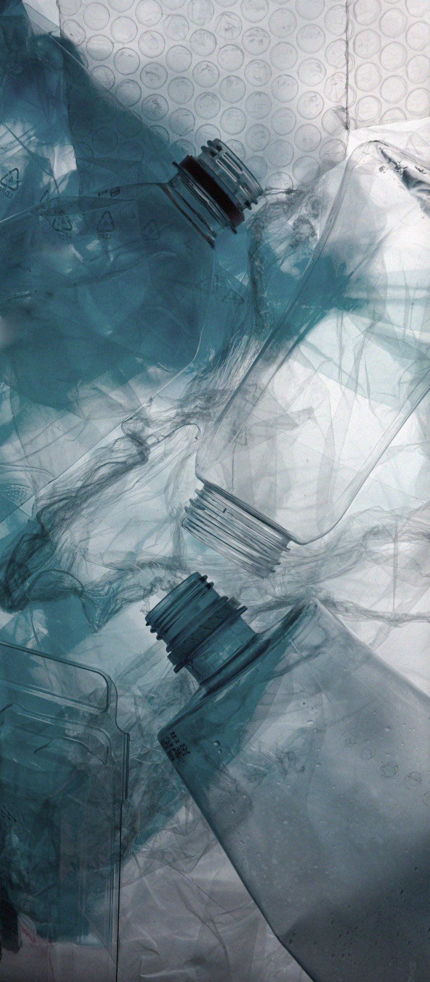
Creating a world without waste
Unique, large impact We transform plastic and organic waste into valuable products—reducing waste and providing circular solutions to some of the world's most pressing waste challenges.
Highly customizable projects Our technology accepts diverse types of feedstock while enabling our feedstock partners to save on landfill tipping fees, and can be sized to meet a community's specific needs.
2

Slide 3
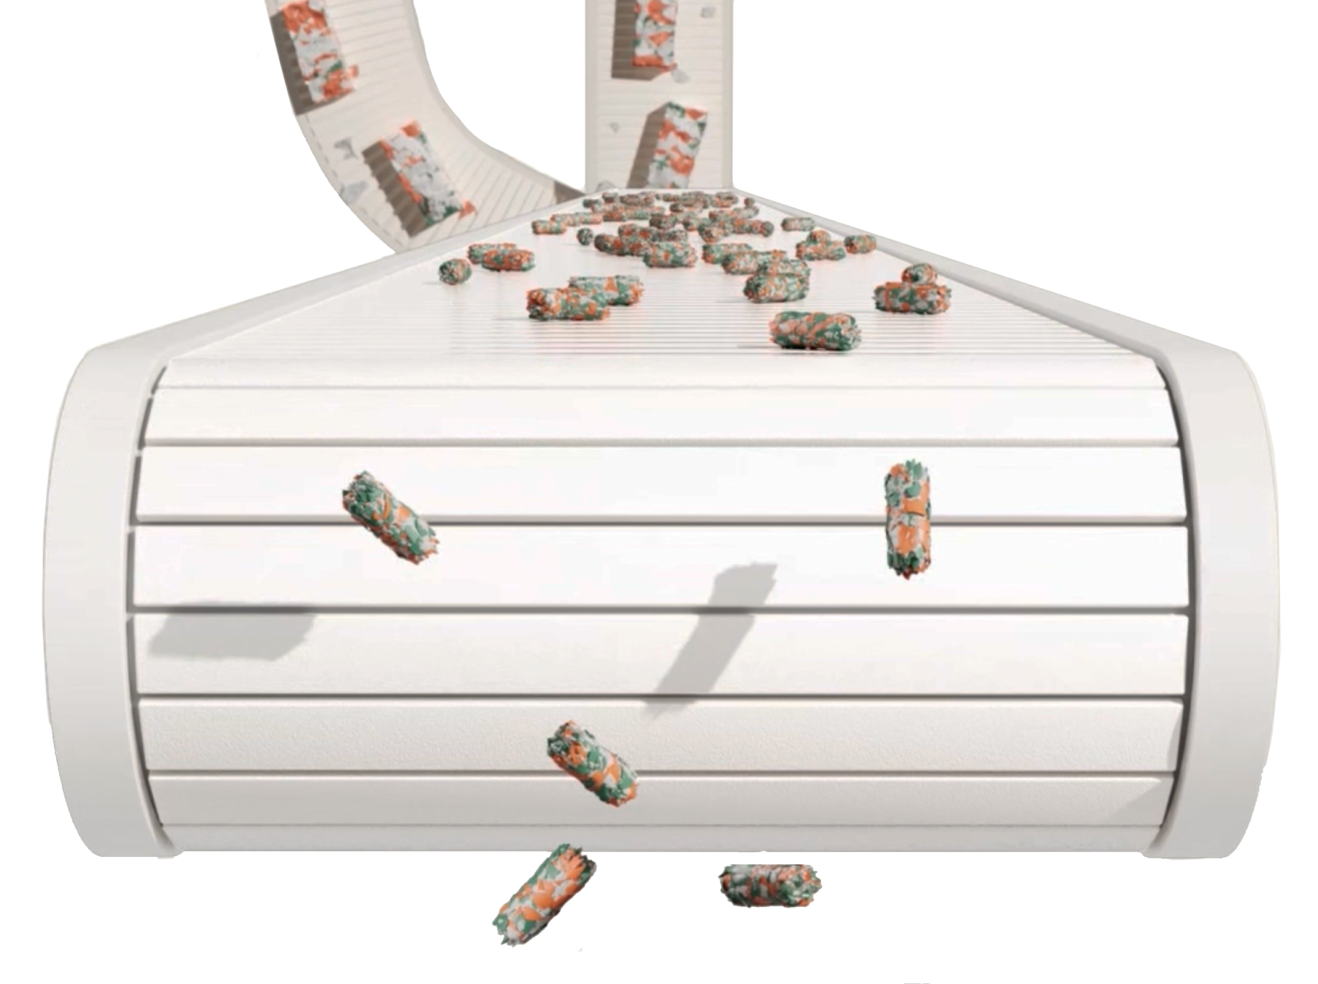
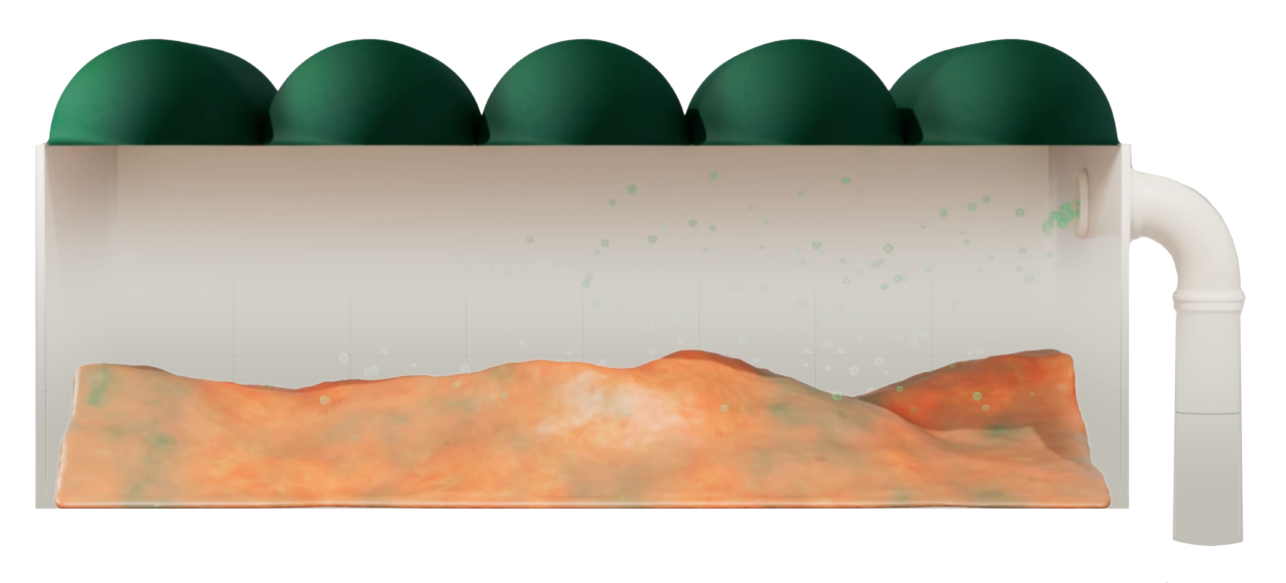
Sustainable and complementary circular innovations
Plastics Renewal™
Anaerobic Digestion
TECHNOLOGY
Converts post-use plastics to new products.
Converts organic waste to renewable natural gas.
EXISTING & IN-PROGRESS CENTERS
200 million pounds of plastic recycled annually at the Ashley Circularity Center.
Over 30 RNG Circularity Centers
PRODUCTS CREATED
ISCC PLUS circular pyrolysis oil​
Federal & California regulatory credits, renewable natural gas.

Slide 4
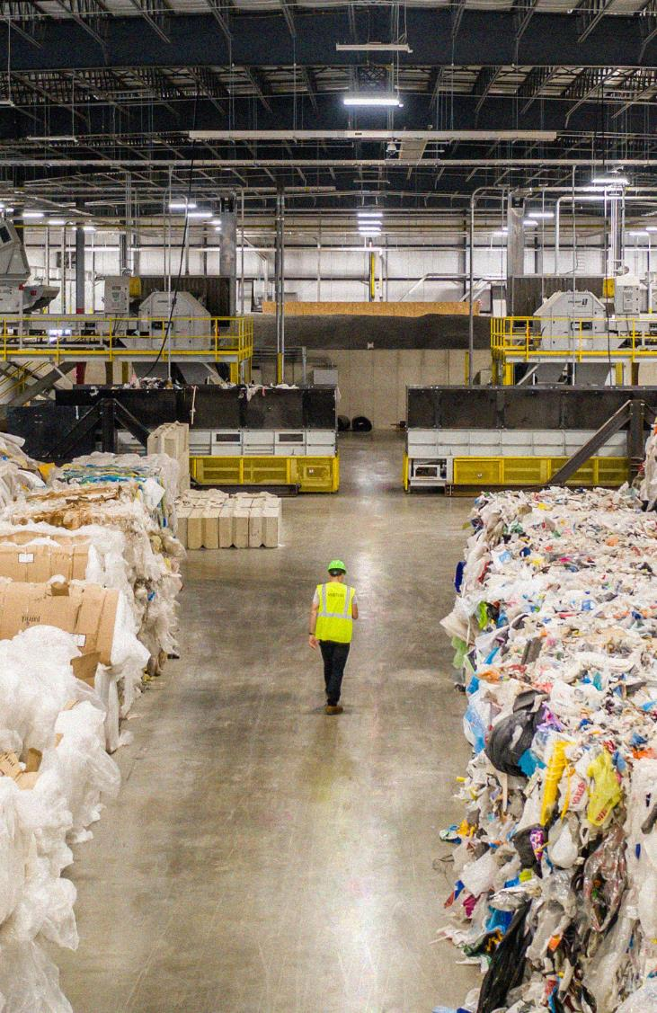
Plastics
RenewalTM
“
95% of plastic made in the U.S. each year is not recycled, ending up in landfills, incinerated or as litter."
National Renewable Energy Laboratory
4
Notes:
Quote Source: https://www.sciencedirect.com/science/article/abs/pii/S0921344922002087

Slide 5
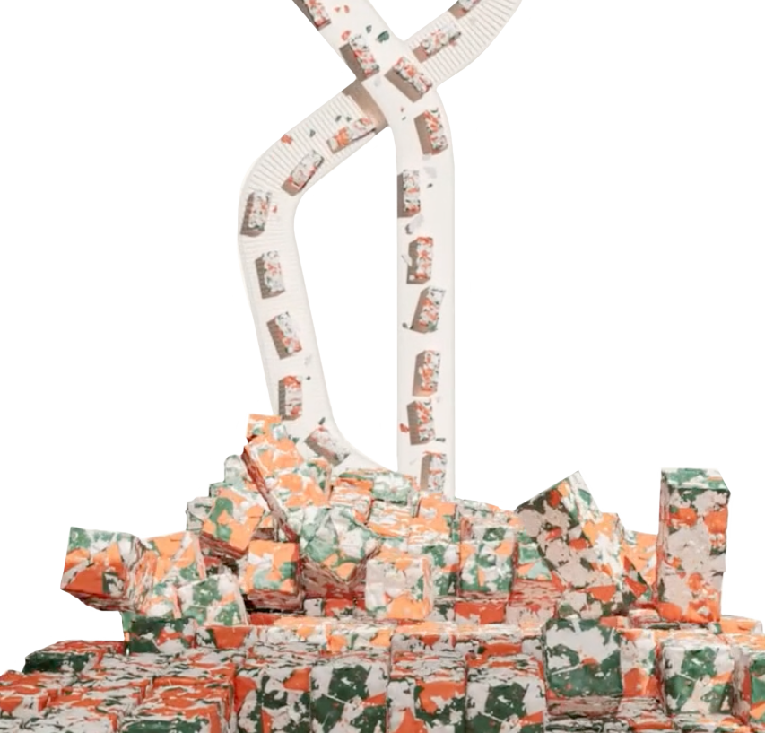
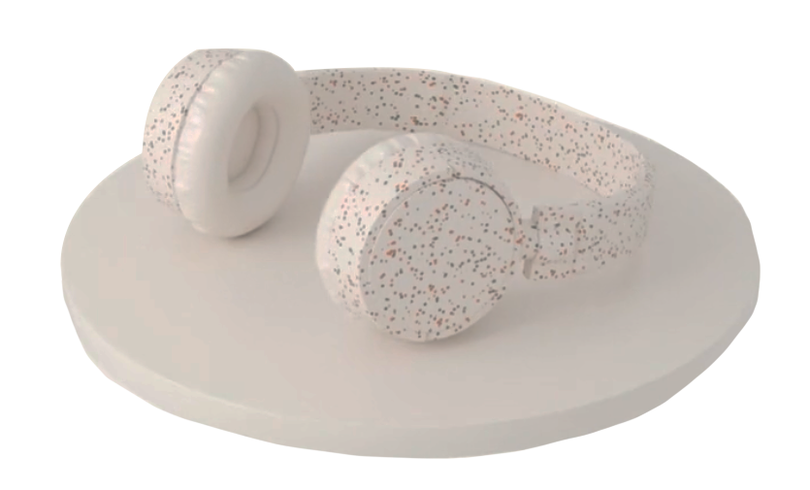
Plastics RenewalTM Technology
1. SHREDDING
2. PROCESSING
3. NEW PRODUCTS
Once the plastic waste is collected, it is prepped for conversion by shredding, removing metals, drying, and pelletizing.
The pelletized plastic material is then heated and vaporized in an oxygen starved environment.
The vapor is captured, cooled into a hydrocarbon liquid, and processed into ISCC PLUS circular pyrolysis oil.

Slide 6
Brightmark Plastics Renewal Circularity Center
Capacity to convert 200 million pounds of plastic annually in the 120,000 sq ft center.
Ashley, Indiana
KEY OUTPUTS
ISCC PLUS circular pyrolysis oil
ENVIRONMENTAL IMPACT
This facility qualifies as a synthetic minor source emitter under the Clean Air Act and diverts plastic waste from local communities.
EXPANSION PLAN
Additional plastics renewal centers in development in the U.S. and internationally
Source: Ellen McArthur Foundation

Slide 7
7

Slide 8
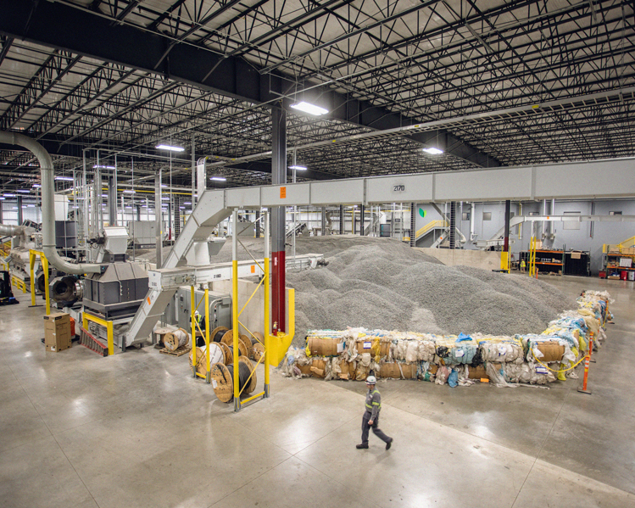
The next generation of plastics recycling
Comingled plastic streams
(rigid and flexible, emphasis on 2, 4, 5, 6)
Scalable centers designed to process large volumes of plastic
Our proprietary technology can be operated continuously and boasts a 1:11 energy conversion factor
8

Slide 9
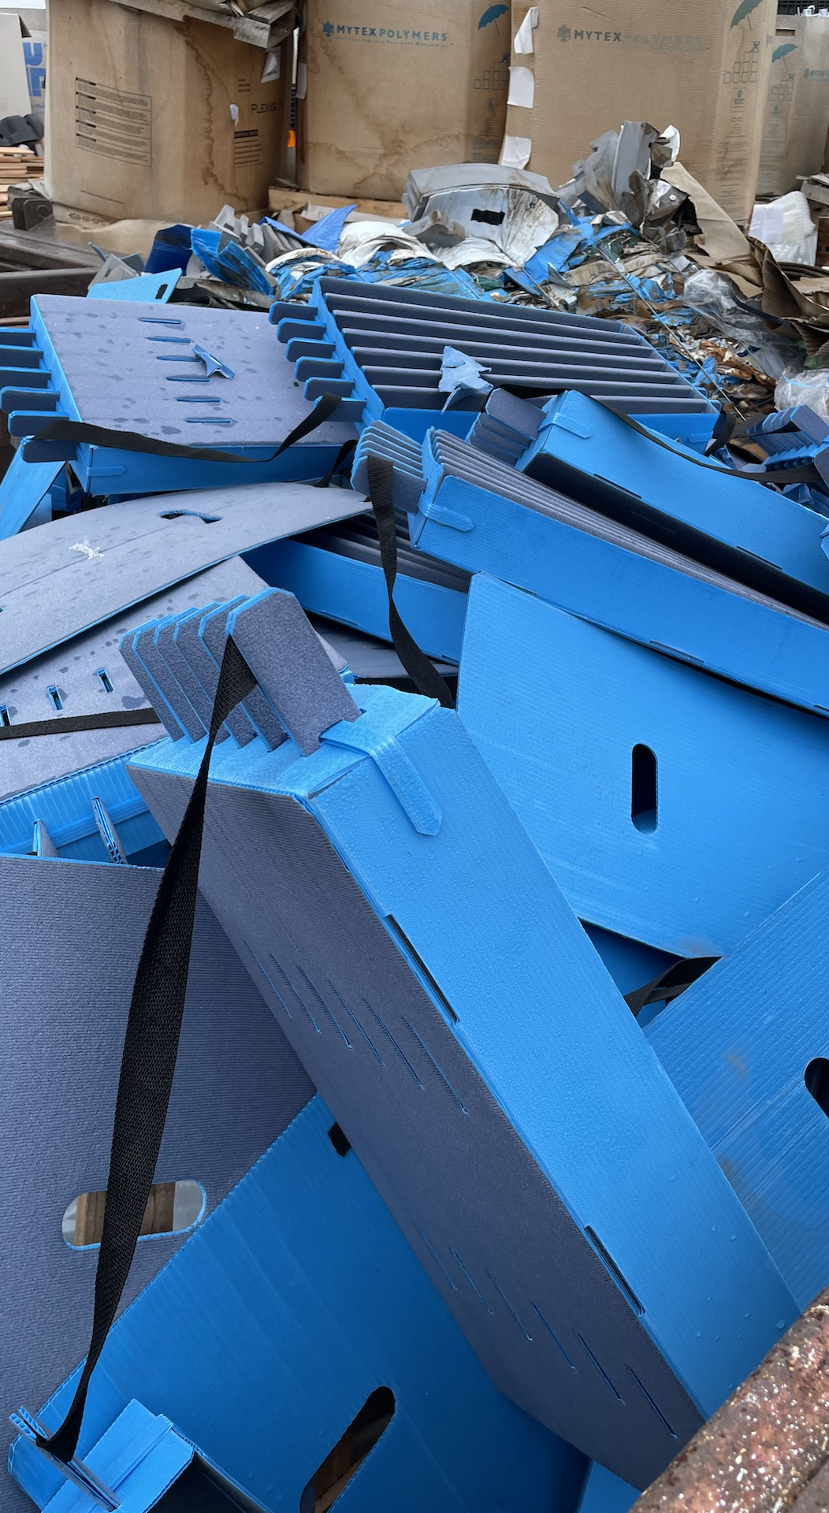
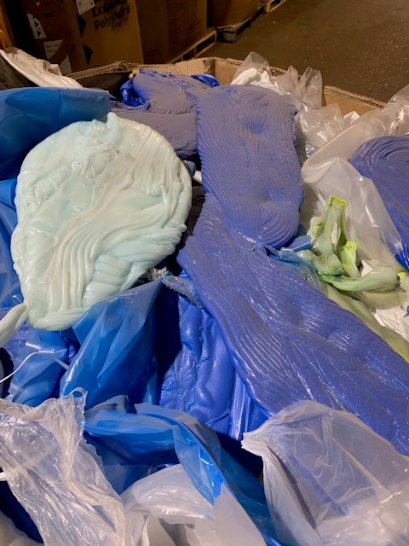
Feedstock types
Plastic feedstock
Source: Ellen McArthur Foundation

Slide 10
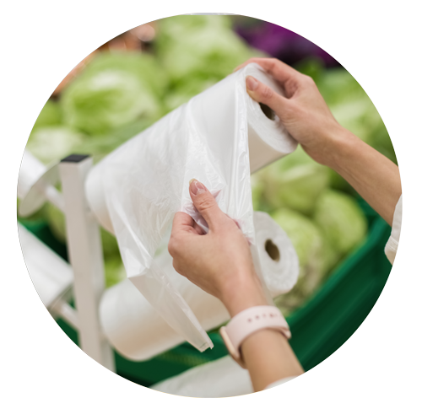
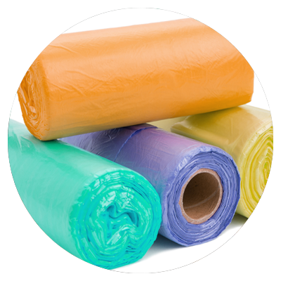
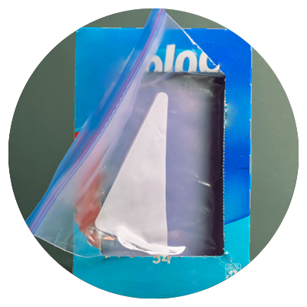
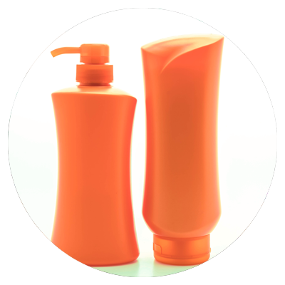
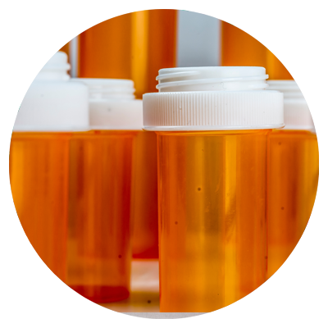
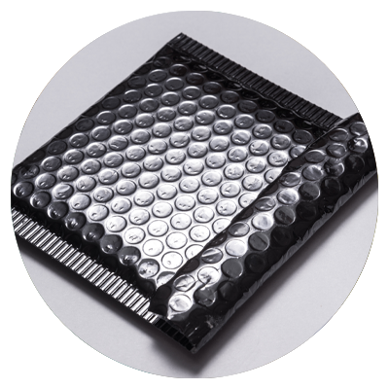
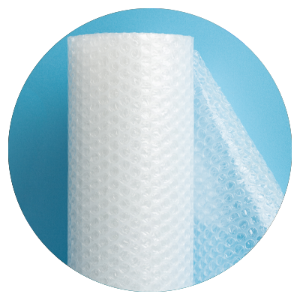
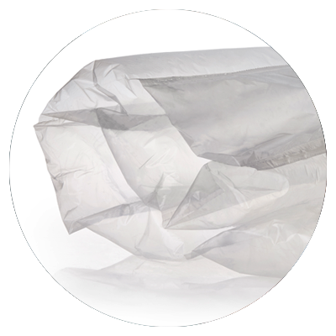
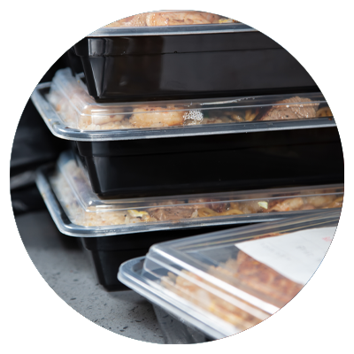
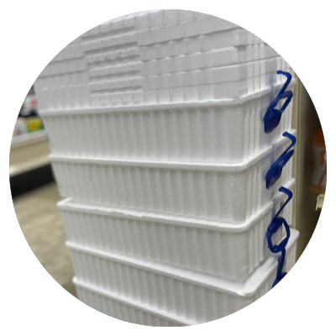
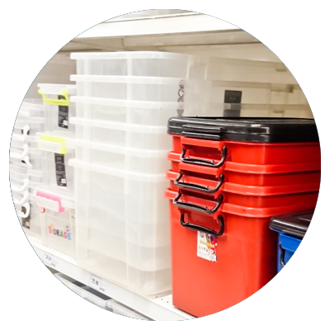
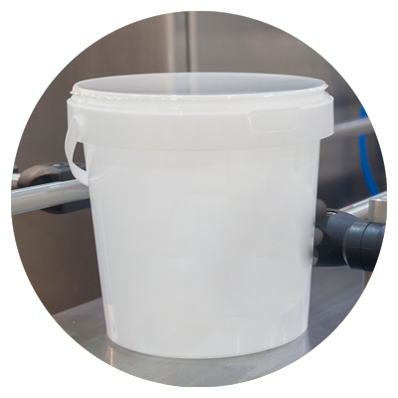
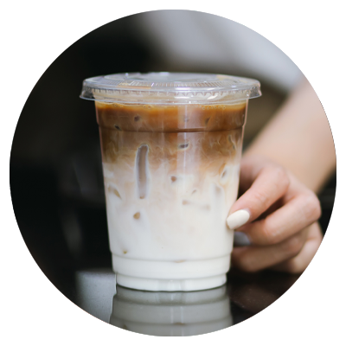
Examples of plastic you can divert from your waste stream
From curbside and commercial places

Slide 11
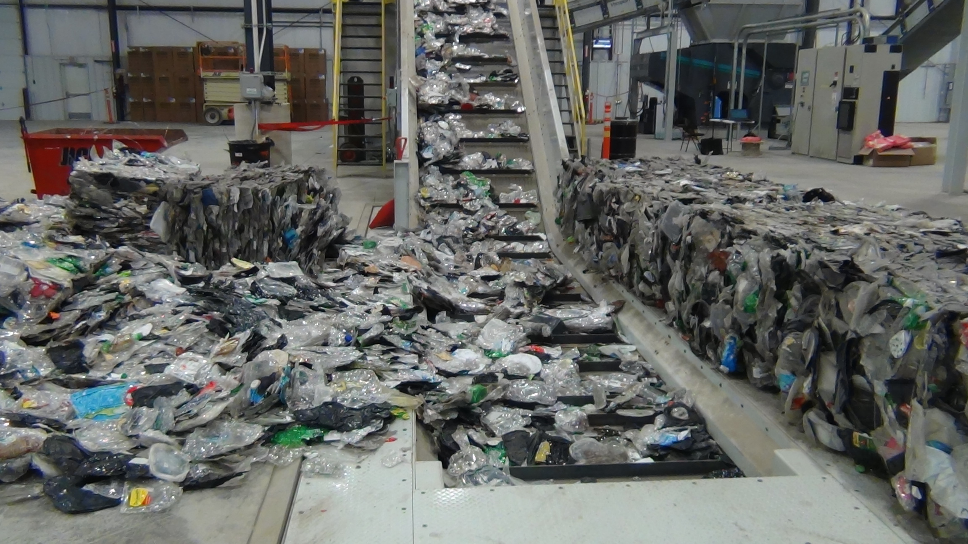
Post Consumer MRF Products:
Co-mingled film/bags - baled
Mixed Bulky Rigids - baled
#3-#7 baled plastic – baled
Post Industrial Material:
Dunnage – stretch wrap, strapping, corner protectors
Spent Material Management Items - supersacks, IBCs, totes, shuttles, drums, pallets
Various form factors– shavings, turnings, purge, floorsweep
Mold shop residuals – purges, sprues, hot-runners, resins
Film packaging – trimmings, butt rolls, slabs
Special Waste:
Electronic waste, marina film, ag film, drainage tile, fiber/cable conduit
Off Spec and Overstock Consumer Products:
Car seats, hangers, food/beverage containers

Slide 12
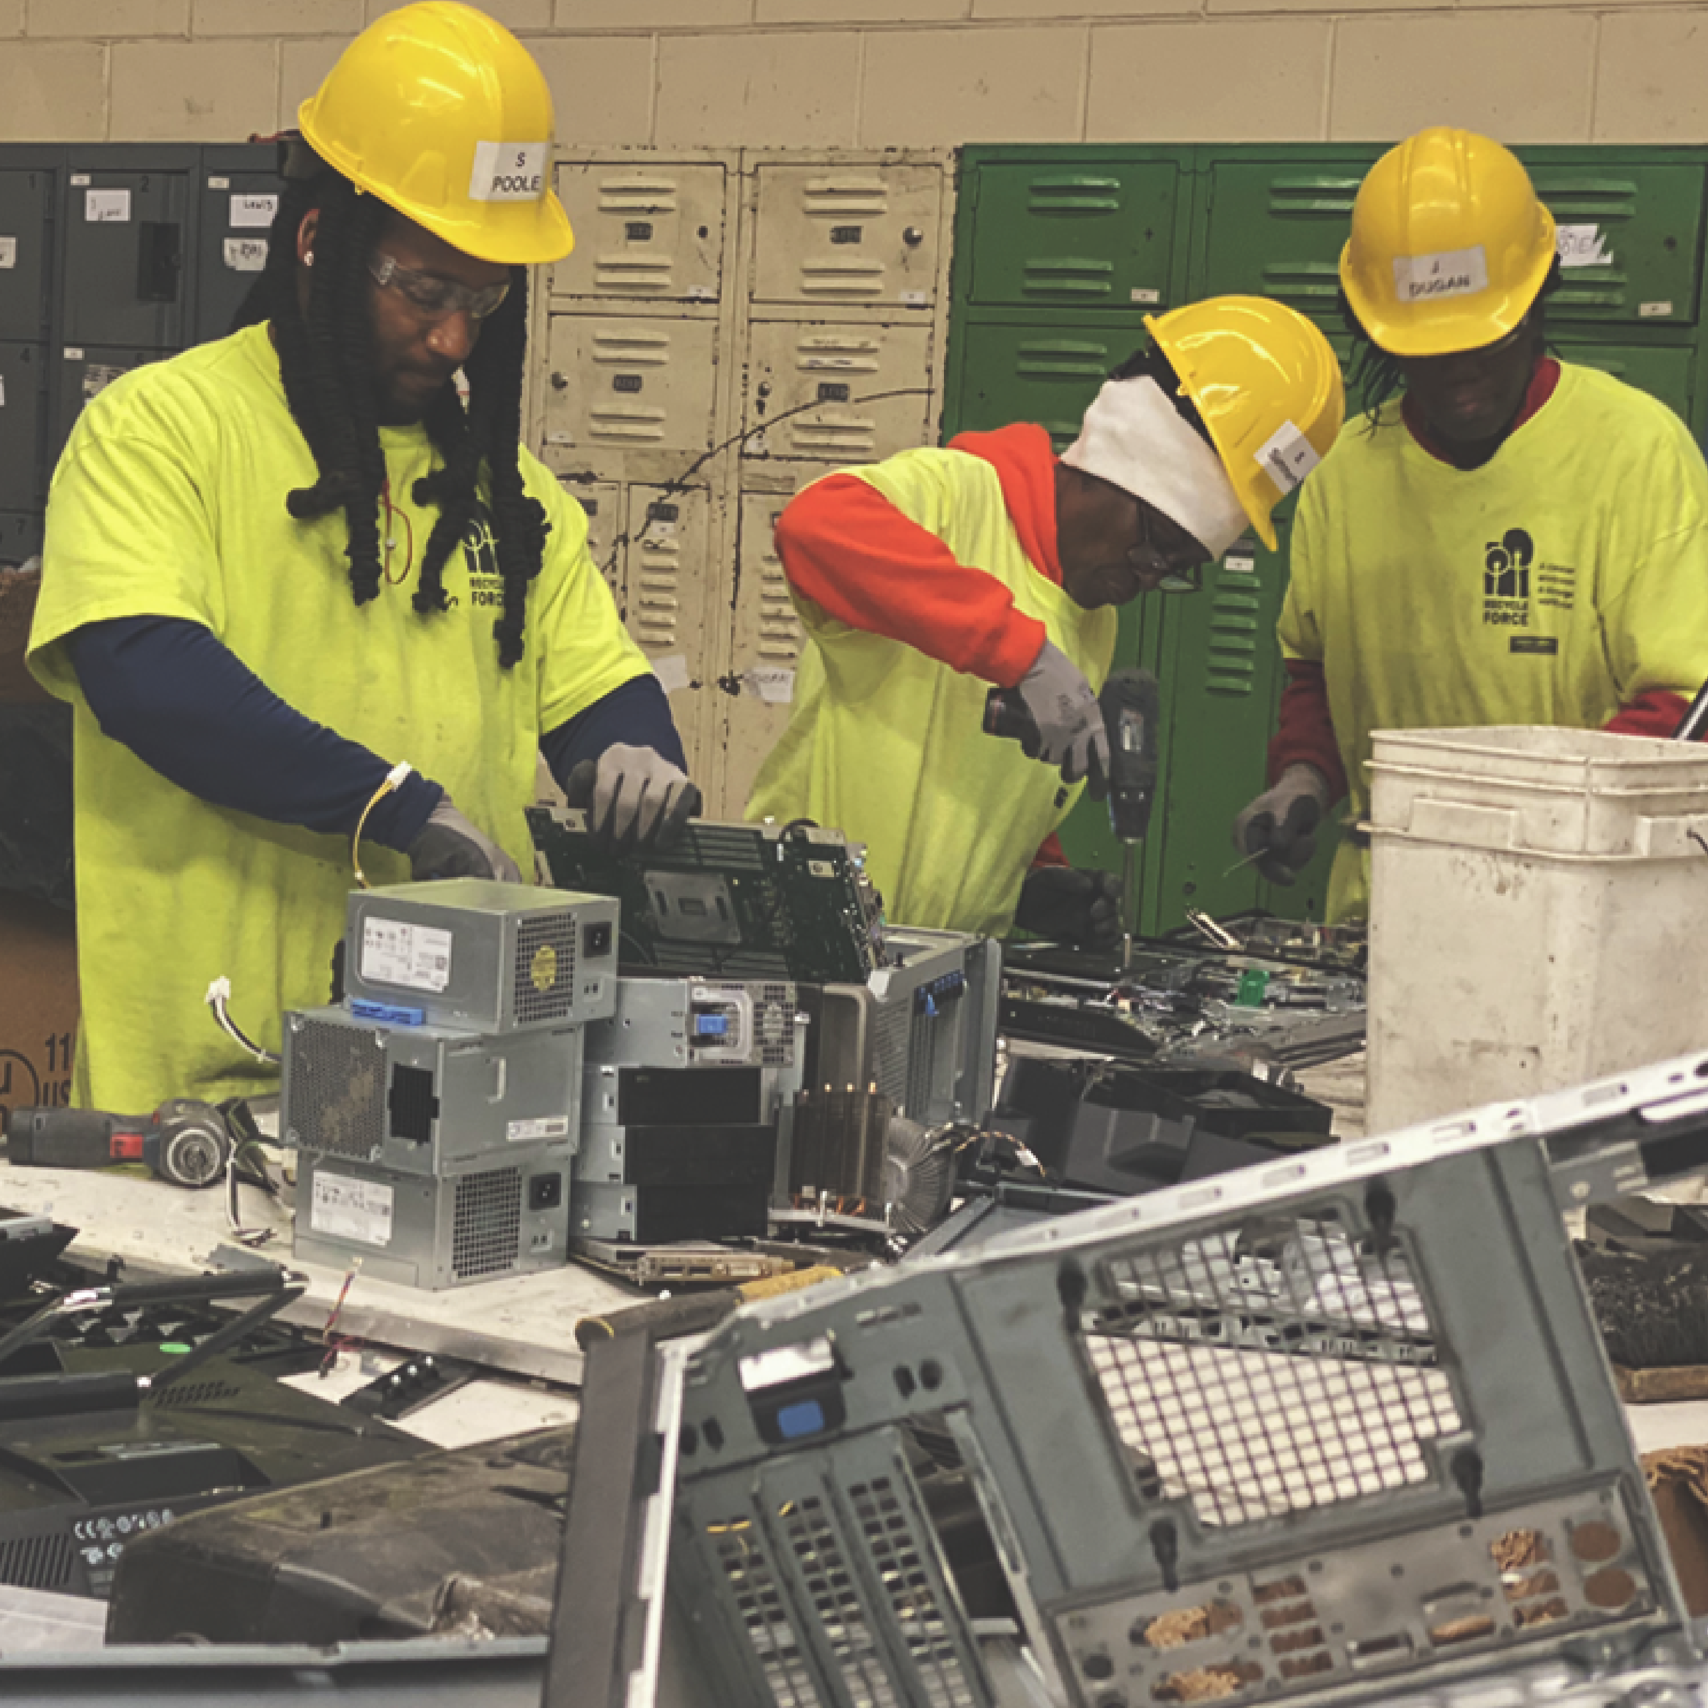
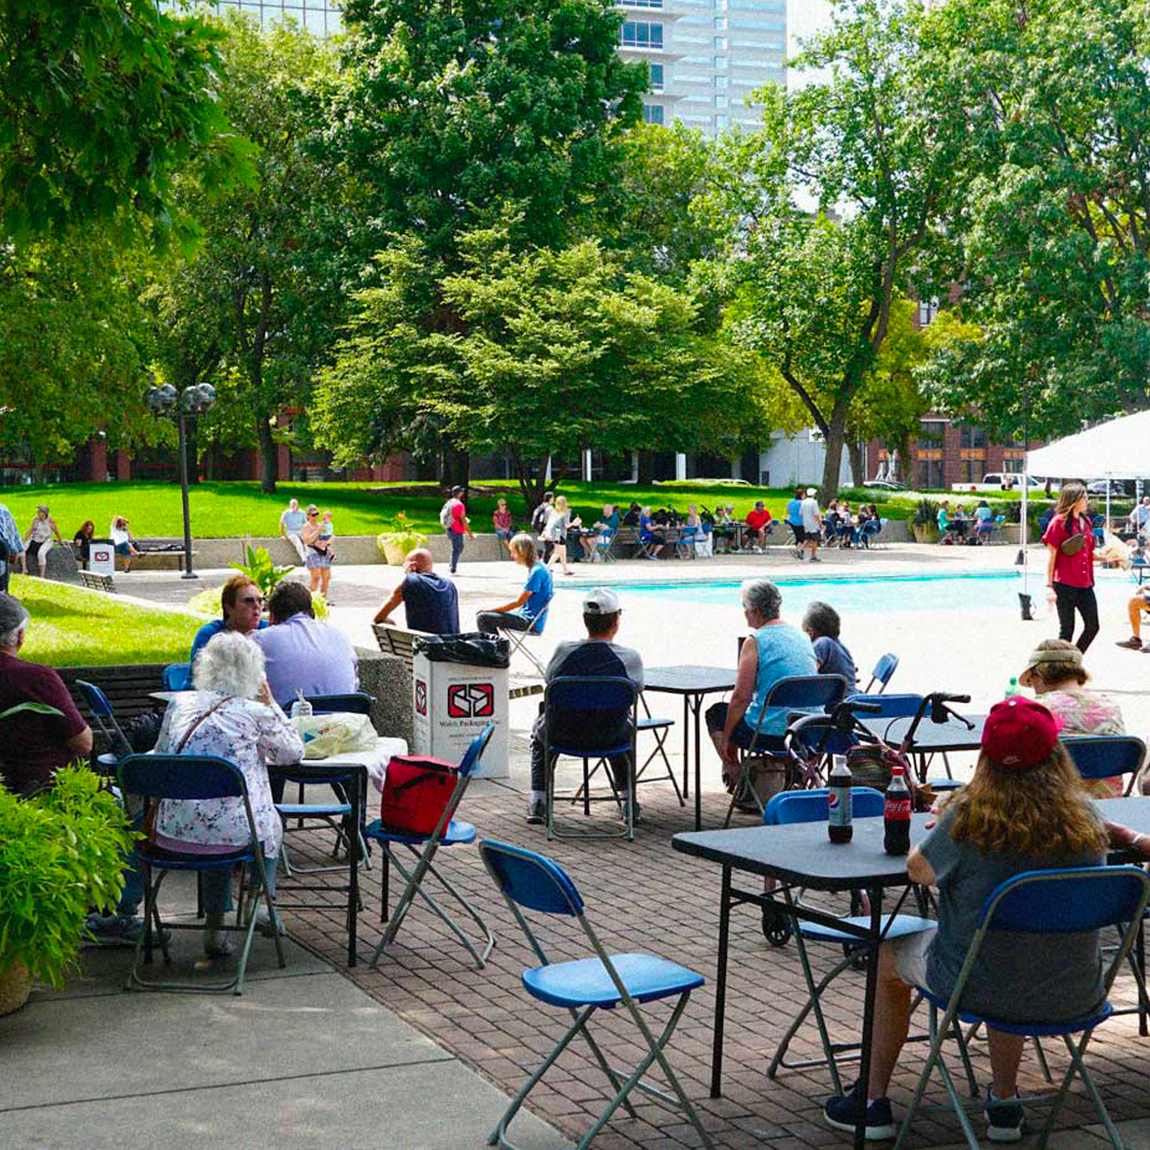
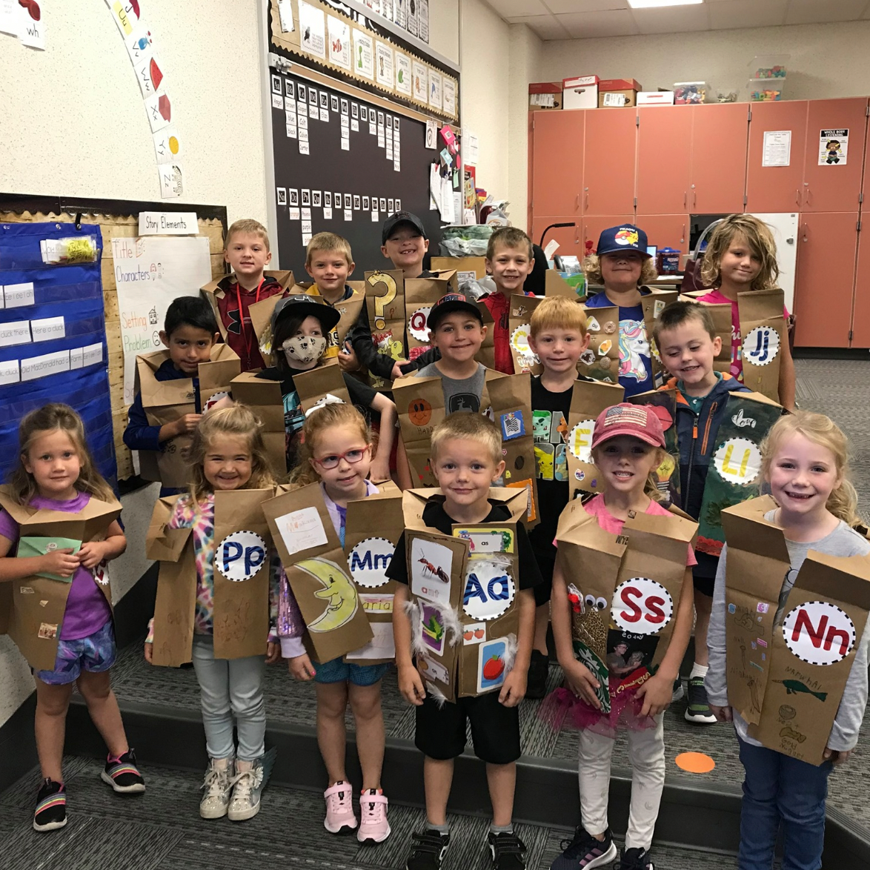
The power of partnerships and communities
RecycleForce in Indiana
Downtown Fort Wayne Lunch on the Square
Country Meadow Elementary School
Notes:
RecycleForce aids in the reintegration of individuals recently released from incarceration, offering them a renewed opportunity to reenter the job market. In collaboration, we also recycle the plastic components accompanying electronic waste.
Develop a recycling program with the city of Fort Wayne summer lunch series centered around educating the general public around the impact of plastic and recycling
Develop a recycling initiative centered around educating elementary school students about the impact of recycling.

Slide 13
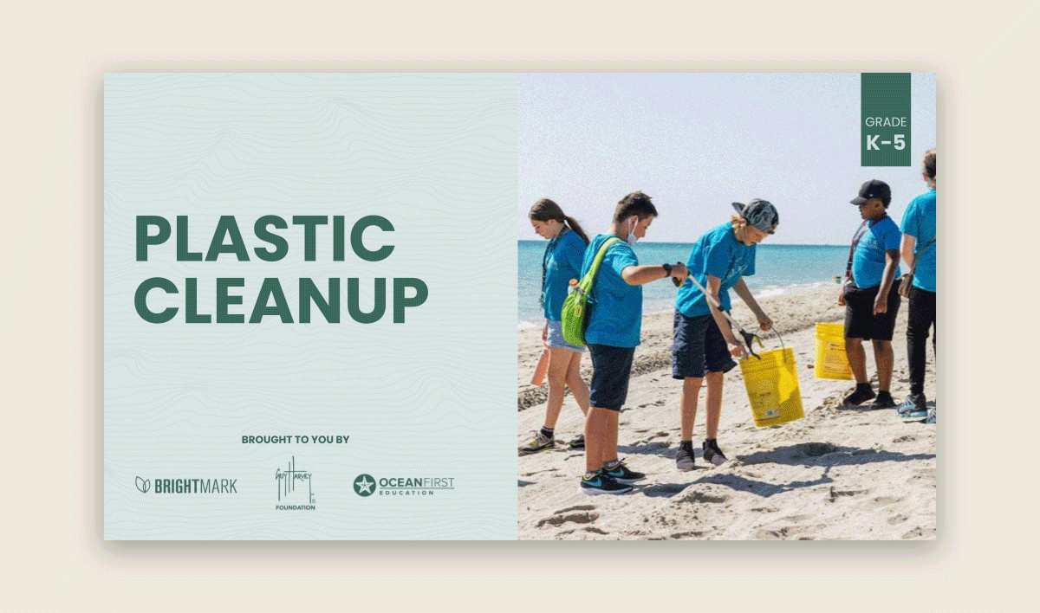
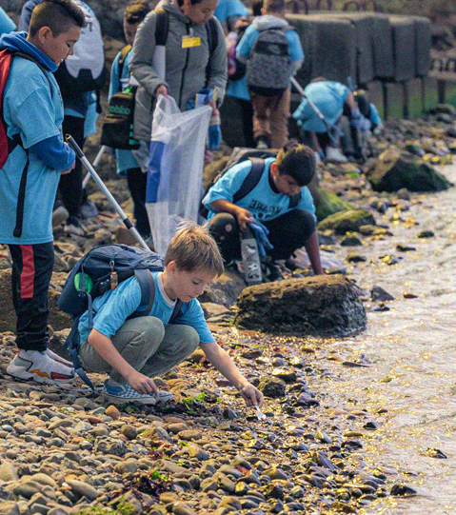
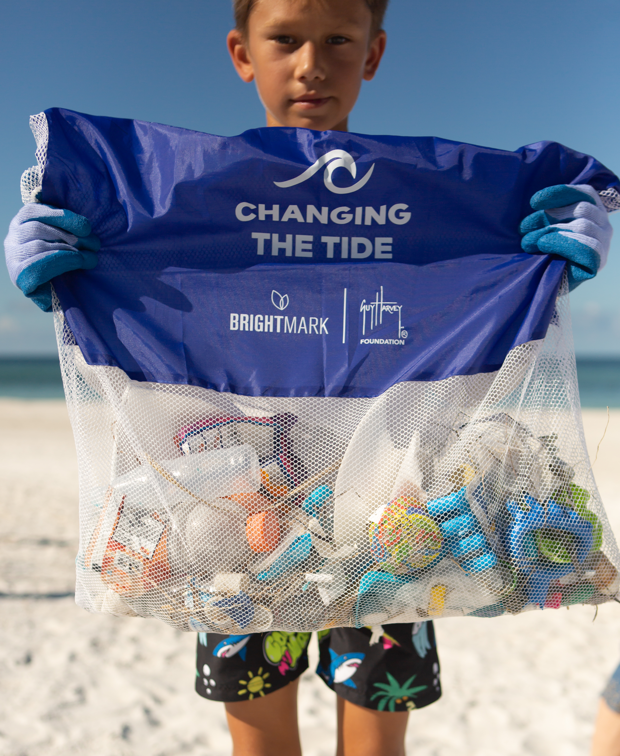
Curriculum with the Guy Harvey Ocean Foundation
Plastic feedstock
Combining expertise on recycling & ocean conservation
Curriculum for high school and elementary school students educating them about plastic pollution and its impact on our oceans.
Foster education
We have created a free unit that reaches students and aims to educate future generations on the impact of post-use plastic on the environment.
Our reach
To date we have reached over 38,000 students with a goal to reach 30,000 students this school year.
Source: Ellen McArthur Foundation

Slide 14
Let’s
Reimagine Waste, together.
Candace Rutherford
Director of Feedstock Origination and Development
candace.rutherford@brightmark.com
+1 650-420-7655
Brightmark.com
@brightmark

