Slide 1
Future Focus: Leveraging data for your success
Keefe Harrison, CEO
October 23, 2023
Notes:
Good morning! Thanks to the pet Sustainability Coalition for inviting us to participate in this important and timely webinar series.
My name is Rachel Kipar, Director of Recyclability Solutions at The Recycling Partnership.
Today I’d like to share 3 digital tools that will help you develop data-backed strategies to design better packaging and improve the system.

Slide 2


Slide 3


Slide 4


Slide 5
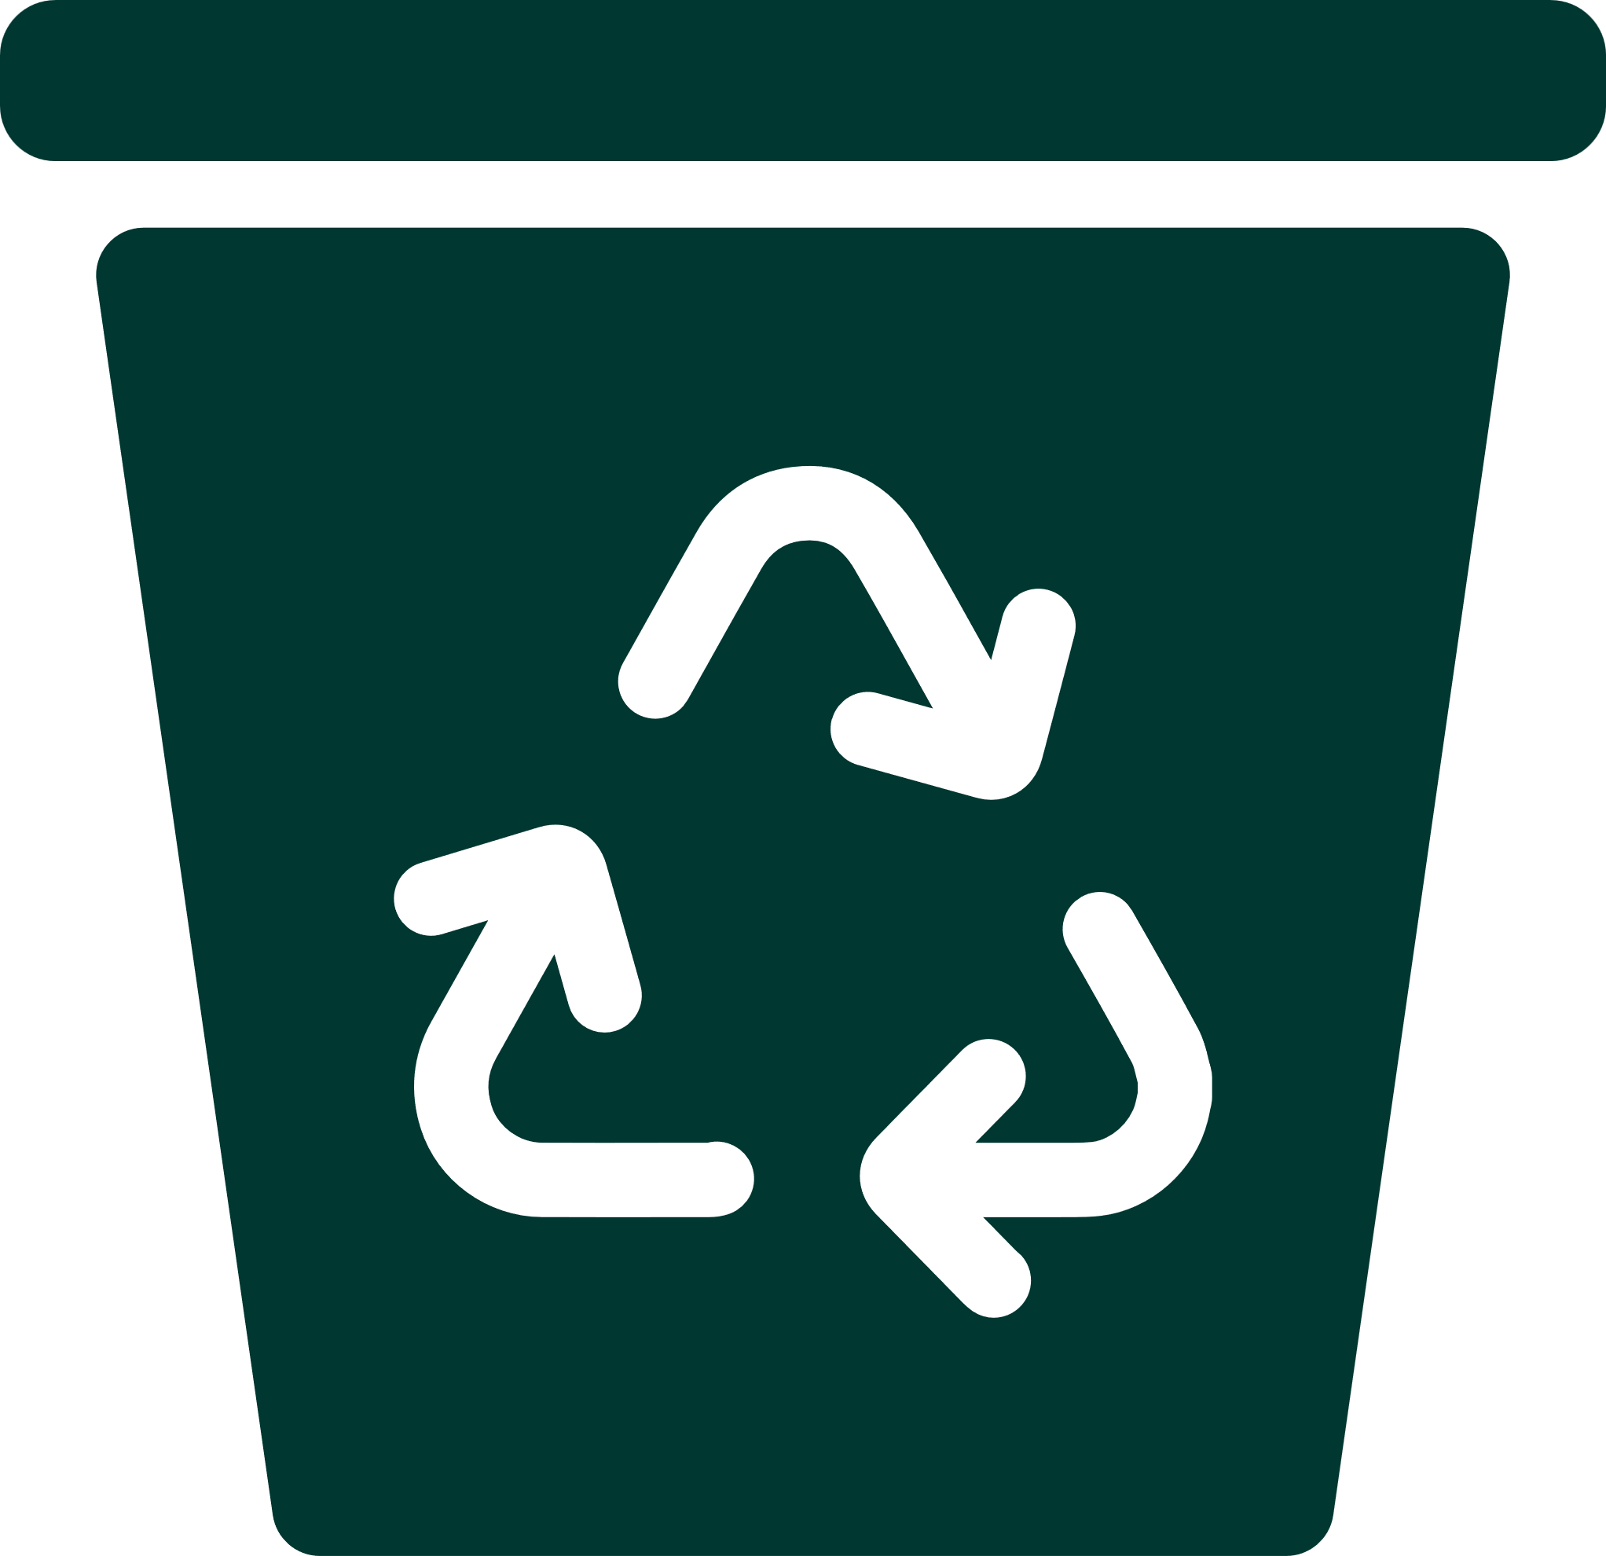
Vision, Mission, and Core Values
Vision
Mission
We envision a future where the burden of waste has been transformed into a beneficial resource.
We empower people and the planet by advancing
recycling and the circular economy.

Slide 6
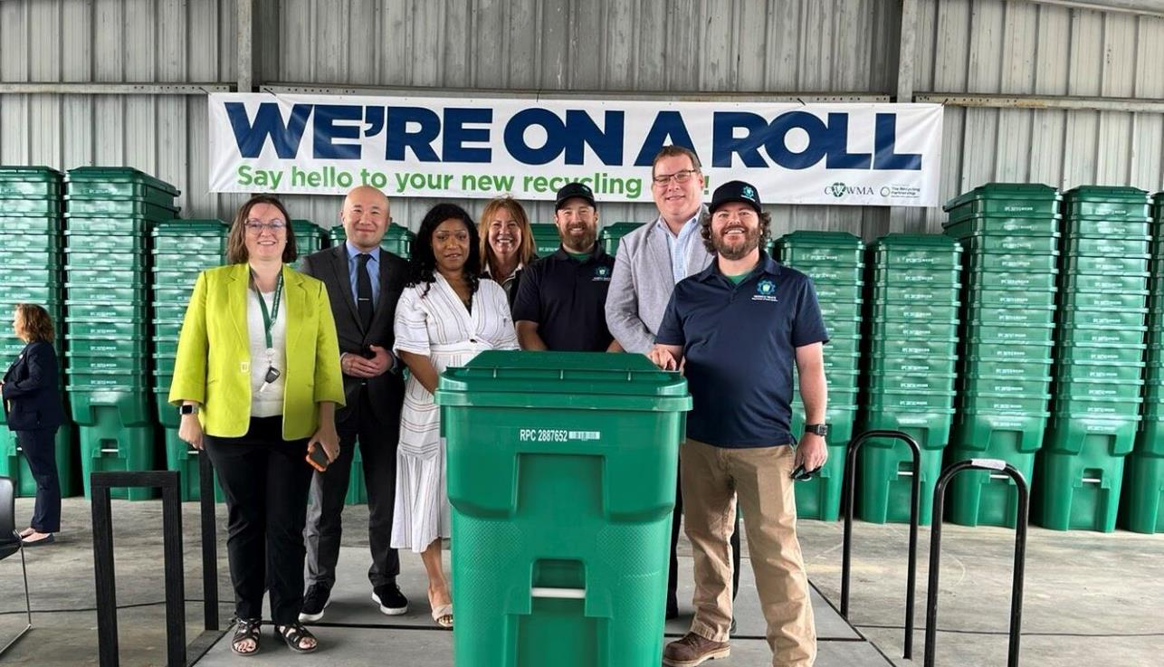
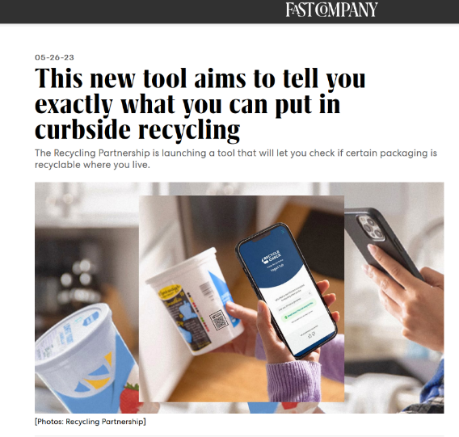
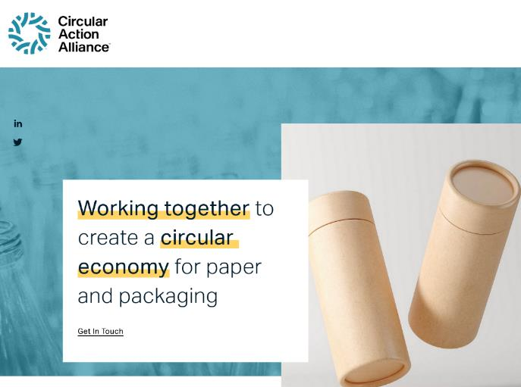

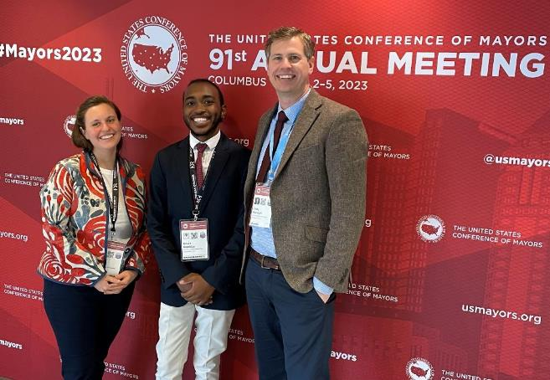
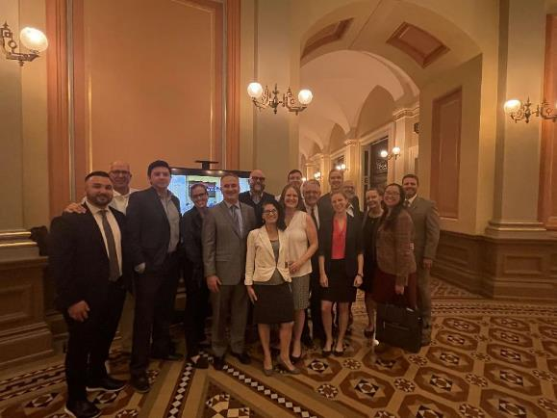
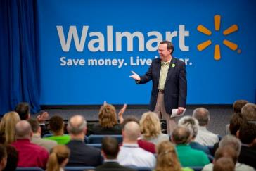
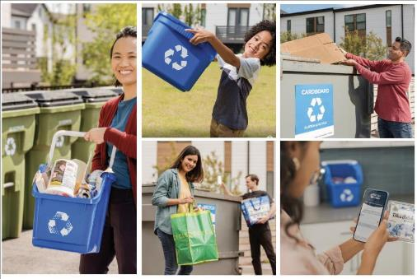

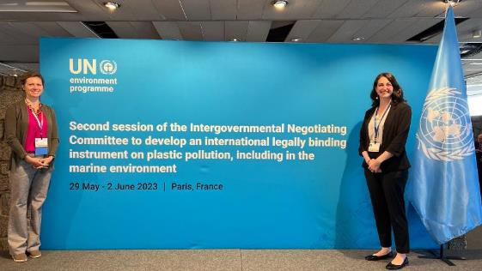

Slide 7
The Recycling Partnership's Focus
4 Verticals of Growth & Impact
Advance & Implement Harmonized Policy
Regional System Change
State & Federal Partnerships
Innovation, Data and Services

Slide 8



The U.S. Policy Landscape
Extended Producer Responsibility Legislation
EPR Laws Passed & Currently Being Implemented​
(California, Colorado, Maine, Oregon)
EPR Legislative Activity in 2023
*
EPR implementation in four states will increase the national recycling rate by 4-5%.

Slide 9

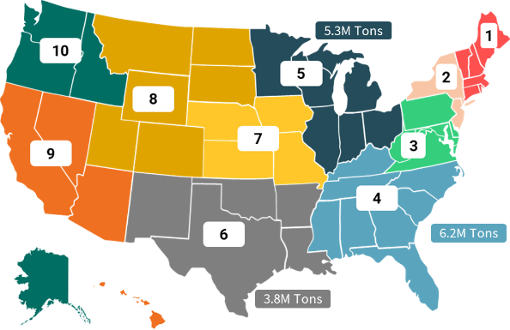
Which Regions Have Strongest Opportunity?
Regions without policy have the largest opportunity to capture tons and improve the national rate.
EPA Region | Lost Tons Per Year (M) | Est. Region Recycling Rate
4 | 6.2 | 18%
5 | 5.3 | 23%
6 | 3.8 | 17%
3 | 3.1 | 20%
2 | 2.1 | 29%
9 | 3.3 | 36%
7 | 1.6 | 15%
8 | 1.2 | 15%
1 | 1.4 | 28%
10 | 1.2 | 28%
Confidential to Members of The Recycling Partnership

Slide 10


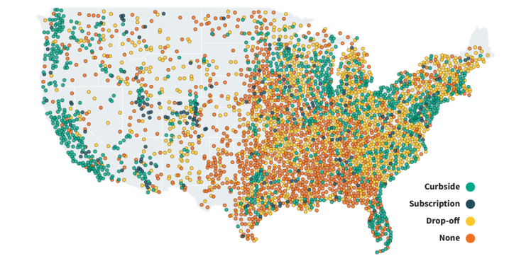
Disjointed Landscape of Local Recycling Programs
9,000+ programs | 30,000+ communities​
Notes:
Did you know that there are more than 9,000 recycling programs supporting over 30,000 communities in the US?
And you've probably noticed if you've ever tried to recycle in a location other while you're traveling, the recycling rules where you are in that moment probably aren't the same as the ones in the place where you live. This is the case for consumers all over the United States. And it's no wonder that people are confused about how to participate in their programs if the rules are changing in every jurisdiction.
Here’s a final layer for the landscape.
We know People support recycling, but they’re confused.
We also know, confidence in recycling is in decline. And we need to act fast to reverse this trend.
Less than half believe their recyclables are made into new things – so why do it?
People are looking to more than just their local government for recycling information. 8 in 10 are looking to product labels!
But we know reducing confusion increases confidence, and increased confidence leads to higher participation and MORE, BETTER recyclables going into the cart

Slide 11
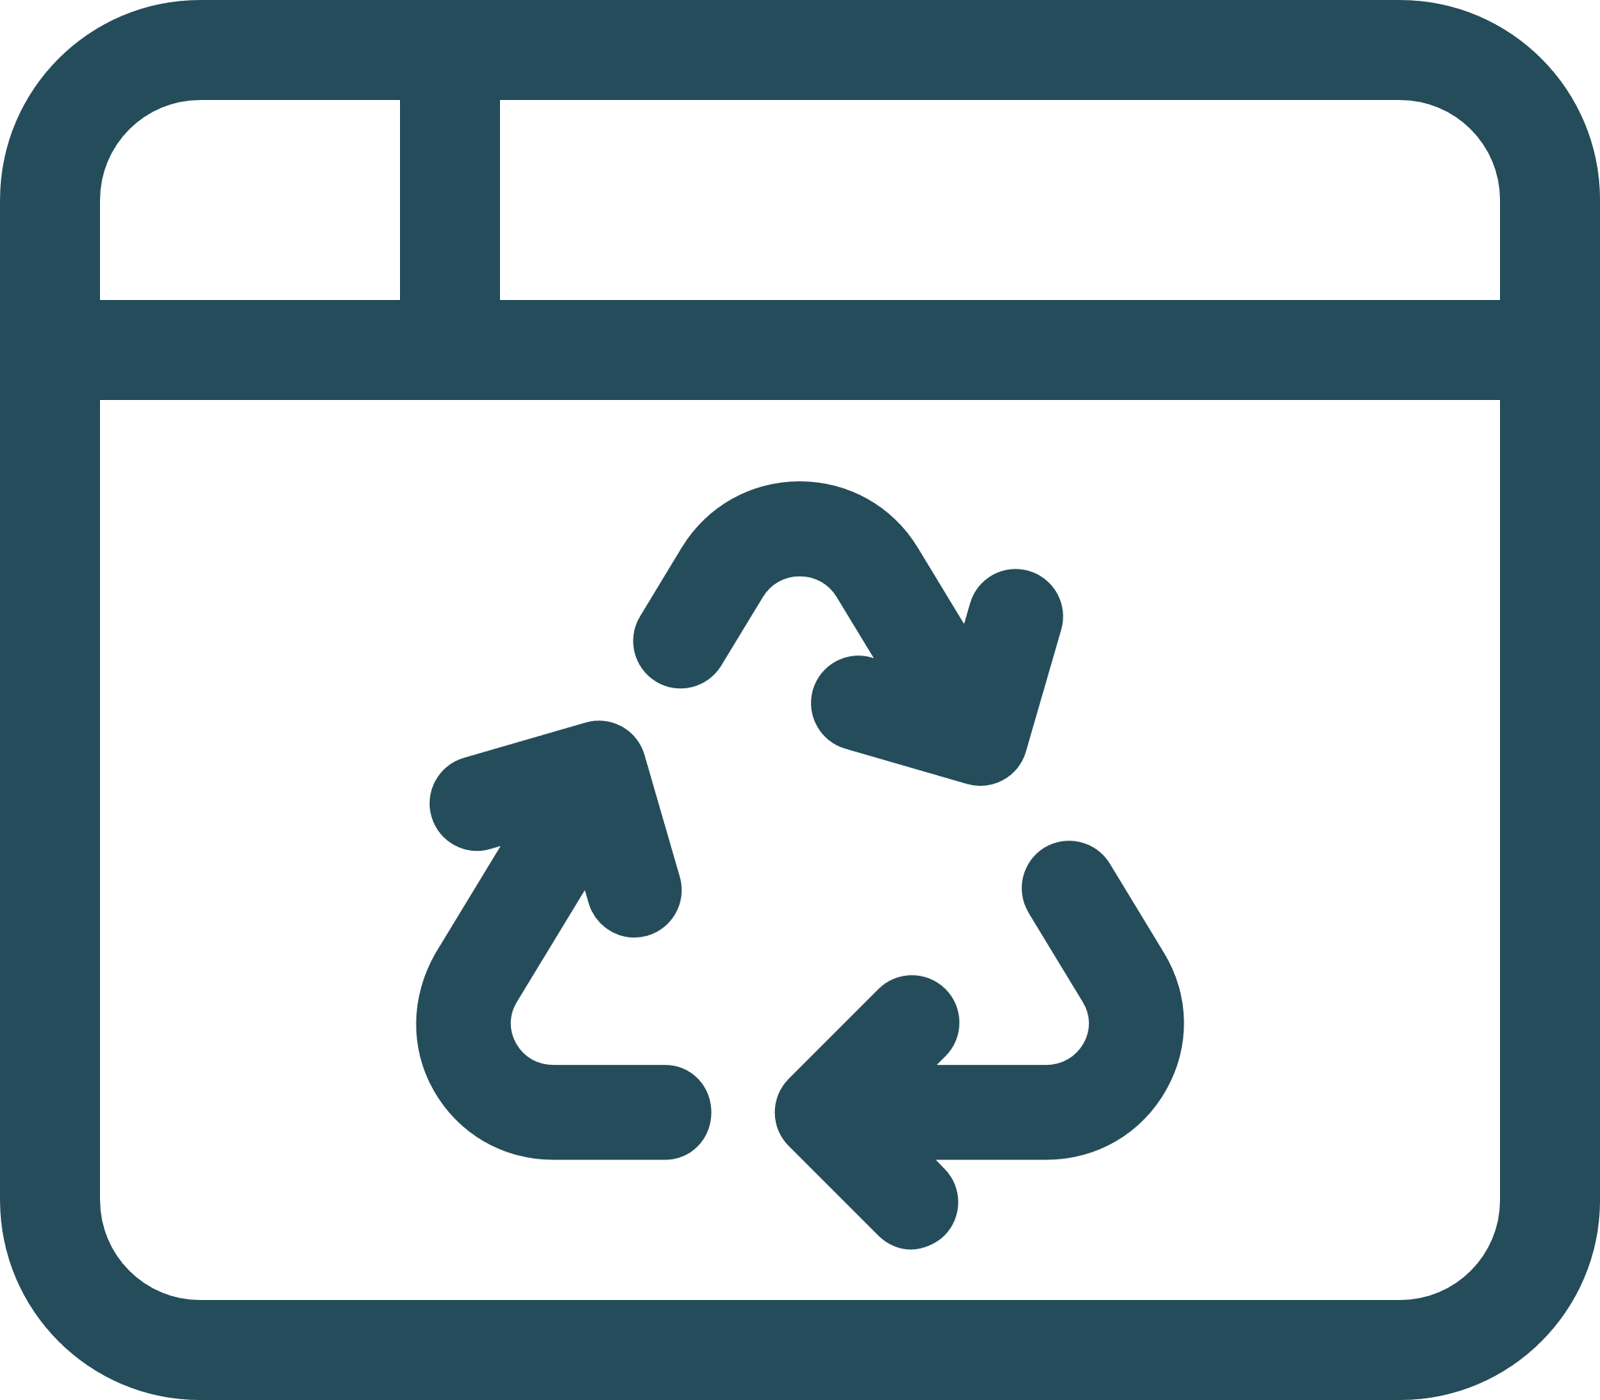
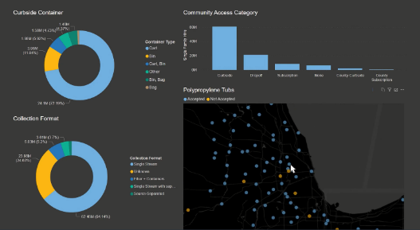

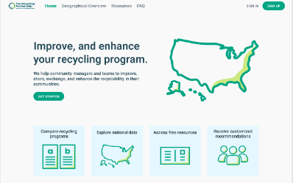
Empowering Local Community Recycling Programs
National Recycling Database
Recycling Program Solutions Hub
11
Notes:
Okay, I can see folks leaning in. We’re waking up, what’s next?
The last two tools are to help companies set solid strategies and design more recyclable packaging – great. A critical link in the value chain.
What about Communities? I’m so glad you asked!
That National Recycling Database (you’re going to see this screen grab a lot) is also the backbone of our hot-off-the-press Recycling Program Solutions Hub.
The Hub no only provides resources and support to all 9,000 communities, but it opens that critical feedback loop to further verify what’s housed in the National Database is up-to-date for each community.

Slide 12
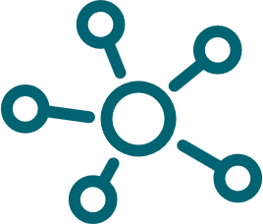
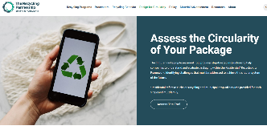
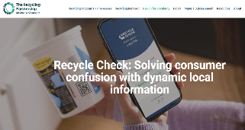
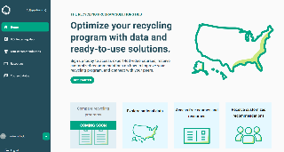
Connecting Data & Improving the System through Digital Tools
Circular Packaging Assessment
Recycle Check
Recycling Program Solutions Hub

Slide 13
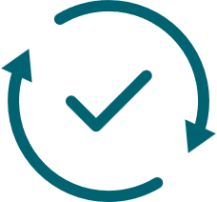
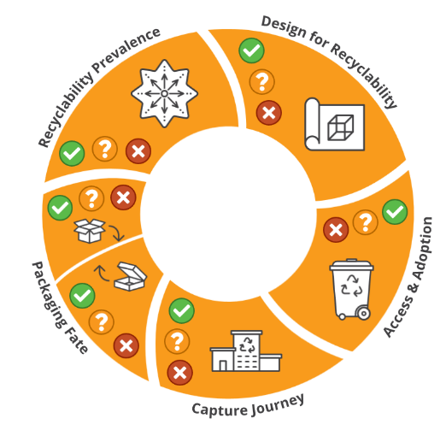

Circular Packaging Assessment Tool
Notes:
Circular Packaging Assessment Tool is the first free, public tool for assessing packaging recyclability on a U.S. system level
Users can take new or existing package(s) through the building block requirements and, based on the information provided, along with information already known about the package(s), determine recyclability.
If the requirements are not met, the Guide suggests actions such as package re-design, or participating in or forming material coalitions that can serve to expedite action and exponentially speed up progress towards recyclability.
First, you plug in your package details, leveraging the industry’s first ever fully digitized design guides from APR (the Association of Plastics Recyclers), American Forestry & Paper, Carton Council, Aluminum Association, and Can Manufacturers Institute. This determines technical recyclability of your Design.
Then, it leverages that National Recycling Database that I told you about earlier, pulling Access information from all 9,000 communities to relay if your package is Widely accepted for recycling or has more work to do to reach the 60% threshold set by the FTC Green Guides.
From there, it let’s you know if your package can be captured at the MRF or Materials Recovery Facility.
Does your package have solid End Markets?
And is your package at risk of non-recyclable look-a-likes that will cause consumer confusion.
For anyone who’s a nerd like me and wants know how each building block is determined and measured, it’s all right there in the tool.
Now I’m sure many of you are asking, how does this align with SPC and the How2Recycle label assessment? GreenBlue and The Recycling Partnership are committed to building industry alignment and harmonization to reduce confusion and improve the recycling system. The recyclability assessments used by How2Recycle and The Partnership are similar in many ways, and our teams are working to further align the two over the course of this year.
This tool is coming live early this Summer, so please be on the lookout or sign up to receive more information on my contact slide at the end.
The underlying Framework was developed by The Recycling Partnership:
In collaboration with 35 industry leaders, known as The Circularity Council (includes organizations representing the entire value chain)
With input received from a month-long public comment period, hosted in summer 2021, and concluded with responses published in December 2021
We see a critical role for the Framework going forward in:
Shaping package design
Helping states with policy by defining what is recyclable
Informing recyclability claims
Driving new innovations
Based on the Residential Recyclability Framework, this PDF will be an industry first, free to access/use, self-assessment guide for assessing packaging recyclability. (**** Update this language to reflect next phase beyond PDF- beta then full tool)

Slide 14

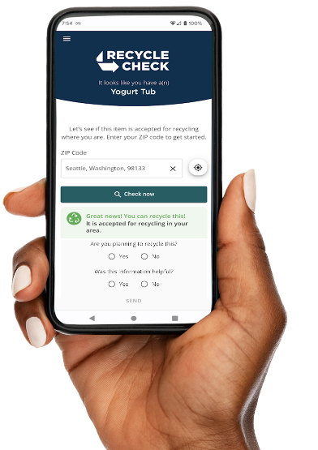
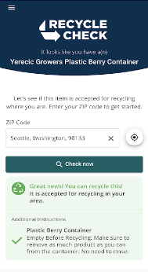
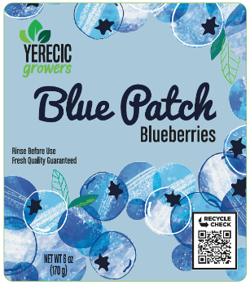

Recycle Check: Connecting Companies, Communities, and Consumers
Recycle Check in action
on a PET clamshell
Geolocation
Community-specific results
Easy to understand instructions, aligned with
Digital app and website integrations with SmartLabel
Designed in collaboration with Yerecic Label.
Notes:
We have launched Recycle Check, an interactive platform that leverages the National Database to deliver local, package-specific, up-to-date recycling information to people across the U.S. in seconds.
With custom links for each package type, anyone in the US can enter their zipcode or allow location permissions and Recycle Check quickly shows consumers if the products they buy can be recycled and how to do so, wherever they are.
It can be used as a digital link on a product webpage, or as a QR code on a physical packaging label.
The platform is for all residential recyclables – plastic, paper, metals, glass. Because of it’s ability to deliver up to date community specific information, it is an especially helpful solution for packages that are accepted in some but not all curbside programs such as thermoforms or clamshells like this one, beverage cups, or items with growing access rates such as polypropylene.
So why don’t you try it for yourselves?!

Slide 15


Recycling Program Solutions Hub
Giving local program managers control over the accuracy of program data
The Recycling Program Solutions Hub is a free tool for recycling program managers to access and verify critical recycling program data.
Interactive Data Map
Custom Recommendations
Learning Hub & Resources
Peer to Peer Connections
https://community.recyclingpartnership.org
Notes:
recycling program managers will have an open-access, free tool for connectivity, resources, and verification of critical information needed for the success of the entire recycling system.

Slide 16
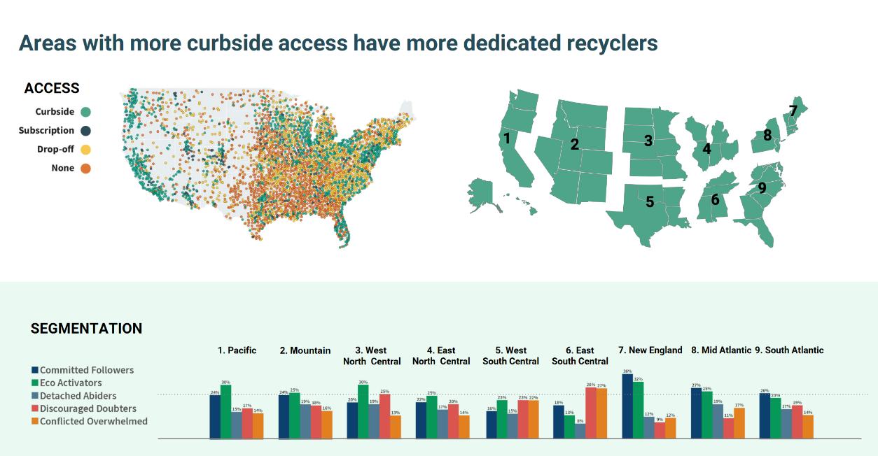

Slide 17
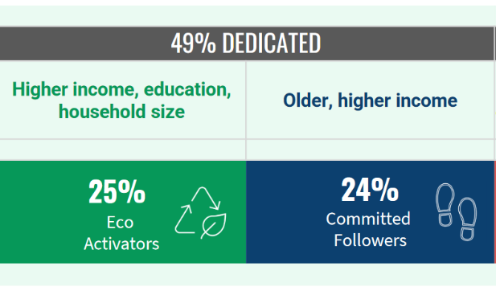
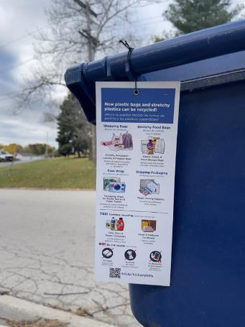
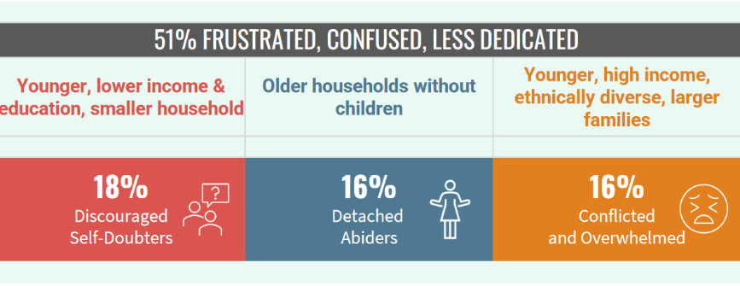

Slide 19
The wind is at recycling’s back – but it’s squirrely. Global, federal, state, public. The better connected you are to trends, the easier the transition.
You can shape the data that shapes how things enter and exit your recycling program.
The size of the solution needs to meet the size of the challenge. Public-private solutions needed to deliver a $17B solution.

Slide 20
Keefe Harrison
kharrison@recyclingpartnership.org
community.recyclingpartnership.org

