Slide 1
Forming a US Composting Council Chapter

Slide 2
2022 Chapters

Slide 3
Benefits to Starting a Chapter
USCC Credibility
Logo & Affilliation
Advocacy Stances
Networking & Communications w/other Chapters
Chapter Bulletins
Networking Calls
Marketing Support
Canva team, templates

Slide 4
Benefits to Starting a Chapter
Financial Support
Chapter Support Funding
COTC profit sharing/locating in your state
Advocacy Support
Legislative & Environmental Affairs Committee
Grassroots template-coming
National Conference Support
Conference Attendance financial support for leadership
Chapter Training, networking event @ Conference

Slide 5
Benefits to Starting a Chapter
Gary Gittere, past president, North Carolina Composting Council & USCC Board Member

Slide 6
Steps to Starting a Chapter
Step 1: Form a group of like-minded organizations and individuals to discuss the goals, resources, and challenges of establishing a chapter in your state. Work to expand that group in both numbers and geographic representation.

Slide 7
Steps to Starting a Chapter
Step 2: Download the New Chapter Admission Criteria and review it for minimum objectives that the CAC has determined are necessary for a successful chapter.
Tier One: Mandatory for Consideration
Tier Two: Optional But Best Practice

Slide 8
Steps to Starting a Chapter
Tier 1:
Minimum members in state:5
5 member petitioning committee-3 must be members
Initial board of directors is presented

Slide 9
Steps to Starting a Chapter
Tier 1:
STRUCTURE
501C organization backer or 501C status
Chapter funds separately accounted & accessible in case of a backer
Recommend MOA/MOU with a backer
FINANCIAL RESOURCES
BUDGET

Slide 10
Steps to Starting a Chapter
Tier 2:
“General” events held or planned
“Statewide” events held or planned
Committee Detail (chairs etc)
Member Recruitment plan
Advocacy activity already begun

Slide 11
Steps to Starting a Chapter
Step 3: Contact the USCC, through the Chapter Relations Director, to ensure that a) there is not already a chapter existing or in formation and b) confirm USCC members who already exist in your state.

Slide 12
Steps to Starting a Chapter
Step 3: Contact the USCC, through the Chapter Relations Director, to ensure that a) there is not already a chapter existing or in formation and b) confirm USCC members who already exist in your state.

Slide 13
Steps to Starting a Chapter
Step 4: Once you feel your group has achieved the Tier One objectives in the Chapter Admission Criteria, submit your Checklist and Chapter Application to the USCC Executive Director and Chapter Relations Director for review.

Slide 14
Steps to Starting a Chapter
Step 5:
Formation Committee Interview with USCC and review of criteria
If criteria are complete, scheduling with Chapter Advisory Committee for review

Slide 15
Steps to Starting a Chapter
NOTE: USCC cap is 3 chapters per year.
If info is incomplete at Step 5, other pending chapters may be considered.

Slide 16
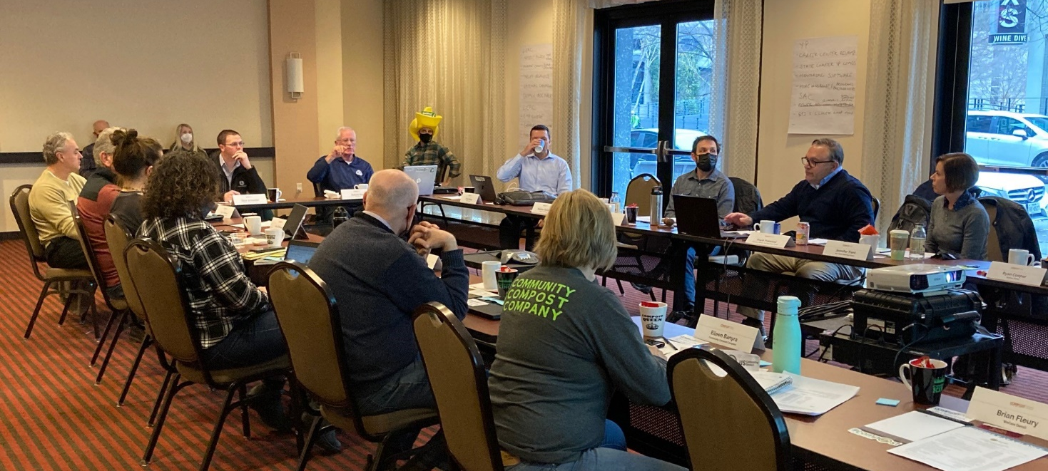
Steps to Starting a Chapter
Upon CAC Approval, USCC Board of Directors considers & approves

Slide 17
Steps to Starting a Chapter
Questions?
www.compostingcouncil.org/statechapters
Linda Norris-Waldt, Chapter Relations Director, lnorriswaldt@compostingcouncil.org

