Slide 1
Recycling Reimagined
Applying AI to Transform Waste to Value
9/22/2022

Slide 2
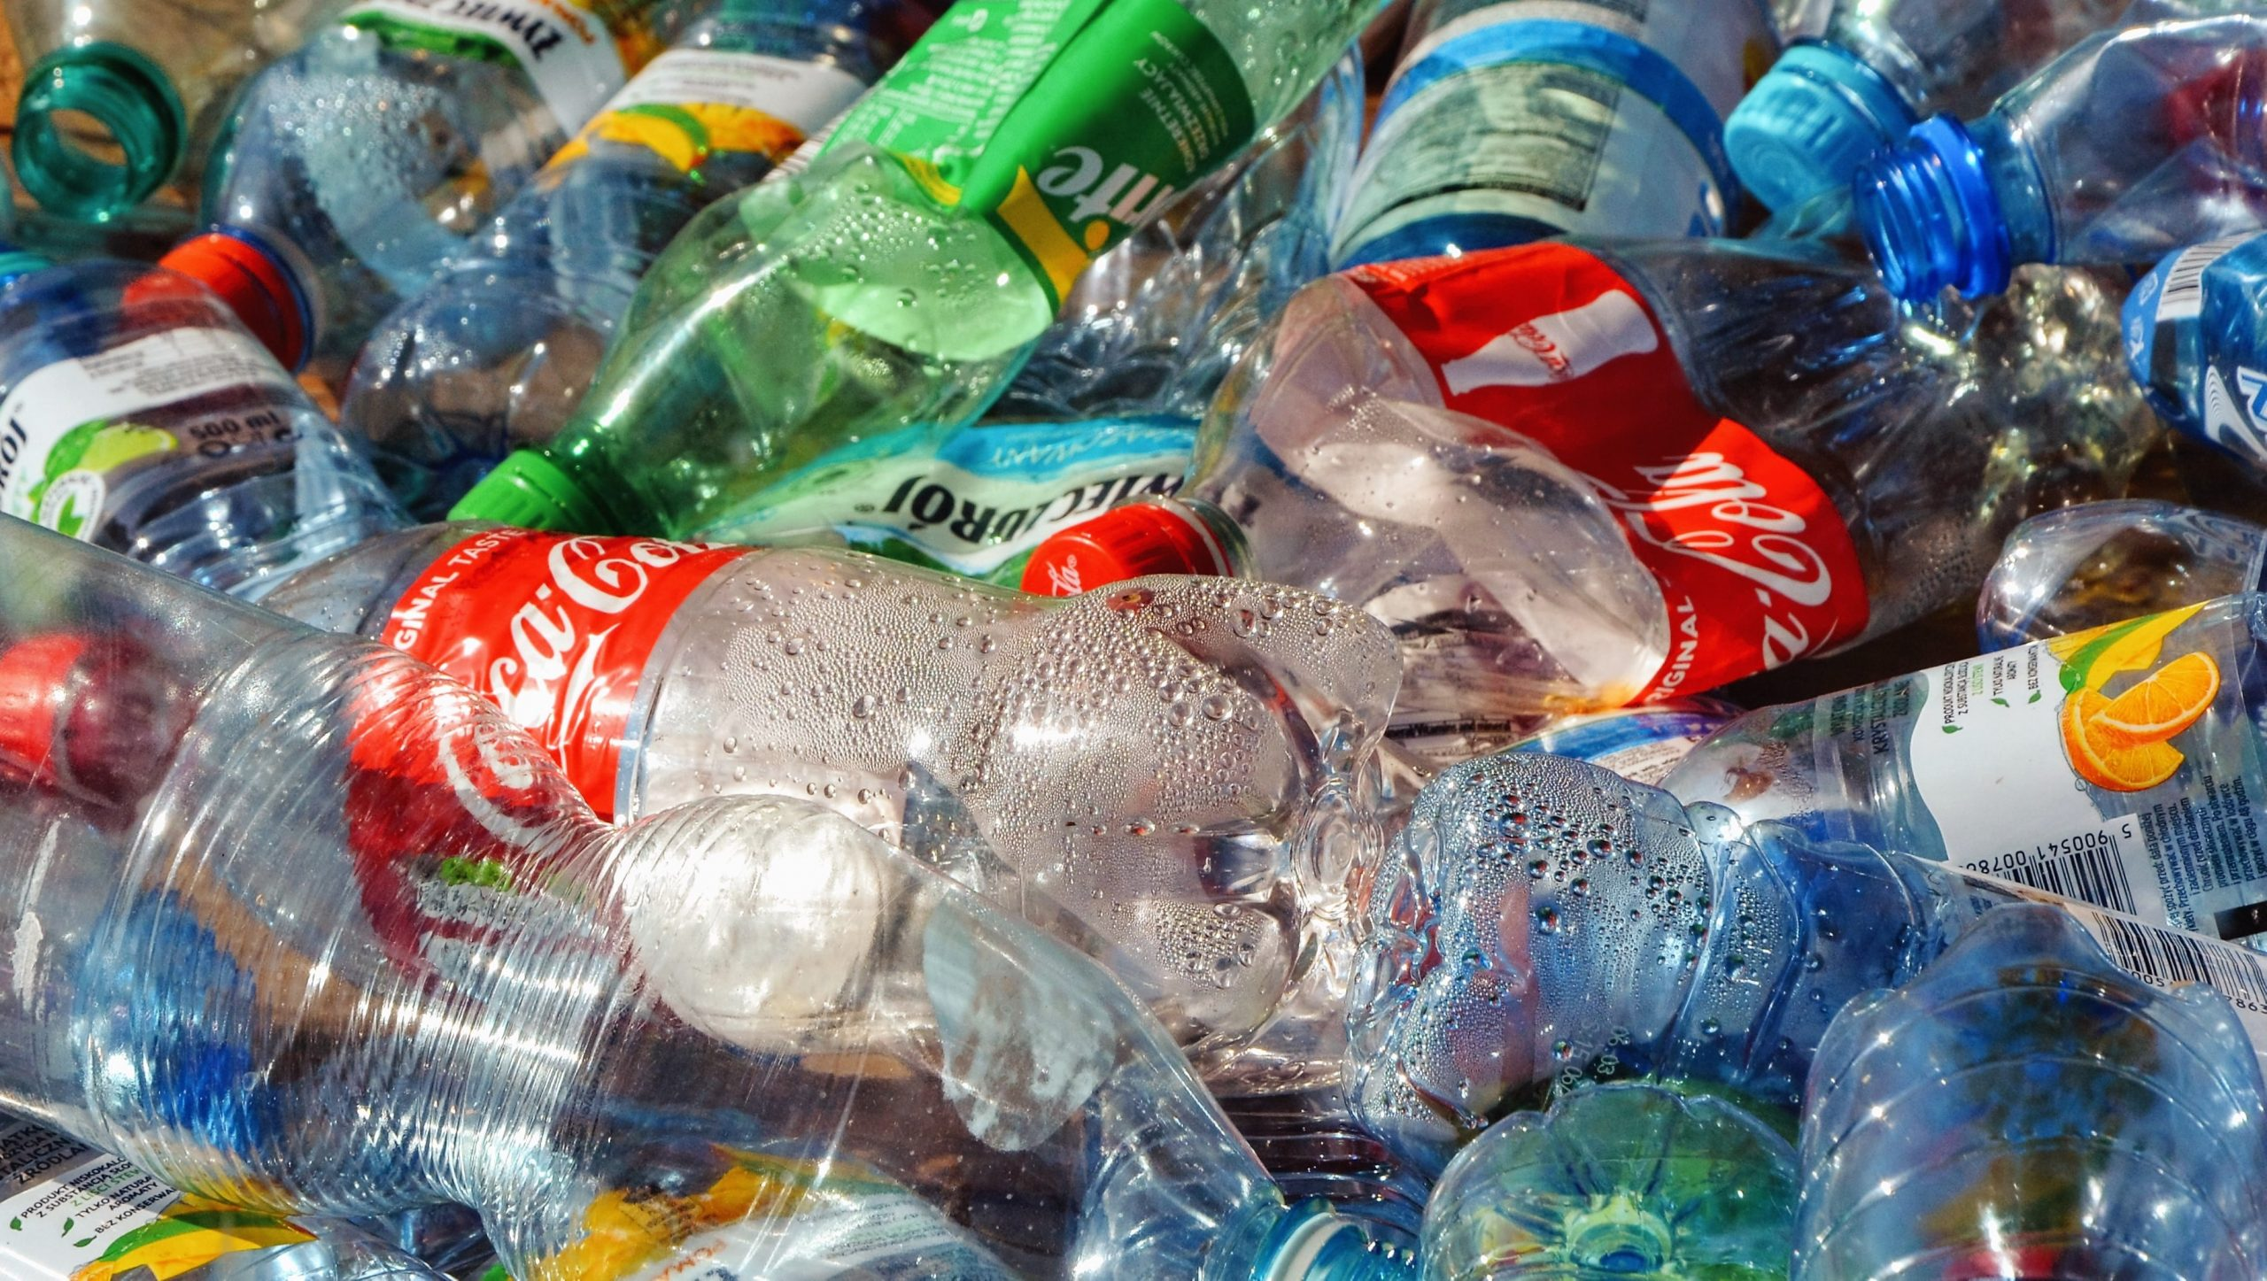
Billions of dollars a year are lost to landfill due to the economics of material recovery.
Notes:
Despite the high demand for recycled content, billions of dollars are lost to landfill due to the economics and complexity of material recovery.

Slide 3
Our mission is to change that with advanced technology and expansion of new recycling infrastructure.
Notes:
At AMP, our mission is to enable a world without waste. AI enables economic improvements to happen via retrofits within today’s waste management infrastructure. The industry is adopting our technology at a rapid pace. And now we are applying our technology to expand new infrastructure that turns what was previously considered contamination into new material markets.

Slide 4
AMP At-a-Glance
Founded in 2014, headquartered in Colorado; Made in the USA
Nearly 300 employees across engineering, manufacturing, and business operations
Retrofitting existing facilities and adding new next-gen automated recycling infrastructure
Full production with systems deployed across the world and in 25 states in the U.S.
Notes:
Allow me to provide some background and perspective on AMP.
Founded in 2014 by Matanya Horowitz, PhD
Engineered and manufactured in Colorado
Nearly 300 employees with 5 USA facilities
Vertically integrated AI and Robotics developed by a team of pioneering scientists, engineers and waste industry veterans
Applications for paper & packaging, C&D, and e-crap
Approximately 275 systems deployed across 25 states in the US, Canada, Japan and Europe
Backed by global investors highly experienced and successful scaling technology and infrastructure businesses

Slide 5
AMP Impact Statistics
Scaling growth from early to mass adoption.
275
80
50B
Systems deployed globally
Number of MRF and PRF
Objects recognized by AI on annual basis
© 2020 AMP Robotics. Confidential. www.amprobotics.com
Notes:
Combine all these factors and AMP has emerged as a technology and innovation leader in the waste recovery industry.

Slide 6
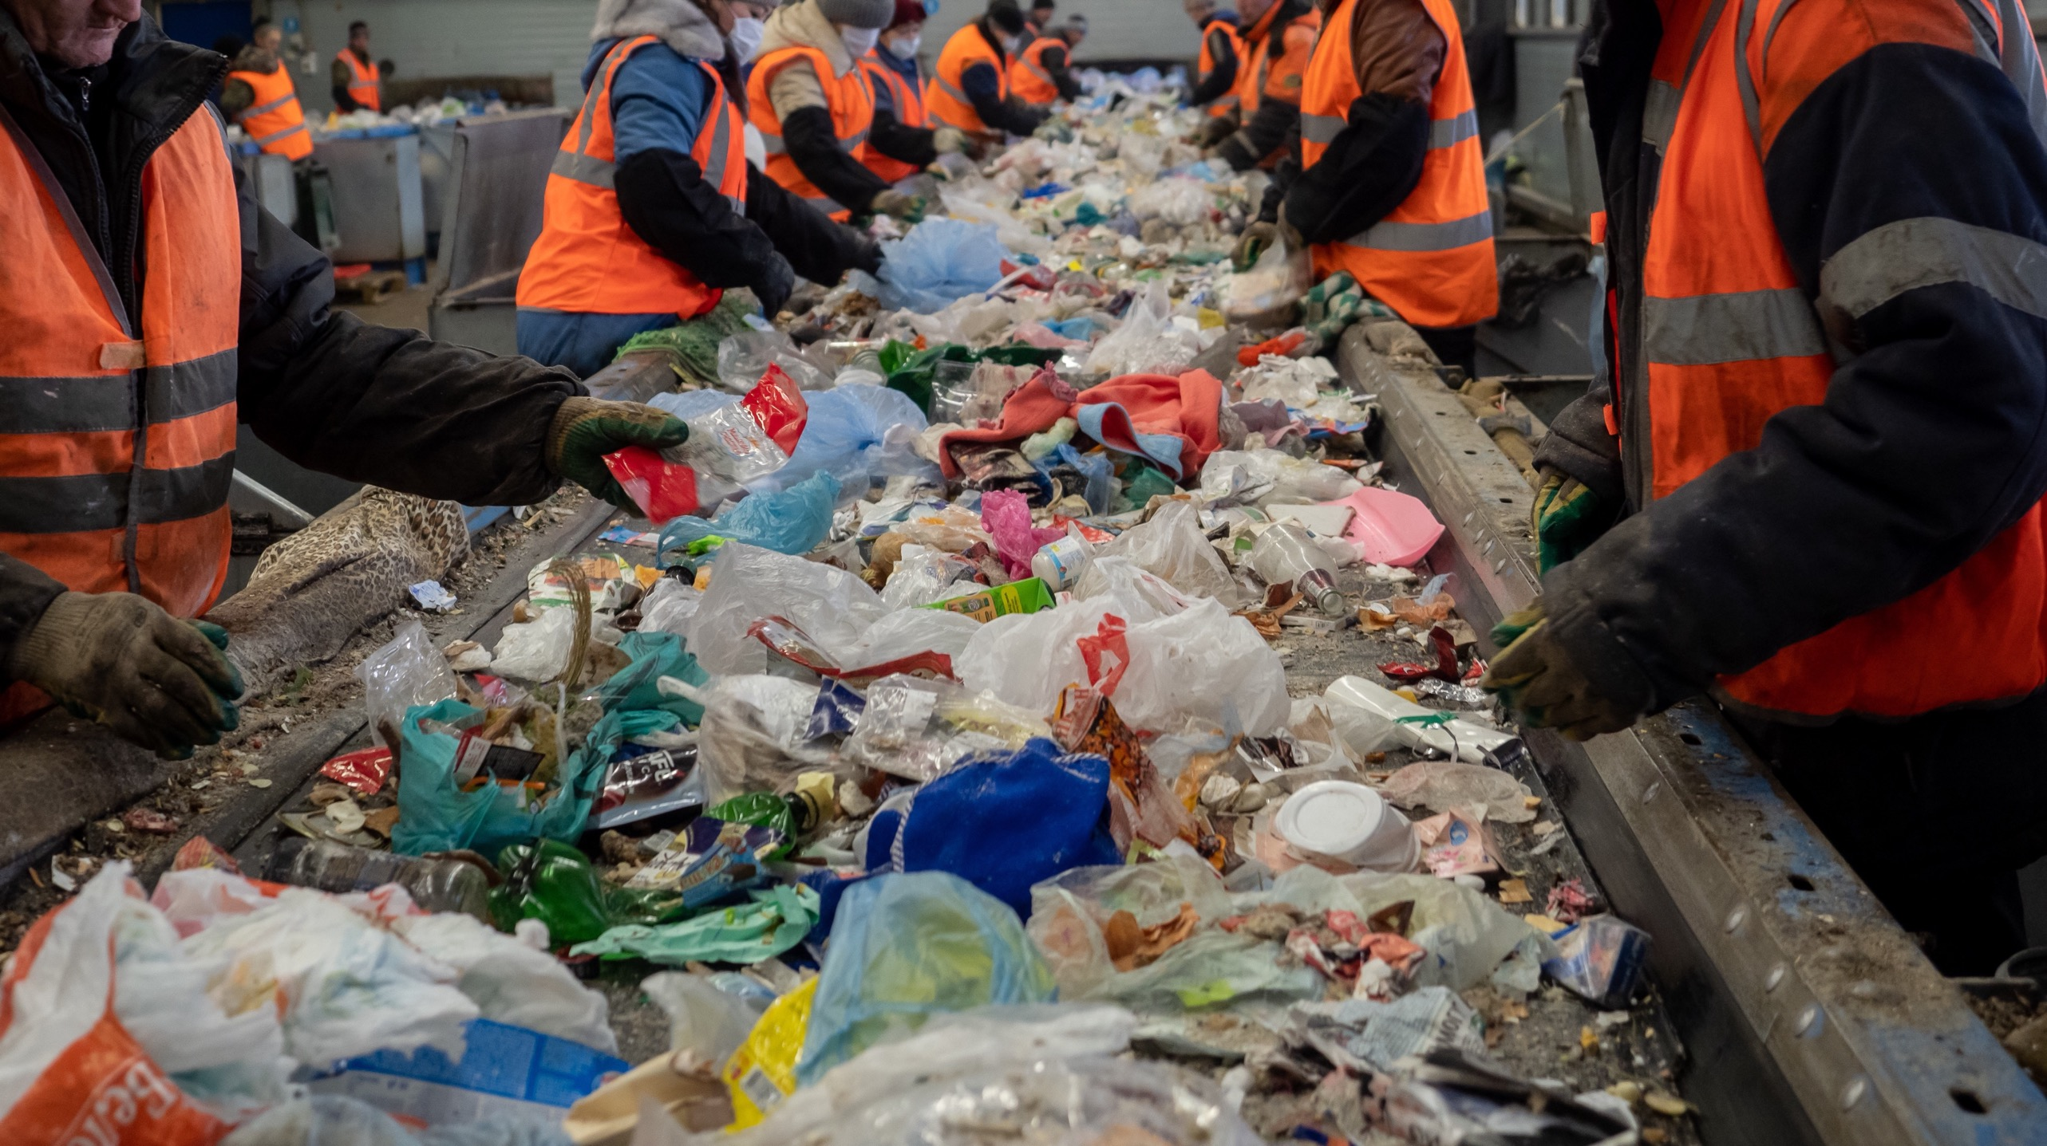
And un
Poor material quality. Contamination.
High operational costs. Labor shortages. Safety.
Productivity constraints. Low recovery rates.
Data transparency and measurement.
AMP’s technology addresses major industry problems
Notes:
We’re working to tackle some of the perennial challenges facing the materials recovery industry today.
As many of you know, in the United States, there are thousands of municipal recycling programs nationwide that are collecting material generated by millions of people.
Between the collection and actual recycling of the commodities, there really are only a small number of MRFs to cope with a tremendous volume of material, thus these facilities are centralized material hubs.
A major challenge is that MRFs incur high costs when attempting to sort out commodities that continue to evolve with complex form factors and material compositions.
Today’s MRFs require a tremendous amount of manual labor and may incur high residue loss and continuous challenges to ensure high bale quality.
This all amounts to an erosion in the value of recyclables due to the high cost of sorting.

Slide 7
What is AMP NeuronTM?
The AMP NeuronTM software uses deep learning to continuously train itself by processing millions of material images into data.
The software uses pattern recognition of colors, textures, shapes, sizes, and logos to infer in real-time the recyclable materials and contaminants in sortation environments.
Notes:
Let’s dive in to how the technology works. AMP NeuronTM is our proprietary AI platform that uses computer vision to recognize patterns of specific recyclable materials within a complex waste stream of smashed, folder, and tattered objects – all combined together.
Neuron distinguishes different plastic polymers, types of paper, metal containers, and multilayered packages to characterize what’s in the recycling stream and what needs to be sorted during different process stages.
Neuron recognizes more than 50 billion objects annually from field installations, a number that’s compounding daily to create the highest levels of confidence in the data produced.

Slide 8
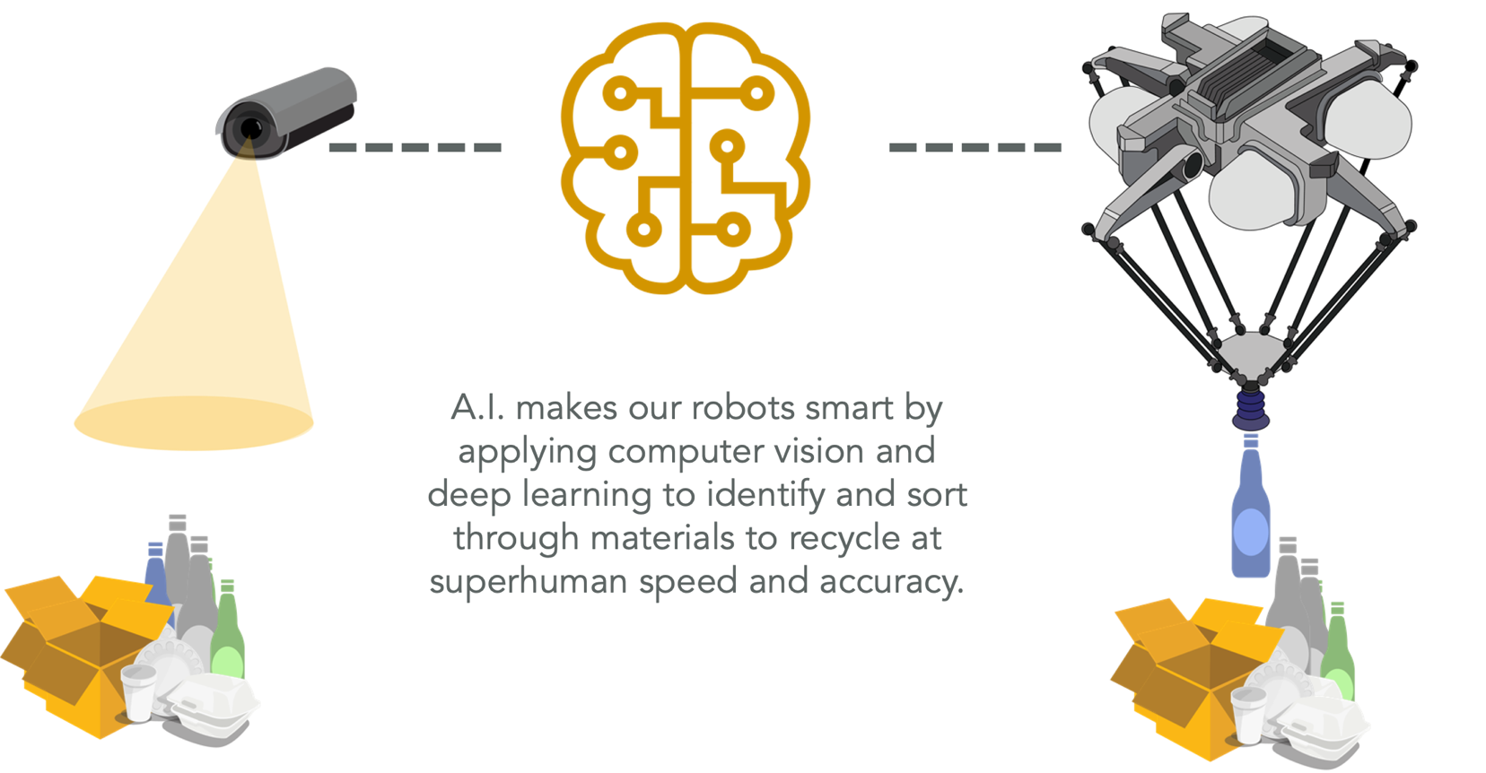
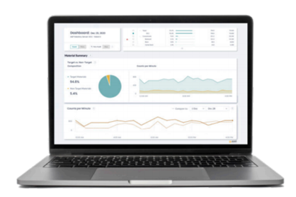
How it Works
[eyes]
[brain]
[arm]
[memory]
8
Notes:
Neuron is the “brain” that, once the camera, or eyes, see the material coming down a conveyor to be picked and sorted, guides the robotic “arms” to pick and place the material to be recovered.
All of this happens at superhuman speed with consistent precision and extremely high accuracy.
During this process, the data captured on what is and is not recovered becomes a tool to validate material quality and value.

Slide 9
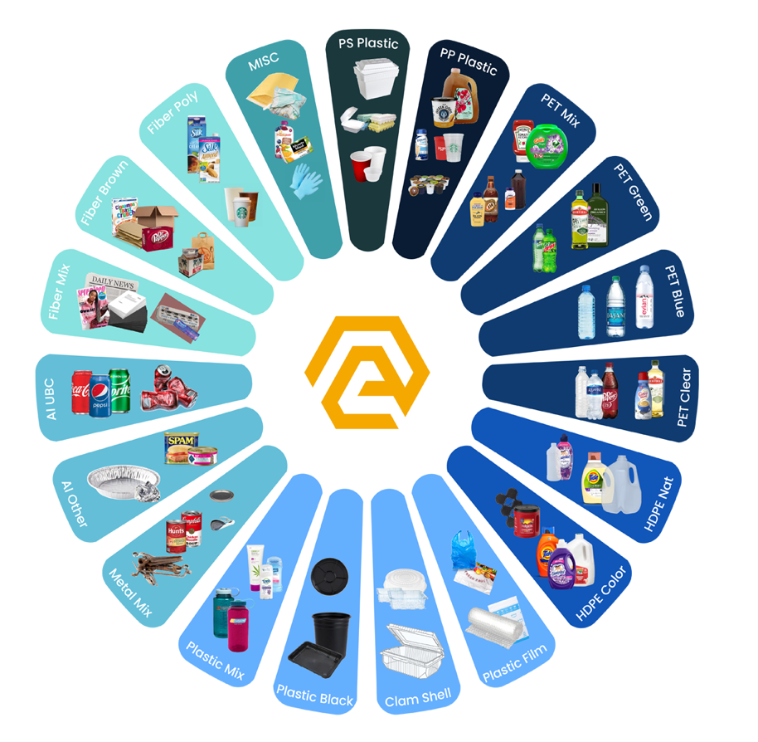
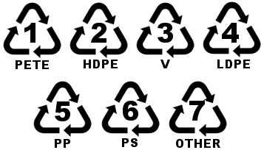
Identifies and Sorts Materials with High Levels of Specificity
Over a 100 categories of paper, plastics, metals and other materials.
Separated by form factor, color, grade and polymer type.
Further iterations by food contact and non-food contact.
Capable of traceability down to the CPG brand owner.
9
Notes:
This technology produces economically sustainable volumes of recycled material types and form factors that previously were not possible. It also creates new value streams and develops new material markets. And ensures chemically compliant bales and custom blends for plastics reclaimers, as well as advanced recycling processes like chemical recycling, gasification, or pyrolysis.

Slide 10
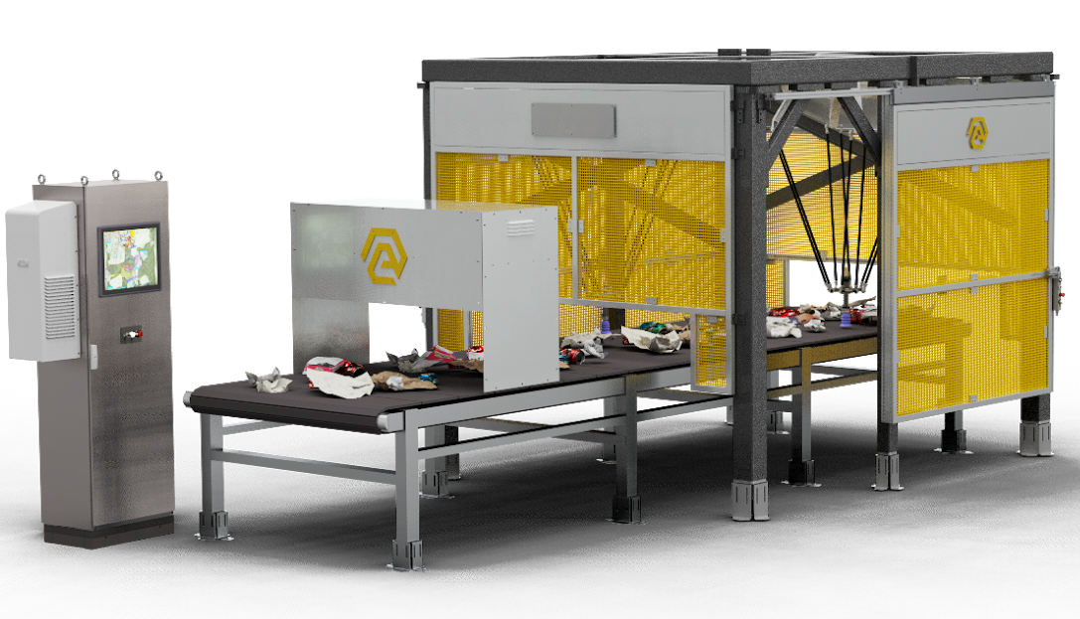
AMP Cortex™
Robotic Sorting System
Increases productivity and recovery rates of recyclables
High precision object recognition of hard to recycle materials
Lowers operational costs of manual process; predictable capacity
Notes:
AMP Cortex is our high-speed AI-driven robotic sorting system that recovers materials and removes contamination across QC, container, fiber and residue lines.

Slide 11
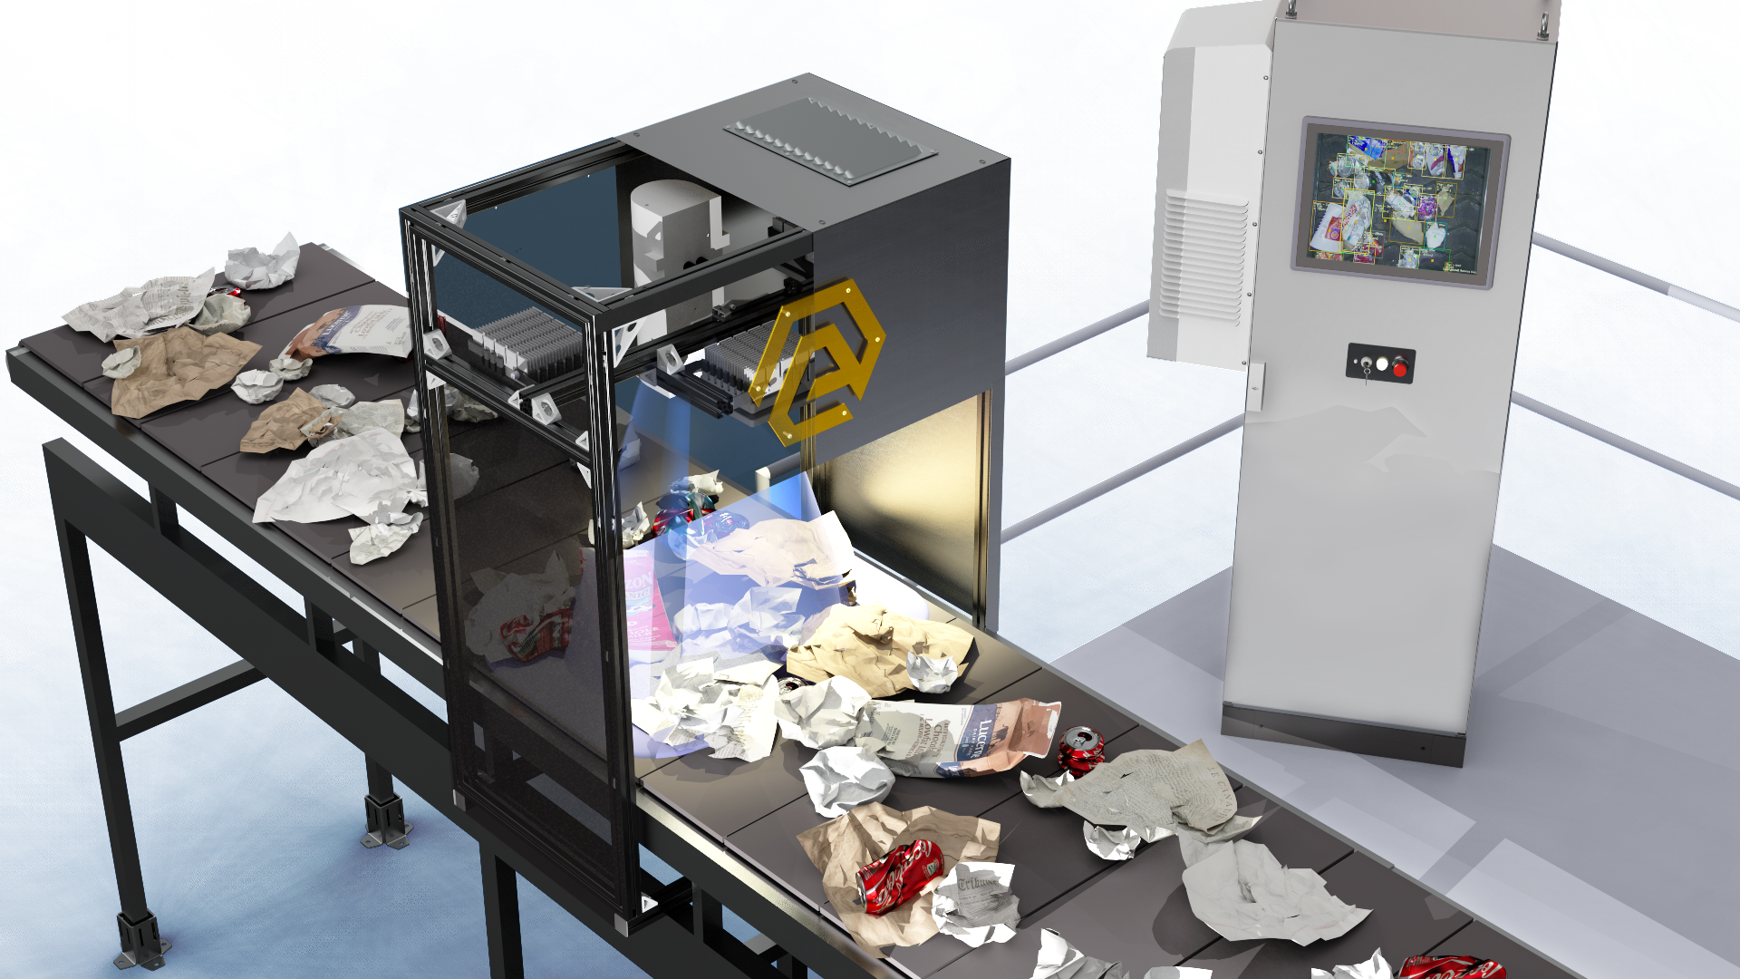
AMP Vision™
Standalone System
Real-time capture of material recovery data
Identifies material composition at different process stages
Characterizes inbound material and validates outbound recovery
Notes:
AMP Vision is a modular computer vision system that you can drop in to key stages of your operation. This system is designed to help you understand your material flow from inbound processing to bale QC to the end of the line.

Slide 12
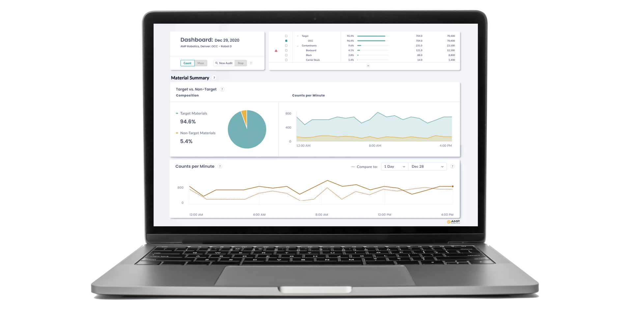
AMP Clarity™
Material Data Intelligence
Real-time material characterization, inbound and outbound
Validation of material quality and industry specs
Standardized data collection. Measurement and audit reporting
Notes:
AMP Clarity is a web-based data portal that provides real-time material characterization and robot performance software solution that allows users to monitor real-time material composition and performance measurement throughout key process stages of sorting operations. Apply your knowledge to see where you can increase productivity, improve material capture, and take action to prevent lost revenue and improve the value of your bales for resale.

Slide 13
Notes:
In this video, you’ll see our installation at RDS of Virginia, where our Cortex robots are sorting PET, HDPE, plastic film, cups, and metals at one of its facilities in Roanoke.
Our technology helped RDS better manage its employee base, allowing the company to stabilize its sorting workforce and improve productivity.
The business also became profitable and more resilient, a shift driven by a pickup in commodity prices and RDS’ greater capacity to capture 10% more of these higher-value commodities with AI-guided robotics.

Slide 14
Thank you
edel.rodriguez@amprobotics.com
9/22/2022

Slide 15
SECONDARY SORTATION TALKING POINTS AND FAQs AMP is developing company-owned secondary sortation facilities.
AMP launched its first test facility in 2021 in Denver. In 2022, AMP brought two more production facilities online in Atlanta and Cleveland.
AMP is not building primary MRFs and competing in that area.
The goal of our high-diversion, secondary facilities is to acquire residual from waste management companies otherwise destined for landfill and aggregate low volumes to sort.
Offtake of residual material creates a new revenue stream and cost containment for waste management companies.
AMP continues to sell robotics systems and solutions to primary MRFs; that business is expanding, with 275+ units deployed in more than 80 facilities globally.
Secondary sortation represents an expansion of, not a change to, our business model because of our continued advancements in our AI technology.
Our secondary model recovers and resells common #1-2 plastics, as well as hard-to-recycle #3-7 plastics in a variety of form factors and attributes—color, opacity, thermoform, etc—with high precision and purity, including bespoke mixes for chemical/polymer blends needed for processors and manufacturers.
AMP is seeking relationships with waste management companies to buy residual material or secondary materials (mixed plastic, mixed paper) and strategic partnerships with plastics reclaimers, chem recycling, and other plastics manufacturers for offtake of plastics recovered.
If interested, we have a Materials Procurement team that manages those relationships and would love to talk with you.
OK TO DISCUSS AMP’s facilities can economically process small volumes of difficult-to-recycle mixed plastics, papers, and metals sourced from primary MRFs.
AMP’s next-generation secondary MRFs apply automated sorting methods enabled by AI, robotics and other automation—driving down the cost of recovery while creating contamination-free, high-quality bales of recyclables for resale.
Secondary sorting economically extracts critical mass of materials for established plastics, paper, and metals markets, as a complement to the processes at primary MRFs that operate at capacity.
Secondary sorting introduces market certainty and new revenue streams for primary MRFs by creating a demand for residue that would otherwise cost waste and recycling businesses to dispose of.
This model is helping to address the millions of tons of recyclables and billions of dollars worth of material feedstock lost to landfill despite the demand from consumer packaged goods companies and brand owners for recycled content.
We are continuing to push the envelope of recovery of other historically hard-to-recover and separate materials like film and flex packaging - working in development with coalition groups and other manufacturers. You can learn more about that from our Business Development team.
DO NOT DISCUSS Do not talk about secondary sortation in any terms other than the approved language above.
Do not use the internal term ‘Project Phoenix.’
Do not say we are building primary MRFs.
Do not say how we are mechanically recovering material in our facilities.
Do not say that we are not using robotics in our facilities.
Do not say how much our facilities cost.
Do not say what our capacity / tonnage produced is in our facilities.
Do not identify the locations for any of our facilities or plans other than the pilot in Denver and facilities near Atlanta and Cleveland.
Do not say who we are buying residue or mixed plastics or mixed paper from.
Do not say who we are working with/to whom we are selling bales.
FAQs “I’ve heard that AMP is using optical sorters in its secondary sortation facilities. Can I buy this equipment?” Short answer: The business model is to source MRF residue and perform a secondary sortation. The facilities use the same core artificial intelligence software, but integrated into a full facility design. The design also includes the logistics of sourcing and transporting MRF residuals, and marketing the sorted material that would have been bound for landfill. Our robots and vision system are also part of the facility design, but the discrete sorting systems within the facility are not able to decouple from the whole system for individual sale. “Can AMP provide material composition data to us about the residual material we supplied to us?” AMP receives high volumes of residual material from numerous suppliers. Based on our continuous flow of incoming material, as of now it’s not possible to trace specific material fractions to suppliers as volumes are often mixed to optimize automated processing. However, as production ramps we are collecting aggregate data on what is diverted vs what is sent to landfill. We are working on reporting high-level data traceable to suppliers so you have data on diversion rates for your needs. We will continue to develop further data detail as your company’s volumes ramp and data is collected. “Can we visit your facility and walk through your process?” AMP is employing a number of developmental and proprietary technologies integrated into our processing facilities. Due to AMP company confidentiality and IP sensitivity, facility tours are not permitted at this time.

