Slide 1
Recycling and Waste Reduction Programs for Local Governments
Sarah Knapp, LEED AP BD+C, ENV SP
Recovered Materials and Abatement Program
Georgia EPD

Slide 2
Recycling, waste reduction, and diversion Grant

Slide 3
What is the RWD Grant Program?
The RWD Grant furthers the goals for the SWTF by providing financial support to projects in Georgia to:
Reduce solid waste
Recover valuable materials
Support manufacturing
Encourage innovation
$2,000,000 for the FY23 grant cycle
No max award
Awarded grants may pay up to 100% of project cost
Grant funds are paid out on a reimbursement basis
Advance funds are permissible with additional information
Eligible applicants include cities, counties, consolidated city-county governments, and public authorities
Notes:
Projects must focus on increasing recycling, reducing waste, and/or diverting recoverable materials from the solid waste stream as described in the authorized uses of the SWTF.
Eligible applicants and recipients for the RWD Grant include:
Counties, municipalities, or any combination of the same, also referred to as local governments IN GEORGIA
Public authorities, agencies, commissions, or institutions
Local government applicants must have Qualified Local Government status as of the date of their application, as determined by the Georgia Department of Community Affairs. The Georgia Department of Community Affairs maintains an active listing of local governments who are ineligible to receive state funding, including grants: https://apps.dca.ga.gov/LocalGovStatus/planning.asp
Nonprofit (such as KGBF Affiliates) or private organizations are not eligible for funding, although applicants may partner or contract with nonprofits or private organizations.
Applicants who are subject to an open EPD consent order or other EPD enforcement action.
Applicants who have received grant funds in past years but have NOT demonstrated successful administration of those grant funds.

Slide 4
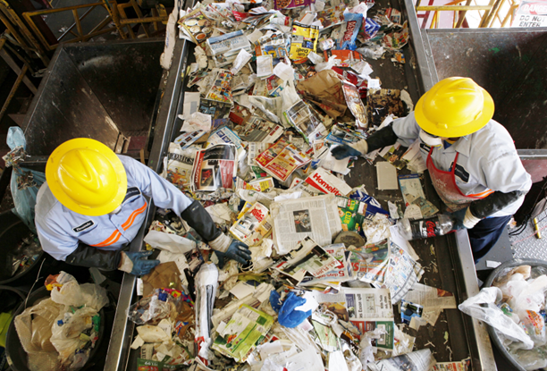
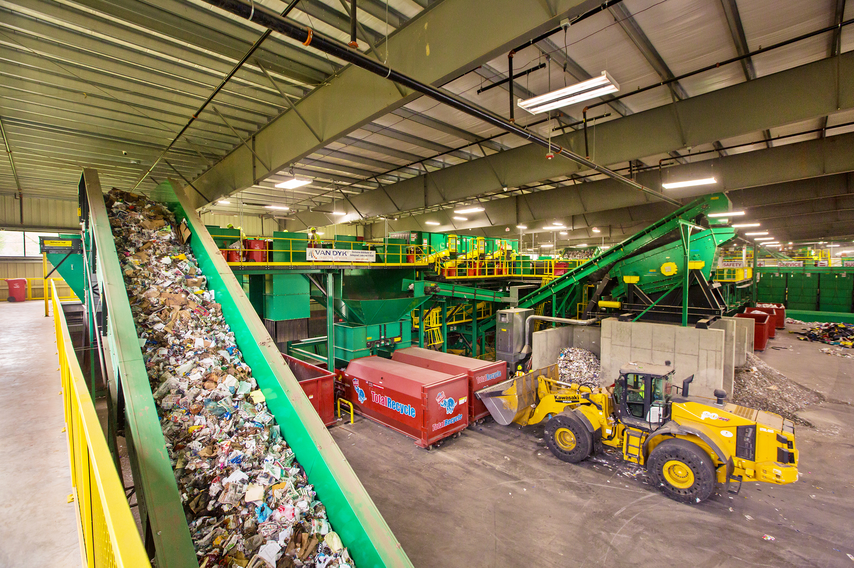
RWD Project Examples
Applicants can develop proposals that best support their communities’ needs
Examples of RWD grant projects may include:
Recycling and waste diversion infrastructure
Hub and spoke development
Hard-to-Recycle materials
Recovery of additional materials
Waste reduction
Innovation
Notes:
Applicants can develop proposals that best support their communities’ needs.
Projects not selected in one grant cycle may be resubmitted in subsequent grant cycles.
Recycling and Waste Diversion Infrastructure – Projects that create, expand, or improve infrastructure at materials recovery facilities (MRF), recycling transfer stations, convenience centers, or through other equipment that will increase the capacity to serve customers.
Hub and Spoke Development – Projects that create, expand, or improve the operation of recycling hub and spoke infrastructure, collection, distribution, and logistics.
Hard-to-Recycle Materials – Projects that create, expand, or improve the operation of hard-to-recycle and/or household hazardous waste recycling facilities.
Recovery of Additional Materials – Projects that collect and/or process new material streams.
Waste Reduction – Projects that to create, expand, or improve programs at the local level to reduce waste.
Innovation – Projects that demonstrate innovative processes for waste reduction or innovative use of recycled products.

Slide 5
RWD Grant Program Application Timeline
Application Period Opens
August 1, 2022
Applications Due by 4:30 PM
September 30, 2022
Application Review
October - November 2022
Grant Awards
December 2022 – January 2023
Second Application Period TBD
February 2023 – March 2023
Notes:
The application period opened August 1, 2022. The deadline for submitting applications is 4:30 p.m. on September 30, 2022. We will get into the application submission details in a bit.
We will review applications between October and November and will be awarding grants between December and January.
Nothing is finalized yet, but we are looking at the next round of applications to be accepted between February and March 2023.

Slide 6
Municipal Measurement Program

Slide 7
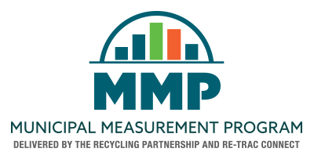
What is the municipal measurement program?
Online platform to track and measure effectiveness of waste and recycling programs
Database that centralizes and streamlines data
Free to use for local governments (cities, counties, consolidated city-county, and solid waste authorities)
Provides reports, metrics, and insights for program improvements
44 enrolled members
18 cities
22 counties
3 consolidated city-county governments
1 solid waste authority
Notes:
The Municipal Measurement Program (MMP™) is a simple and free tool designed to track and measure the effectiveness of waste and recycling programs.
It was created exclusively for local government (cities, counties, and municipalities).
The MMP creates a centralized database to streamline data.
Waste and recycling performance data is benchmarked against national averages.
The tool provides reports that deliver insights and actionable recommendations to improve waste and recycling programs.
The program was developed by Re-TRAC, which is also an online waste tracking platform (but anyone can use Re-TRAC)
The MMP is jointly administered by the Recycling Partnership who is responsible for verifying data in the system to ensure that everything was reported as accurately as possible.

Slide 8
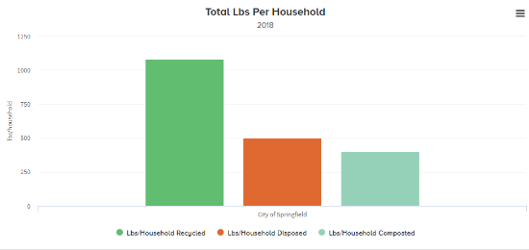
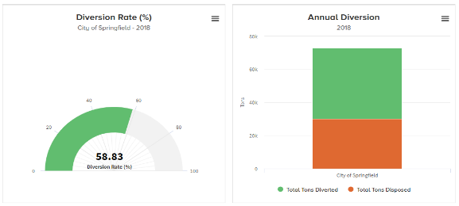
Benefits
Centralized and streamlined data
Landfill tonnage
Recycling
Reports and analytics
Overall performance
Annual diversion rate
Economic benefits
Environmental benefits
Benchmarking
Recommendations
Notes:
Centralized data – the MMP gives you a centralized place to save your waste and recycling tonnage data. Now you might already be doing this to an extent, but there are so many other elements that go into a successful waste/recycling program beyond just the numbers. For example, you are able to enter what your perceived challenges are for waste and recycling, and it will help you keep track of drop-off locations (if you have them) and what materials those facilities take.
You don’t have to use the MMP just for recycling/waste diversion performance. Many of our local governments don’t have the resources to implement recycling in their community. While MMP is definitely geared towards waste diversion, you can still use it to see how much waste is going to landfill. That is a major concern for many of our local governments who are dealing with capacity issues. It will give you a clear, clean way to view tonnage and will help you start thinking about options for waste diversion, and help you plan for that.
One of the functions of the MMP is benchmarking. Waste and recycling performance data is benchmarked against national averages, so you can see how your local government is functioning to others in the state and in the country.
You can generate reports and analytics to assess your performance. Some of the reports provide insights and actionable recommendations on how to improve waste and recycling programs. Nice charts/graphics are produced from some of the reports which you can use in your reporting to upper management/public. but the MMP has reports and analytics to analyze your data in ways that you aren’t currently. The first survey (about your county/municipality) will ask you questions about what are your challenges, what is your current reach to residents. All together, the MMP combines your waste and recycling data along with other program components (like reach/challenges) which helps you see the big picture.
There are a ton of different reports you can run.
Provides graphs and charts that you can use to visualize how your program is operating
This is great for publications; annual sustainability report, monthly newsletters etc.
1. Performance Reports
ANNUAL DIVERSION RATE (%)
ANNUAL TONNAGE BY PROGRAM
MUNICIPAL PROGRAM PER CAPITA ANNUAL TONNAGE
MUNICIPAL PROGRAM ANNUAL TREND
MUNICIPAL PROGRAM ECONOMIC BENEFITS OF RECYCLING
MUNICIPAL PROGRAM ENVIRONMENTAL BENEFITS
MUNICIPAL PROGRAM PERFORMANCE SUMMARY
SUMMARY OF DROP-OFF SITES BY MATERIALS ACCEPTED
SUMMARY OF STAFFED VS. NON-STAFFED DROP-OFF SITES
TOTAL LBS PER HOUSEHOLD SERVED BY RESIDENTIAL CURBSIDE PROGRAMS
2. Benchmarking Reports
AVERAGE LBS/HOUSEHOLD RECYCLED COMPARED TO U.S. NATIONAL AVERAGE
3. Program Recommendations
PROGRAM RECOMMENDATIONS SUMMARY
I’ve had a few interested local governments reach out to me about the MMP and ask “why should I participate if I am not tracking anything or , if I don’t receive regular reports”. And the advice I have given has been, the MMP can work for you however you need it to. There are options to indicate if you do not have data. You can start with the information you do have and it gives you a starting place to start thinking about program improvements. You can’t measure what you don’t track.

Slide 9
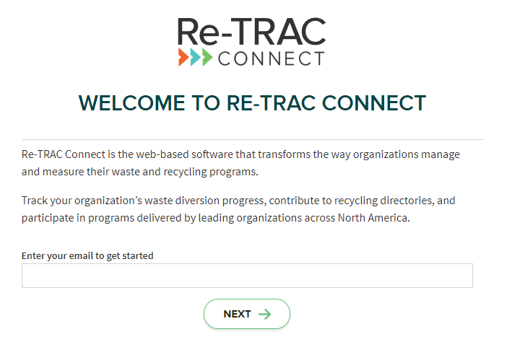
How to Participate
Fill out application/create account
Complete 3 required surveys (online)
About your county/municipality
Residential curbside collection
Drop-off collection
Surveys completed annually
Can complete any time
Takes 90 minutes or less
Synergies with other programs
RWD Grant
ARC Green Communities
Other grant opportunities
Notes:
There are 3 required surveys and 2 optional surveys for public space program (how are you recycling/collecting waste in public spaces) and processing facilities assessment (this survey is about the types of facilities you have access to for waste and recycling, such as MRF, landfill, etc).
About your county/municipality – this survey asks basic questions about population size, perceived waste challenges, etc.
Curbside program assessment – this survey assesses residential curbside waste and recycling. It goes into detail about number of households and population. We mentioned this at the beginning, but this is really what the TRP is looking at when the verify. They want to make sure that the numbers for population and households align with the census to get the most accurate deception of waste/recycling performance. This survey will ask for tonnage (if you have it) and items collected/services provided, etc. This has been the case for several members, but you may not offer any curbside programs, or your curbside programs are through a third party contracted by residents and you don’t have the tonnage or the details about collected materials. This is okay. You have the option to select “I don’t have this info, or I don’t know” for these instances. What I tell members is to just fill out what you have. And for many, this was the first time that the waste/recycling program was “mapped out”/written down.
Dropoff program assessment - this survey ask questions about any drop-off centers and the materials collected at these locations.
The surveys are completed online after you create your account. This was a little confusing to some members who thought the surveys would be sent to them on paper.
It takes about 90 minutes or less to complete the 3 required surveys. Surveys are completed once a year, and you can enter data as far back as 2014. This is not a huge time requirement, this isn’t a new project for you to take on, it is 90 minutes or less once a year.
Surveys are completed every year and can be completed really at any time. The surveys for FY 2021 will open up early January 2022. And, if you are a current participant, most of the data from previous years will auto populate so you don’t have to enter more than once. You would only enter if things change and of course the tonnage.

Slide 10
Scrap tire abatement reimbursement program

Slide 11
STAR program
The Scrap Tire Abatement Reimbursement (STAR) provides funding to eligible local governments to recycle scrap tires
Amnesty collection events
Right-of-way collection
Tire dumps
$50,000 max per local government per state fiscal year (July 1 – June 30)
Tires must be sent to a beneficial reuse processor
Documentation of proof required for reimbursement
Must have an agreement in place for reimbursement
EPD cannot reimburse LGs for scrap tire abatement efforts conducted before agreement execution
How to participate
Complete application and submit via email to epd.star@dnr.ga.gov
Host event
Submit required documentation for reimbursement after event

Slide 12
Contact INFORMATION and resources
Sarah Knapp
Environmental Specialist, LEED AP, BD+C, ENV SP
Sarah.Knapp@dnr.ga.gov
470-524-0632
RMA Program:
Resources available at: https://epd.georgia.gov/about-us/land-protection-branch/recovered-materials-and-abatement
RWD Grant:
Send questions and applications to: SWTF.Grant@dnr.ga.gov
Resources available at: https://epd.georgia.gov/recycling-waste-reduction-and-diversion-grant
MMP:
To apply: https://www.municipalmeasurement.com/participate-in-the-mmp-old/application-page/
Resources available at: https://epd.georgia.gov/about-us/land-protection-branch/recovered-materials-and-abatement/recovered-materials/mmp
STAR:
Send questions and applications to: epd.star@dnr.ga.gov
Resources available at: https://epd.georgia.gov/about-us/land-protection-branch/recovered-materials-and-abatement/recovered-materials/star-program

