Slide 1
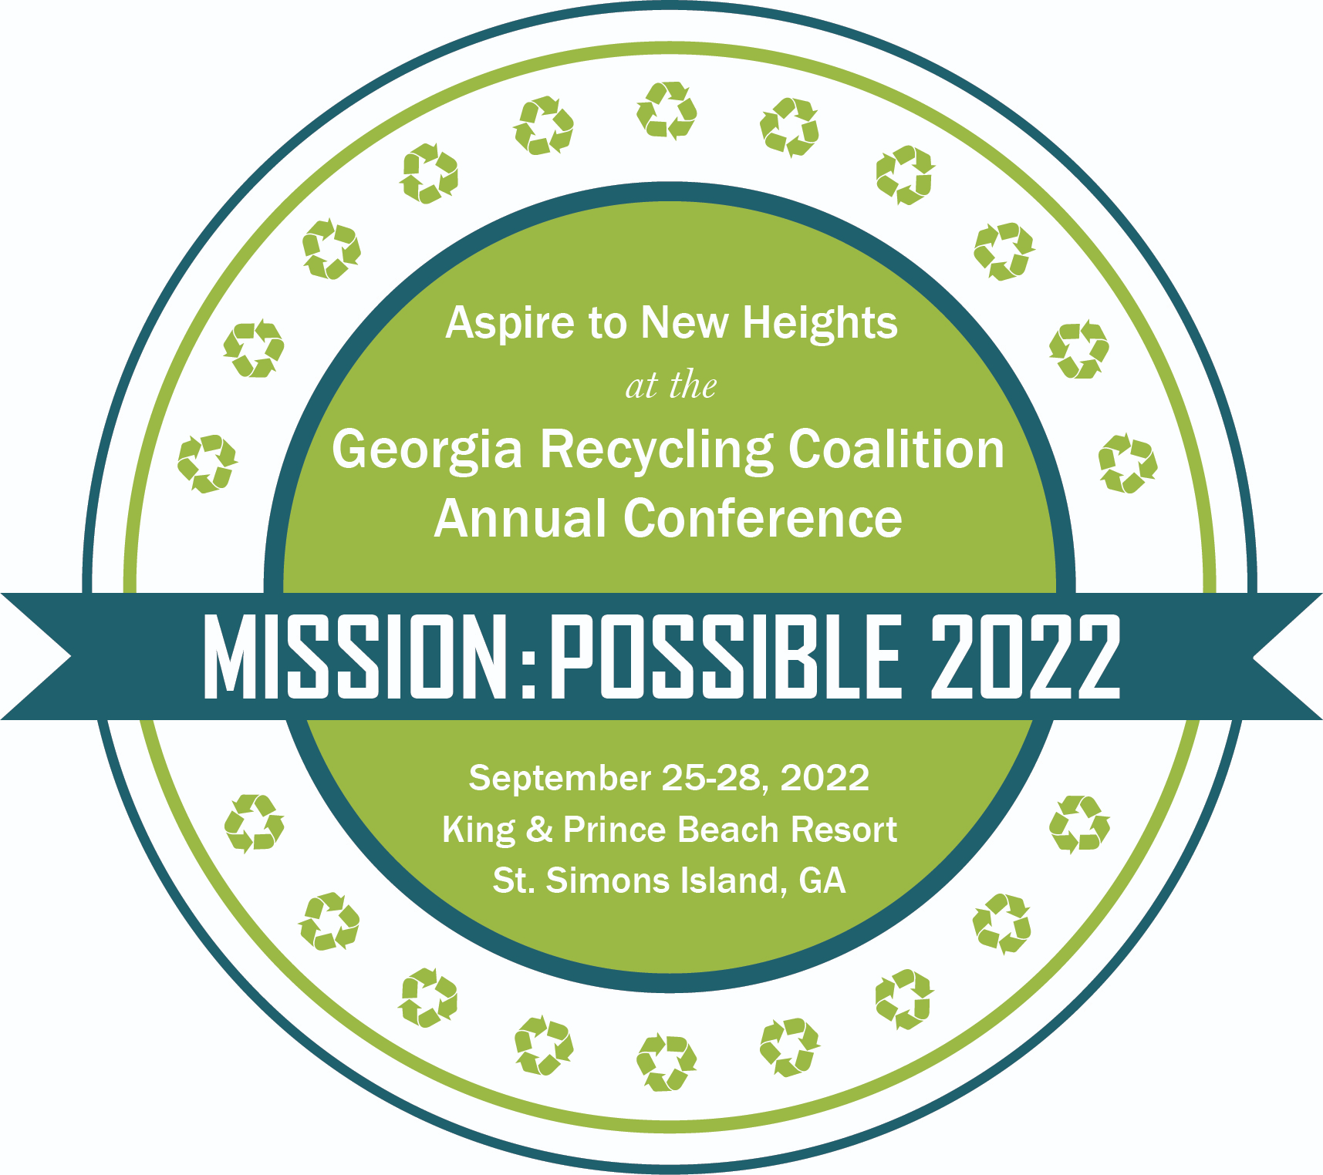
Circular Economy:
Closing the Intention-Action Gap
Kellie Ballew​
Vice President​
Global Sustainability & Innovation
Notes:
Good morning, everyone! My name is Kellie Ballew, I'm vice president of global sustainability and innovation at Shaw Industries, and I'm honored to kick off this year's Georgia Recycling Coalition Conference.
I have to say I was energized by this year's theme (Mission: Possible 2022 – Aspiring to New Heights). And I hope you are, too.
Let’s face it, we need something to start going right for the world.
We’ve all experienced a particularly tumultuous few years – right? We've all faced a global pandemic, social unrest, and political divisiveness, BUT -- I also see lots of progress and lots of hope...especially when it comes to working together to create a safe, just, circular economy.
We all have an important role to play in making that a reality. We have to. One of my friends in the sustainability profession uses every time he delivers a presentation to talk about the sense of urgency we should all have on this subject.
Today, I’m going to spend a few minutes telling you about Shaw's efforts to fuel the circular economy with safe, sustainable, cradle-to-cradle inspired products – but more importantly, I’m going to share why I'm optimistic about turning the corner in creating this circular economy we’ve all talked about.
But before I do anything, let me tell you a little bit more about me...

Slide 2
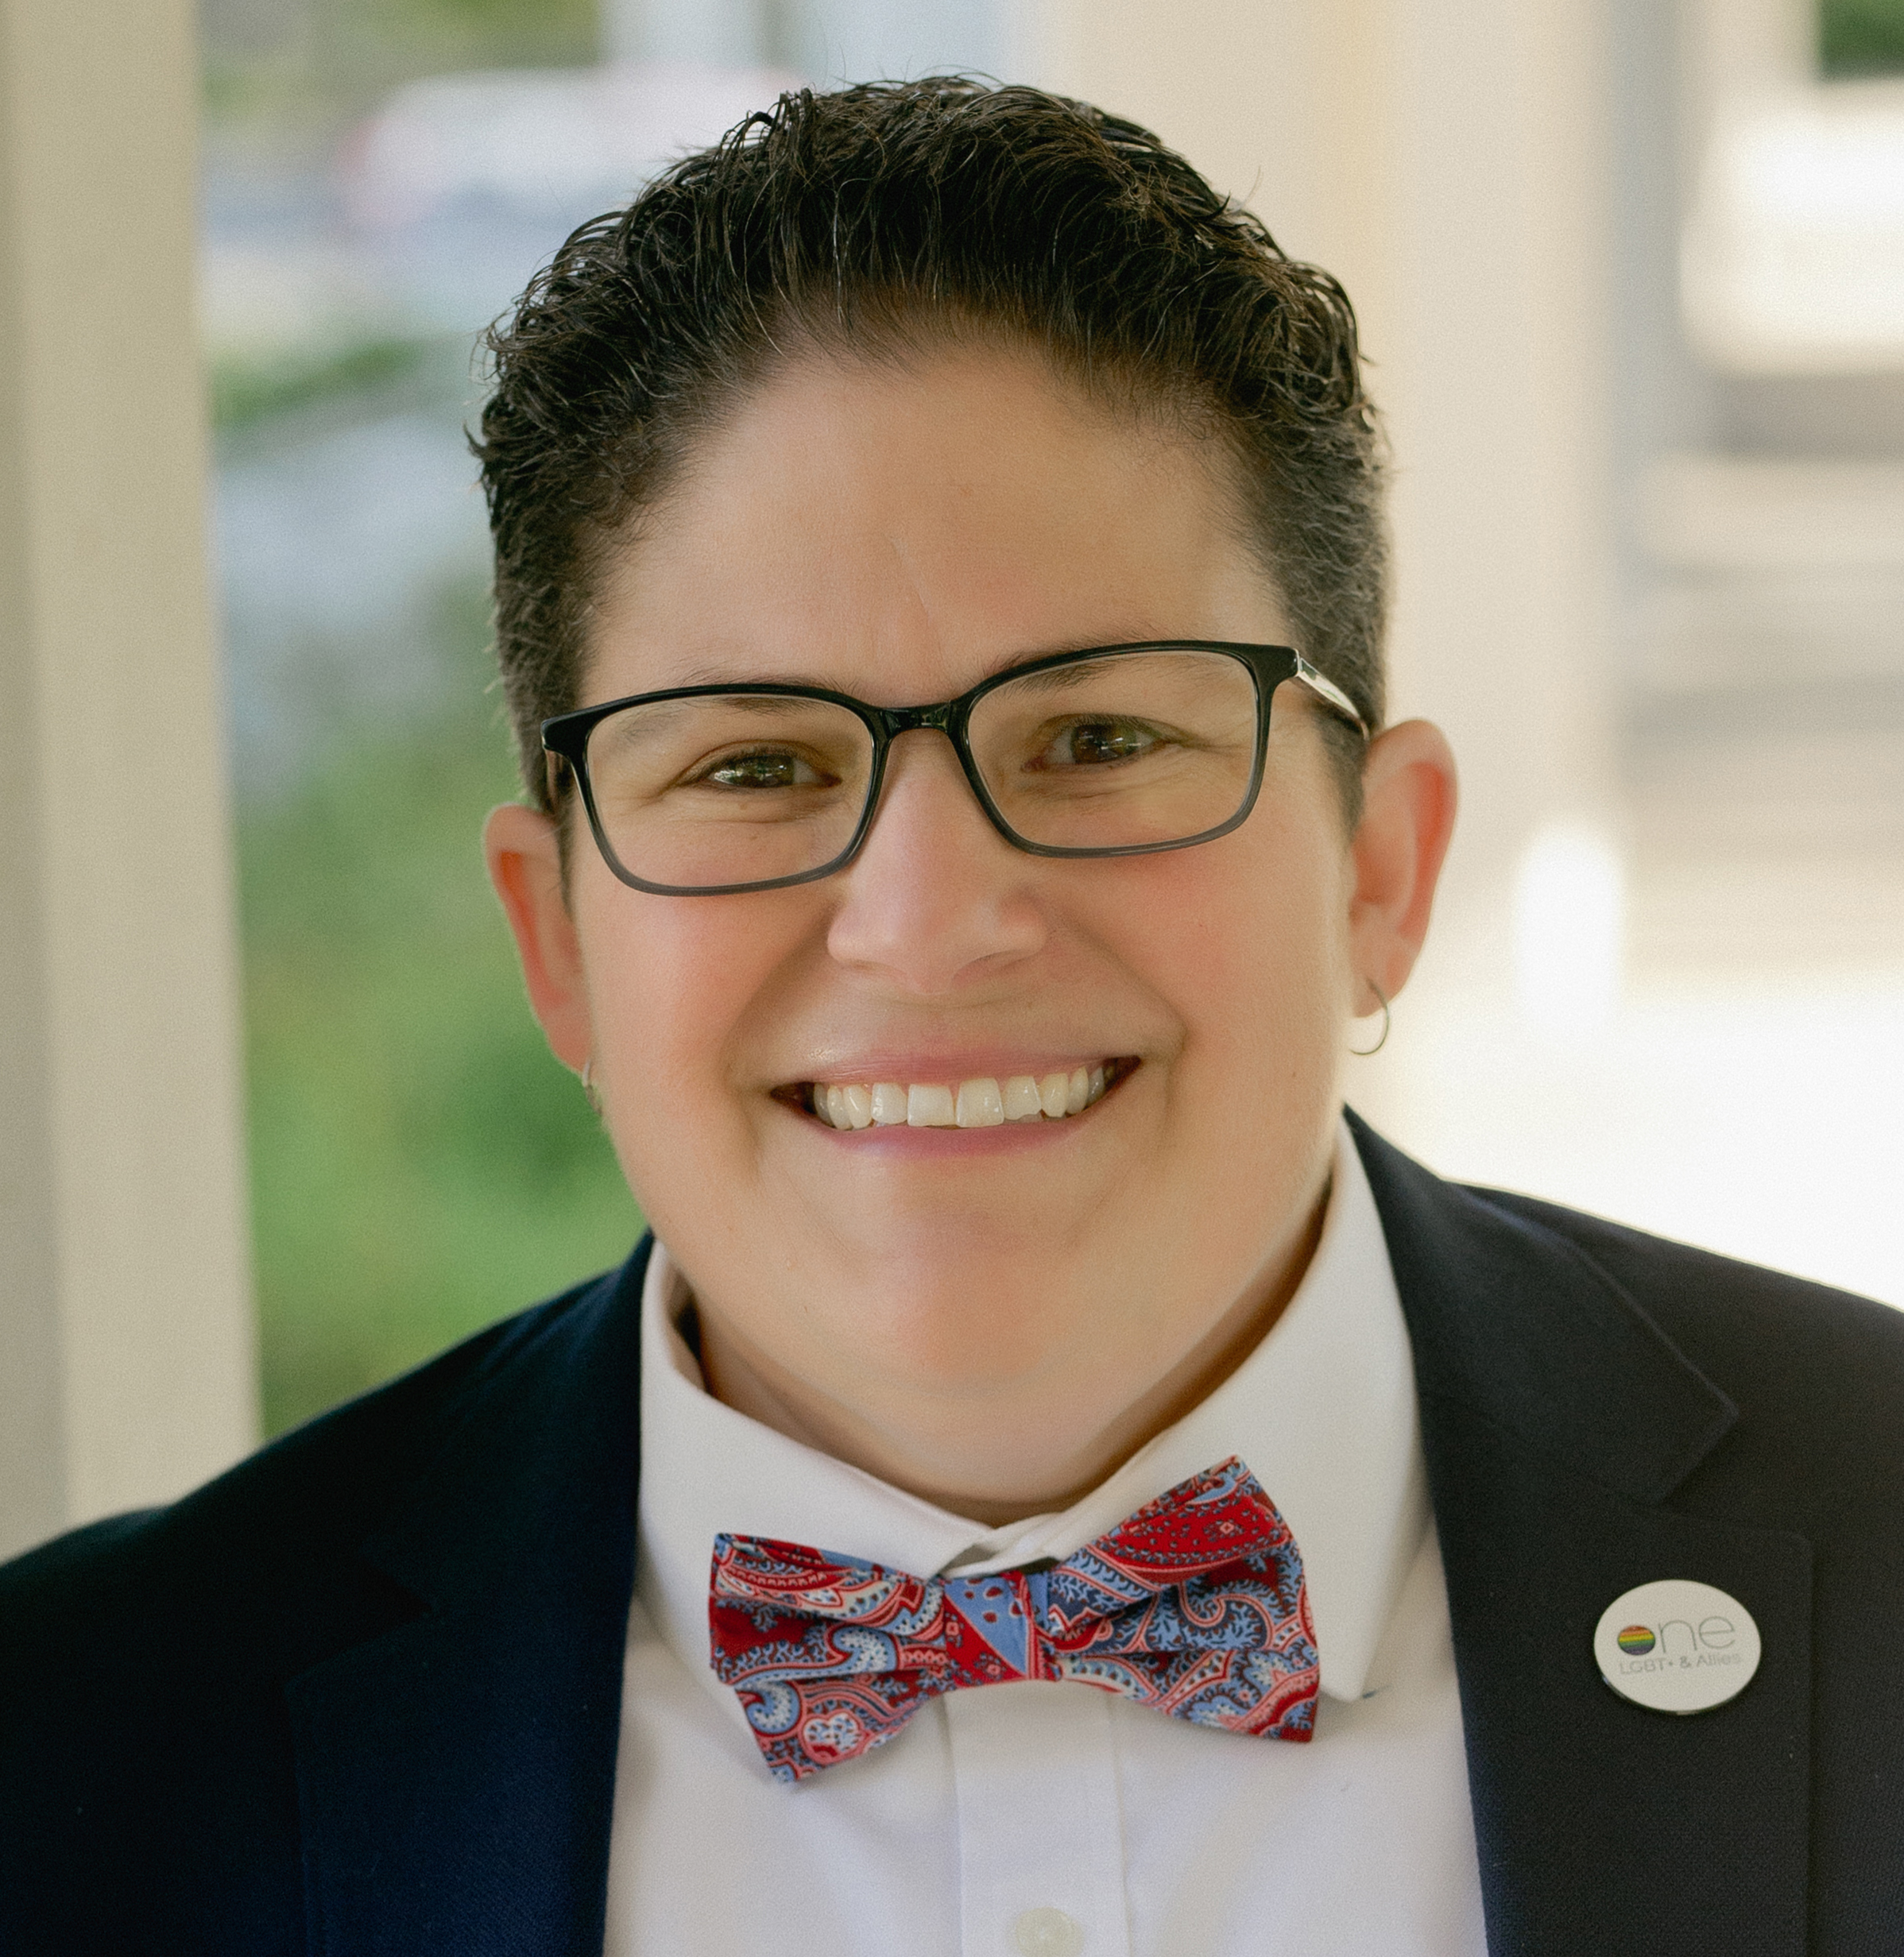
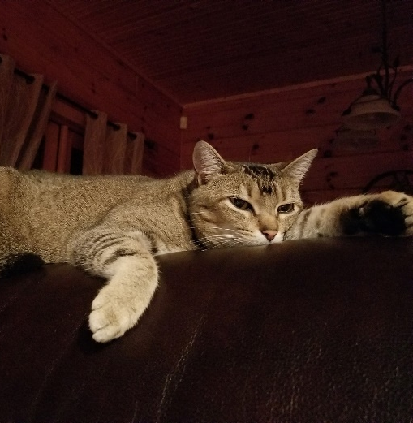
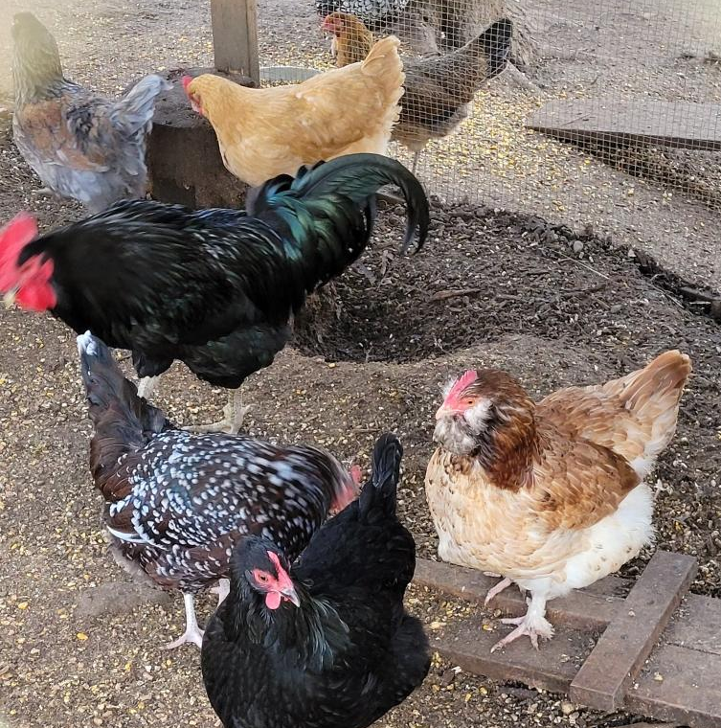
Notes:
My wife and I live in Ellijay, Georgia in the beautiful north Georgia mountains with our 5 dogs, 3 cats, 44 chickens, and 800,000-ish honey bees.
I’m originally from Georgia – born and raised.
It's a pretty idyllic life in the mountains, but I must confess to you all, I have an addiction...

Slide 3
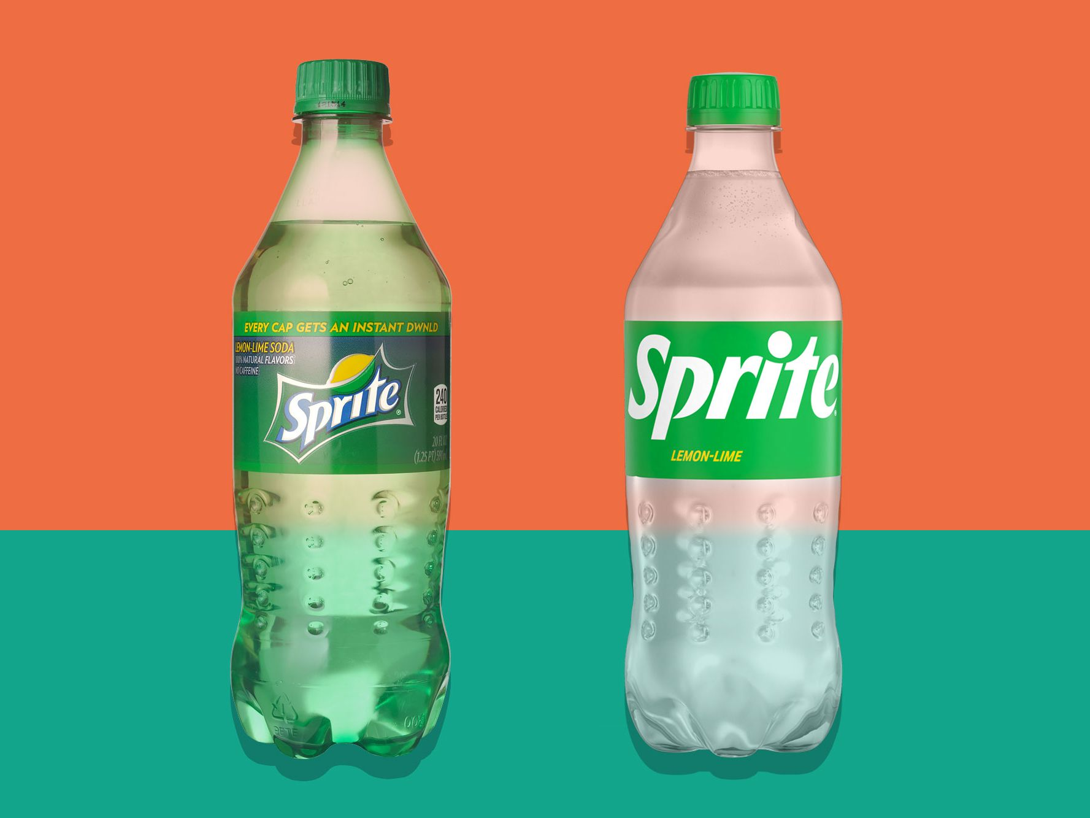
Notes:
I drink a lot of Sprite. Many of you like your coffee in the mornings, but alas, I can’t have caffeine. So, my substitute day-drinkable vice is Sprite.
I believe there are probably some Coca-Cola folks in the room today, and I'm not looking for an endorsement deal…
The good news is about my addiction is that I happen to know that there’s an active recycling solution for the dozens of bottles of Sprite I drink a day, errrrmmmm, I mean, per week.
Even those legacy green ones that just got phased out...I’ll come back to that a bit later.
You may say that, of course, I care about recycling, I'm the head of sustainability for a living.
But what about the average consumer? What’s the state of the state where they are concerned?

Slide 4
Notes:
Very recent consumer research (by the Shelton Group) actually shows that 42% of people want to be seen as someone who buys eco-friendly products. This is an image thing. People want to be seen as – associated with – know by – kind of behavior.
This same research said that people want to buy products and services from "good" companies.

Slide 5
Notes:
So immediately, you want to ask yourself what do consumers think actually makes a company “good”?
As you might expect, treatment of employees was by far the leading driver along with myriad other topics.
But when it came to the environment, there was a clear top 3:

Slide 6
Notes:
Consumers believe that a "good" company
recycles,
manufactures its products in the US, and
makes products that can be recycled.
These were the 3 most important things that consumers said a company should be doing to positively impact their purchase decisions.

Slide 7
If you build it,
they will come
Notes:
OK – Probably dating myself a little bit with this reference.
And, I’m not going to say recycling is the Field of Dreams – but the early premise was that if we built the infrastructure to make recycling available – it would happen, and it would work.
Of course, people would do it, right?

Slide 8
Not Quite...
Notes:
And as you all know – in the various roles you all have within the recycling industry – that’s just not the way it worked.

Slide 9
Notes:
In fact, in reality here in the US – looking at just a few of the recycling statistics published in 2022 – we are going in the wrong direction. You all probably know that already, right?
Looking at the one statistic I’ve highlighted -- In 2015, the American recycling rate was 34.7% and that has now dropped to 32.1% here in 2022.

Slide 10
Intention – Action Gap
Brands can help consumers close the gap by decreasing the effort, increasing the rewards or both.
Notes:
I’m going to refer to this as the Intention-Action Gap. We believe people have the intention to recycled – but their actions unfortunately just don’t match that.
And how can brands and companies be the driving force that help close that intention-action gap by;
making it easier,
creating interesting incentives, (gamification)
driving a systemic change people’s behavior
And so on?
PAUSE –
Whew, that’s a heavy setup. But it’s not called mission impossible – it’s called mission POSSIBLE, right?

Slide 11
Notes:
So, I’m here to tell you that there IS hope.
Give me just a few minutes to tell you about the journey my company has been on….
Let me tell you just a little about Shaw Industries.

Slide 12
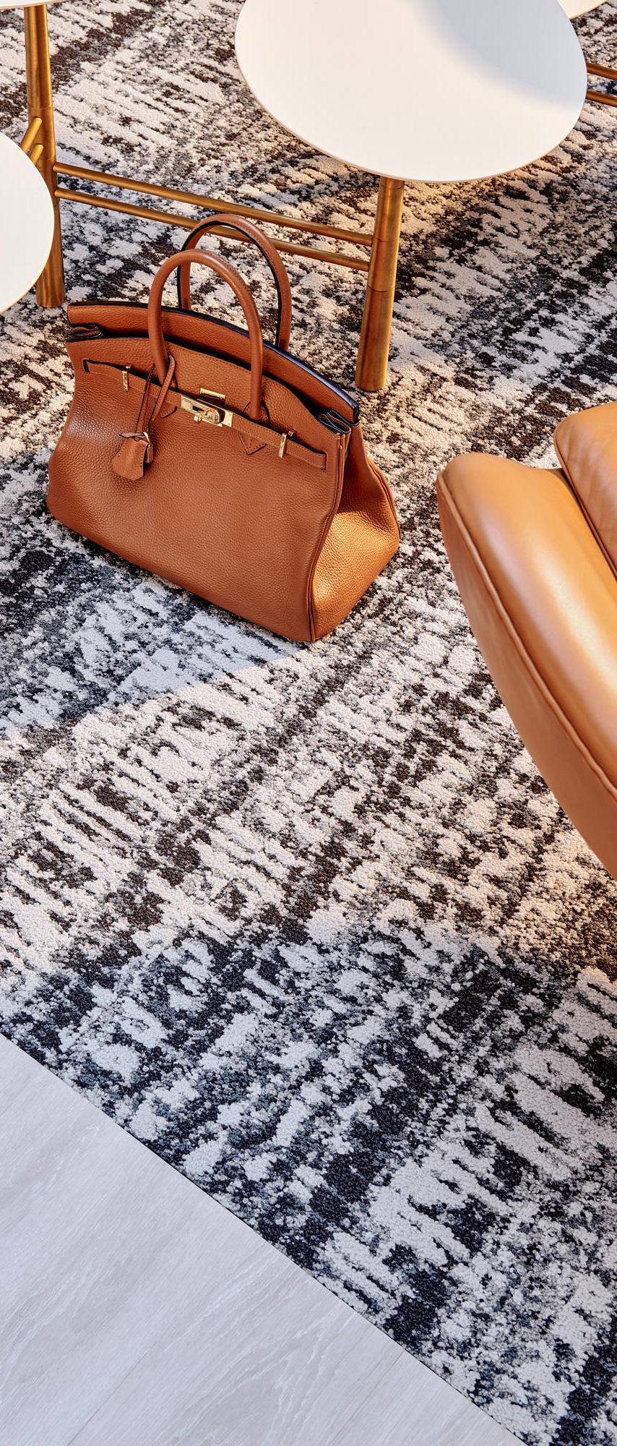
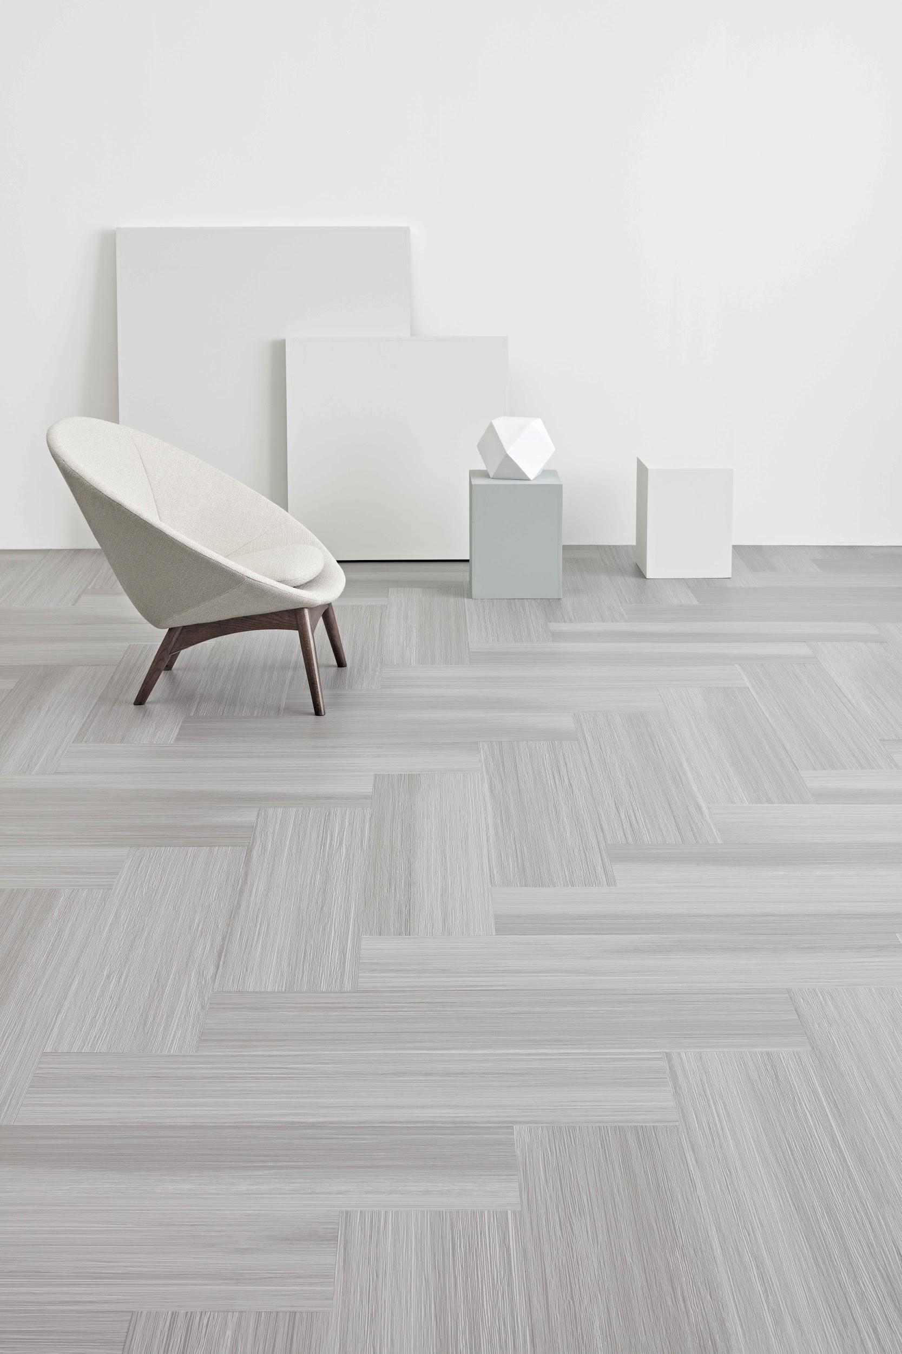
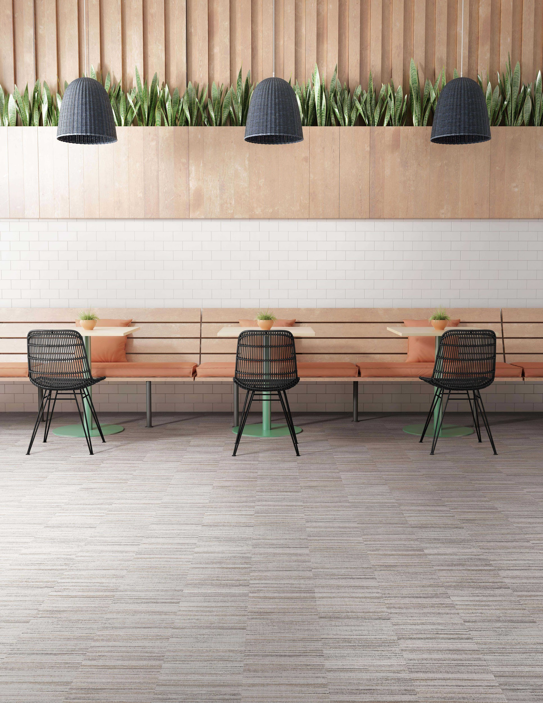
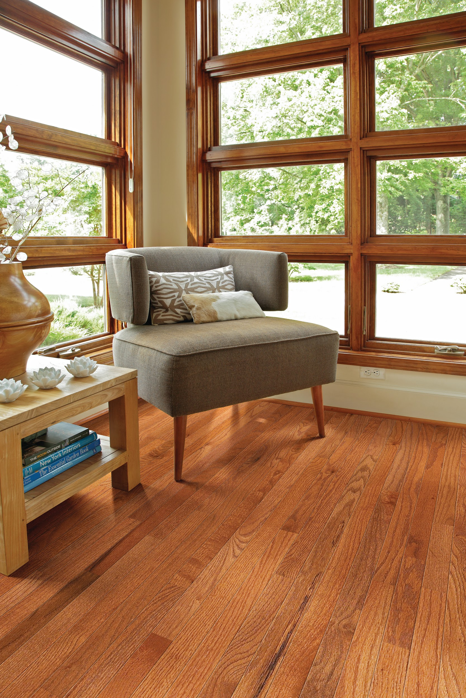
Global provider of commercial & residential flooring solutions – carpet, resilient, hardwood, laminate, tile & stone, turf, pad underlayment & sundries
Wholly owned subsidiary of Berkshire-Hathaway, Inc.
22,000+ associates
$6B+ annual revenue
Notes:
For those who might not know us well, Shaw Industries is a $6 billion flooring provider and a wholly owned subsidiary of Berkshire Hathaway. Our company has grown globally from our founding in north Georgia more than half a century ago. We have built on our legacy in carpet manufacturing to include floor coverings (and turf) for every possible place and space --

Slide 13
Notes:
We serve residential and commercial markets around the world through numerous customer-facing brands...

Slide 14
EcoWorx®
Carpet Tile
Safe Ingredients, Perpetually Recycled​
Since 1999
Notes:
And we’ve long been focused on sustainable manufacturing operations and providing beautiful, sustainable flooring products for our customers around the globe.
Our sustainability journey – and really our circularity journey – began more than 20 years ago with the introduction of EcoWorx carpet tile in 1999. It was our first product truly designed with the end-in-mind and it can be recycled back into more EcoWorx carpet tile once it's ready to be removed from the floor.
But it's about so much more than recycling, it's about fueling a safe and just circular economy.

Slide 15
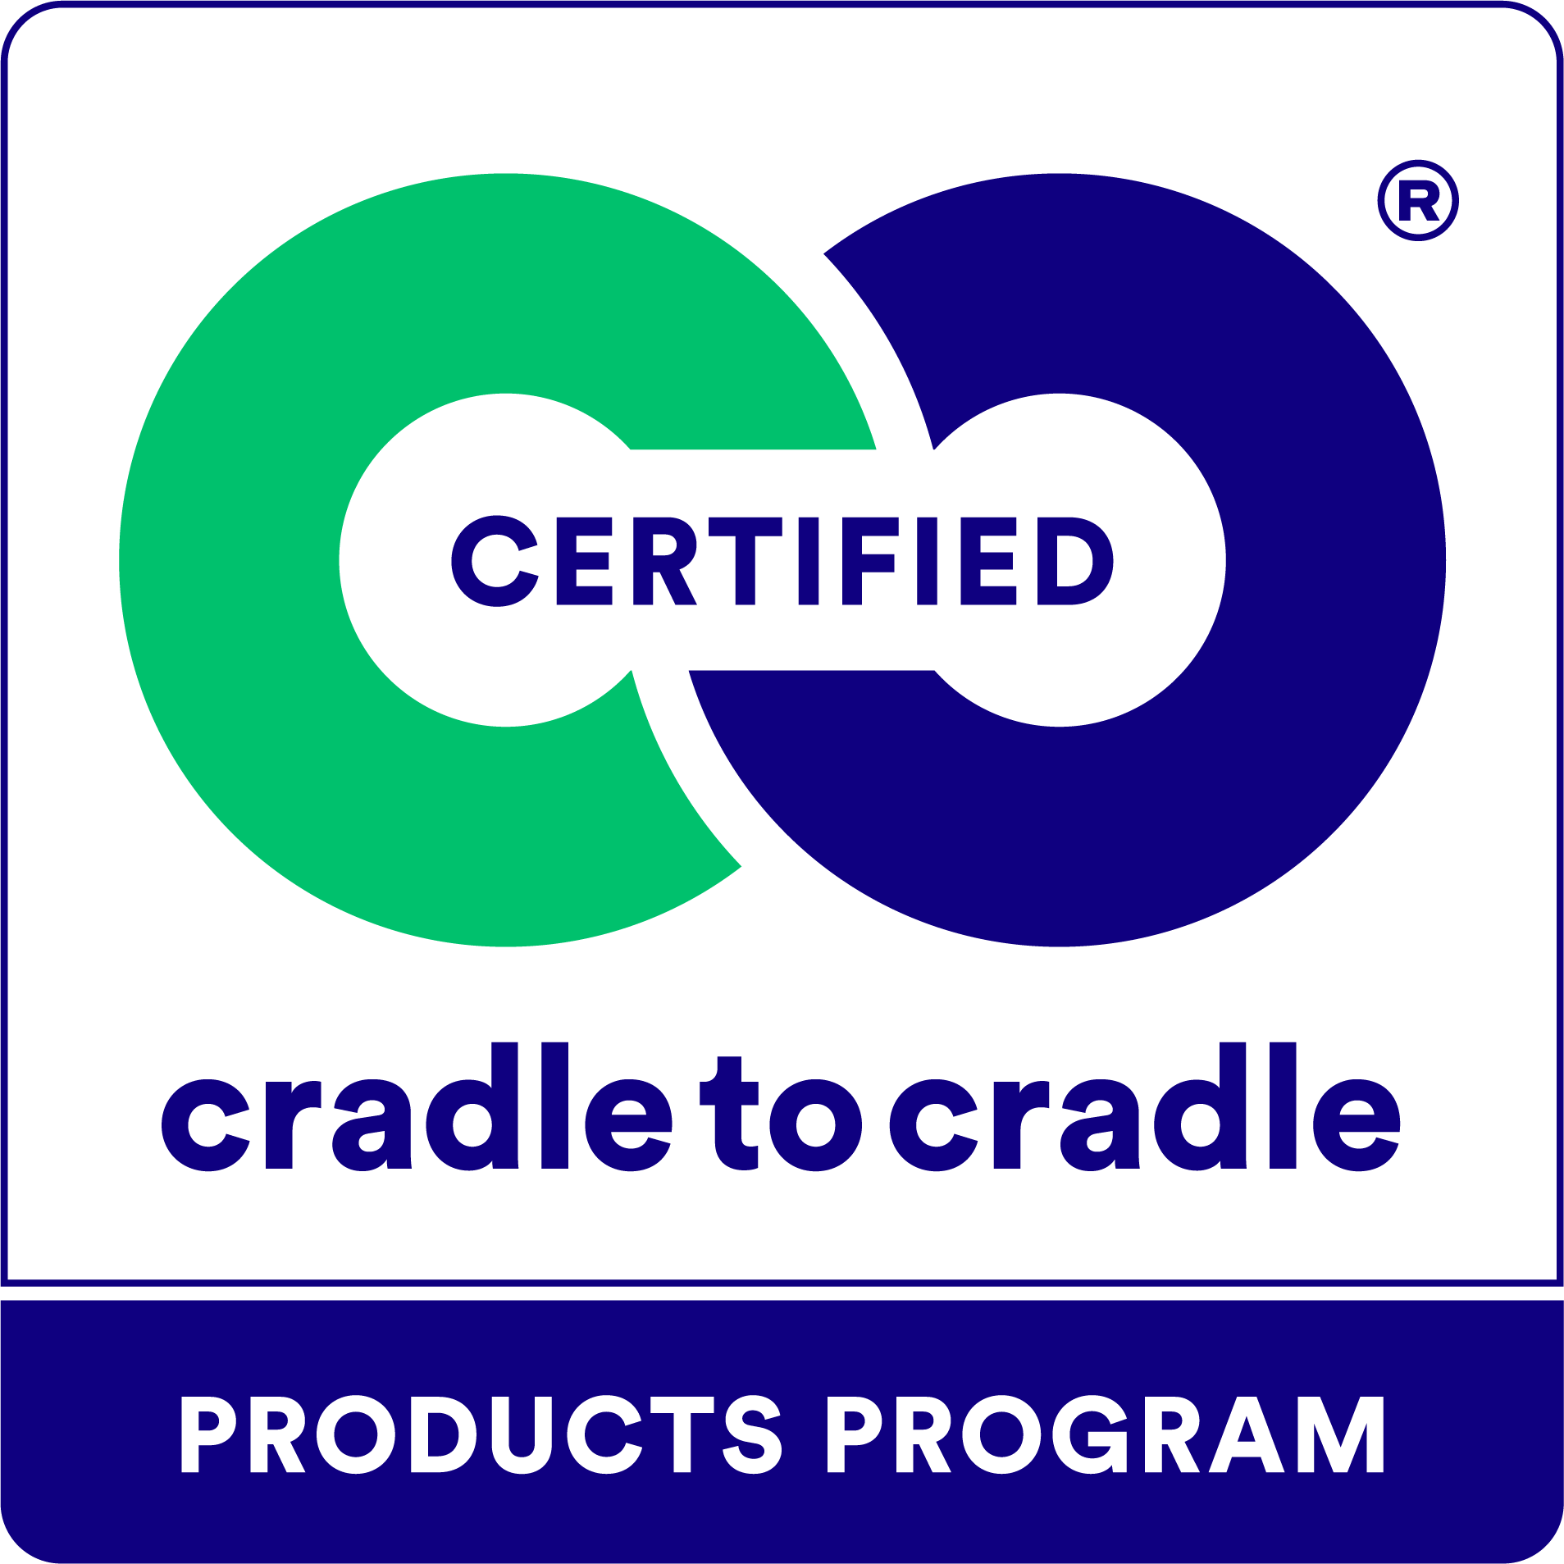
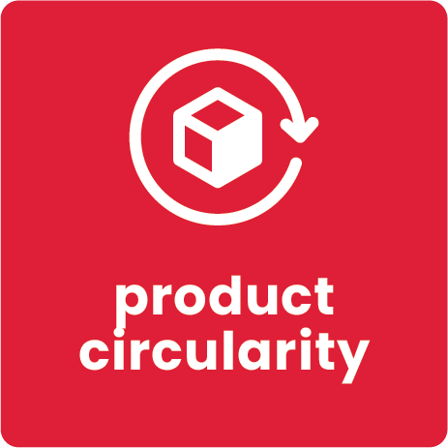
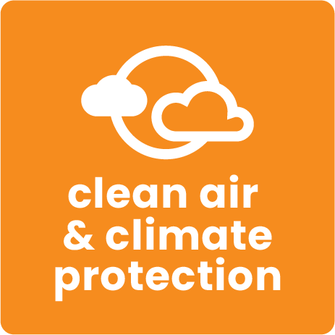
Notes:
Shaw’s approach to sustainability is largely based on the Cradle to Cradle Design principles – now a 3rd party product certification.
The rigorous Cradle to Cradle Certified Product Program focuses on five key sustainability categories:
material health, (toxicological review of the chemistry of the ingredients that go into our products)
product circularity, (designing products that contribute to the circular economy -- using recycled materials and designing for re-use)
clean air and climate protection, (utilizing clean, renewable sources of energy -- mindful of the carbon impact and carbon emissions from the manufacture of the product)
water and soil stewardship, and (protecting our precious natural resources)
social fairness. (considering people at all stages of the value chain -- from our suppliers to our own operations ensuring no forced labor, safe working conditions, preventing exposure to hazardous chemicals -- access and equity for everyone.
We're proud that EcoWorx was the first Cradle to Cradle Certified flooring product in the world and one of the first products of any type to be Cradle to Cradle Certified. What began with the introduction of a single product has become foundational to our product design.

Slide 16
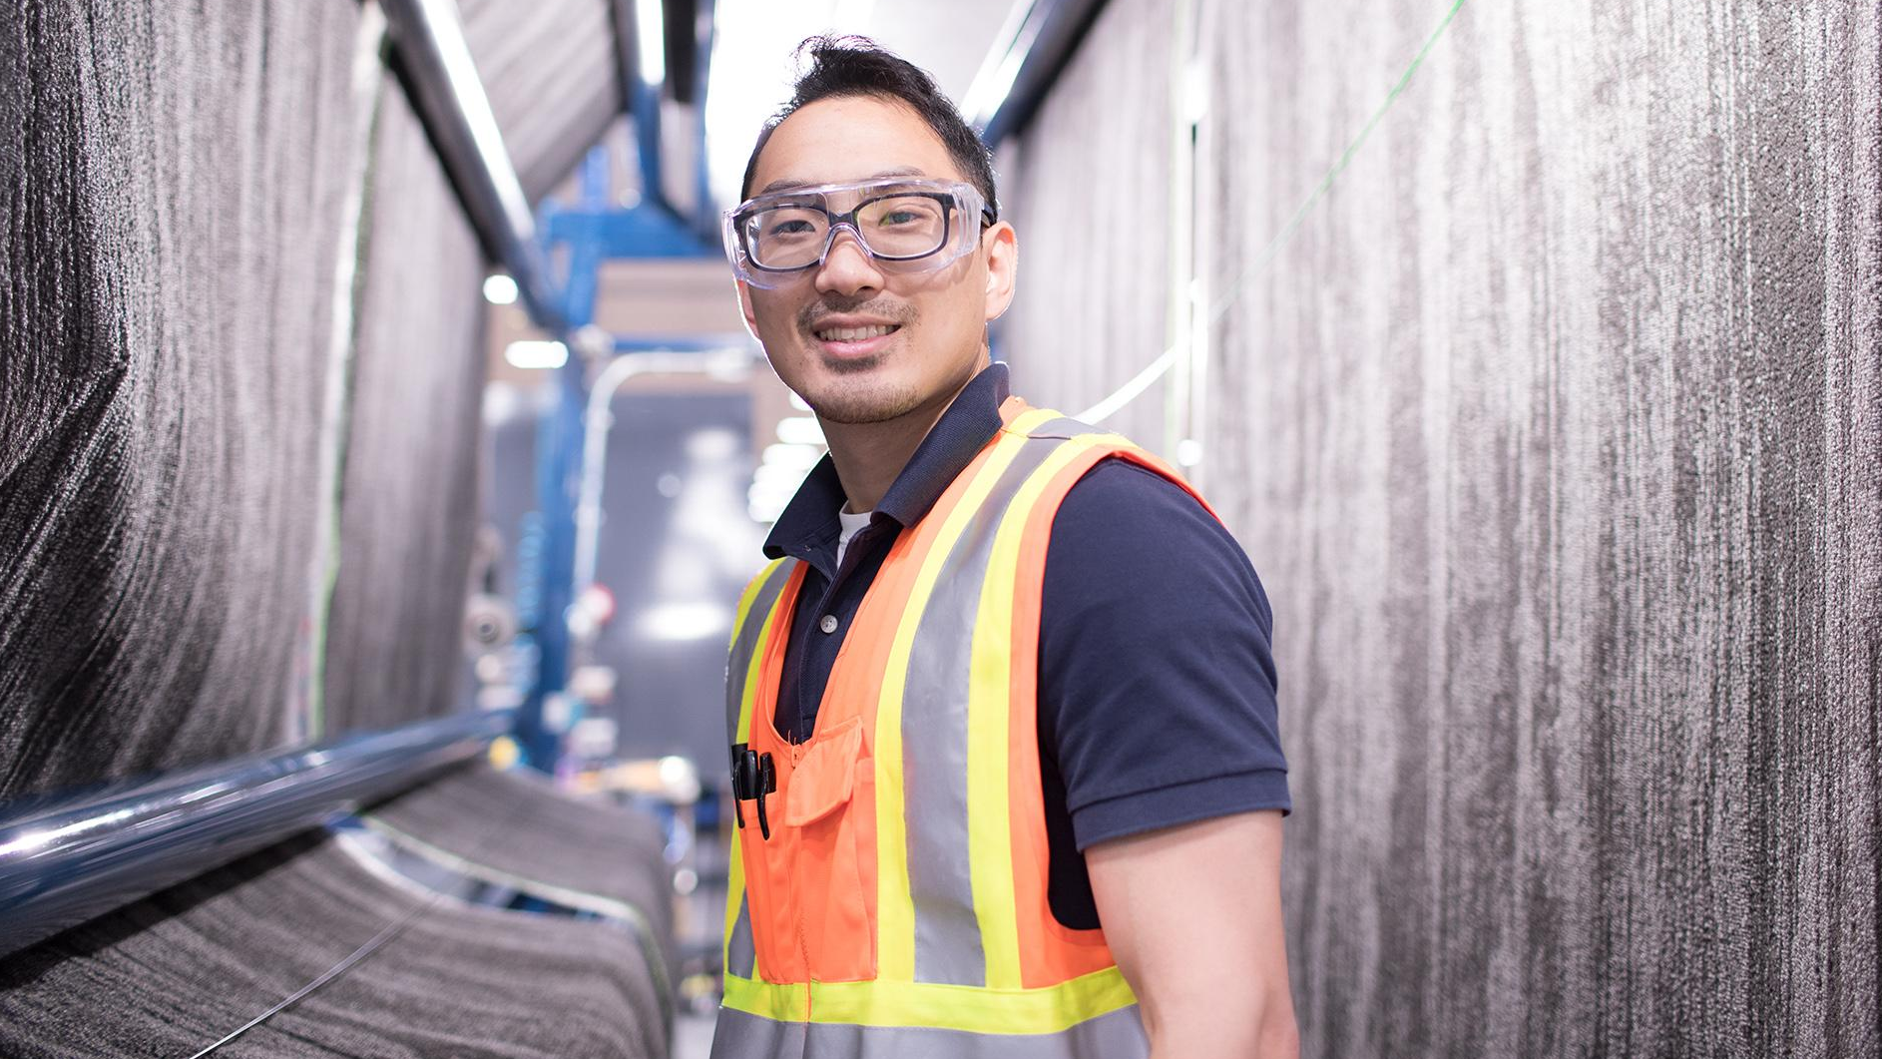
Almost 90% of the products we manufacture are Cradle to Cradle Certified®
Notes:
In fact, today, almost 90% of the products we manufacture are Cradle to Cradle Certified. And we have a growing portfolio of circular products, too. I break those up into 2 groups, really – those that use sources of recycled content – and those that are designed to be recycled – and frankly, sometimes both.

Slide 17
Recycled Content
Notes:
This next section – I want to break into 2 distinct pieces – the innovative uses of recycled content
Part 1 = recycled content
And secondly, products that are designed to be recycled.
Part 2 = products that can be recycled
And then, in reality, you can actually do both of those things in tandem.

Slide 18
NXTPlay®
Performance Turf Pad
Notes:
Take NXTPlay -- A performance shock pad made from recycled synthetic turf sports fields. For every field of pad produced the equivalent of one turf field is diverted from the landfill. This product not only provides a second life for an athletic field, but it combines superior playability with really impressive sustainability attributes. It is also C2C Bronze.

Slide 19
Turning Waste
Into a Resource For 20+ Years
In 2021, Shaw recycled
2.5 billion plastic bottles a year into flooring.
Notes:
We all know the world is clamoring over polyester drink bottles -- How about all the flooring products that use these recycled PET bottles as a key raw material? Like:

Slide 20
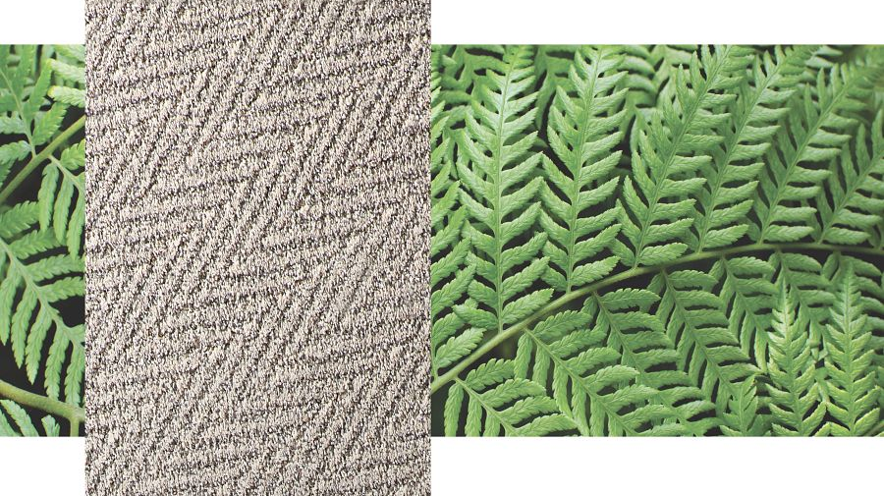
High Performance PET
Residential Carpet
Notes:
Our High Performance, white dyeable PET residential carpet fiber. In this example product, we use over 76 recycled plastic bottles per square yard.

Slide 21
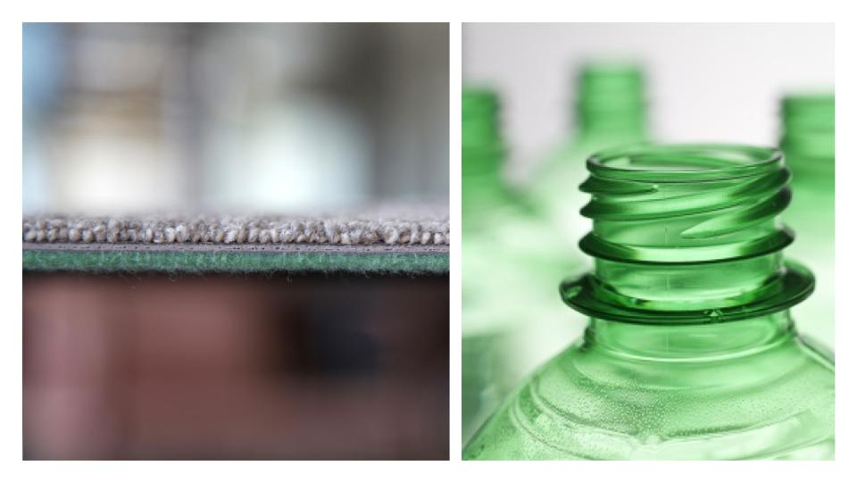
EcoLogix®
Commercial Carpet with Cushion
Notes:
And remember all of my green Sprite bottles...
Those historically have been significantly less valuable as a recycled material stream just because of their color, right?
But they make an amazing cushion for carpet tile backing that can use 100% recycled PET in an attached carpet padding in our EcoLogix carpet tiles.
It adds cushion underfoot, extra acoustical benefits, and even a lower embodied carbon footprint.

Slide 22
& Recyclability
Notes:
OK, now out of recycled content and onto design for recyclability --

Slide 23
EcoWorx®
Carpet Tile
Notes:
Back to EcoWorx carpet tile – that pioneering product we introduced more than 2 decades ago. I’ll go into more detail about this in just a second.

Slide 24
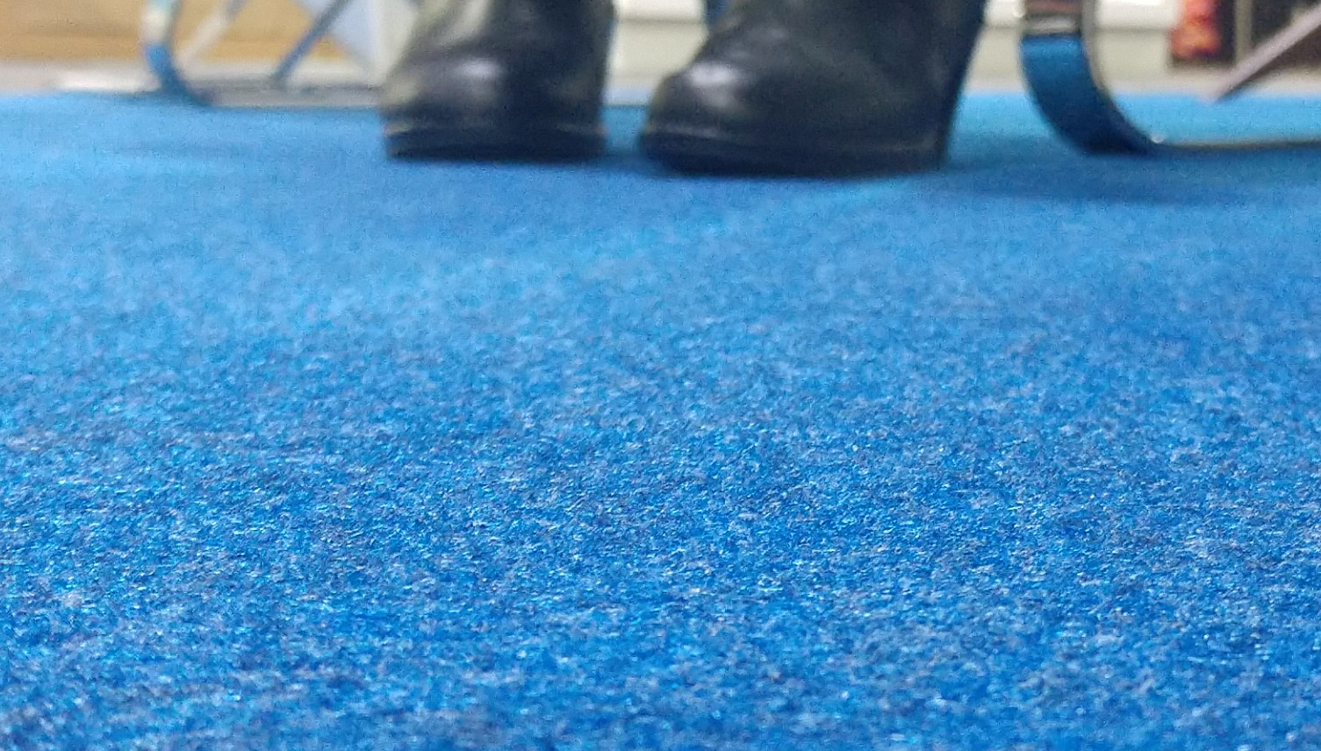
COMFOR3T
COMFOR³TTM
Trade Show Carpet
Notes:
But how about our new trade show and expo carpet aptly named COMFORT – this innovative product provides added comfort underfoot for those standing on their feet during long trade show days. The product cleans easily and maintains its beauty over multiple uses. Made with 60-80 percent recycled content (depending on the color), COMFOR3T reduces the use of virgin materials by incorporating both post-consumer and post-industrial recycled content AND once it’s ready for replacement, the Cradle to Cradle Certified Bronze product is 100% recyclable.

Slide 25
ReWorxTM
PET Hybrid
Notes:
And most recently ReWorx, a hybrid flooring innovation that offers the warmth and cleanability of a soft surface, with the durability of a hard surface.
Designed for commercial properties
Will be available from 3 Shaw brands by Q1 2023
Also Cradle to Cradle Certified Bronze.

Slide 26
Notes:
ReWorx is a 100% PET flooring that contains an average of 61 recycled bottles per square yard using both clear and those often less-desirable-colored bottles.
An award winning flooring at that. It's been recognized with numerous awards from the interior design community and most recently was honored by Fast Company with an Innovation by Design Award in 3 categories:
Circular Design
Materials
Sustainability
And when it's reached the end of its useful life on the floor, Shaw will take it back and make it into more ReWorx flooring.

Slide 27
If you design it,
they will recycle it
Notes:
So back to my Field of Dreams parable --
If you design it to be recycled, they'll recycle it, right?

Slide 28
Not Quite...
Notes:
Here we are again, that’s not exactly how everything went for us, either. We’ve had to amp up our approach….

Slide 29
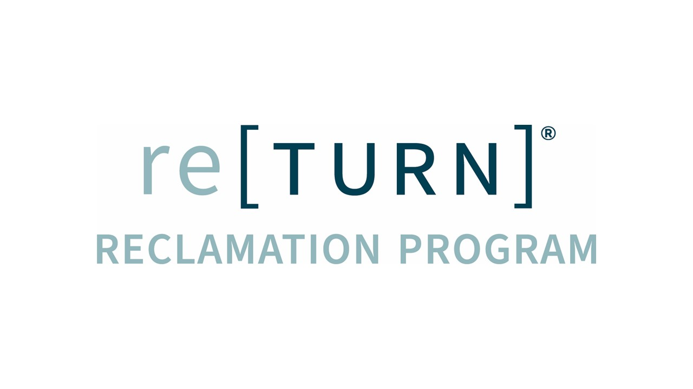
Fuel the circular economy
with safe, sustainable, cradle-to-cradle inspired products.
Notes:
We make returning these products at the end of their useful life as easy as possible through our re[TURN] Reclamation Program. A few ways we make it easy include…

Slide 30
MAKING IT EASY
An Environmental Guarantee
Through our Environmental Guarantee, Shaw pledges to transport and recycle [PRODUCT] within the United States and Canada at no cost to the customer.*
*500 SY Minimum
Notes:
Offering multiple flooring products with an Environmental Guarantee for takeback and recycling at no cost to the customer.

Slide 31
MAKING IT EASY
Educational tools & easy-to-use guidelines
Notes:
We make it easy by providing step-by-step instructions with pictograms of what it means to stack on a pallet, etc.

Slide 32
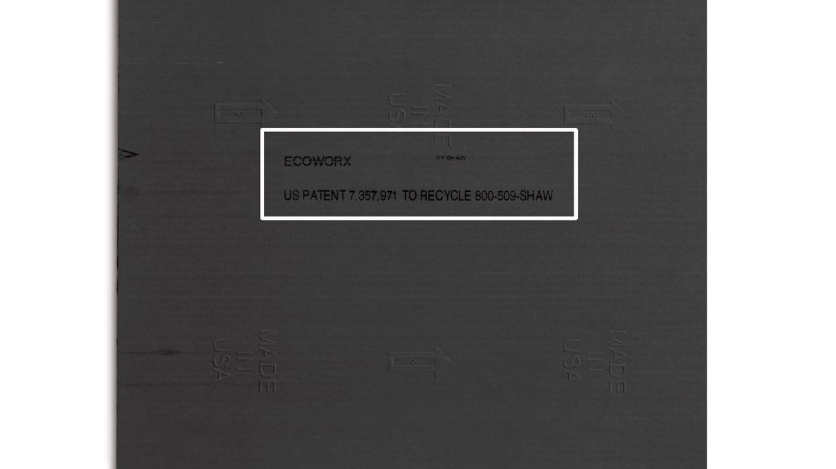
MAKING IT EASY
Toll-free number & URL printed on the back
Notes:
We emboss directly into the carpet tile backing a toll-free phone number and www.shawrecycles.com to help facilitate take back years later when the person taking it off the floor is not likely the person that bought it in the first place.

Slide 33
MAKING IT REWARDING
Customer certificates to show impact
Notes:
Once material is returned to Shaw, we calculate and communicate the positive impact that the reclamation job has actually had on the world.
We use metrics like equivalent gallons of gas, or miles not driven, or trees planted – so people can actually understand the scale of their carbon impact.

Slide 34
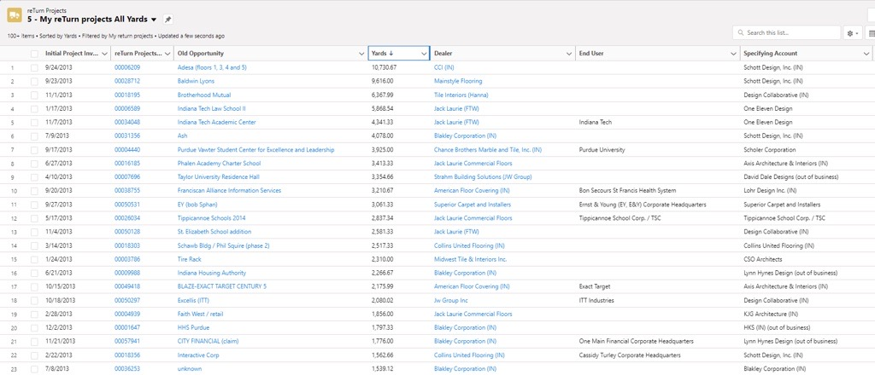
MAKING IT REWARDING
Incentives for sales: re[TURN]® pipeline
Notes:
And for our own sales organization – we use Salesforce.com to help them see projects that have been installed for more than 8 years so that we can go actively harvest material that is “ready” for reclamation.

Slide 35
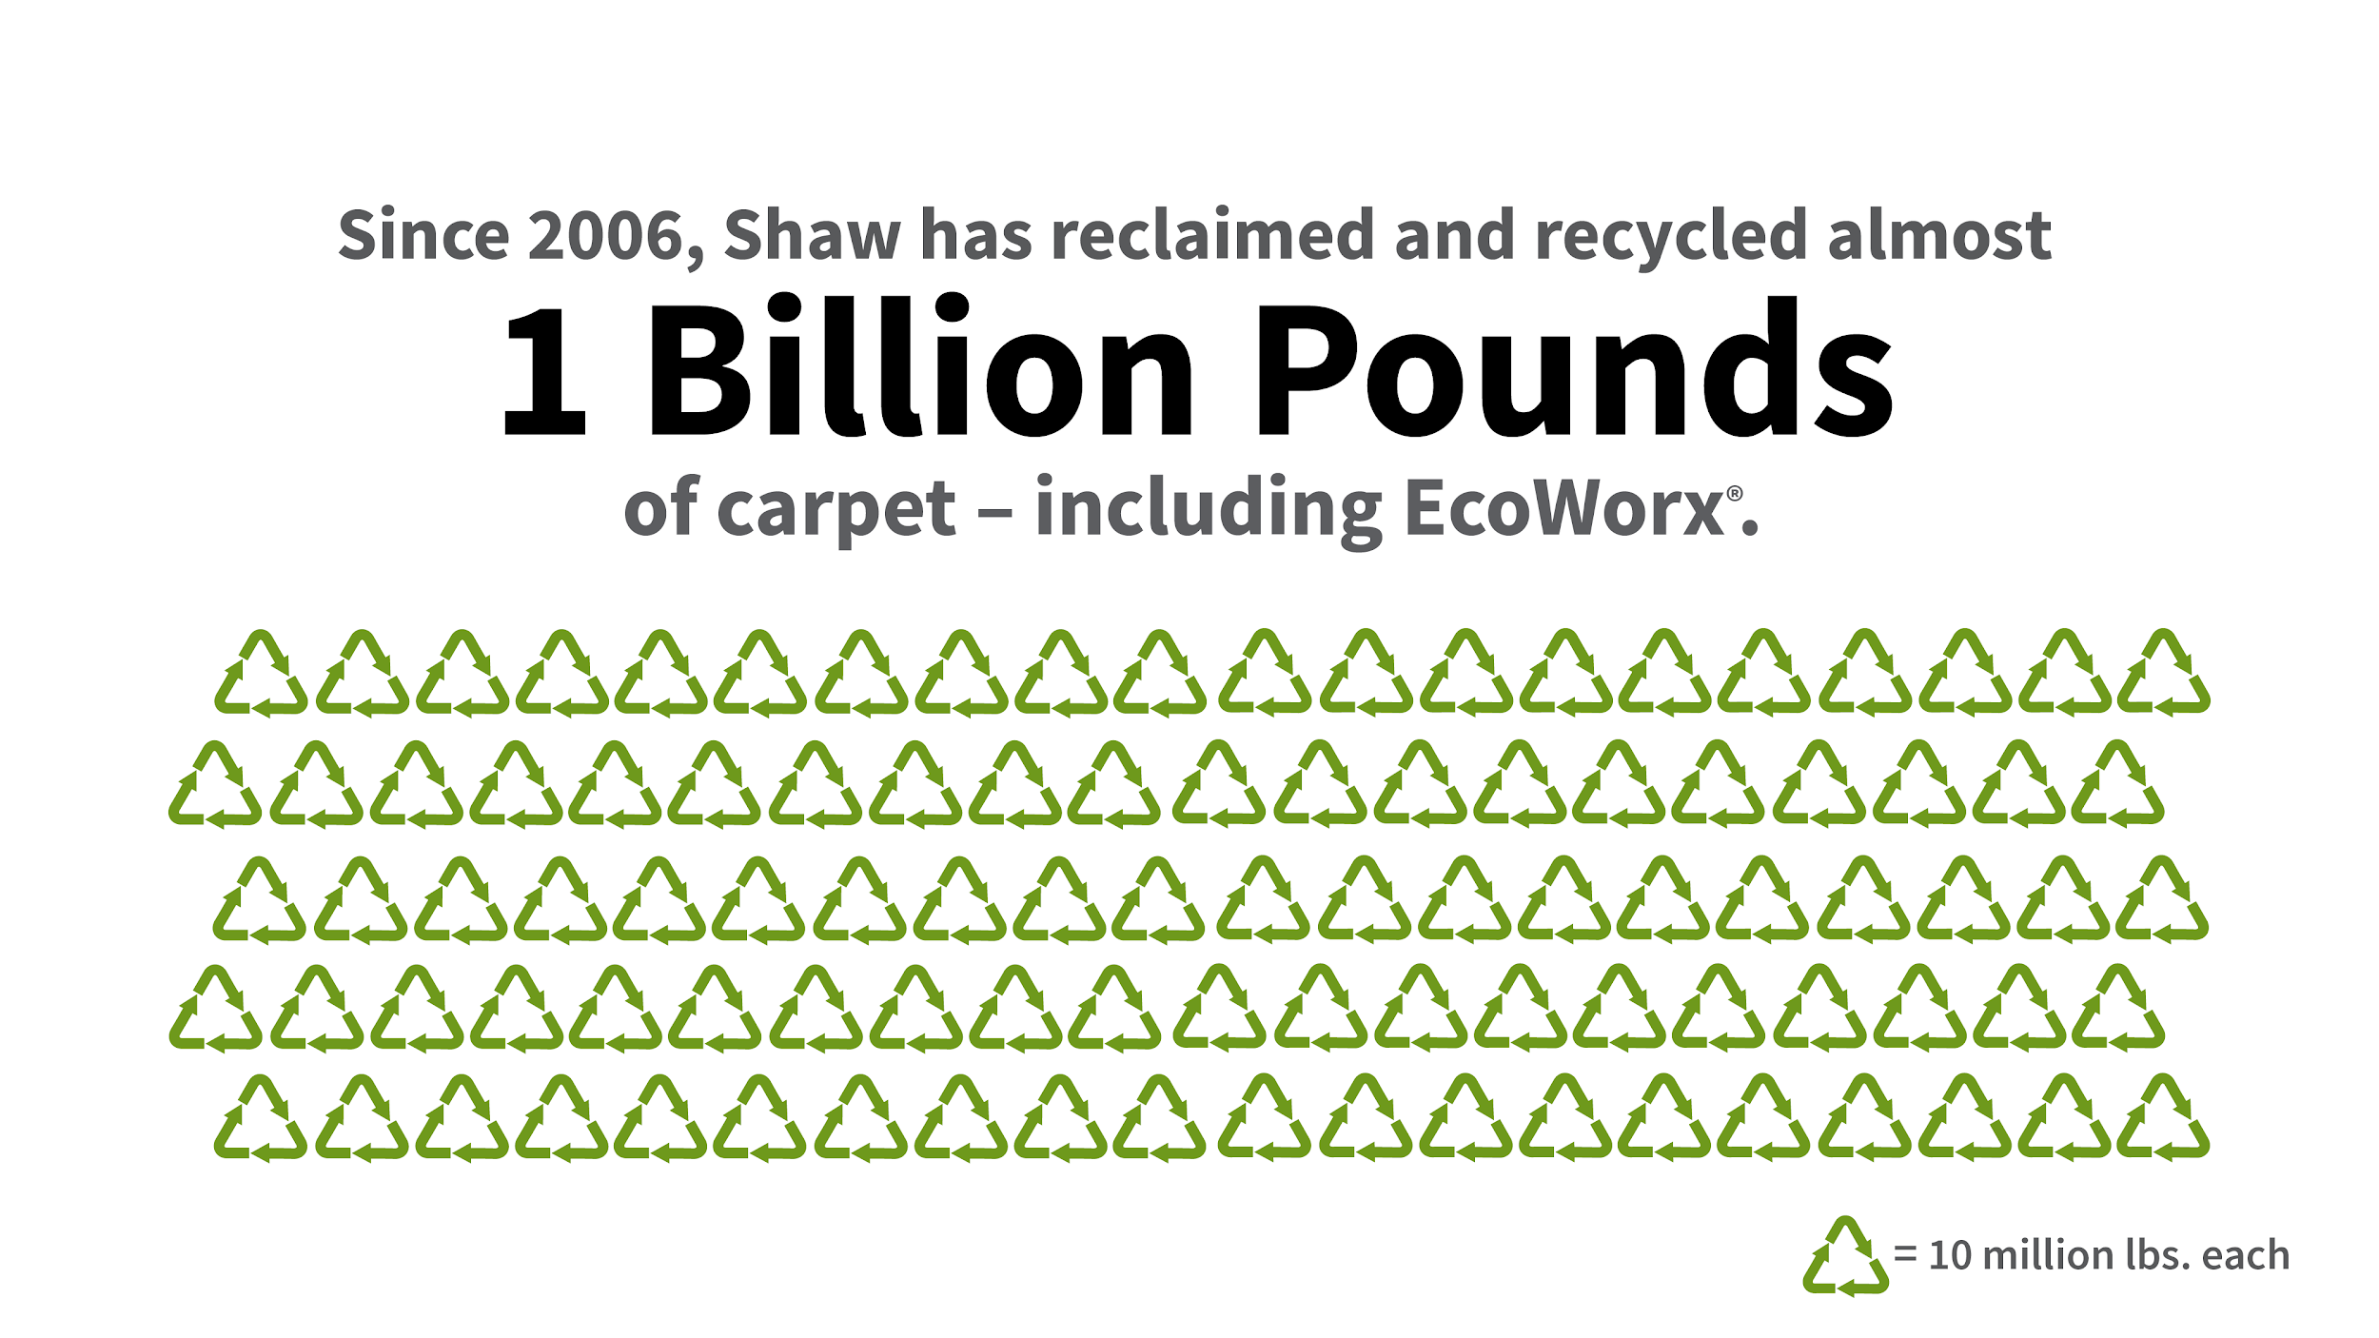
Notes:
As a result, through this program, we’ve reclaimed and recycled almost 1 billion pounds of carpet since 2006 - ours and competitors combined.
I’m also really proud to say that we maintained a consistent level of reclamation among our commercial customers even during the height of the COVID-19 pandemic.

Slide 36
Notes:
So, why did I take my time today to share Shaw’s story? Because it is our Mission Possible. To fuel the circular economy with cradle-to-cradle inspired products. To use recycled content to lower our carbon impact. To design products that can be recycled and participate in our re[TURN] reclamation program.
Despite all of the forces against all of us, and amidst challenging times – we HAVE to figure this out as a global community – so it might as well start right here in Georgia. We don’t have a choice and I’ll reiterate my friend’s sense of urgency.
I leave you this morning with a personal challenge for the next 2 ½ days. “Mission Possible”. Flip the script from what isn’t working to what can we do differently. In this audience today, I am confident that we have the right combination of experience, diversity, perspectives, industries, organizations, etc. to inspire and help one another. Identify new opportunities. Uncover unlikely partners. Ask hard questions. Make new friends. Ask yourself “how might we”….?
Thank you.

