Slide 1
Recycling Innovation At The Federal Law Enforcement Training Centers
Glynco Campus

Slide 2
Stephen W. Brooks Chief Assets and Logistics Management Division Federal Law Enforcement Training Centers (912) 267-2893

Slide 3
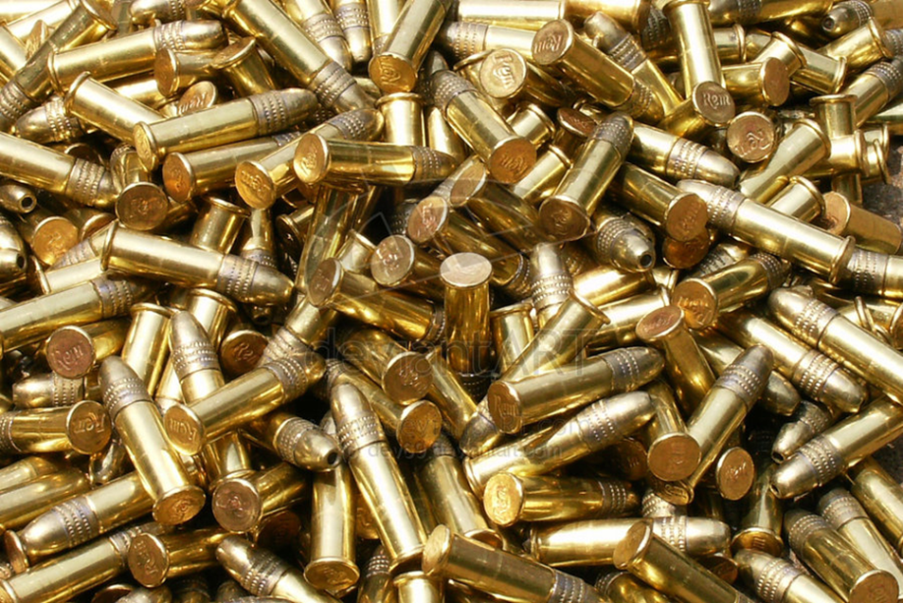
Prior to the establishment of a recycling program at the Glynco campus, the only solid waste generated from law enforcement firearms training being recycled were brass casings while the frangible bullet dust and lead bullet fragments were handled as hazardous waste.

Slide 4
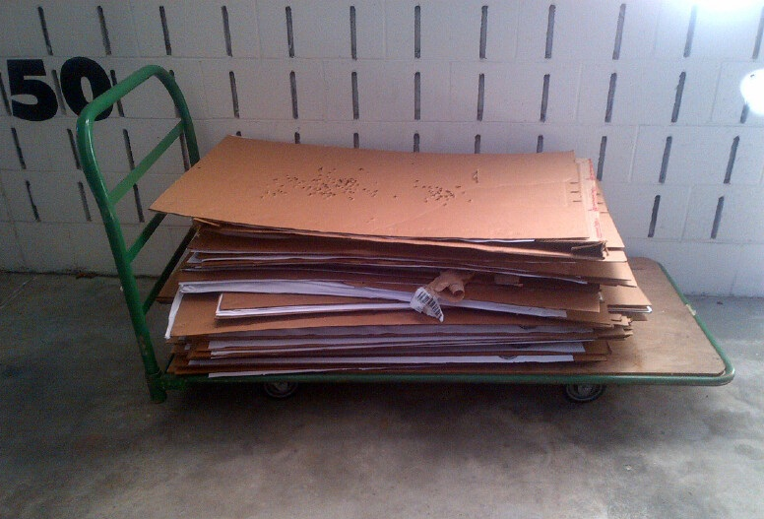
The paper targets, cardboard target backers, plastic ammunition trays, and paperboard ammunition boxes from law enforcement firearms training were all tossed into the trash dumpster and hauled to the local landfill for disposal.

Slide 5
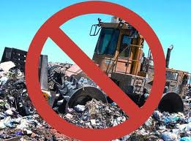
A paradigm shift was required for the innovation to begin. The shift was from thinking all the solid waste generated from firearms training was “trash” and should be discarded as such to thinking those items contained “value” in the recycling marketplace.

Slide 6
Value in what was previously seen as trash
Polypropylene (PP): 8,722 lbs. / $2,865.60
Polyethylene (PE) 6,662 lbs. / $1,126.80
Polystyrene (PS) 14,323 lbs. / $5,318
Old Corrugated Cardboard (OCC): 64,096 lbs. / $4,093.09

Slide 7
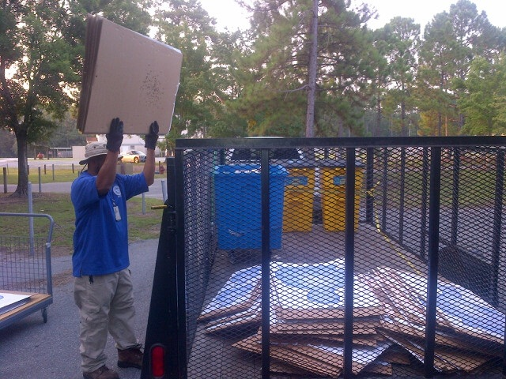
The shift in thinking began in earnest in November 2013, when the FLETC’s Assets and Logistics Management Division (ALM) in collaboration with the Firearms Division (FAD) and Sustainability Officer initiated a pilot recycling project on two firearms ranges

Slide 8
Once the process and procedures for collection of commodities was refined the project was expanded to all 15 FLETC firearms ranges. Cardboard target backers, paper targets, plastic bullet trays, and paperboard ammunition boxes were collected and transported to Building 2400 for processing.

Slide 9
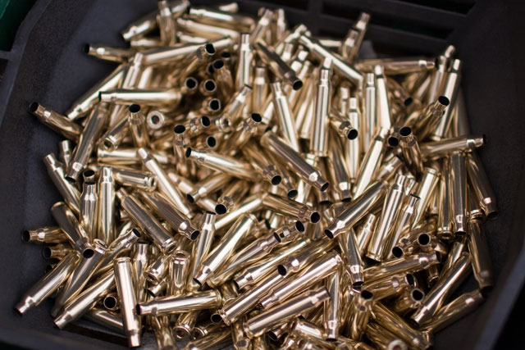
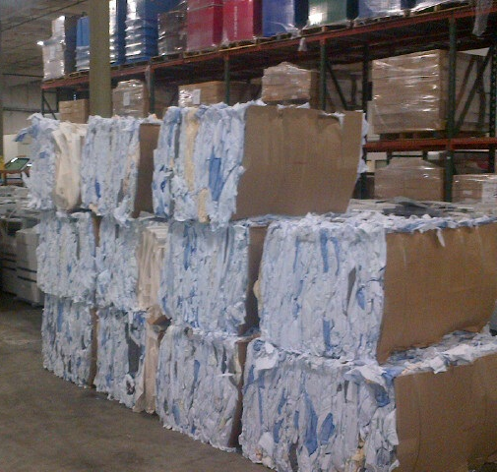
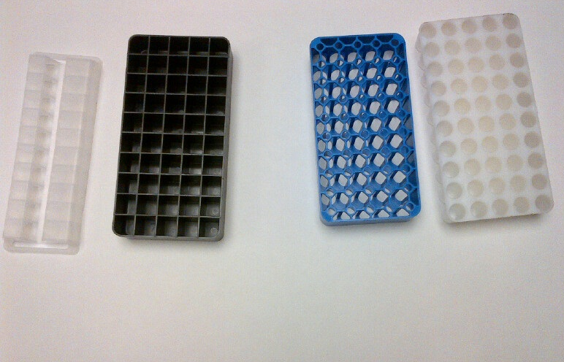

Slide 10
To facilitate the shift in thinking that solid waste was recyclable containers were placed on all firearms ranges for collecting those items previously disposed of in a dumpster.

Slide 11
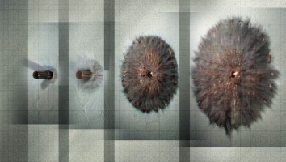
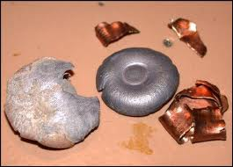
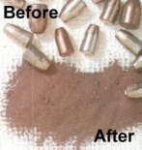
Lead bullet fragments and frangible bullet dust moved removed from the hazardous materials arena to that of recyclable commodities. Instead of paying to dispose of them they are now a positive revenue stream to support the overall recycling program.

Slide 12
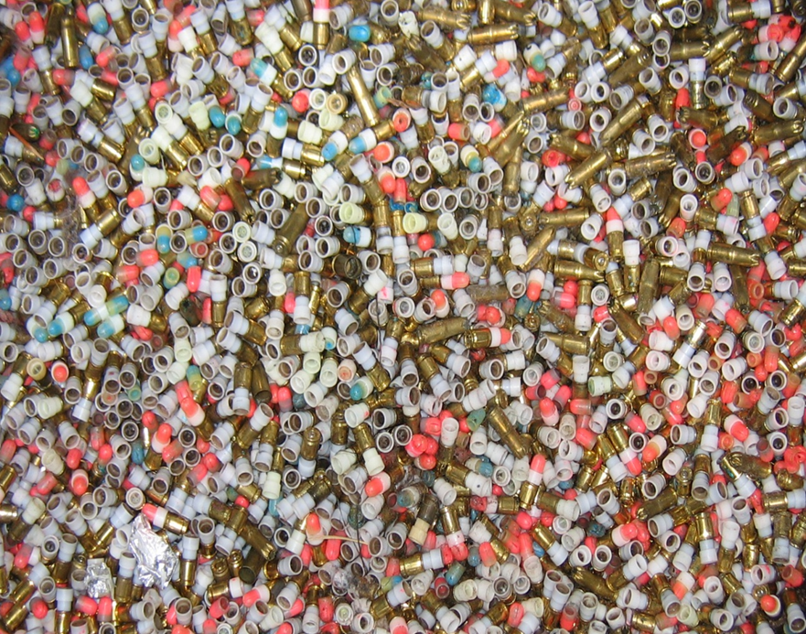
Non-Lethal Training Ammunition

Slide 13
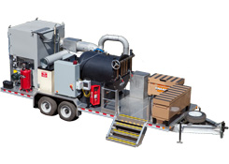
Non-Lethal Training Ammunition
Mobile Thermal Treatment Unit

Slide 14
Effectiveness
Of the eight categories of solid waste generated from FLETC law enforcement firearms training, , or 87.5%, are being recycled and are now generating a revenue stream for sustaining the FLETC recycling program. This is a significant accomplishment in that prior to the concerted recycling effort, the FLETC paid to have these items removed from the Center and deposited into the local landfill.
With all frangible bullet waste, expended lead bullet fragments, cardboard target backers, paper targets, and plastic ammunition inserts, and paperboard ammunition boxes being recycled, FLETC firearms training is approximately 95.3% sustainable.

Slide 15
Through FY2014 and until Q3 of the 2015 calendar year, following commodities were collected and sold generating revenue:
Polypropylene (PP): 8,722 lbs. $2,865.60
Polyethylene (PE): 6,662 lbs. $1,126.80
Polystyrene (PS): 14,323 lbs.
$5,318
Old Corrugated Cardboard (OCC): 66,038 lbs.
$5,408.53
Standard Office Paper (SOP): 3,183 lbs.
$423.40
Wood: 52 useable pallets
$52.00
Metals: 10,904.38 lbs.
$13,523.73
Batteries: 2,075 lbs.
$795.30
Brass: 63,557 lbs.
$90,524.55
Frangible Dust: 76,237 lbs. $76,922.08

Slide 16
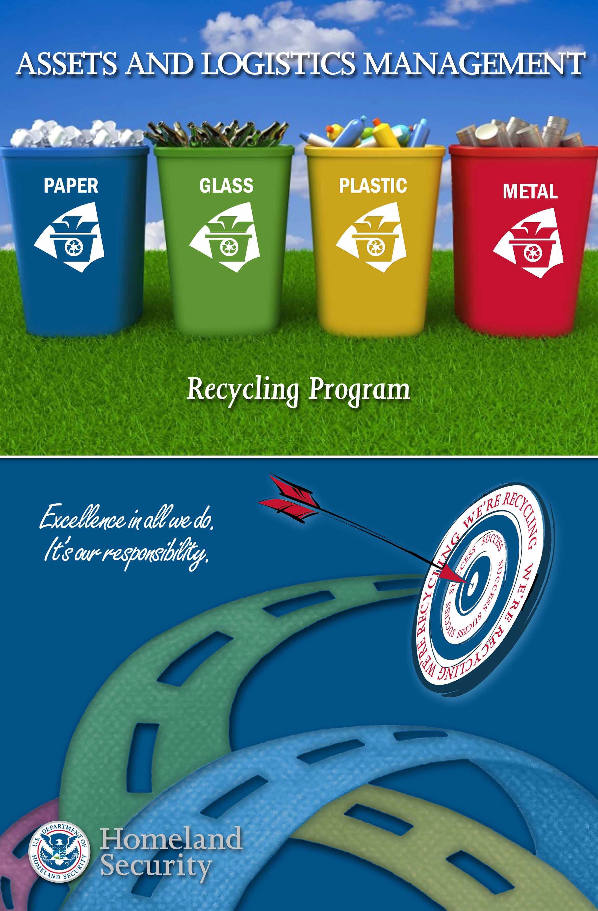
Questions?

Slide 17
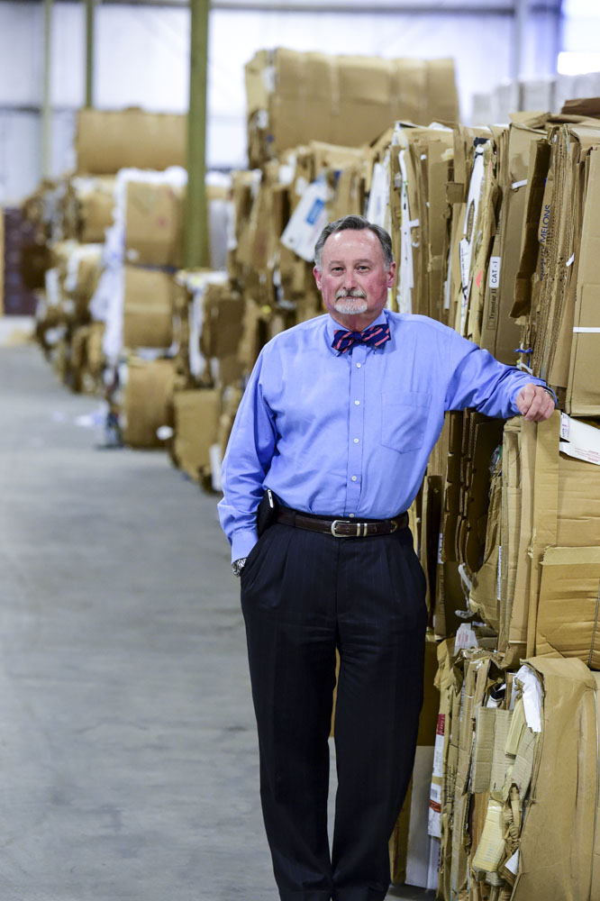
Shifting paradigms and the recycling program at FLETC
http://www.federaltimes.com/story/government/solutions-ideas/2015/03/09/fletc-glynco-recycling-program/24657977/

