Slide 1
The Economics of Scrap Recycling:
Responding to Disconnected Markets and Global Imbalances
Joseph C. Pickard
Chief Economist and Director of Commodities
Institute of Scrap Recycling Industries, Inc.
24th Annual GRC Conference, Trade Show and Membership Meeting
August 19, 2015
King & Prince Beach Resort
St. Simons Island, Georgia

Slide 2

ISRI: Voice of the Recycling Industry
1,600+
Member companies
7,000+
Recycling facilities worldwide
34
Countries
Notes:
Institute of Scrap Recycling Industries (ISRI)
ISRI is an international trade association that represents more than 1,700 member companies that process, broker and consume scrap (ranging from small, family-owned businesses to large, multi-national corporations)
Representing 7,000+ facilities worldwide - that process, broker & consume scrap metals, paper, plastics, glass, textiles, rubber, and electronics.

Slide 3







Institute of Scrap Recycling Industries
Ferrous &
non-ferrous metals
Paper
Plastics
Glass
Rubber
Textiles
Electronics

Slide 4
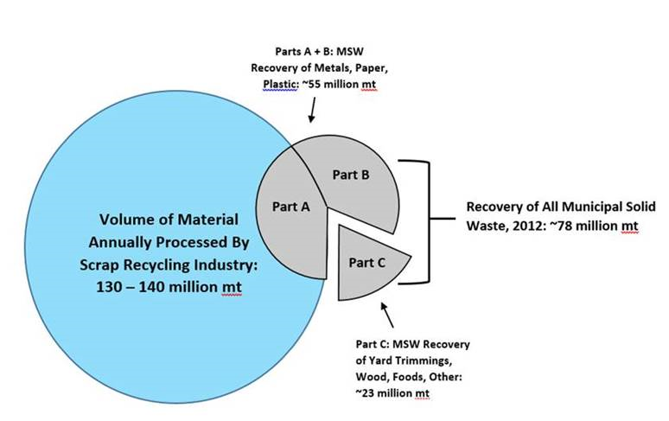
The Recycling Industry

Slide 5
Recycling Industry in the US
$105 Billion Industry
149,000 472,000
Direct Employees Direct + Indirect
+135,000,000
Tons processed annually
75 million tons ferrous
5.4 million tons aluminum
2 million tons copper
46 million tons paper

Slide 6
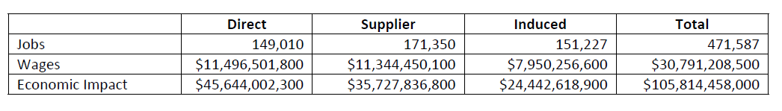
Scrap Recycling Jobs Study
In 2015, the Institute of Scrap Recycling Industries (ISRI), Inc. retained the independent economic consulting firm of John Dunham and Associates to perform an economic impact analysis to document the size and scope of the scrap recycling industry in the United States and document its significant contribution to the U.S. economy, in terms of employment, tax generation and overall economic benefit.
The study found that the people and firms that purchase, process and broker old materials to be manufactured into new products in America provide 471,587 adults with good jobs in the United States and generate more than $105.81 billion annually in economic activity.
The study also found that the scrap recycling industry generates about $4.39 billion in state and local revenues annually and another $6.76 billion in federal taxes are paid annually by the industry and its employees.

Slide 7
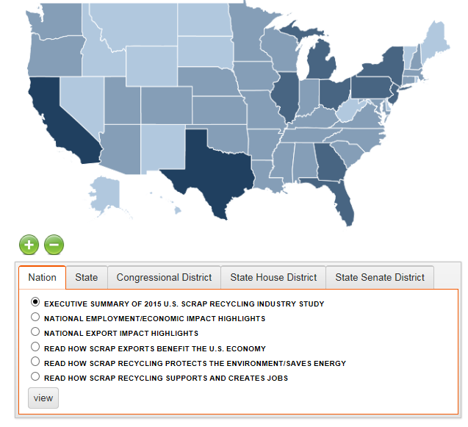
GA Scrap Recycling Industry
In the state of Georgia, the Dunham Study found that 5,154 jobs are being supported by the manufacturing and brokerage operations of the scrap recycling industry in Georgia.
In addition to this, 11,600 jobs are indirectly supported by the scrap recycling industry through suppliers and the indirect impact of the industry’s expenditures.
All of this activity generates $3.5 billion in economic benefits in Georgia.
All told, the GA scrap recycling industry generates $216.6 million in tax revenues for the federal government and $121.9 million in state and local revenues.

Slide 8
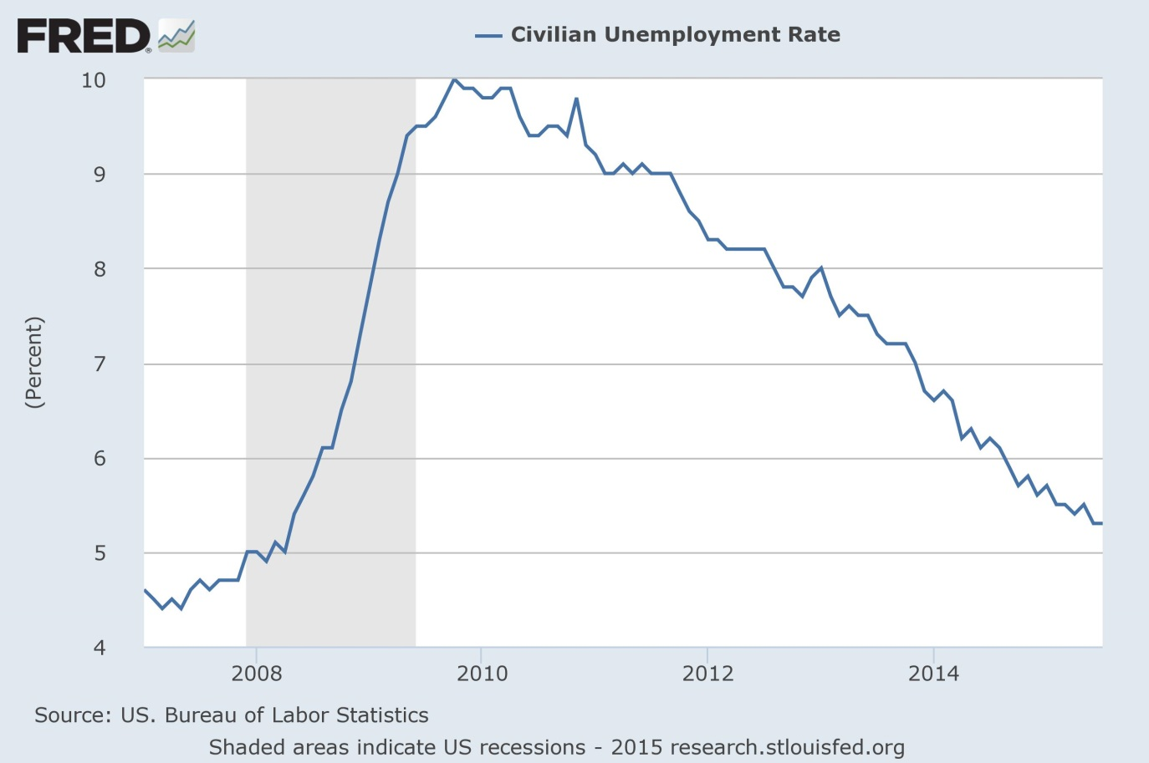
Labor Market Improving

Slide 9
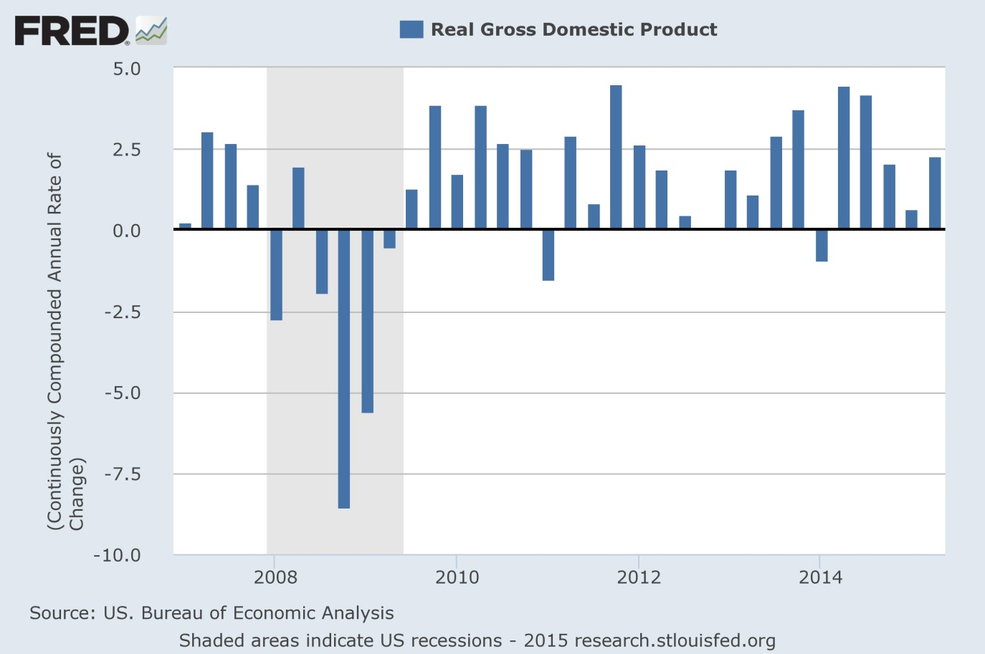
U.S. Economic Growth

Slide 10
But Disconnect Persists
Uneven domestic manufacturing growth contributing to volatile consumer demand for scrap
Falling commodity prices
Transportation bottlenecks
Constantly shifting regulatory landscape
China financial market volatility and economic slowdown
Euro zone and Middle East not helping
Exchange rates in the balance
Investors still skittish on commodities amid excess supply

Slide 11
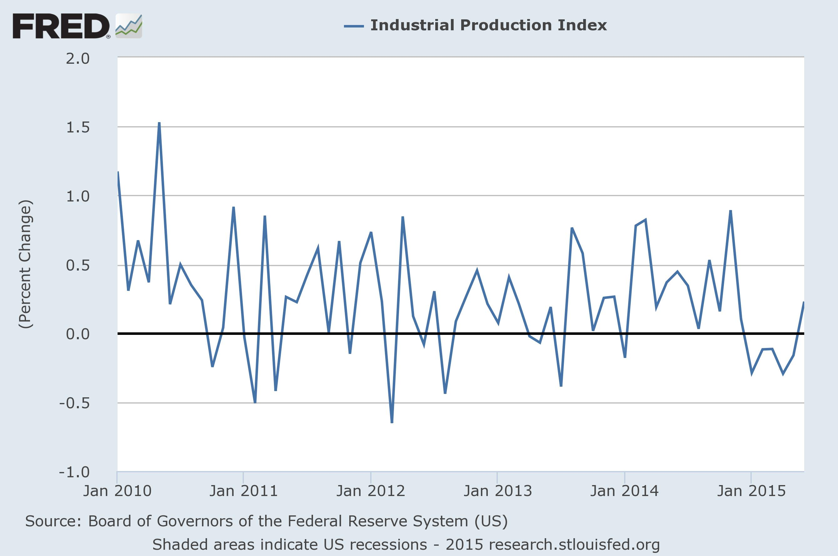
Scrap Industry Health Connected to Manufacturing Sector

Slide 12
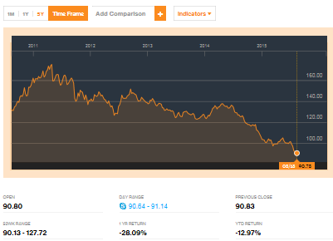
Scrap Industry Still A Commodities Business
The Bloomberg Commodity Index down 13% YTD and 28% over the last year.

Slide 13
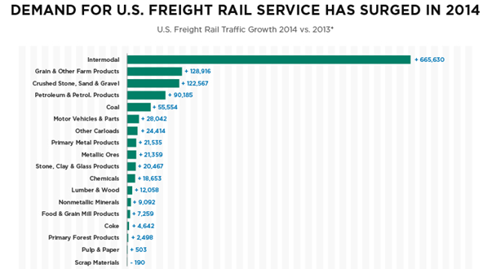
Other Issues: Transportation Headaches Persist: Ports, Trucking and Rail

Slide 14
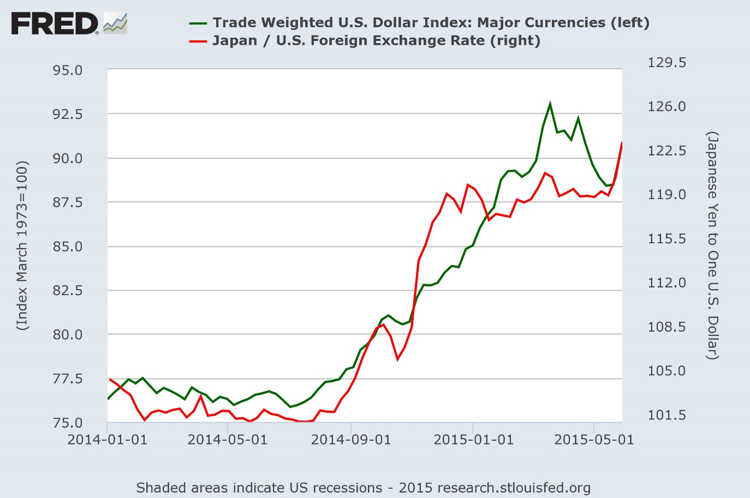
Dollar Strength Hurting Exports (Boosting Imports)

Slide 15
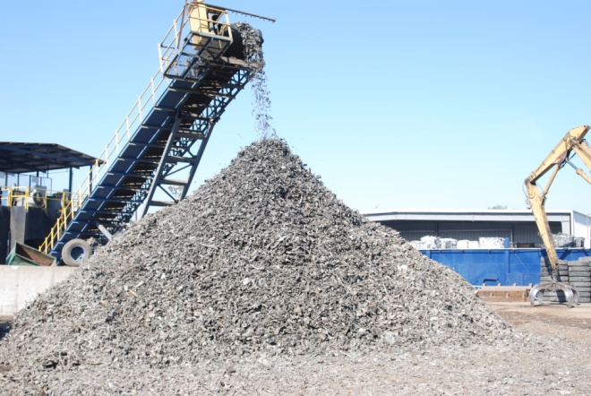
Impacts on the Scrap Industry
Impacts …
Scrap processors squeezed between tougher supply and demand
Heightened competition for available feedstock
Excess recycling capacity (particularly in shredding)
Declining scrap export sales revenue
Margin compression
Industry consolidation
Notes:
15

Slide 16
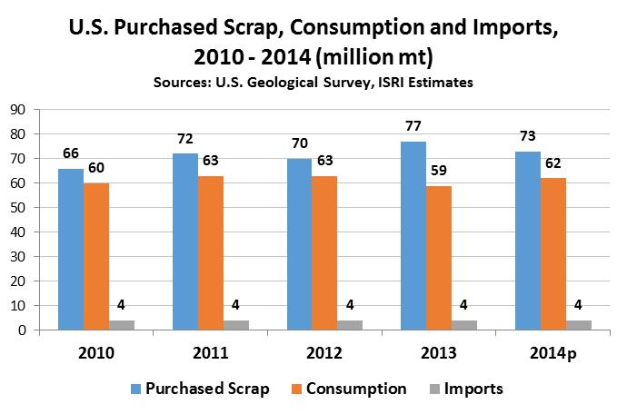
U.S. Market Trends: Ferrous

Slide 17
U.S. Steel Imports
AISI reports that for the first seven months of 2015 (including July SIMA and June preliminary), finished steel imports were 20,370,000 NT, respectively up 9% from the same period in 2014. The estimated finished steel import market share in July was 27% and is 31% year-to-date (YTD).

Slide 18
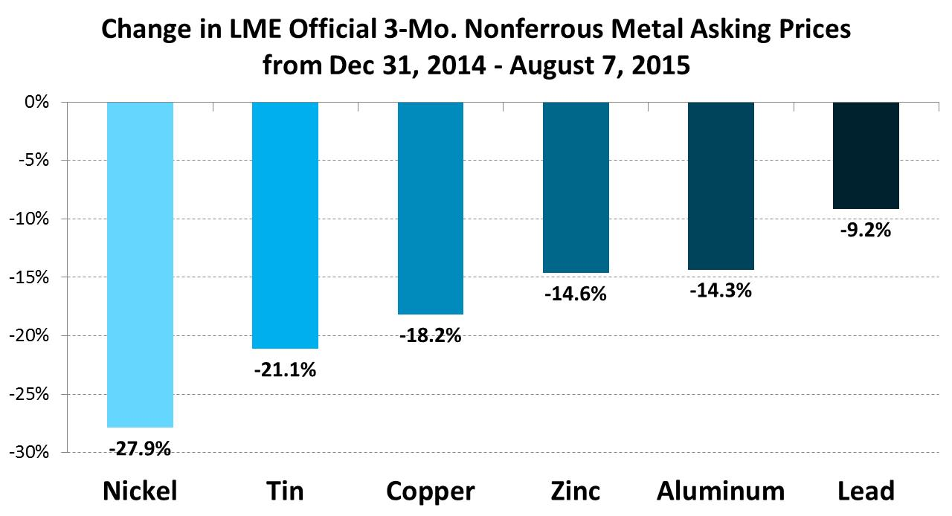
Nonferrous Price Trends

Slide 19
U.S. Market Trends: Recovered Paper and Fiber
 | New Supply (Short Tons) | Recovered (Short Tons) | Recovery Rate | U.S. Exports (Short Tons)
2010 | 81,784,000 | 51,545,000 | 63% | 20,811,000
2011 | 79,444,000 | 52,767,000 | 66% | 23,233,000
2012 | 78,498,000 | 51,092,000 | 65% | 22,325,000
2013 | 78,954,000 | 50,128,000 | 63% | 21,030,000
2014 | 78,206,000 | 51,171,000 | 65% | 21,179,000
Notes:
New supply peaked at 105 million tons in 1999 according to AF&PA. Paper industry revenue in 2014: $7.8 billion.

Slide 20
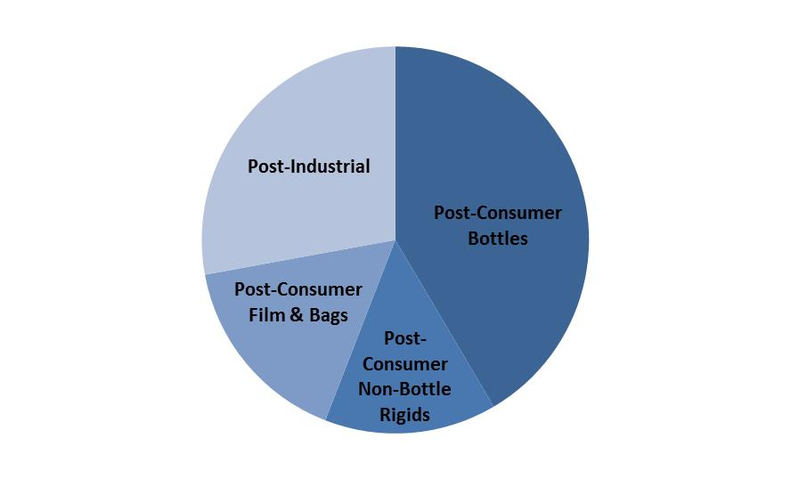
U.S. Plastic Scrap Recovery + 3.5 Million Tons
The U.S. Recycled More than 3.5 Million Tons of Post-Industrial and Post-Consumer Plastic Scrap in 2013
Sources: American Chemistry Council, Moore Recycling Associates, ISRI estimates.
Notes:
Recycling Globally
U.S. is the world’s largest scrap exporter.

Slide 21
Scrap Has Become a Global Industry
Part of the Global Industry
40
$21B
160
Total exported
(million metric tons)
Value of materials
exported
Destination countries to which
recyclables were sold
With between 30 & 40% of all scrap processed in US destined for export each year, the health of the US recycling industry is directly tied to the health of the global economy
Notes:
Recycling Globally
U.S. is the world’s largest scrap exporter.
51 million metric tons exported.
The value of exported materials is $39 billion in 158 countries.

Slide 22
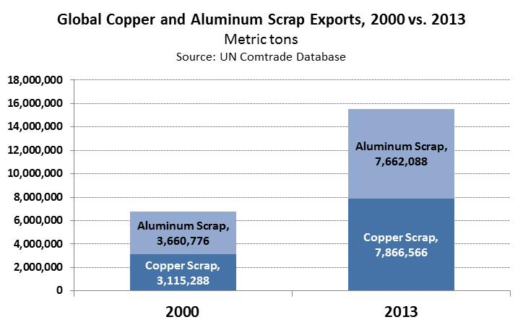
Global Nonferrous Scrap Exports

Slide 23
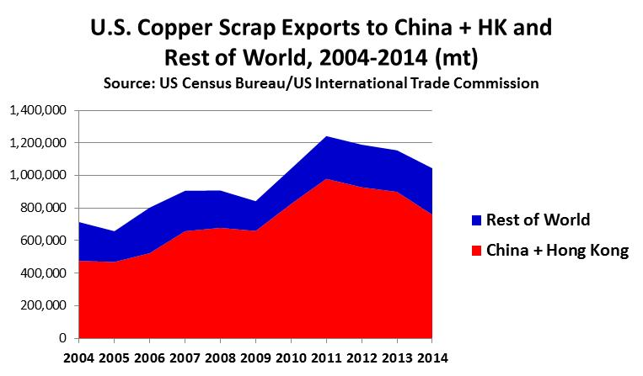
China and Hong Kong Accounted for 73% of Copper Scrap Exports from the U.S. Last Year
In 2014, the U.S. exported more than 1.04 million metric tons of copper and copper alloy scrap valued at nearly $3.5 billion.
By volume, China and Hong Kong together accounted for 73% of total U.S. Cu scrap exports.
Source: U.S. Census Bureau/U.S. International Trade Commission.

Slide 24
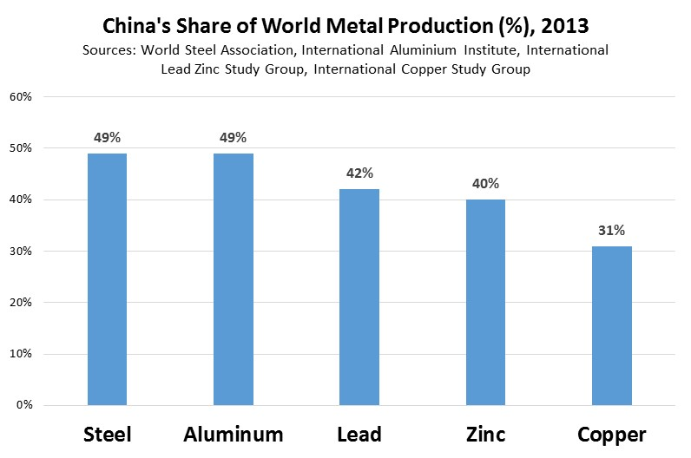
China – Key Driver in Global Recycling Trade

Slide 25
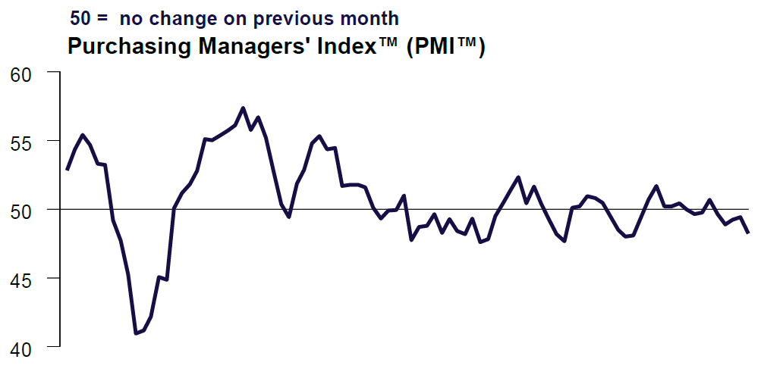
Chinese Manufacturing Slowing, and Chinese Commodity Demand is Falling Faster Output
Caixin Flash China General Manufacturing PMI

Slide 26
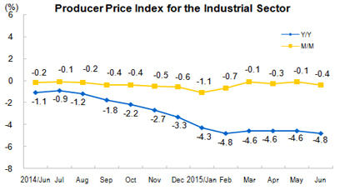
Chinese Deflationary Pressure
China’s National Bureau of Statistics reported that Chinese “producer prices deflated for a 40th consecutive month, dropping 4.8 percent from a year ago in June… The sustained decline in producer prices reflects the downturn in China's housing market, which had led to excess supply of the materials used in the housing boom.”

Slide 27

China
Slower apparent growth
Seeking to balance economic growth with environmental concerns.
Increased – although not always consistent -emphasis on quality of scrap imports through green fence, green goddess & other efforts
  It is the inconsistency & lack of
  transparency that hurts the industry the most
Chinese demand sensitive to relative primary and secondary prices.
Commodity import financing cuts
Questions of rising self-sufficiency in domestic scrap generation.
Bottom Line: China Still Has Oversized Impact of Commodities For Now

Slide 28
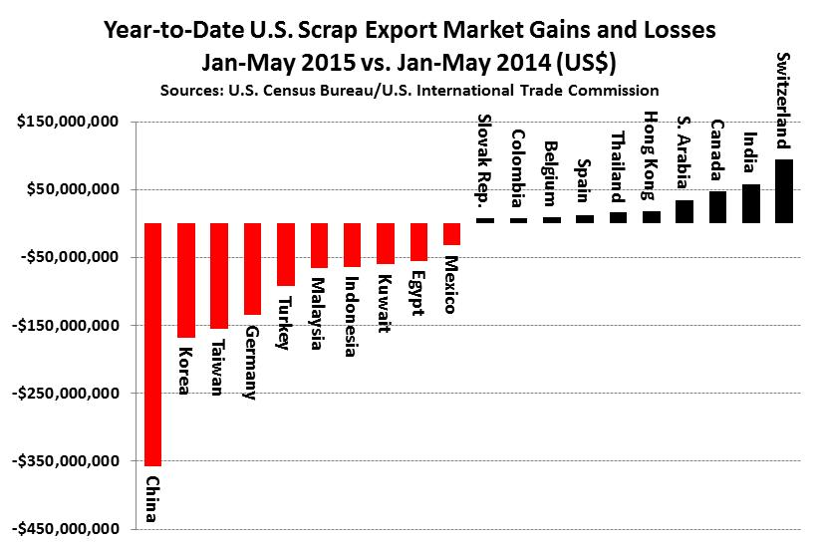
China Continues to Drag on Global Scrap Market

Slide 29
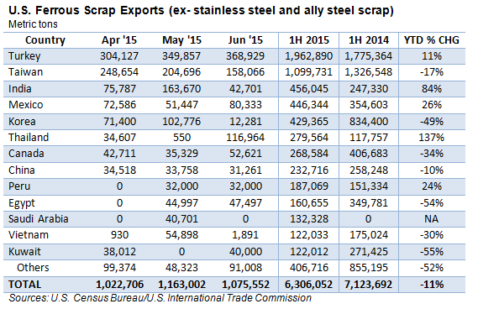
China Down to 8th Market for Ferrous Scrap

Slide 30
China Slump Not Restricted to Metals
As for current market conditions in China, Steve Wong, Executive President of the China Scrap Plastics Association reports that “Plastic recycling market has been badly affected by the stock market bubble in China recently. Liquidity decreases as buyers’ cash flow has been tightened up by stock market, affecting both their ability and incentive to source. People in the market commented the situation is even worse than that during Operation Green Fence as in spite of how low the prices quoted, customers have no money to buy, the one who has money to buy indeed command the prices. Instead of selling and buying at reasonable market equilibrium price, materials were sold at customers’ offered prices.”
As for Chinese import conditions, Dr. Wong report “In respect of scrap plastic import policy of China, major ports such as Shanghai, Tianjin have further tightened the restrictions on materials involving contamination to different extent. Some suppliers in the U.S. reflected that some customers abandoned shipments that already paid deposit for and arrived at port. Hundreds of containers have stuck at port of Tianjin as the buyers were unwilling or not even dare to declare the materials. Hence, suppliers have been busy contacting shipping lines to extend demurrage. Since the market is gloomy and the underlying cause is the external factor under macroeconomic situation rather than the problem of the industry itself, people in the industry are conservative and do not foresee a miracle in near future.”

Slide 31
Keys Going Forward
Hard to see short-term bullish scenario for commodities: Goldman Sachs forecasting cash copper will fall to $4,500/mt by the end of the year while BofA has a 2016 copper price forecast of $4,969/mt.
Given Commodity Performance, Increased Emphasis on Operational Efficiency And Quality
Need to Develop New Markets
Industry Consolidation/Rationalization
Cyclical Industry
Longer Term Positive Trends
ISRI

Slide 32

Thank You
Joseph Pickard, ISRI
1615 L St., NW
Washington DC 20008 I (202) 662-8542
joepickard@isri.org I www.isri.org

