Slide 1

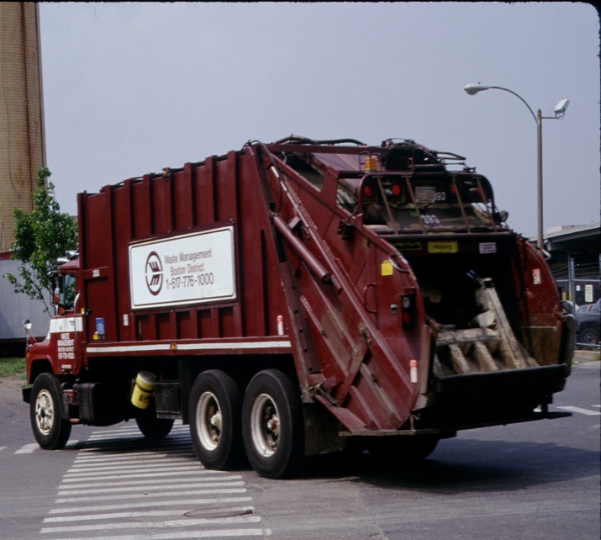
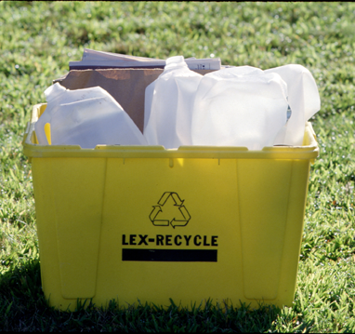

PAYT…SMART City Solution
Jan Canterbury
Resource Conservation & Sustainability Division
Notes:
OK… and Why Recycling Matters (Blanket?)

Slide 2
Climate & Waste Connection
Recycling
Cuts GHGs
Georgia Recycling Coalition
March 22, 2011
Notes:
OK… and Why Recycling Matters (Blanket?)

Slide 3
PAYT… Conserves
Natural Resources & Citizens’ Money…!
Notes:
OK… and Why Recycling Matters (Blanket?)

Slide 4

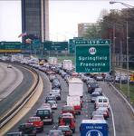
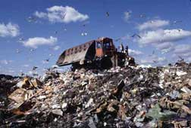
SW is a Major Climate Sector
of Greenhouse Gases
Energy
Transportation
“Solid Waste”

Slide 5
SW is a Major Climate Sector
of Greenhouse Gases
Energy
Transportation
“Solid Waste”
3rd Largest Source of a City’s GHGs!

Slide 6

Garbage…. Natural Resources
Our Forests, Mountains, Air, Water, etc.
Notes:
First, its critical to remember that all products we use…
And which quickly become garbagebegin as NRs upstream…
To understand this C&W connection… we must turn to LCA… which looks at all stages of production to compare the full range of environmental and economic costs of products…an increasingly complex and sophisticated field…
Let's look at it simply… (Plastic Bottle - AL Can) from Product LC perspective.

Slide 7



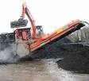

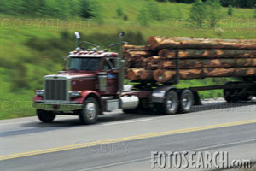
Extraction “Upstream”
Oil Drilling
Mining Extraction
Tree Harvesting
Transportation
Notes:
Oil drilling, mining and tree harvesting

Slide 8
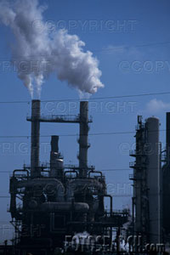
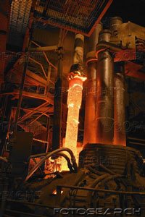
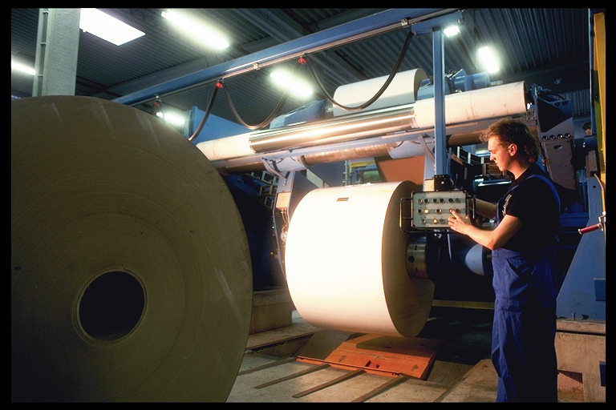


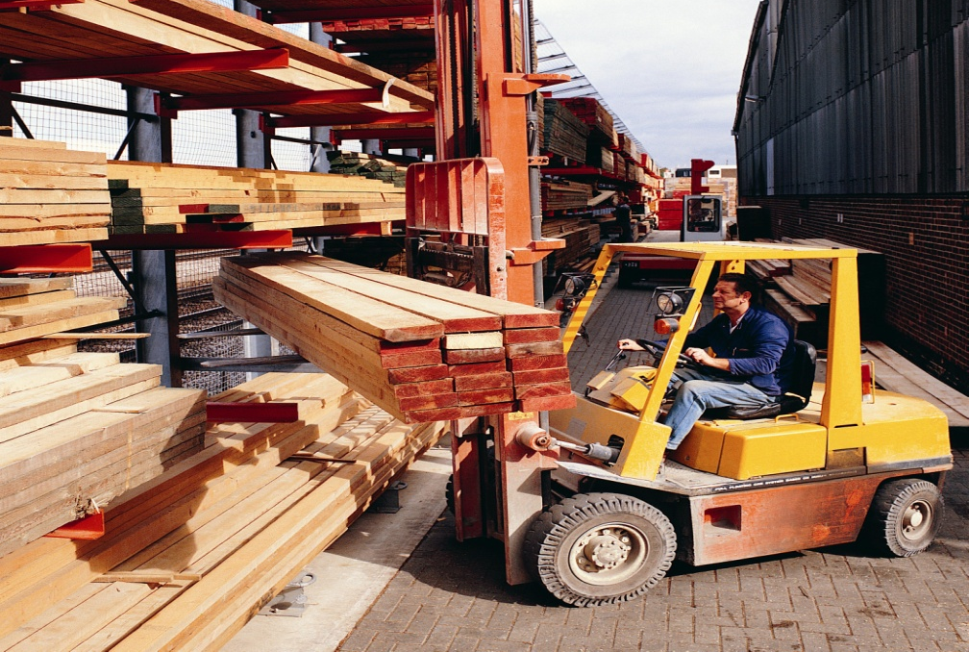


Manufacturing - Most BTUs & GHGs
Notes:
– steel plants or papermills (Smokestack industries)

Slide 9
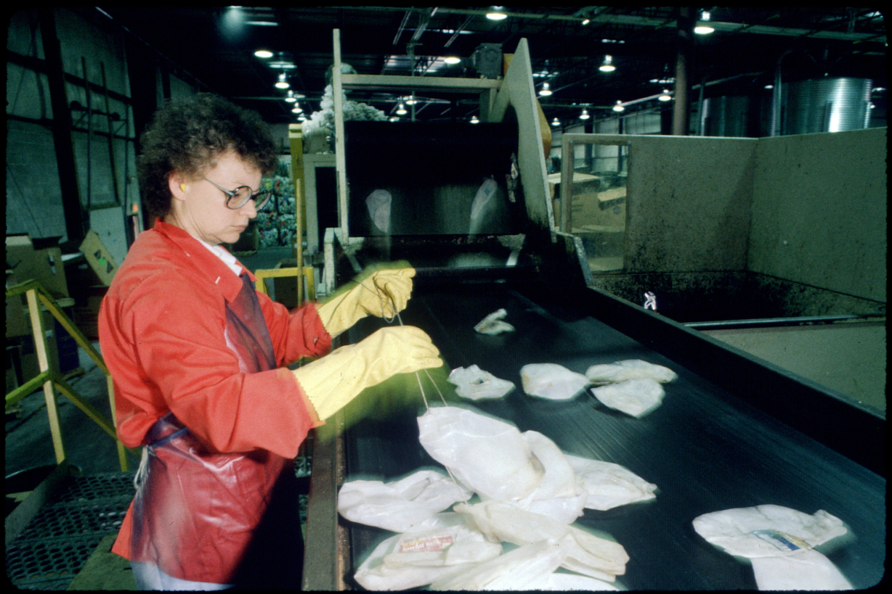
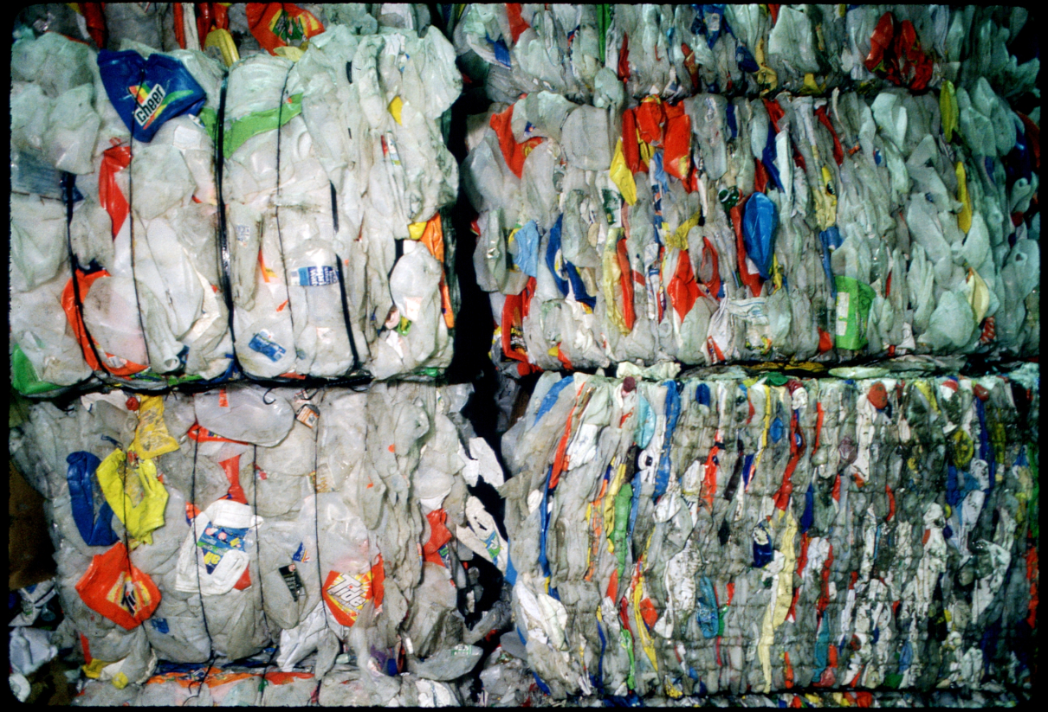
Waste Reduction…
Conserves Natural Resources &
BTUs of Energy
3rd Largest Source of a City’s GHG Reductions!
Notes:
Recycling these natural resources… saves… not only money… but, reduces - Lion's Share of GHGs and BTUs of Energy
In fact, making products from recyclable materials saves 70-90% of energy. Recycling a stack of newspapers -- 5" high = saving a medium size tree.
It also saves a tremendous amt $ - Economists estimate we throw ~ $8 billion Copper into well-engineered hole in ground (landfills)/ ea year.
Tip of the Iceberg… of FICC (Metals A-Z).

Slide 10
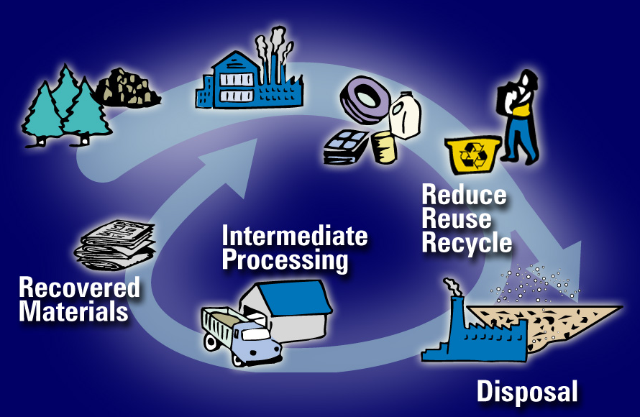
Linear to Cyclical Life Cycle

Slide 11
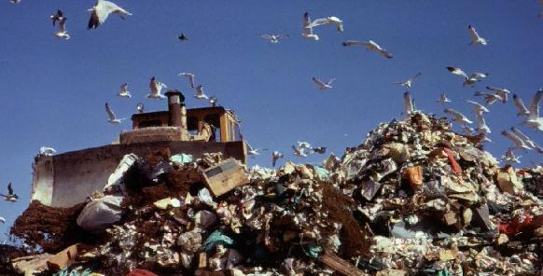
Why PAYT is so Powerful?
It helps change the way
we VALUE Trash…!
Notes:
Let’s be honest – We all realize…
Sitting here - Era of Great Global Crisis – Country facing multiple, unparalleled challenges - Economically & Environmentally… UR watching your State & City Services struggling to stay afloat – yet, still committed to upholding our environmental values. And, we’re all feeling Tension of having to do More… with Less.
So, we’re here today - looking for Strong, Sustainable Solutions –- which is PAYT – because it Uses “Economic Incentives” to help us Align - Environmental & Economic Goals… in the same direction. WHY?

Slide 12
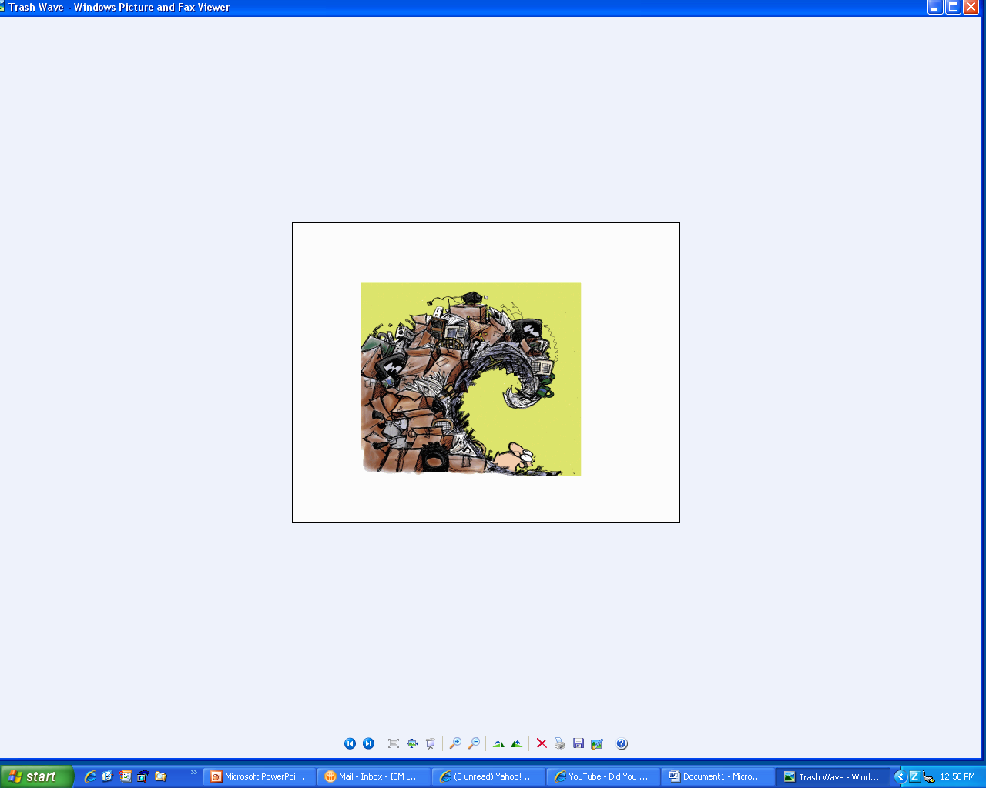
Lack of “Value” for our Resources…
4.6 Pounds Trash/Day
U.S.
5% World Population - yet, we Consume
25% of Energy & Natural Resources
Notes:
As you know, Aver Amer ~ 4.6# trash/day…
And, even though we represent just 4% of World Population… collectively, we consume ~ 25% of its Energy & NRs. (Amazing statistic – Fair, S?)
Let’s Drill a bit Deeper… First Face a Persistent Problem…
“Lack of Value for our Natural & Financial Resources”
Why is this? We contend… absence of clear Price Signals.

Slide 13
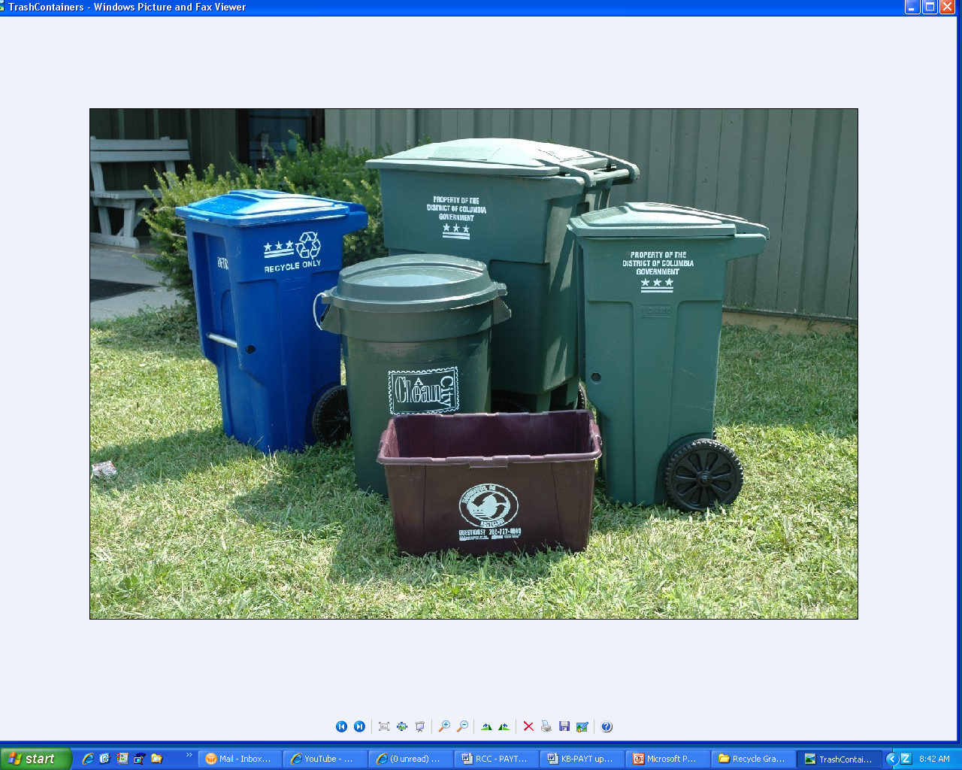
The Myth of “Free Waste”
How much do you pay for Trash Services?
Notes:
13
Why is this?
Simple. Our Waste Fees are hidden in the Tax Base… we have NO Price Signals (nothing in the Marketplace to help, guide, motivate us…) to Value our NRs or, to think about how much we pay for our garbage services. Essentially, we Reward the Big Waste Generators through these trash Subsidies.

Slide 14

The Myth of “Free Waste”
Do you have a Garbage Fairy?
Notes:
14
Ya might say… most Americans still believe in the Garbage Fairy… who comes along and waves her wand and pooh the waste magically disappears…
Ah, U smile… but, How many here today… know how much U pay for your MSW Services? How much do U pay /week for your Trash? Don’t worry - U R not alone… Watch Thjs… : >)
PAYT Video
So our mission… in this panel is to talk about Correcting this Market Failure by combining Economic Incentives in tandem w/ Enhanced Education Efforts.
Together, this Dynamic Duo achieves significant increases in WR and decreases in Energy & GHG emissions.

Slide 15
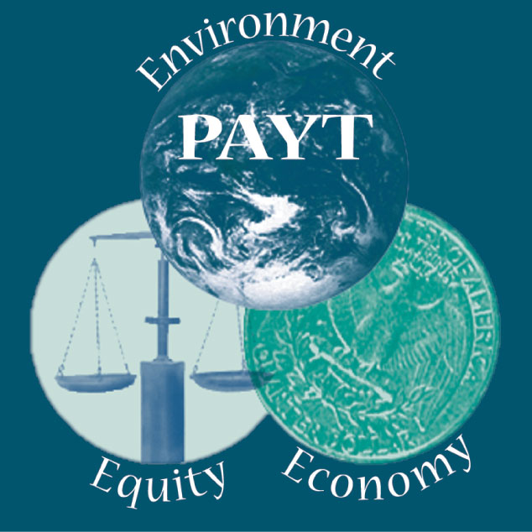
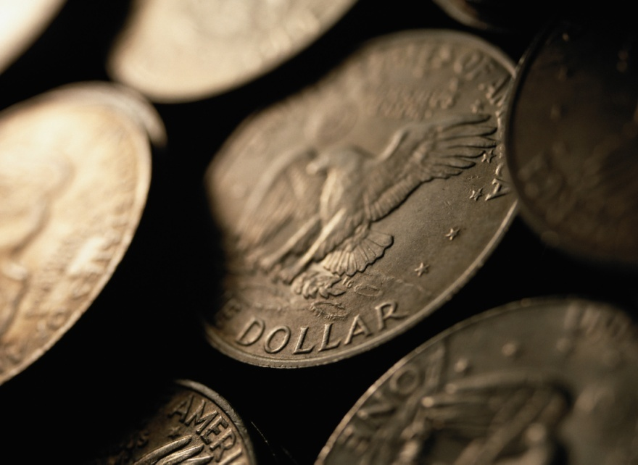
Pay-As-You-Throw is SMART
SMART – Saves Money and Reduces Trash…!
This creates a direct economic incentive to recycle more and to generate less waste.
“3Es”
This is the fair & equitable way to pay for trash services.

Slide 16
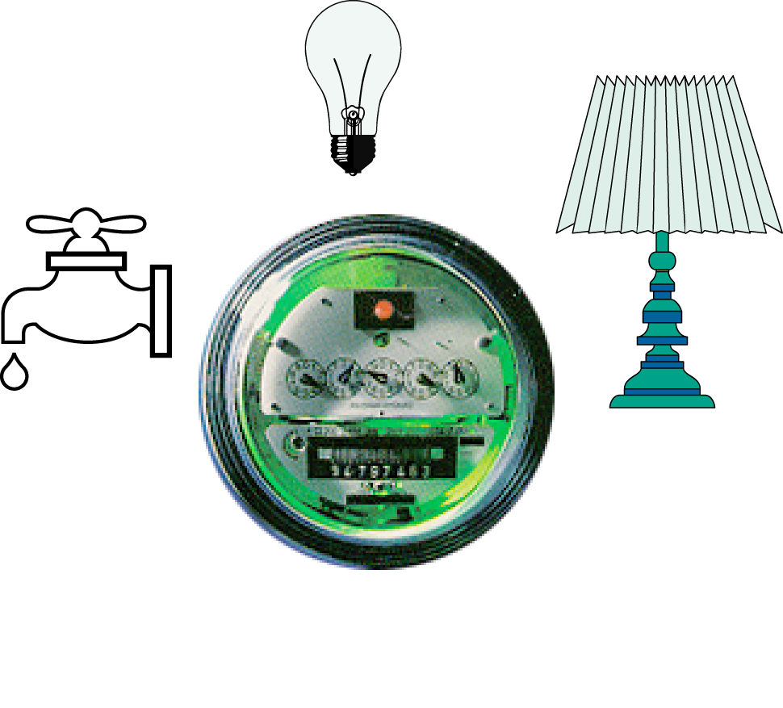
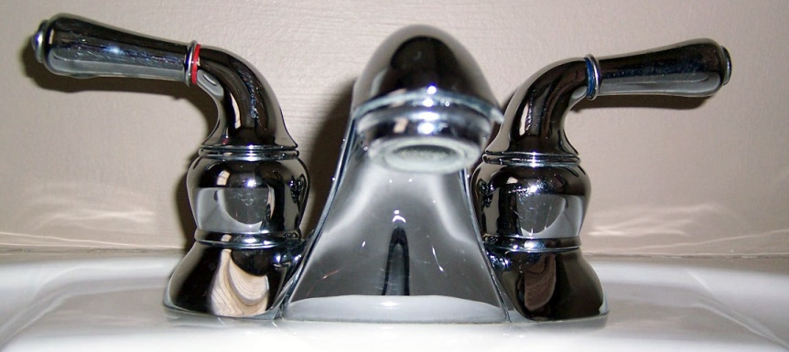
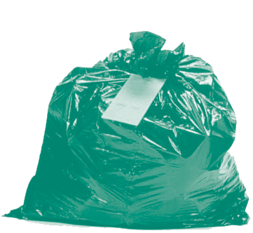
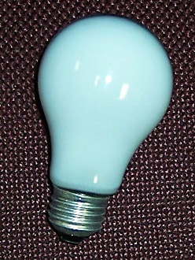
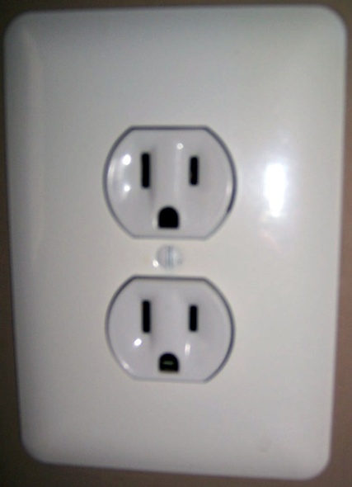
PAYT Functions Like a Utility
Residents only pay for service they use

Slide 17
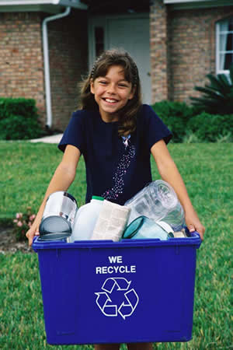
Types of PAYT Programs
Cans— fees based on size of containers
Bags— fees based on # of garbage bags
Stickers— stickers affixed to bags

Slide 18
Rate Structure Design
Carts
Bags / Stickers
96 gal 64 32
$2 $2
$3 $2 $1
Proportional Pricing
$4 $1.50 $.50
Multi-tiered Pricing
Direct Costs left in Tax base
$2 $3 $1

Slide 19

Duke University National Study
32 to 59% increase in Recycling
19% found slight increase in illegal dumping
This report is available online at
www.epa.gov/epaoswer/non-hw/payt/pdf/swlitrep.pdf

Slide 20
MA Study: 49% Less Trash
250 Communities
(7 million people)
Lbs

Slide 21
Half the Waste per Capita
Lbs
916
Lbs/capita
472
Lbs/capita
Notes:
21

Slide 22
Third Less in total Waste Generation
Source Reduction 35%

Lbs
Notes:
This proves the importance of source reduction and long term behavior change. Specifically that PAYT communities are incentivised to manage the electrons, toxics, and yard waste properly because PAYT limits them to a ‘measuring cup’
22

Slide 23
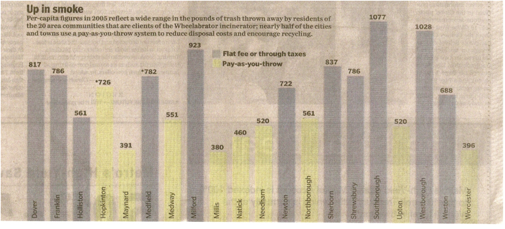
Boston Globe Article - “Up in Smoke”
44% Increase in Recycling

Slide 24
Immediate Sustainable Change
Worcester MA
Middletown RI
Malden MA
Vancouver WA
24
Notes:
waste generation per capita
24

Slide 25
Economics is the main driver
Ft. Worth, TX – disp. costs dropped >$7 million.
City earned $540,000 from the sale of recycled materials over course of a year, after PAYT. (Monthly household costs not higher for PAYT.)
Worcester, MA - decreased SWM costs >$1.2 million. Increased recycling rate from 3% to 36% immediately after adopting PAYT in 1993.
Dover, NH - saved 27% of MSW budget ($1.2 million to $878,000) after adopting PAYT.
San Jose, CA—(Population 850,000) reduced cost by $4 million annually

Slide 26
Economic value of waste reduction
Avoided Disposal Costs
Cost becoming increasingly important
Decrease disposal site availability
NIMBY
Rising costs
Recycling Revenue Potential
Commodities are market sensitive
In good markets - potential for additional revenue
Decreased Labor through Source Reduction & Reuse
Reduce Reuse Recycle
Overall waste generation decrease - requires less handling & transport of materials
Job Creation
$42 Billion Waste Industry
$200 Billion Recycling Industry
Jobs for Region & State
Jobs for America
26

Slide 27
Because of the “3Es”…
Notes:
1) Environment: Promote RC / Curb GHGs
Change Consumer Behavior Patterns… beyond… “the Choir” / beyond… the “Greens”
to reach millions of folks who are busy with life’s other pressing priorities… “Soccer Moms” & “Joe the Plumbers” in order to achieve real, measurable change… broadly… across all sectors of society.
2) Economy: Our programs need to Save Cities & Citizens Money… and Create Good, Green jobs
3) Equity: And, last but not least… like any other public Utility… policies should be Fair & Equitable – getting rid of Subsidies for Waste Generators.

Slide 28
Growth in PAYT Programs
# of Communities
1965
1970
1975
1980
1985
1990
1995
2000
Tally data based on SERA: Skumatz Economic Research Associates

Slide 29
SMART Successes
More than 7,000 PAYT cities in the U.S.
Tally data based on SERA: Skumatz Economic Research Associates

Slide 30
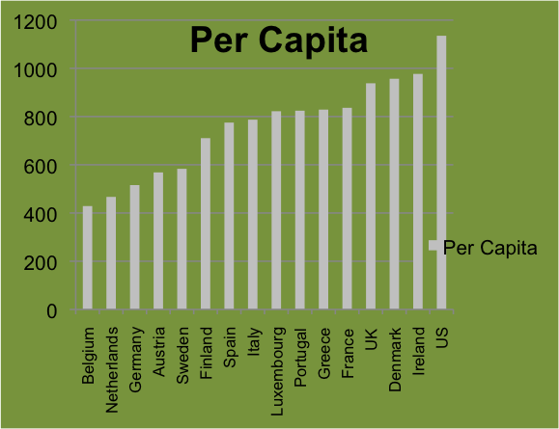
International Growth in PAYT

Slide 31
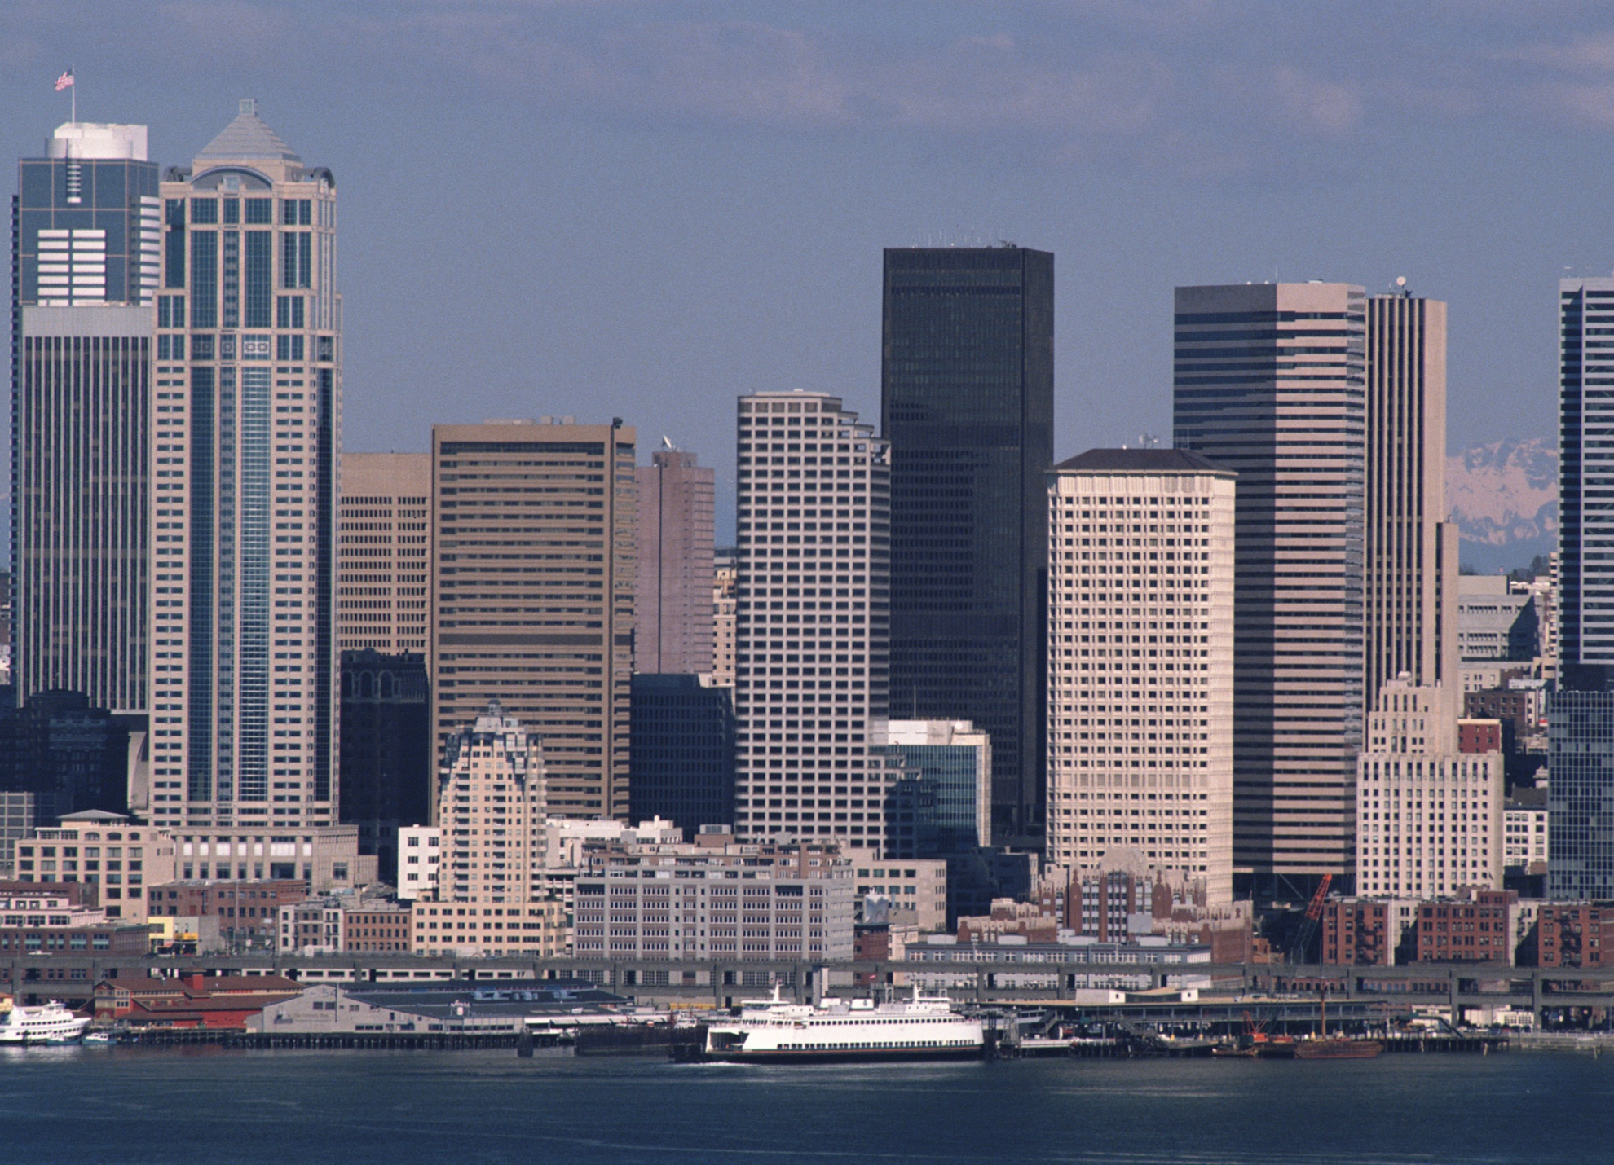
Large Cities adopting PAYT
City Population
Ft. Collins, CO 118,652
Athens, GA 100,266
San Jose, CA 782,248
Portland, OR 437,319
San Francisco, CA 723,959
Dubuque, IA 57,686
Portland, ME 230,000
Platteville, WI 9,858
Fayetteville, AR 68,726
Ft. Worth, TX 1,728,826

Slide 32
SMART Cites Conserve…
Natural Resources and, Money…!
Notes:
So, now… we’ve seen… the Sense of Urgency / RC from LC perspective –
3rd largest source of GHG mitigation / which means we must Change Consumer
Behavior to conserve NRs and reduce GHGs / and, Finally, we know the most
Powerful Economic Incentive to do this is the SMART City solution of PAYT.
TU - Now, let’s open it up to Qs and Ideas of Solutions.

Slide 33
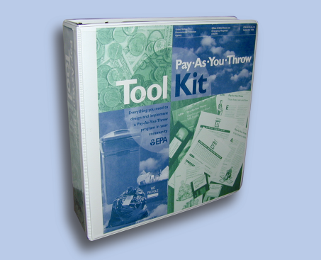
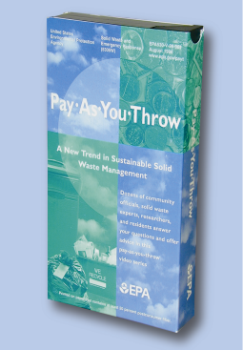
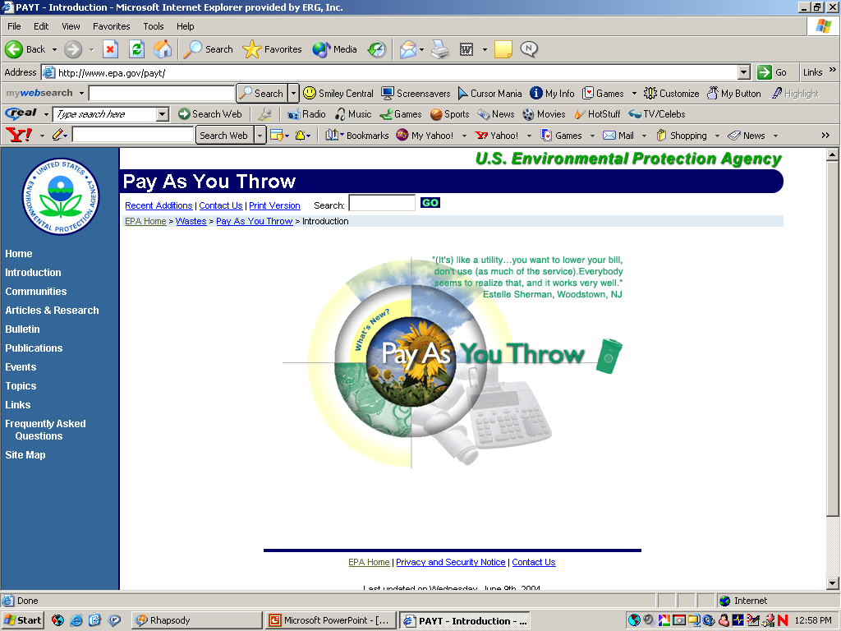
PAYT Web Site
Studies, reports, and articles
Video
PAYT Bulletins
Toolkit
Presentation
Fact sheets, Success Stories, Lessons Learned
www.epa.gov/payt

Slide 34
Barriers vs Myths
Real or Perceived?
Illegal Dumping
Hidden Taxation
Regressivity/Low-Income Families
Difficult to Change Status Quo
Incineration - Put or Pay Contracts
Lack of Recycling Infrastructure

Slide 35
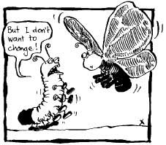
Be Creative… Break Barriers
Low Income
Illegal dumping
One free container
Waste limit
Free bags
Life line rate
Duke University study shows minimal dumping
New England study confirms minimal dumping – helps to have strict enforcement the first weeks
Solutions: Education; Enforcement: Peers
Political fear of change
Residents want the right to choose
‘Kicking the Cans ‘July 29, 2008
Should people who throw out more trash pay higher disposal bills?
84% - YES 16% - NO
35
Notes:
waste generation per capita
35

Slide 36
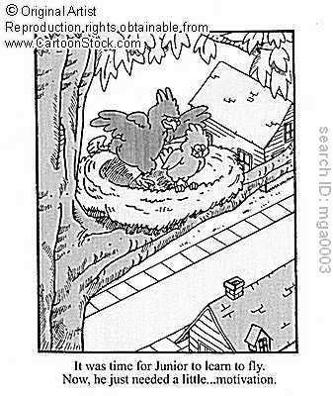
Biggest Barrier: Fear of Change
Knowing WHY as important as knowing HOW!

